Slide 1
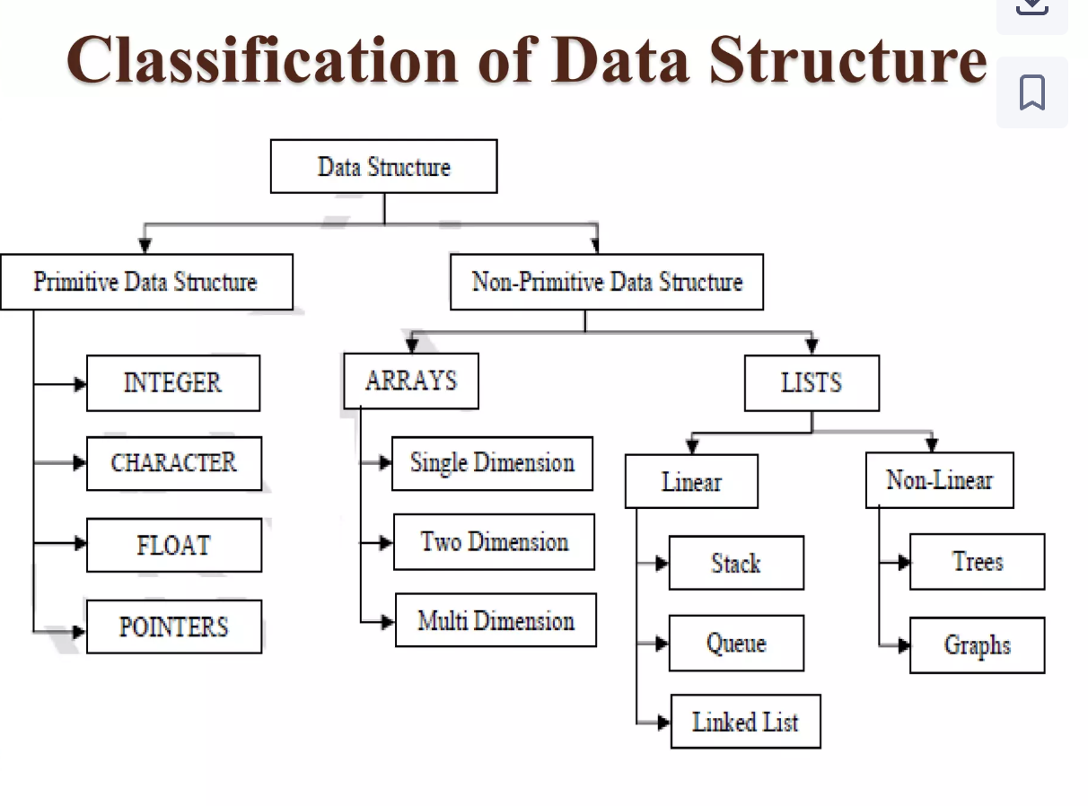

Slide 2
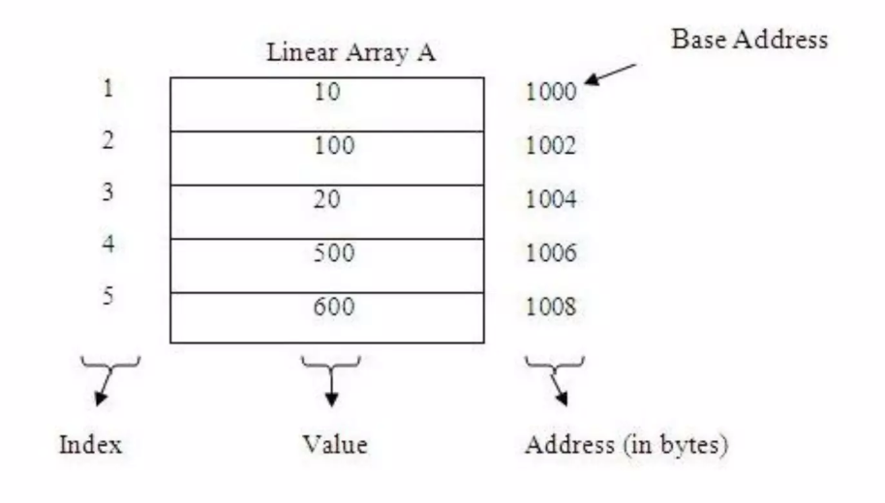
Represent an Linear Array in memory:
- The elements of an linear array are stored in consecutive order as shown in this image.

Slide 3
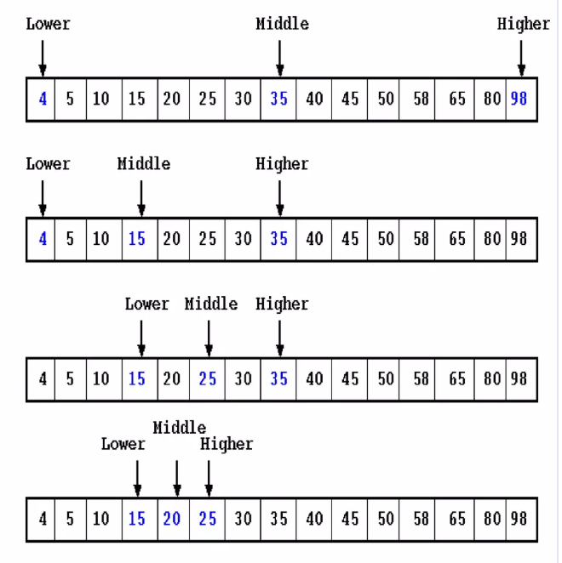
Binary Search
Binary search is an efficient algorithm used to find a specific target element within a sorted array or list. It operates by repeatedly dividing the search interval in half.
How does it work: - The algorithm starts by defining a search interval using two pointers, low (pointing to the beginning of the array) and high (pointing to the end of the array).
- It calculates the middle index within the current search interval.
- The value at the middle index is compared with the target value:
1) If the middle element is equal to the target, the search is successful, and the index of the element is returned.
2) If the target value is less than the middle element, the search continues in the left half of the array (by updating high to mid - 1)
3) If the target value is greater than the middle element, the search continues in the right half of the array (by updating low to mid + 1)

Slide 4
Array Types
Arrays can be single dimensional, two dimensional, or multi dimensional.

