Slide 1
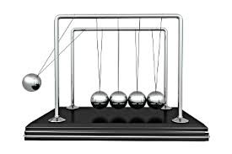
Newtons cradle…

Slide 2
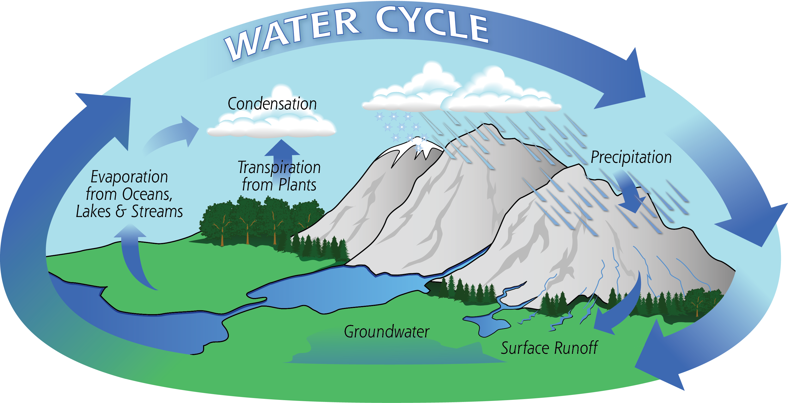

Slide 3

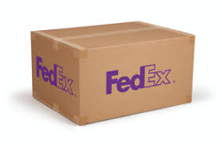
Two different boxes: one is an present box and one is an fedex package

