Slide 1
*Second water cycle
Test by Irene Ha

Slide 2
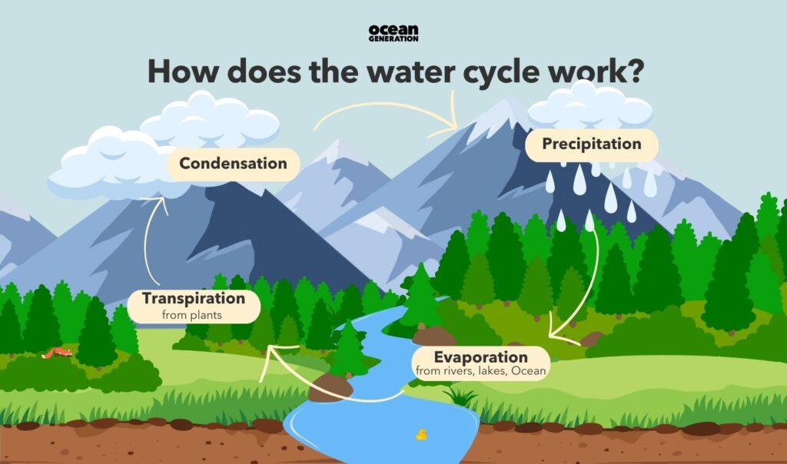
This is how the water cycle works: an over view

Slide 3
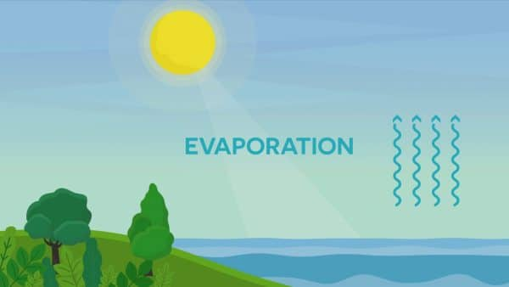
1^{st step in the water cycle}

Slide 4
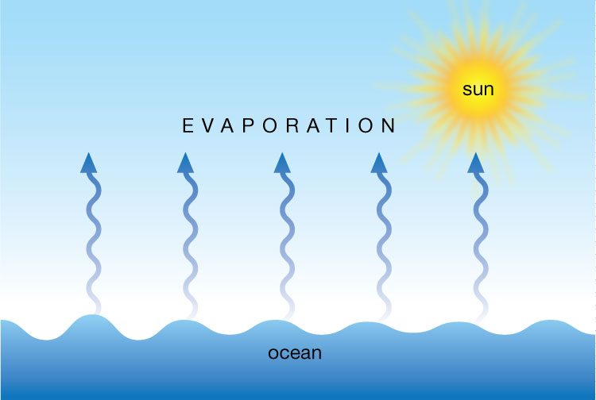
Evaporation is the process that drives the first stage of the water cycle, transforming liquid water from the Earth's surface into a gas (water vapor) that rises into the atmosphere. It is powered by energy from the sun, which heats water in large bodies of water like oceans, lakes, and rivers.

Slide 5
3rd step in the water cycle
In the water cycle, condensation is the crucial process where water vapor in the atmosphere cools, transforms into liquid water droplets, and forms clouds. These clouds then release water back to Earth through precipitation (like rain or snow), a vital part of the continuous water circulation that sustains life.

Slide 6
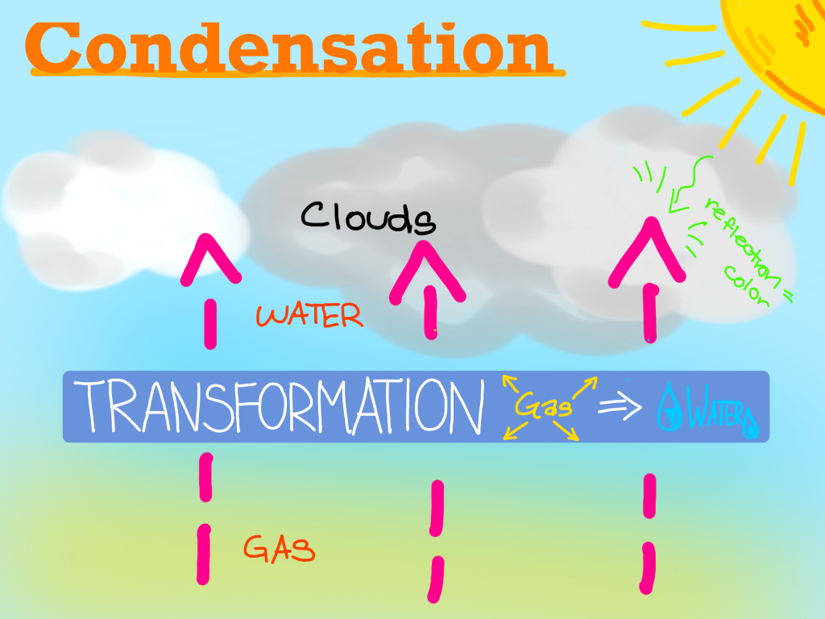
condensation

