Slide 1
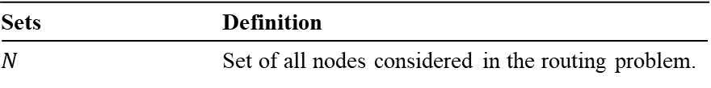
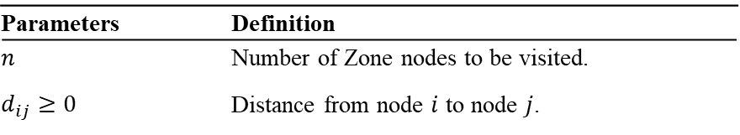
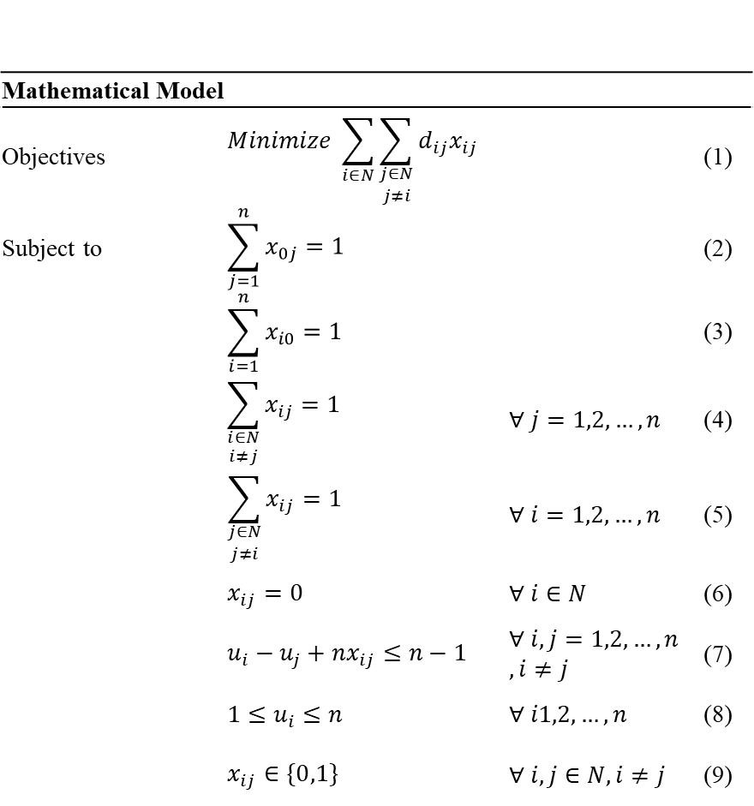
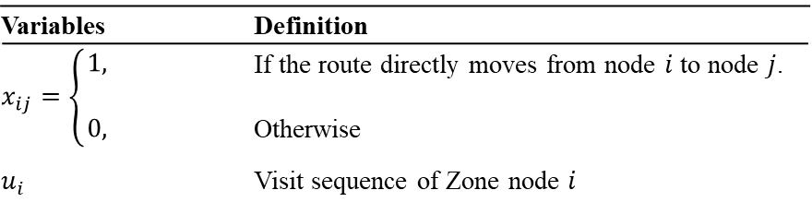
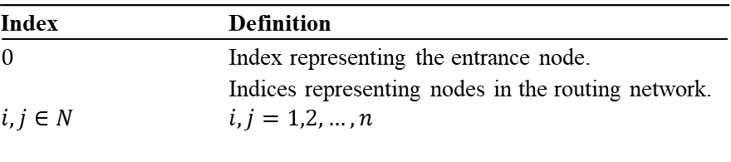
Sets | Definition
$$N$$ | Set of all nodes considered in the routing problem.
Mathematical Model
Objectives | $$Minimize \sum_{i∈N}{\sum_{\begin{aligned}j∈N \\ j≠i\end{aligned}}{d_{ij}x_{ij}}}$$ |  | (1)
Subject to | $$\sum_{j=1}^{n}{x_{0j}}=1$$ |  | (2)
 | $$\sum_{i=1}^{n}{x_{i0}}=1$$ |  | (3)
 | $$\sum_{\begin{aligned}i∈N \\ i≠j\end{aligned}}{x_{ij}}=1$$ | $$∀ j=1,2,…,n$$ | (4)
 | $$\sum_{\begin{aligned}j∈N \\ j≠i\end{aligned}}{x_{ij}}=1$$ | $$∀ i=1,2,…,n$$ | (5)
 | $$x_{ij}=0$$ | $$∀ i∈N$$ | (6)
 | $$u_{i}−u_{j}+nx_{ij}≤n−1$$ | $$∀ i,j=1,2,…,n$$ $,i≠j$ | (7)
 | $$1≤u_{i}≤n$$ | $$∀ i1,2,…,n$$ | (8)
 | $$x_{ij}∈\{0,1\}$$ | $$∀ i,j∈N,i≠j$$ | (9)
Index | Definition
$$0$$ | Index representing the entrance node.
$$i,j∈N$$ | Indices representing nodes in the routing network. $i,j=1,2,…,n$
Parameters | Definition
$$n$$ | Number of Zone nodes to be visited.
$$d_{ij}≥0$$ | Distance from node $i$ to node $j$.
Variables | Definition
$$x_{ij}=\left\{\begin{aligned}1, \\ \\ 0,\end{aligned}\right.$$ | If the route directly moves from node $i$ to node $j$. Otherwise
$$u_{i}$$ | Visit sequence of Zone node $i$

