Slide 1
Term Project Presentation
Reinforcement Learning
using OpenAI Gym
Project Team 1
Dasol Lee (20155546) & Sunyou Hwang (20164486)

Slide 2
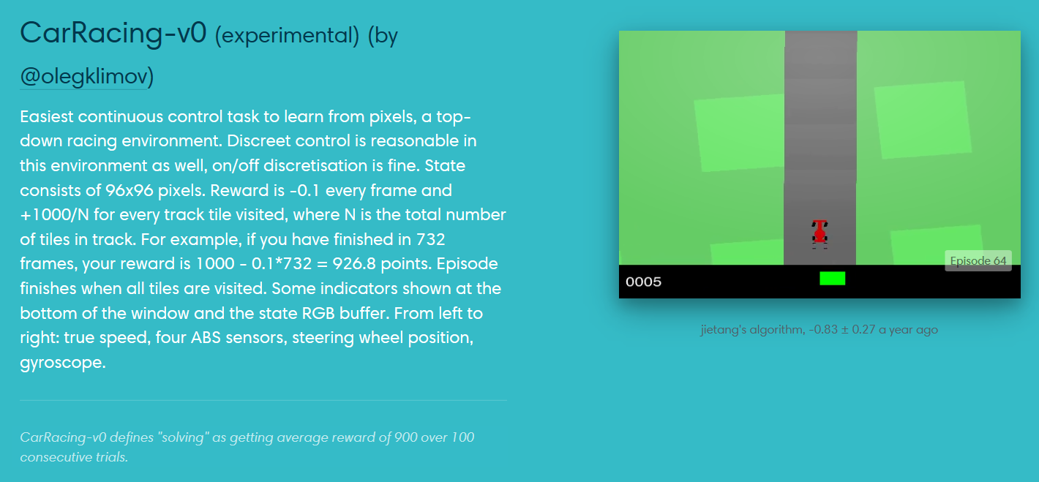
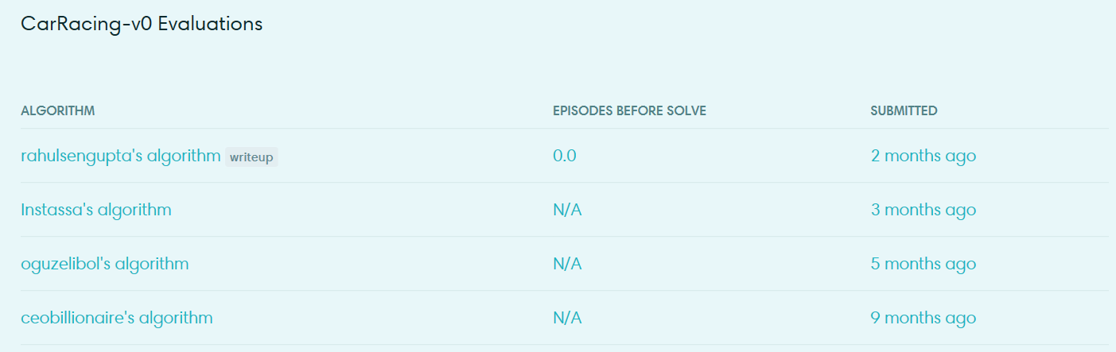
Reinforcement Learning using OpenAI gym - Car Racing
Environment
State space
- 96x96x3 RGB pixels
Action space
- Steer angle
- Gas
- Brake

Slide 3
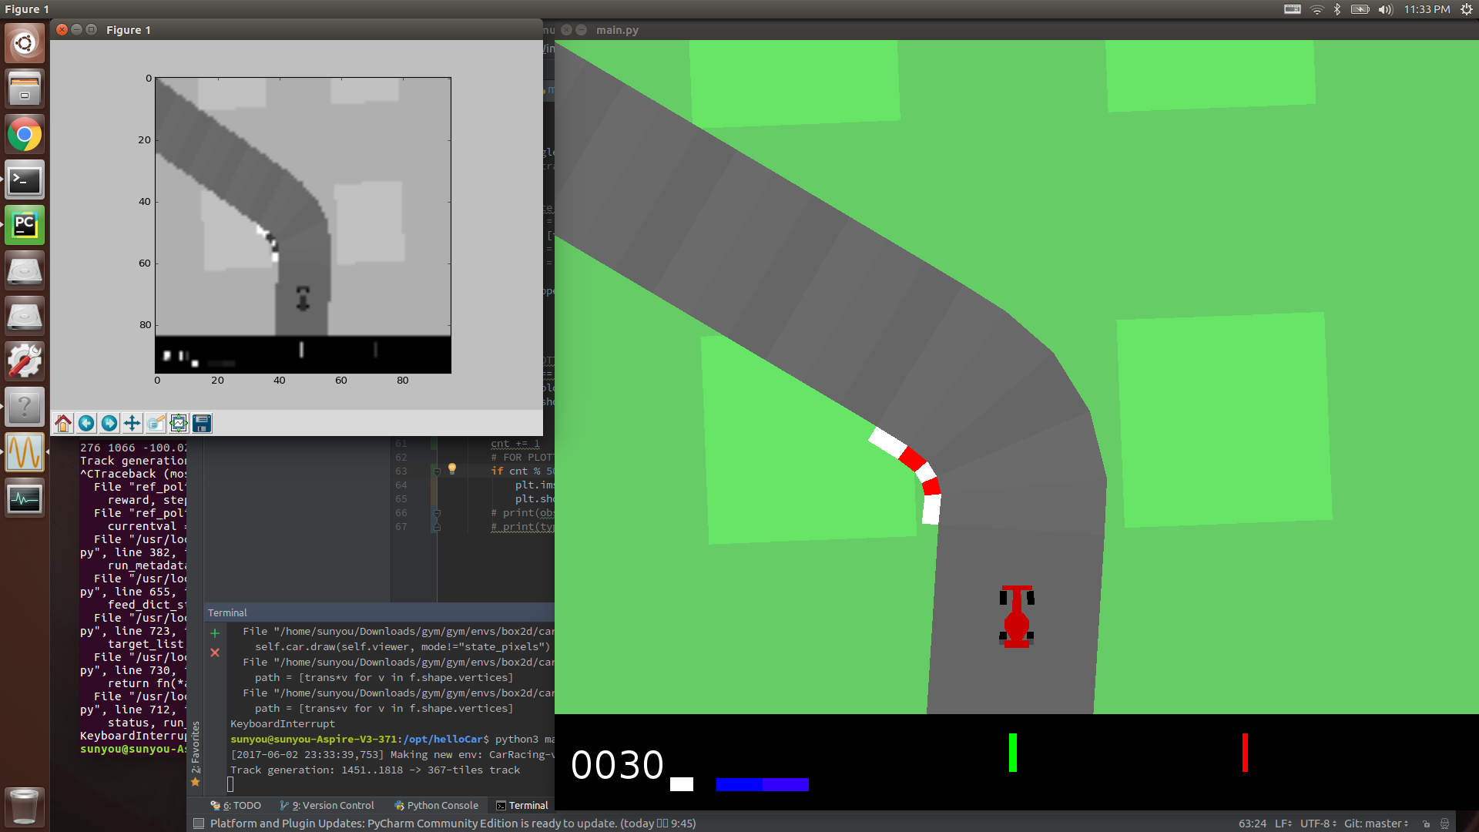
Reinforcement Learning using OpenAI gym - Car Racing
Problem Solving Approach
State: 96x96 RGB
- RGB → Grayscale 변환하여 사용
- State 전체를 학습에 이용하거나, feature를 추출해야 함
- 주어진 문제에 대해 feature가 될 수 있는 것이 명확
→ Feature 추출하여 사용하는 접근 방식 사용

Slide 4
Reinforcement Learning using OpenAI gym - Car Racing
Feature Extraction
Track angle, Speed 추출
Track angle
- 영상 내 일정 범위에 있는 트랙의 상대 각도에 대한 평균 값
Speed
- 하단 Speed indicator의 scale로부터 추출
- Observed state의 [84:, 13] 상에서 RGB [255, 255, 255] 의 값으로 나타나는 픽셀 수의 합
True Speed

Slide 5
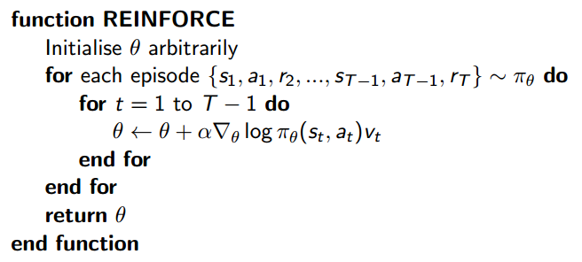

Reinforcement Learning using OpenAI gym - Car Racing
Learning Algorithm
Monte-Carlo Policy Gradient with Gaussian Policy
Gaussian Policy
- Continuous action space
→ Gaussian policy is natural
- Score function
Monte-Carlo Policy Gradient
- Episodic task & continuous action space
- Update parameters by stochastic gradient ascent
Monte-Carlo Policy Gradient Algorithm Pseudo-code

Slide 6
Reinforcement Learning using OpenAI gym - Car Racing
Results

Slide 7
Reinforcement Learning using OpenAI gym - Car Racing

