Slide 1
Sentiment Analysis of the Werewolf Game Dialogue in Japanese
学際情報学府 総合分析情報学コース
金子研 M2
孫 映雪
(ソン エイセツ)

Slide 2

Introduction
The werewolf game is an imperfect information game where the communication between players is the only public information that could be truth or lies.
This research try to examine sentiment analysis on the werewolf game dialog written by human players and generate useful information for creating AI agents that can understand natural languages.
http://img.ruanwencheng.com/14990586008.png

Slide 3
Backgroud: the Werewolf Game
http://img.ruanwencheng.com/14990586008.png

Slide 4
Backgroud: the Werewolf Game
Identity unknown
Werewolf Side
Villager Side
Know the identity of other werewolf side players
Can kill a villager every night
Only know their own identity
Winning condition: Live until all players in the other side get eliminated

Slide 5
Backgroud: the Werewolf Game
Daytime Stage
Conversation session: Players state their opinion freely
Vote Session: Everyone vote for the player that they think is the most likely to be a werewolf
Night Stage
Werewolf: Chose a player to kill
Roles with special ability: Use their ability

Slide 6
Related Research
Designing agents with a higher winning rate based on a protocol platform which simplified the communication part but focuses more on the optimization of strategies.
Using protocol game logs to predict agent votes and werewolves^{[1]}.
Applying deep Q learning to create the werewolf game agents^{[2]}.
Studying the natural languages in the werewolf games.
Dividing the dialog by its’ function into classes, for example, voting, coming out^{[3]}.
Generating human-like dialog through translating protocols using dialog from real human players^{[4]}.
[1]Kondoh, M., Matsumoto, K. and Mori, N.: Development of Agent Predicting Werewolf with Deep Learning, International Symposium on Distributed Computing and Artificial Intelligence, Springer, pp. 18–26 (2018).
[2]Wang, T. and Kaneko, T.: Application of Deep Reinforcement Learning in Werewolf Game Agents, 2018 Conference on Technologies and Applications of Artificial Intelligence (TAAI), IEEE, pp. 28–33 (2018).
[3]Nakamura, H., Katagami, D., Toriumi, F. and et al.: Generating human-like discussion by paraphrasing a translation by the AIWolf protocol using werewolf BBS logs, 2017 IEEE International Conference on Fuzzy Systems (FUZZ-IEEE), IEEE, pp. 1–6 (2017).
[4]Fukui, T., Ando, K., Murakami, T., Ito, N. and Iwata, K.: Automatic classification of remarks in Werewolf BBS, 2017 5th Intl Conf on Applied Computing and Information Technology/4th Intl

Slide 7
Basic Idea
Sentence
Sentiment
A
そういうのをニコラスくんからは特に感じるので、まあ狼だろうな。
Negative
B
今日のログ見てヤコブさんはやっぱり村と思いますね。
Positive
● ● ●
● ● ●
Current Situation:
A ニコラス Negative
B ヤコブ Positive
…
suspicious player:
ニコラス, …
Innocent players:
ヤコブ, …
…

Slide 8
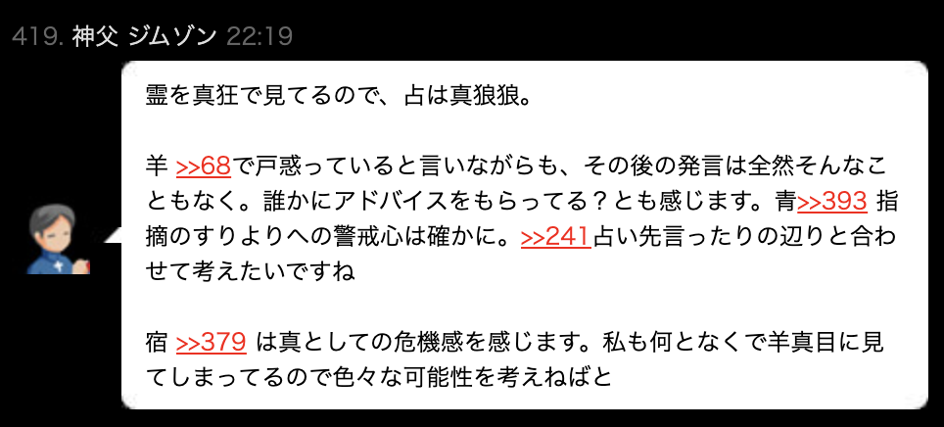
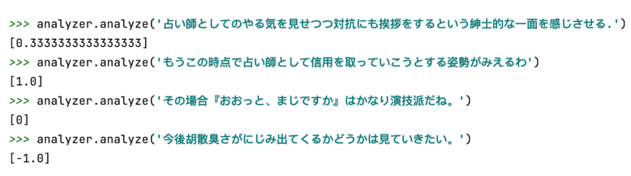
Proposed Method: Sentiment Points
Sentiment Points: Points assigned by sentiment analysis model to indicate positive or negative attitude in the sentence. In preliminary experiment, the model is oseti which is based on Japanese Sentiment Polarity Dictionary.
Fig.2 Sentiment Points Examples given by oseti
Fig.1 “>>” Mark Example
Werewolf BBS G, http://ninjinix.x0.com/wolfg/index.rb.
Yukino, I.: oseti:Dictionary based Sentiment Analysis for Japanese, https://github.com/ikegami-yukino/oseti.

Slide 9
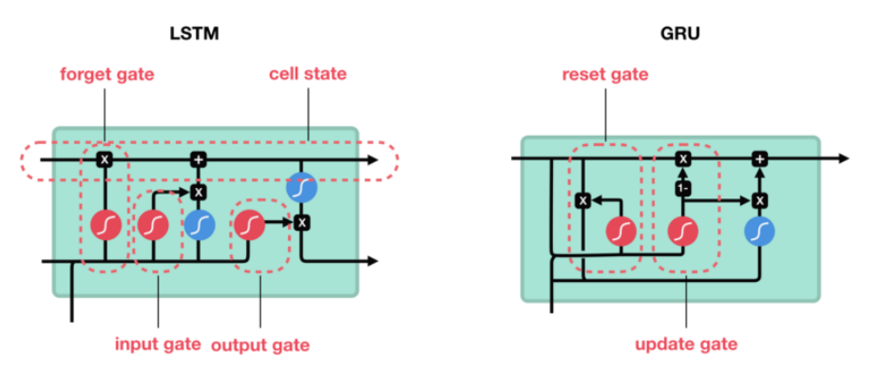
Proposed Method: Gated Recurrent Unit
Long and Short-Term Memory Unit (LSTM): Solving the problems of memory and forgetting by adding multi-threshold gates to RNN and handling long-term dependencies problem to some extent.
Gated Recurrent Unit (GRU): An effective variant of LSTM with simpler structure and similar performance in many problems.
https://ichi.pro/lstm-oyobi-gru-no-zukai-gaido-suteppubaisuteppu-no-setsumei-75771469479713

Slide 10
Preliminary Results: Werewolf prediction
Timeline
1GRU+
2FCN
Werewolf-Werewolf
A
B
Werewolf-Villager
A
C
Villager-Villager
B
C
Villager-Werewolf
● ● ●
GRU
Classification
Network
Input Sentiment Points series
Classes

Slide 11
Preliminary Results: Werewolf prediction
Get probabilities for other players being a werewolf
Calculate likelihood for each combination and choose the combination with the maximum likelihood
. •••
Agents as a villager
Other players
(identity unknown)
Classification
Network
 | Accuracy
 | Proposed | Random
Werewolf included in combinations of highest 3 likelihood | 65.5% | 55%
Werewolf included in the combination of highest likelihood | 48.3% | 40%

Slide 12
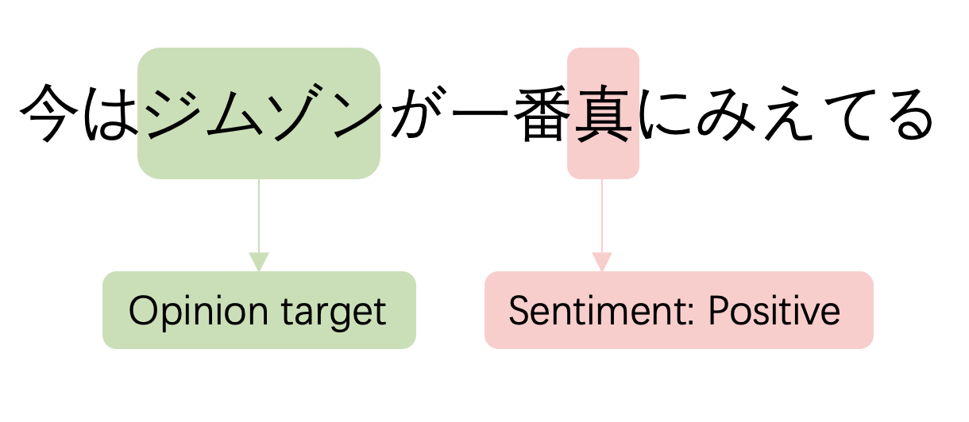
Proposed Method: Aspect-Based Sentiment Analysis
Aspect-Based Sentiment Analysis (ABSA) : Sentiment analysis with investigation at entity and aspect level to identify entities and related aspects and classify sentiments associated with these entities and aspects.
Three Subtasks:
Opinion target extraction
Aspect category detection
Sentiment Polarity
Three Subtasks:
Opinion target extraction
Aspect category detection
Sentiment Polarity
Aspect-Term Sentiment Analysis (ATSA) : Sentiment analysis that can identify the sentiment polarity and the target entity associated with the sentiment.
Fig.3 ATSA example in a sample sentence
Fig.2 Three tasks of ABSA in a sample sentence
Do H H, Prasad P W C, Maag A, et al. Deep learning for aspect-based sentiment analysis: a comparative review[J]. Expert Systems with Applications, 2019, 118: 272-299.

Slide 13
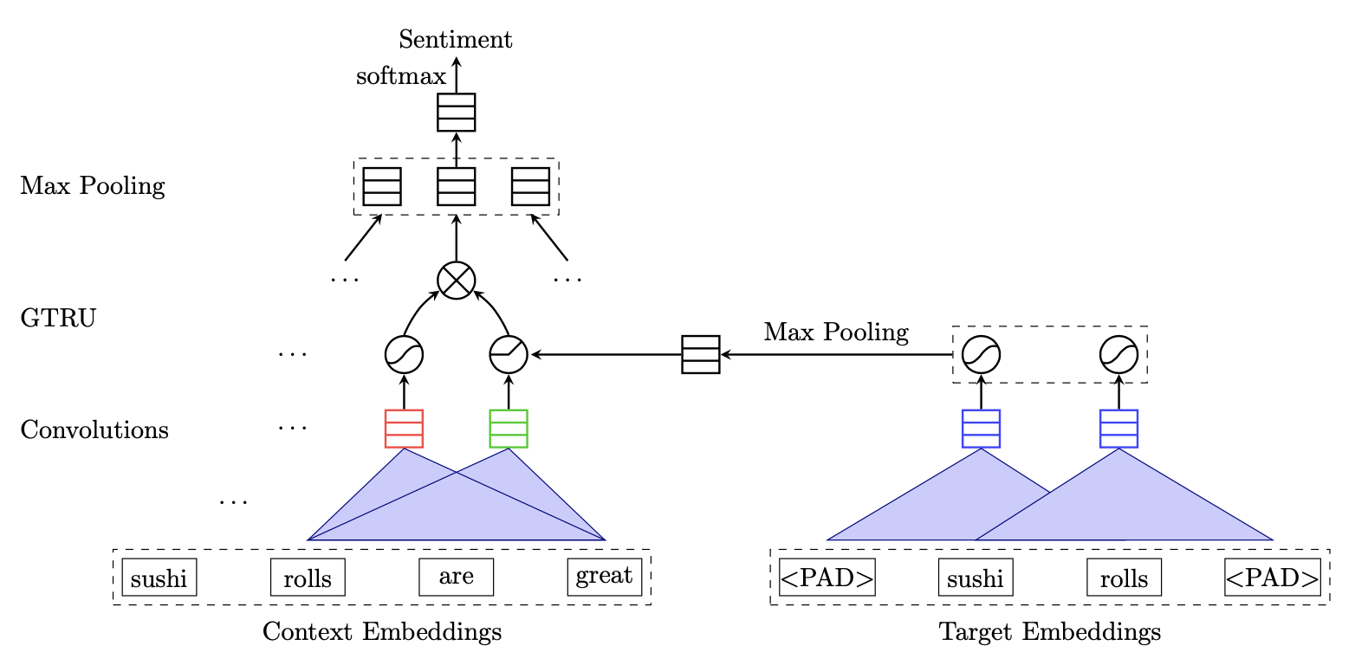

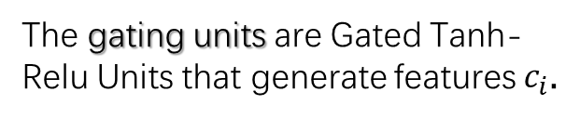


Proposed Method: GCAE model with ATSA task
The max-pooling layer will keep the most salient features and finally the fully-connected layer with softmax will use these features to generate the prediction.
$$c_{i}=s_{i}×a_{i}$$
The gating units are Gated Tanh-Relu Units that generate features $c_{i}$.
$$s_{i}$$
$$a_{i}$$
The convolutional layers consist of an embedding layer, a one-dimension convolutional layer and a max-pooling layer.
Fig.4 GCAE model with ATSA task
Gated Convolutional Network with Aspect Embedding: This model is based on convolutional layers and gating units.
Xue W, Li T. Aspect based sentiment analysis with gated convolutional networks[J]. arXiv preprint arXiv:1805.07043, 2018.

Slide 14
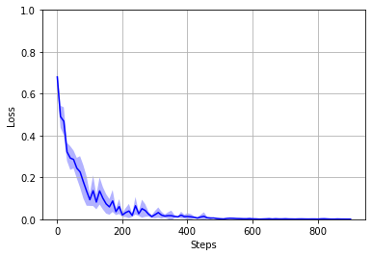
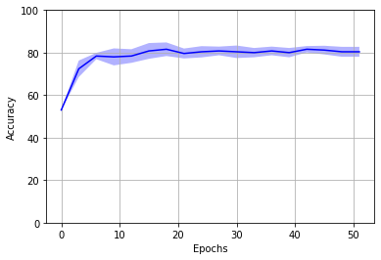
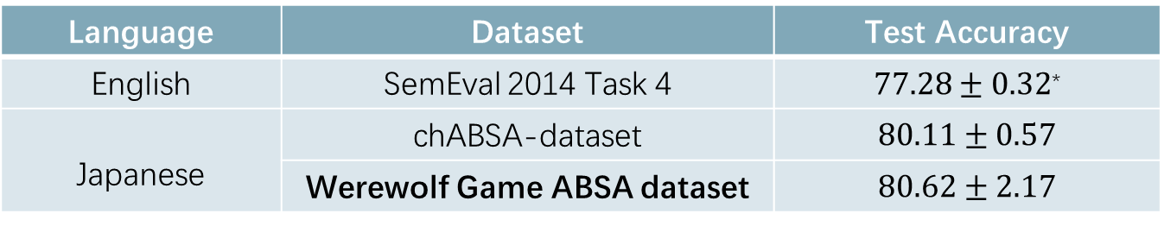
Current Result
Fig.5 Training Loss
Fig.6 Test Accuracy
Language | Dataset | Test Accuracy
English | SemEval 2014 Task 4 | $77.28±0.32$*
Japanese | chABSA-dataset | $$80.11±0.57$$
 | Werewolf Game ABSA dataset | $$80.62±2.17$$
Werewolf Game ABSA Dataset：500 samples for training and 50 for testing, which are automatically labelled by Japanese Sentiment Polarity Dictionary and Werewolf Dictionary, then revised manually.
Word Embedding: Spacy* Japanese middle-sized model with 300 dimensions.
Xue W, Li T. Aspect based sentiment analysis with gated convolutional networks[J]. arXiv preprint arXiv:1805.07043, 2018.

Slide 15
Future Plan
Higher Accuracy:
Enlarge and refine the dataset for ATSA task, try the new assignment of sentiment points in the previous model.
Change the input way of sentiment points to solve the problem of sparsity.
Upgrade the GRU model.
Experiments on the viewpoint of the werewolf:
Seer prediction and possessed prediction.
Strategies of killing.(optional)

Slide 16
Summary
Research Goal: Using sentiment analysis on the werewolf game dialogs to generate usable information for AI agents, for example: werewolf prediction, seer prediction.
Finished:
Created preliminary GRU model to analysis sentiment points (werewolf prediction and so on)
Created small werewolf ATSA dataset.
Trained a model to identify sentiment and sentiment target associated and create more reliable sentiment points
Future Plan:
Enlarge and refine the ATSA dataset.
Adjust the GRU model with new sentiment points to generate analysis result with higher accuracy.
Try other tasks to analyze the sentiment points and produce more usable information.

Slide 17
References
Werewolf BBS G, http://ninjinix.x0.com/wolfg/index.rb.
Werewolf Game Dictionary, https://w.atwiki.jp/wolfbbsdictionary/
Lab, T. N.: Japanese Sentiment Polarity Dictionary, http: //www.cl.ecei.tohoku.ac.jp/Open_Resources-Japanese_ Sentiment_Polarity_Dictionary.html.
Toriumi, F., Osawa, H. and Inaba, Michimasa, a. e. a.: AI wolf contest—development of game AI using collective intelligence—, Computer Games, Springer, pp. 101–115 (2016)
Fukui, T., Ando, K., Murakami, T., Ito, N. and Iwata, K.: Automatic classification of remarks in Werewolf BBS, 2017 5th Intl Conf on Applied Computing and Information Technology/4th Intl Conf on Computational Science/Intelligence and Applied Informatics/2nd Intl Conf on Big Data, Cloud Computing, Data Science (ACIT-CSII-BCD), IEEE, pp. 210–215 (2017).
Kondoh, M., Matsumoto, K. and Mori, N.: Development of Agent Predicting Werewolf with Deep Learning, International Symposium on Distributed Computing and Artificial Intelligence, Springer, pp. 18–26 (2018).
Wang, T. and Kaneko, T.: Application of Deep Reinforcement Learning in Werewolf Game Agents, 2018 Conference on Technologies and Applications of Artificial Intelligence (TAAI), IEEE, pp. 28–33 (2018).

Slide 18
Nakamura, H., Katagami, D., Toriumi, F. and et al.: Generating human-like discussion by paraphrasing a translation by the AIWolf protocol using werewolf BBS logs, 2017 IEEE International Conference on Fuzzy Systems (FUZZ-IEEE), IEEE, pp. 1–6 (2017).
Cho, K., Van Merri¨enboer, B., Gulcehre, C. and et al.: Learning phrase representations using RNN encoderdecoder for statistical machine translation, arXiv preprint arXiv:1406.1078 (2014).
Yukino, I.: oseti:Dictionary based Sentiment Analysis for Japanese, https://github.com/ikegami-yukino/oseti.
Do H H, Prasad P W C, Maag A, et al. Deep learning for aspect-based sentiment analysis: a comparative review[J]. Expert Systems with Applications, 2019, 118: 272-299.
Xue W, Li T. Aspect based sentiment analysis with gated convolutional networks[J]. arXiv preprint arXiv:1805.07043, 2018.
Kubo T.; Nakayama H., “chABSA: Aspect Based Sentiment Analysis dataset in Japanese”, https://github.com/chakki-works/chABSA-dataset , TIS, 2018.

