Slide 1
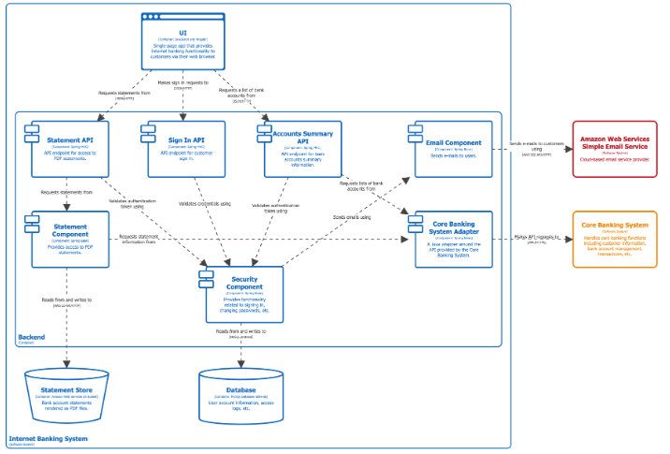
Architecture Output (what is expected of the software architect)
I. High-Level System Design: Diagram and description of overall structure, showing how the 18 modules interact.
1. A block diagram showing your 18 modules as boxes, with lines connecting them to illustrate communication. It defines the system boundaries, major components, and the interactions between them.
https://c4model.com/diagrams/system-context

Slide 2
Architecture Output (what is expected of the software architect)
II. Technology Stack Recommendation: Specific languages, frameworks, and databases justified by our requirements.
1. A table with:

Slide 3
Architecture Output (what is expected of the software architect)
III. AI Integration Strategy: A blueprint for where and how AI agents will be embedded in each applicable module (e.g., agent orchestration, model hosting, data flow).
1. A blueprint detailing how AI agents will be built, hosted, and invoked within the modules. Also prevents the 18 AI agents from becoming chaotic, unmanageable, or conflicting with each other. It defines the "rules of engagement" for all AI components.
2. Visual: An Orchestration Diagram. This shows how a user request triggers an agent. For example: User Input -> Supervisor Agent -> [Module A Agent | Module B Agent] -> Response.
3. "Agent Topology" Diagram
https://learn.microsoft.com/en-us/azure/architecture/ai-ml/guide/ai-agent-design-patterns
4. "Agent Definition" Table

Slide 4
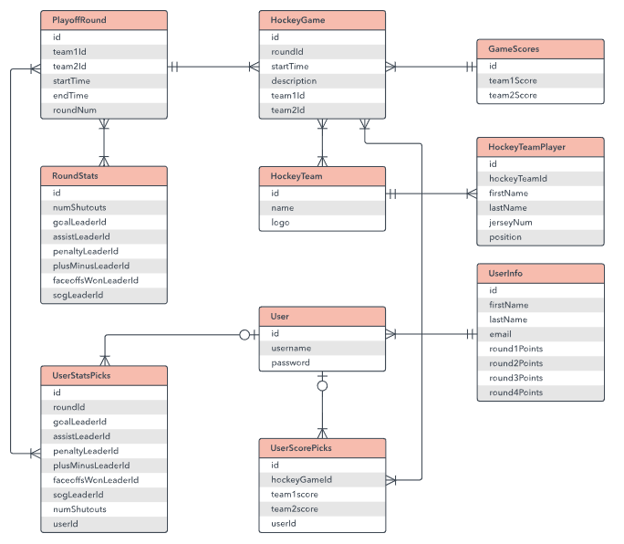
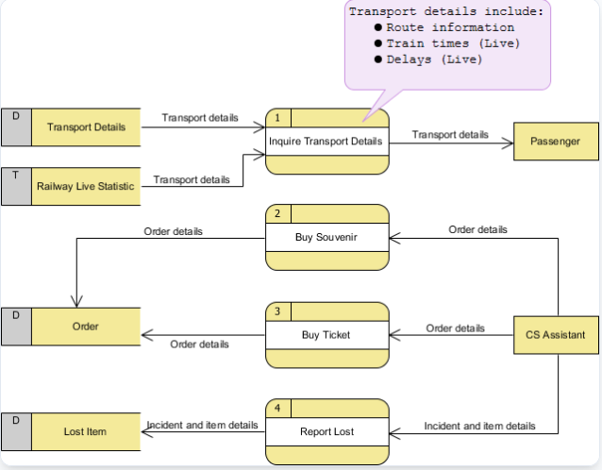
Architecture Output (what is expected of the software architect)
IV. Data Architecture: ER diagrams and specifications for data storage and flow between modules.
The design of your databases and how data moves between them. Crucial for 18 modules to share a single source of truth.
1. An Entity-Relationship Diagram (ERD) . Tables (entities) with columns (attributes) connected by lines showing relationships (one-to-many, many-to-many).
https://www.lucidchart.com/pages/er-diagrams
2. A Data Flow Diagram (DFD) . Shows where data originates, how it transforms, and where it is stored.
https://www.visual-paradigm.com/tutorials/data-flow-diagram-example-cs-system.jsp
3. Data dictionary defining every data field.

Slide 5
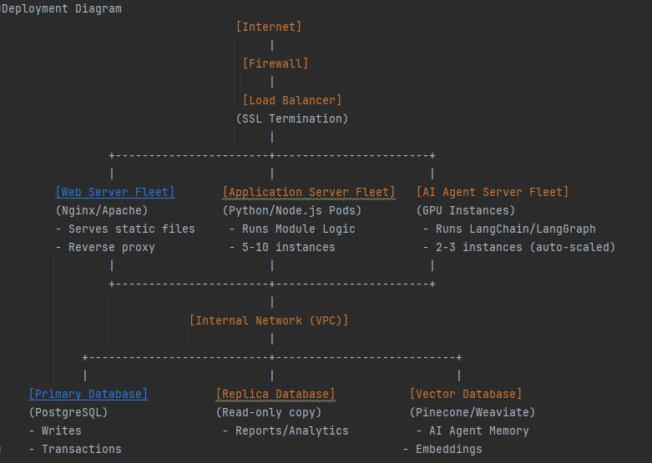
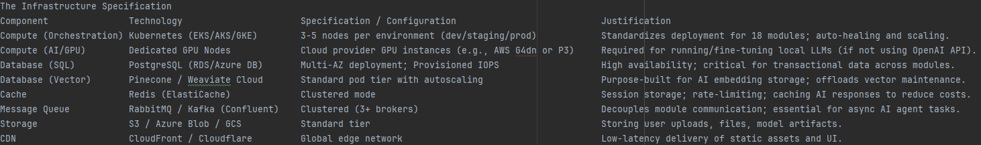
Architecture Output (what is expected of the software architect)
V. Infrastructure Design: Cloud vs. on-premise decision, deployment diagrams, and scalability plans.
A blueprint for the physical or cloud environment where
your software will live and run. It answers: "Where will
this be deployed, and how will it handle traffic, failures,
and scaling?“
1. Deployment diagram
2. Infrastructure specification

Slide 6
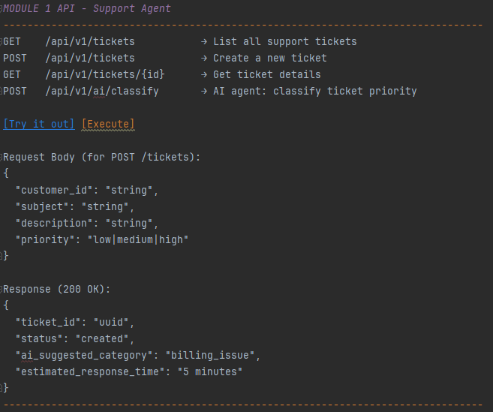
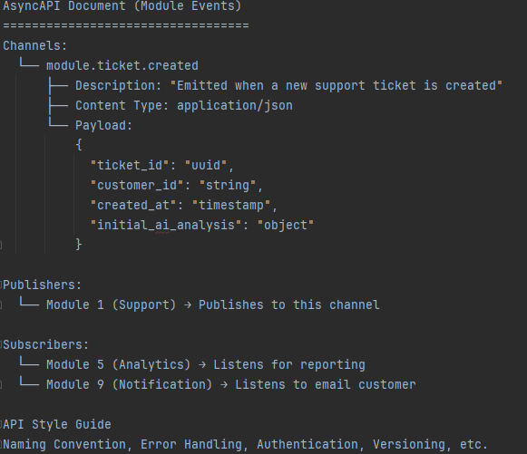
Architecture Output (what is expected of the software architect)
VI. API Contract / Interface Definitions: Clear specifications for how modules communicate (REST, GraphQL, message queues).
The technical "handshake" agreement between modules. Since different teams might build
different modules, this defines how they talk to each other.
1. OpenAPI/Swagger Specification 2. AsyncAPI Specification (For Event-Driven Communication)
3. API Style Guide: Naming Convention, Error Handling, Authentication, Versioning, etc.

Slide 7
Architecture Output (what is expected of the software architect)
VII. Technical Roadmap: Prioritized breakdown of which modules to build first based on technical dependencies.
A phased plan for building the software based on the architecture
1. Gantt chart or Timeline view
Phase 1 (MVP): Core Module 1, Module 2, Database Setup, Authentication.
Phase 2 (AI Integration): Implement AI agent in Module 3, Setup Vector DB.
Phase 3: Remaining modules.
Text: Identification of "critical path" dependencies (e.g., "Module 5 cannot start until the Data Architecture for Module 1 is complete").

