Slide 1
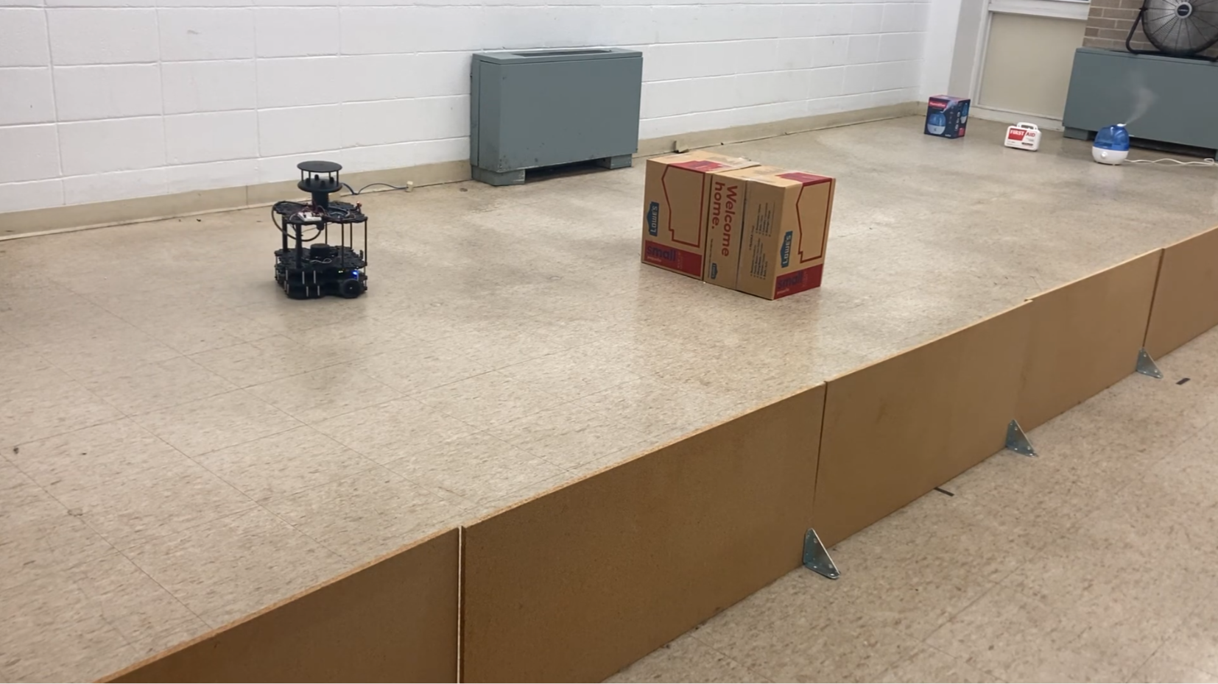



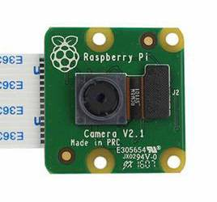
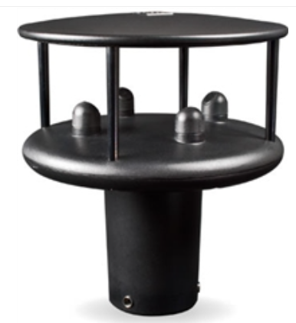
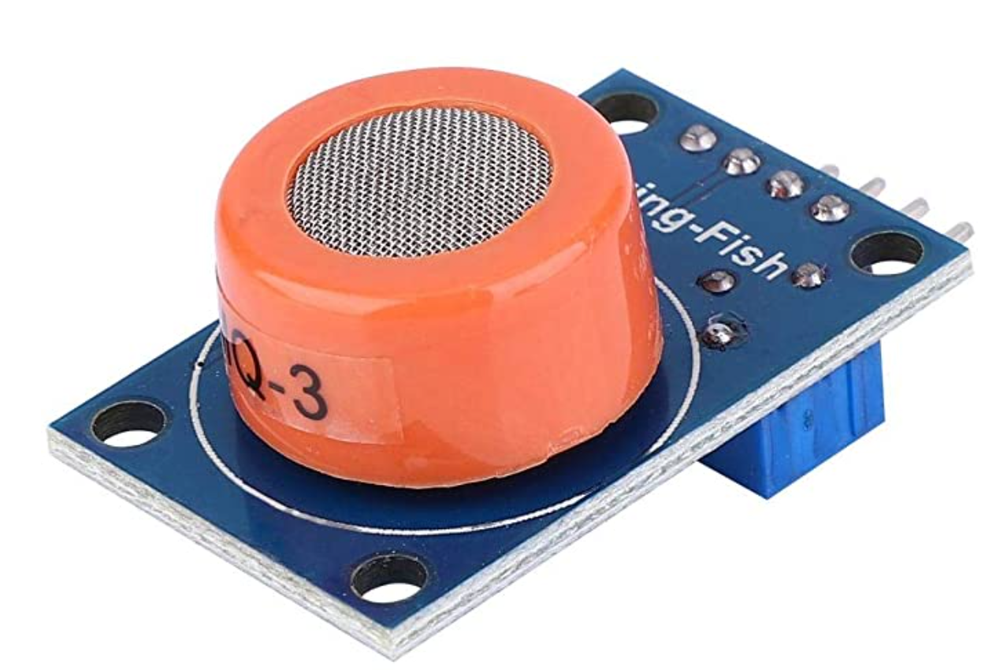
Can Robots Think Like Humans?
Environment
Robot Takes Action
Robot Senses the Environment
Control Command
Objective and Sensor data
Behavior
Prompt
Plan Behavior
LLM Thinking
Understanding
Reasoning

