Slide 1

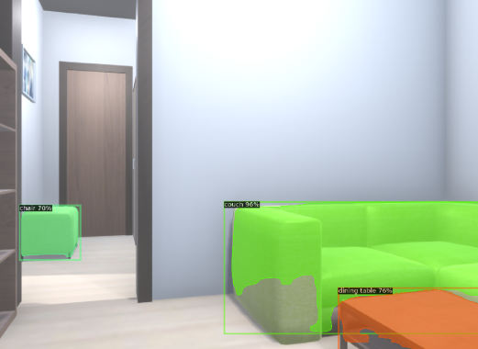
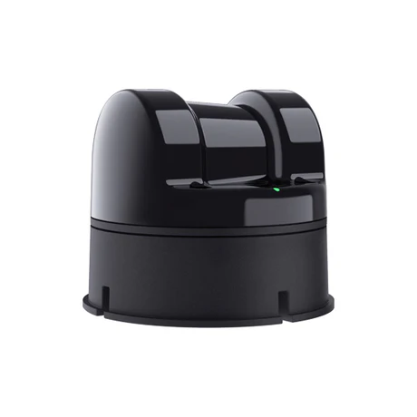
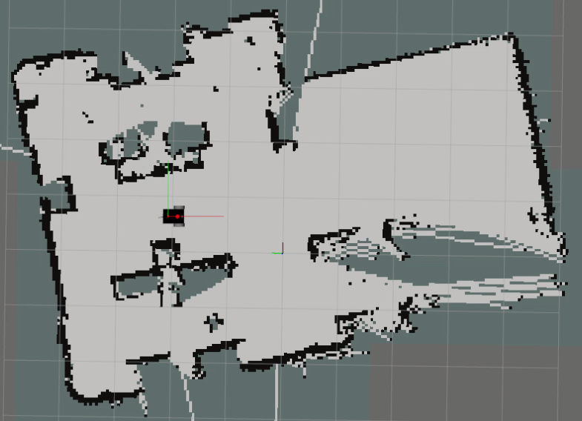
E-Nose Chemical Reading
Olfaction: E-nose chemical reading to potential odor source object identification using Flavornet DB and LLM reasoning.
Vision: Building a semantic 3D graph representation using RGB-D input.
Localization: Object query in 3D scene graph. Using object position for direct localization.
Validation:
GADEN-VGR simulation environment for vision-olfaction.
Real-world for semantic olfaction.
LLM Query on Flavornet DB
Possible Odor Sources
LLM
Query
on
Semantic 3D Scene Graph
Input RGB-D Sequence
ConceptGraph
Navigate
To Object Position using
Occupancy Map
LiDAR
SLAM/VSLAM

