Slide 1

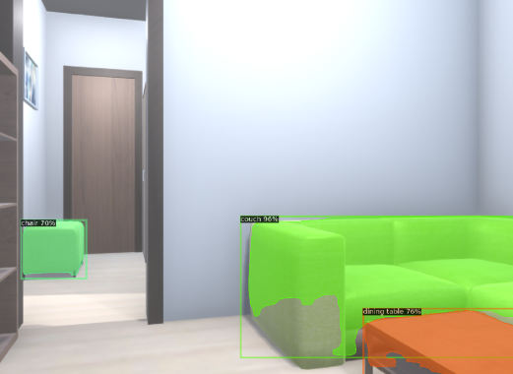
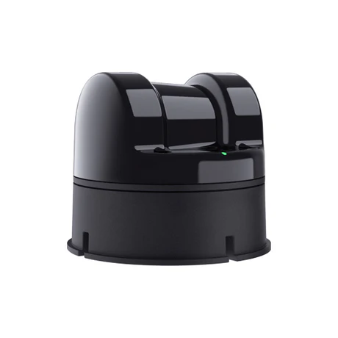
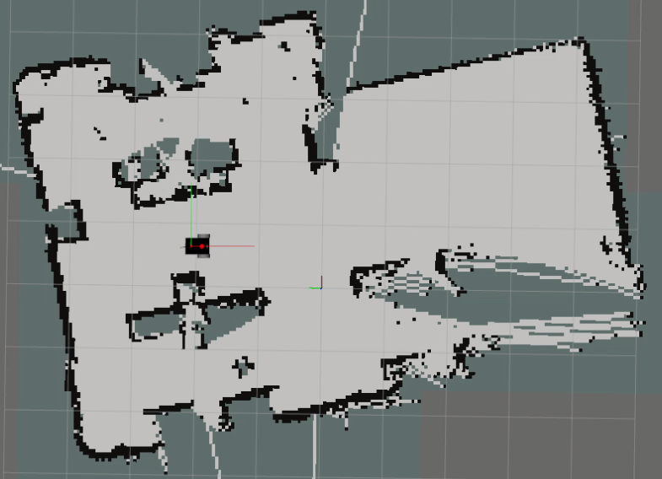
E-Nose Chemical Reading
Olfaction: E-nose chemical reading to potential odor source object identification using Flavornet DB and LLM reasoning.
Vision: Building a semantic 3D graph representation using RGB-D input.
Localization: Object query in 3D scene graph. Using object position for direct localization.
Validation:
GADEN-VGR simulation environment for vision-olfaction.
Real-world for semantic olfaction.
LLM Query on Flavornet DB
Possible Odor Sources
LLM
Query
on
Semantic 3D Scene Graph
Input RGB-D Sequence
ConceptGraph
Navigate
To Object Position using
Occupancy Map
LiDAR
SLAM/VSLAM

Slide 2


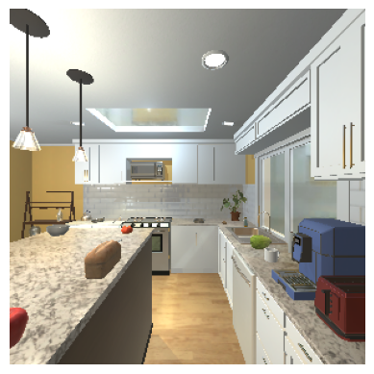


AI2Thor Environment
Environment Sensing
Vision Sensing
Navigation
Sensing
Vision Sensing
Olfaction Sensing
Navigation Sensing
Multimodal Prompt
LLM Analysis
Olfaction Sensing
Con: 0.9
Vision Analysis
Olfaction Analysis
Navigation Analysis
Sense
Reasoning Output
Act
Action Decision Parser

Slide 3
Sequentially perform the following input analysis to select the best action:
Visual Analysis: do you see an object that is a possible source for {goal}?
If yes, list the most likely object's name.
If yes, and the front is obstacle free, move forward.
Olfactory Analysis:
If the sensed concentration decreases, turn back.
If the sensed concentration increases and front is obstacle free, move forward.
If the sensed concentration stays the same, focus on visual and navigation analysis.
Navigation Analysis:
If the front is blocked, turn to the side that is obstacle free and is more likely to lead you to the possible {goal} related object.
If the last action was to turn (Action_id = 2 or 3), and the forward direction is blocked, then Turn Back.
Semantic Analysis Instructions

Slide 4
Vision branch: RGBD > environment knowledge.
Object Detection using YOLO.
3D coordinate of the detected objects: using YOLO bounding box coordinate, 90th percentile depth (instead of midpoint), robot position/orientation, camera parameters.
Environment knowledge: storing 3D object points.
Olfaction branch: odor semantic and concentration.
2D odor dispersion model > turbulent concentration.
E-nose chemical mix (VOC, CO, CO2, etc.) > lookup odor semantics.
Fusion - 2 behaviors: exploration and OSL
Exploration: visit unseen parts of the environment to update environment knowledge.
OSL: if odor concentration > threshold
Calculate cosine similarity of the detected odor type to the objects in environment knowledge. Generate a sorted list of object coordinates to visit.
Localize the top object – if odor concentration decreases while moving towards it, localize the second object, and so on.
Source declaration: if the robot reaches within a threshold of the object, while odor detection keeps on rising.
Point-goal navigation while avoiding obstacles: RL or path planning for action selection > low-level controller for execution.

