Slide 1
Introduction to Parallel Processing
3.1 Basic concepts
3.2 Types and levels of parallelism
3.3 Classification of parallel architecture
3.4 Basic parallel techniques
3.5 Relationships between languages and parallel architecture
TECH
Computer Science
CH03

Slide 2
3.1 Basic concepts
3.1.1 The concept of program
  ordered set of instructions (programmer’s view)
  executable file (operating system’s view)

Slide 3
The concept of process
OS view, process relates to execution
Process creation
  setting up the process description
  allocating an address space
  loading the program into the allocated address space, and
  passing the process description to the scheduler
process states
  ready to run
  running
  wait

Slide 4
Process spawning
(independent processes)
Figure 3.3 Process spawning.
A
B
C
D
E

Slide 5
3.1.3 The concept of thread
smaller chunks of code (lightweight)
threads are created within and belong to process
for parallel thread processing, scheduling is performed on a per-thread basis
finer-grain, less overhead on switching from thread to thread

Slide 6
Single-thread process or multi-thread (dependent)
  Figure 3.5 Thread tree
Process
Threads

Slide 7
Three basic methods for creating and terminating threads
1. unsynchronized creation and unsynchronized termination
  calling library functions: CREATE_THREAD, START_THREAD
2. unsynchronized creation and synchronized termination
  FORK and JOIN
3. synchronized creation and synchronized termination
  COBEGIN and COEND

Slide 8
3.1.4 Processes and threads in languages
Black box view: T: thread
T2 T0 T1 T1 T2 T0 . . . Tn
FORK
COBEGIN
. . .
FORK
JOIN
COEND
JOIN
(a)
(b)

Slide 9
3.1.5 The concepts of concurrent execution (N-client 1-server)
Non pre-emptive
Pre-emptive
Time-shared
Priotized
Priority
Sever
Sever
Sever
Client
Client
Client

Slide 10
Parallel execution
N-client N-server model
Synchronous or Asynchronous
Client
Sever

Slide 11
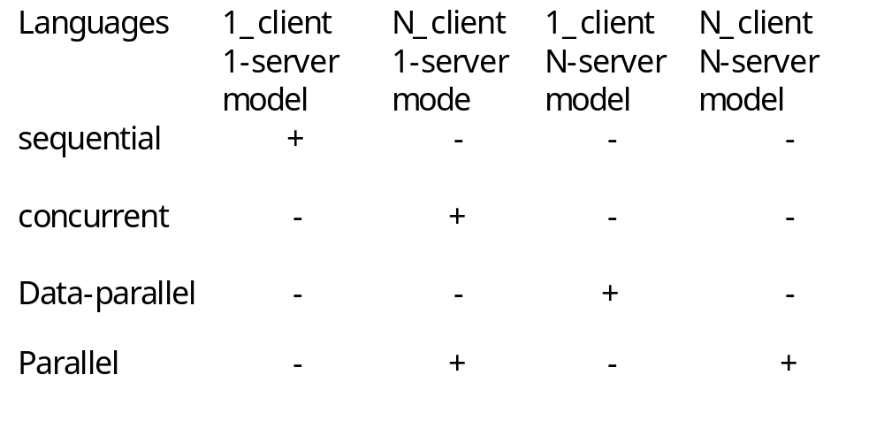
Concurrent and parallel programming languages
Classification
Table 3.1 Classification of programming languages.

Slide 12

3.2 Types and levels of parallelism
3.2.1 Available and utilized parallelism
  available: in program or in the problem solutions
  utilized: during execution
3.2.2 Types of available parallelism
  functional
    arises from the logic of a problem solution
  data
    arises from data structures

Slide 13
Figure 3.11 Available and utilized levels of functional parallelism
Available levels
Utilized levels
User (program) level
User level
2
Procedure level
Process level
Loop level
Thread level
1
Instruction level
Instruction level
1.Exploited by architectures
2.Exploited by means of operating systems

Slide 14

3.2.4 Utilization of functional parallelism
Available parallelism can be utilized by
  architecture,
    instruction-level parallel architectures
  compilers
    parallel optimizing compiler
  operating system
    multitasking

Slide 15
3.2.5 Concurrent execution models
User level --- Multiprogramming, time sharing
Process level --- Multitasking
Thread level --- Multi-threading

Slide 16
3.2.6 Utilization of data parallelism
by using data-parallel architecture

Slide 17

3.3 Classification of parallel architectures
3.3.1 Flynn’s classification
  SISD
  SIMD
  MISD (Multiple Instruction Single Date)
  MIMD

Slide 18
Parallel architectures //
Parallel architectures
PAs
Data-parallel architectures
Function-parallel architectures
Instruction-level
PAs
Thread-level
PAs
Process-level
PAs
DPs
ILPS
MIMDs
Vector
Associative
SIMDs
Systolic
Pipelined
VLIWs
Superscalar
Ditributed
Shared
and neural
architecture
processors
processors
memory
memory
architecture
architecture
MIMD
(multi-
(multi-computer)
Processors)
Part III
Part II
Part IV

Slide 19

3.4 Basic parallel technique
3.4.1 Pipelining (time)
  a number of functional units are employed in sequence to perform a single computation
  a number of steps for each computation
3.4.2 Replication (space)
  a number of functional units perform multiply computation simultaneously
    more processors
    more memory
    more I/O
  more computers

Slide 20

3.5 Relationships between languages and parallel architecture
SPMD (Single Procedure Multiple data)
  Loop: split into N threads that works on different invocations of the same loop
  threads can execute the same code at different speeds
  synchronize the parallel threads at the end of the loop
    barrier synchronization
  use MIMD
Data-parallel languages
  DAP Fortran
    C = A + B
  use SIMD

Slide 21

Synchronization mechanisms
Figure 3.17 Progress of language constructs used for synchronization
Test_and_set
Send/receive
message
Semaphore
Broadcast
Shift
Net_send
net_receive
(processor form)
Conditional
Critical region
Monitor
Remote procedure calls
Rendezvous

Slide 22
Using binary Semaphore p1 or queue semaphore p2
P1
P2
Busy
Wait
P(S)
S
Semaphore
P(S)
Critical
region
Critical
region
Shared
data
structure
V(S)
V(S)
Figure 3.18 Using a semaphore to solve the mutual execution problem

Slide 23
Parallel distributed computing
Ada
  used rendezvous concepts which combines feature of RPC and monitors
PVM (Parallel Virtual Machine)
  to support workstation clusters
MPI (Message-Passing Interface)
  programming interface for parallel computers
COBRA ?
Windows NT ?

Slide 24
Summary of forms of parallelism
See Table 3.3

