Slide 1
9. Code Scheduling for ILP-Processors
{Software! compilers optimizing code
for ILP-processors, including VLIW}
9.1 Introduction
9.2 Basic block scheduling
9.3 Loop scheduling
9.4 Global scheduling
TECH
Computer Science
CH01

Slide 2
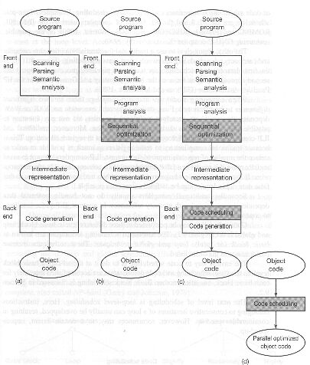
Typical layout of compiler: traditional, optimizing, pre-pass parallel, post-pass parallel

Slide 3
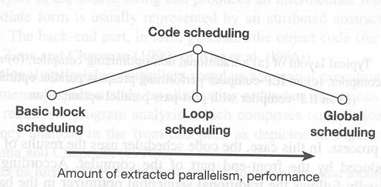
Levels of static scheduling

Slide 4
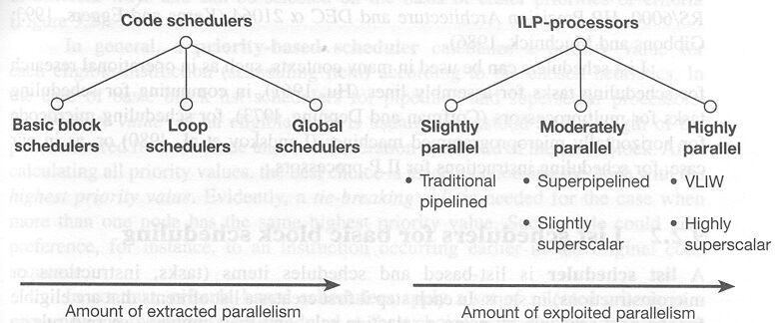
Contrasting the performance of {software/hardware} static code schedulers and ILP-processor

Slide 5
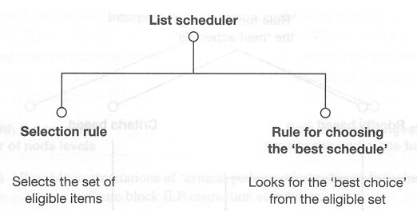
9.1 Basic Block Schedulers:
List scheduler: in each step
Basic Block:
  straight-line code,
  can only enter at beginning and left at end

Slide 6
-Eligible Instructions are
dependency-free
  no predecessors in the Data Dependency Graph
  or data to be produced by a predecessor node is already available
    timing: checking when the data will be ready
hardware required resources are available

Slide 7
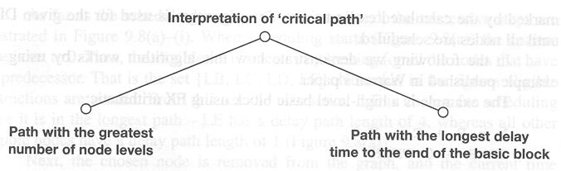
-Looks for the ‘Best Choice’ from the eligible set of instructions {critical path in Data Dependency Graph}
Choose First: Schedule instructions in the critical path
Choose Next: others

Slide 8
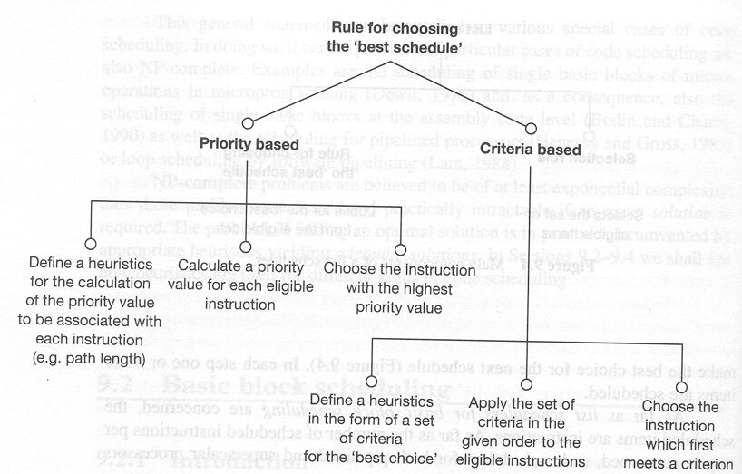
Heuristic Rule for choosing the next instructions

Slide 9
Set of criteria
1. whether there is an immediate successor that is dependent on the instruction in question
2. how many successors the instruction has
3. how long is the longest path from the instruction in question to the leaves

Slide 10
Case Study: compiler for IBM Power1
Basic block approach: list scheduler
Using Data Dependency Graph
Critical path
  the longest (in term of execution time)
Earliest time
  when check the data for the instruction will be available
Latency value (on each arc of DDG)
  how many time units the successors node have to wait before the result of the predecessor node becomes available

Slide 11
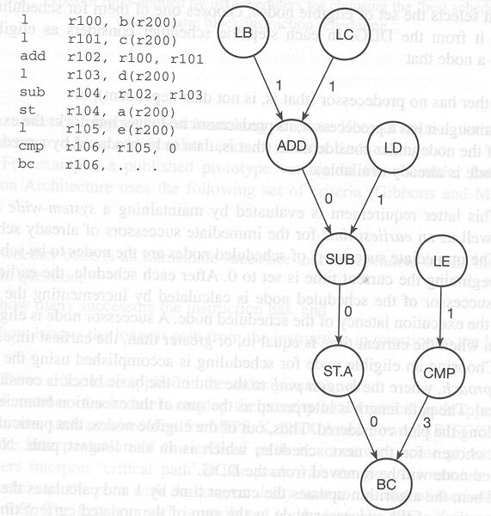
Example program:
The intermediate code and the corresponding DDG

Slide 12
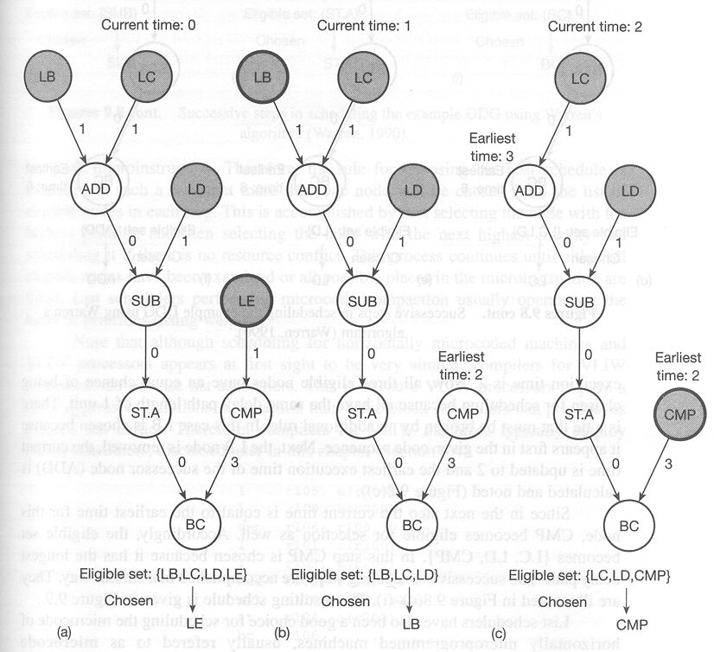
The first three steps in scheduling the example DDG using Warren‘s algoruthm

Slide 13
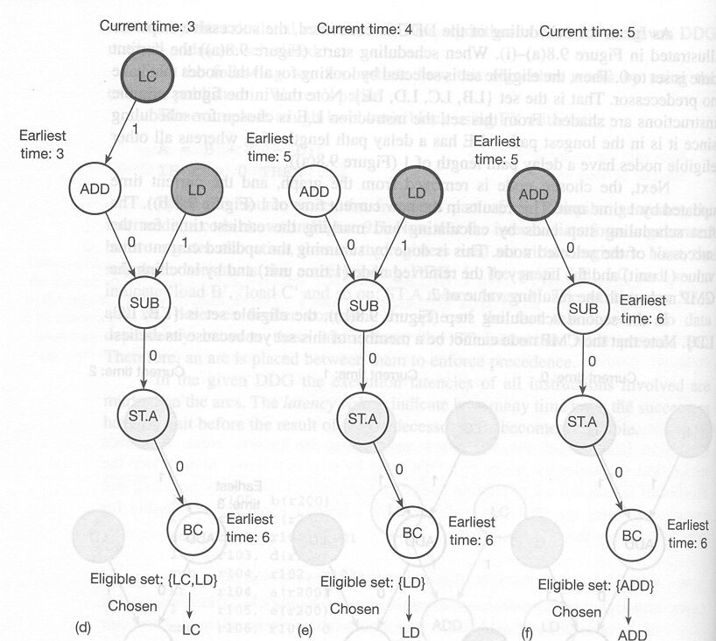
Successive steps in scheduling the example DDG

Slide 14
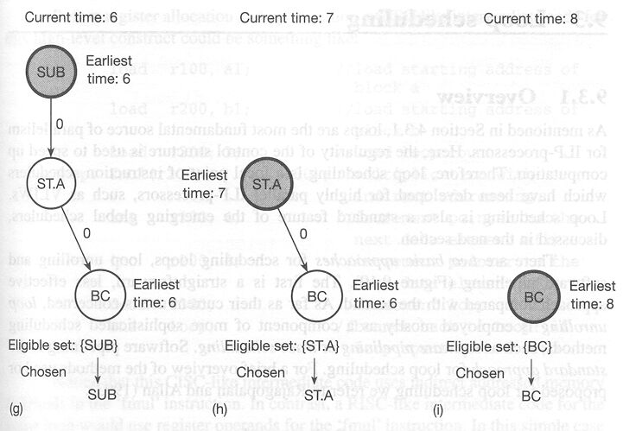
Successive steps in scheduling the example DDG

Slide 15
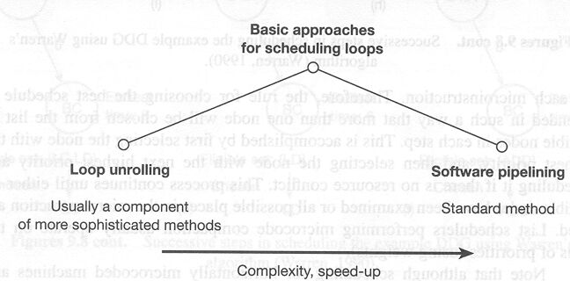
9.3 Loop Scheduling

Slide 16
-Loop Unrolling
  for I = 1 to 3 do {
  b(I) = 2 * a(I)
  }
Loop Unrolled: basic concept
  b(1) = 2 * a(1)
  b(2) = 2 * a(2)
  b(3) = 2 * a(3)
save execution time at the expense of code length
omitting inter-iteration loop updating code
  performance improvement
enlarging the basic block size
  can lead to more effective schedule with considerable speed up

Slide 17
Simply unrolling is not practicable
  when a loop has to be executed a large number of times
solution:
  unroll the loop a given number of time (e.g. 3)
  → larger basic block
Inter-iteration dependency
  only feasible if the required data becomes available in due time

Slide 18
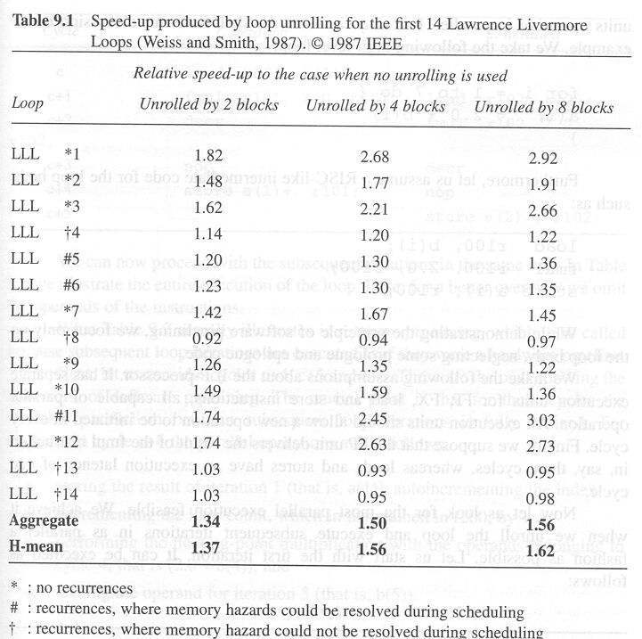
Speed-up produced by loop unrolling for the first 14 lawrence livermore loops

Slide 19
-Software Pipelining
Software pipelining is an analogous term to hardware pipelining
Software pipelining
  each pipeline stage uses one EU
  each pipeline cycle execute one instruction
E.G.
  for I = 1 to 7 do {
  b(I) = 2 * a(I)
  }

Slide 20
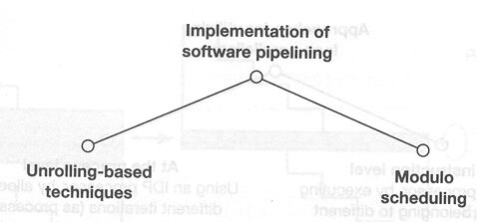
Basic methods for software pipelining

Slide 21
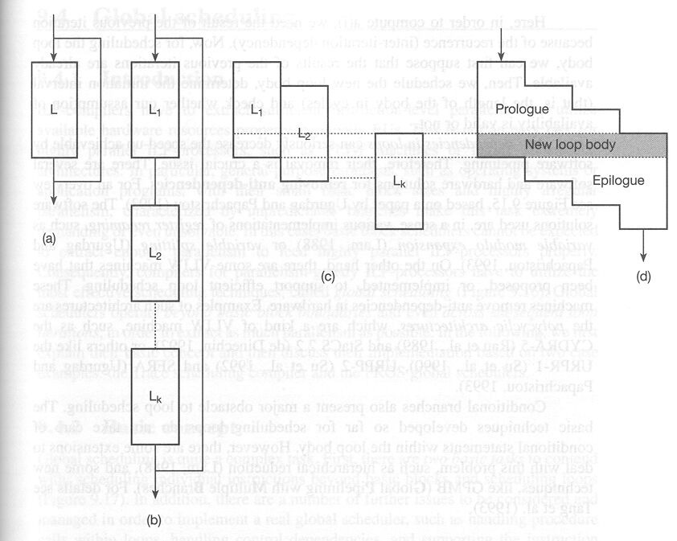
-Principle of the unrolling-based URPR sofeware pipelining method

Slide 22
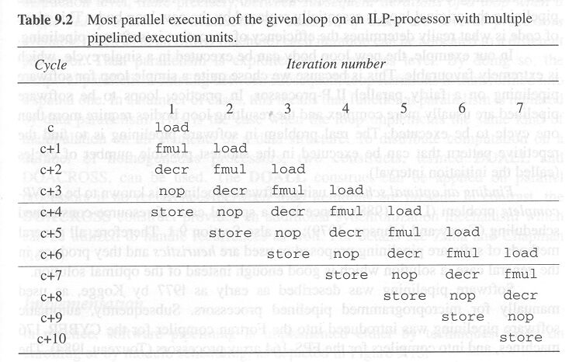
E.G. loop 7 times, 4 EU’s VLIW, fmul takes 3 cycles

Slide 23
-Modulo scheduling //
→ find the repetitive character of the schedule
guess the minimal required length of the new {partially unrolled} loop
  period of repetition
try schedule for this interval {period}
  taking into account data and resource dependencies
if the schedule is not feasible
  then the length {period} is increased
try again

Slide 24
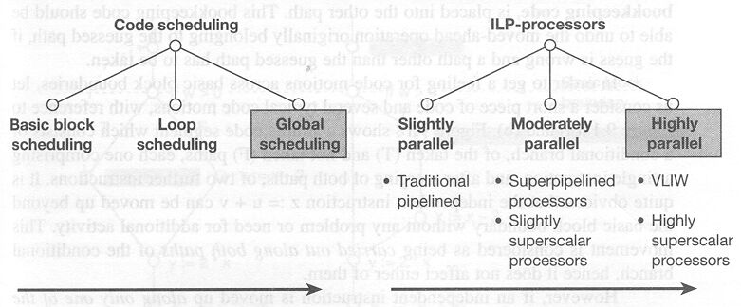
9.4 Global Scheduling:
Scheduling of individual instructions beyond basic blocks

Slide 25
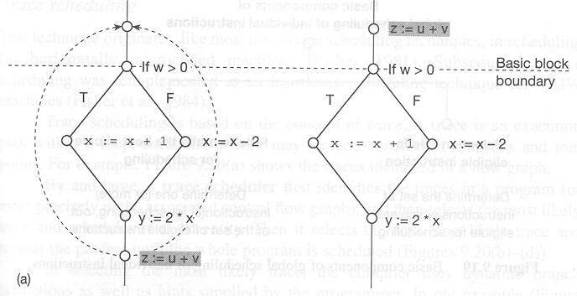
Moving up an independent instruction beyond a basic block boundary
‘along both paths ’ of a conditional branch

Slide 26
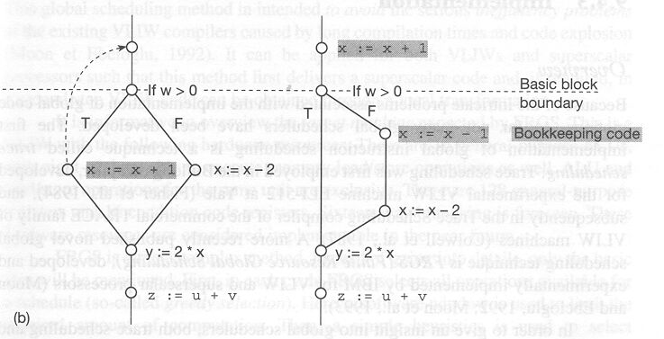
Moving up an independent instruction beyond a basic block boundary
‘along a single path’ of a conditional branch {guess T}

Slide 27
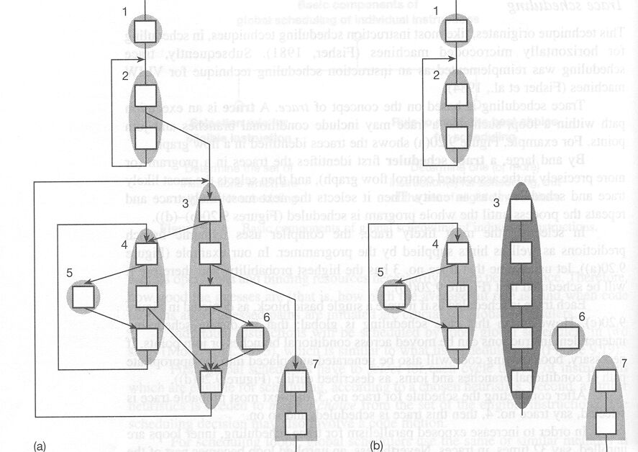
Trace Scheduling: flow graph, guess 3

Slide 28
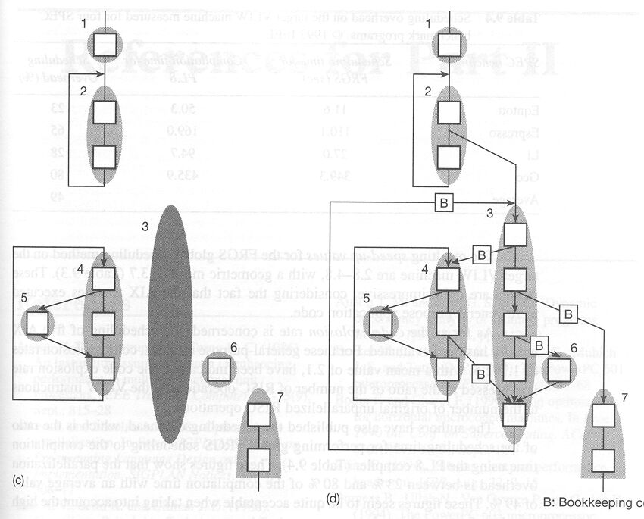
Bookkeeping Code [B]

Slide 29
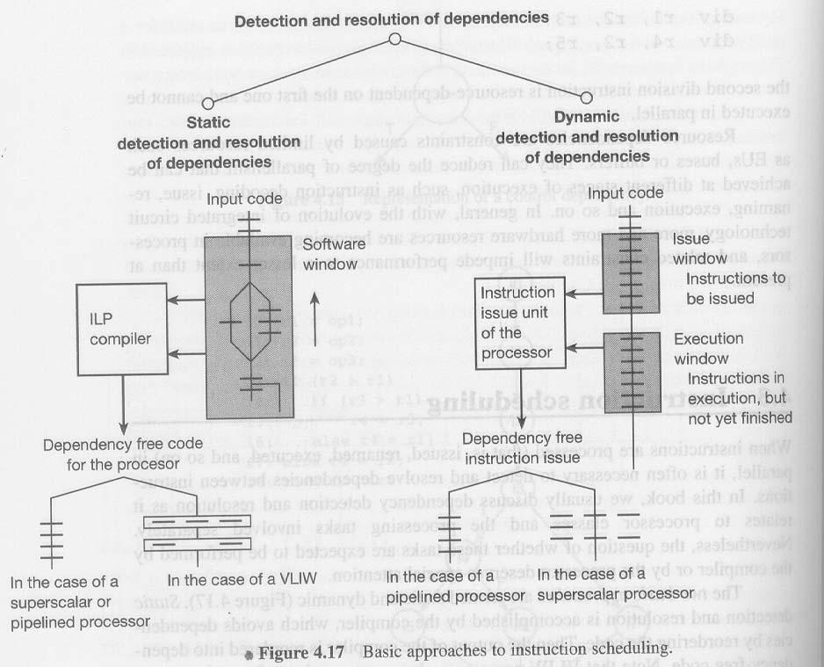
Finite Resource Global Scheduling: solving long compilation times and code explosion
For VLIW
  3.7 Speed-up over Power1
  49% Compilation time over PL.8
  2.1 Code explosion over RISC

