Slide 1
Introduction to MIMD architectures
{Multi-processor}
{Multi-computer}
15.1 Architectural concepts
15.2 Problems of scalable computers
15.3 Main design issues of scalable MIMD computers
TECH
Computer Science
CH01

Slide 2
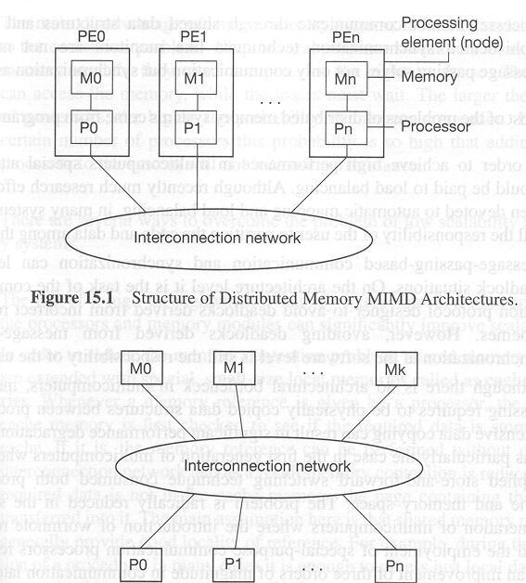
Multi-computer:
Structure of Distributed Memory MIMD Architectures

Slide 3
Multi-computer (distributed memory system):
Advantages and Disadvantages
+Highly Scalable
+Message passing solves memory access synchronization problem
-Load balancing problem
-Deadlock in message passing
-Need to physically copying data between processes

Slide 4
Multi-processor:
Structure of Shared Memory MIMD Architectures

Slide 5
Multi-processor (shared memory system):
Advantages and Disadvantages
+May use uniprocessor programming techniques
+Communication between processor is efficient
-Synchronized access to share data in memory needed
-Lack of scalability due to (memory) contention problem

Slide 6
Best of Both Worlds
(Multicomputer using virtual shared memory)
Also called distributed shared memory architecture
The local memories of multi-computer are components of global address space:
  any processor can access the local memory of any other processor
Three approaches:
  Non-uniform memory access (NUMA) machines
  Cache-only memory access (COMA) machines
  Cache-coherent non-uniform memory access
  (CC-NUMA) machines

Slide 7
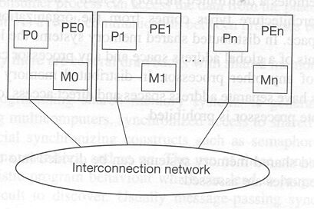
Structure of NUMA Architectures

Slide 8
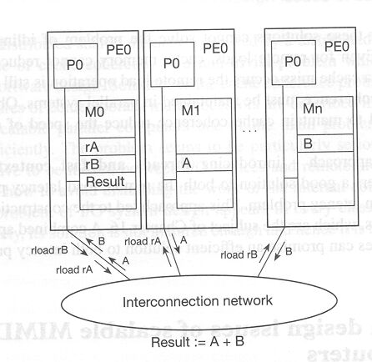
NUMA: remote load

Slide 9
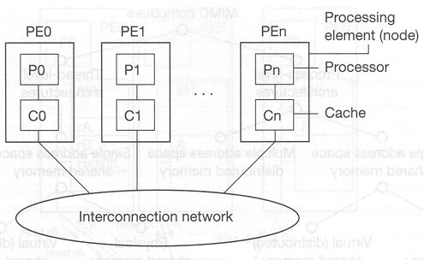
Structure of COMA Architectures

Slide 10
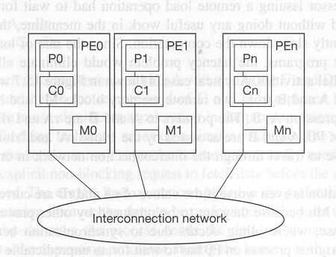
Structure of CC-NUMA Architectures

Slide 11
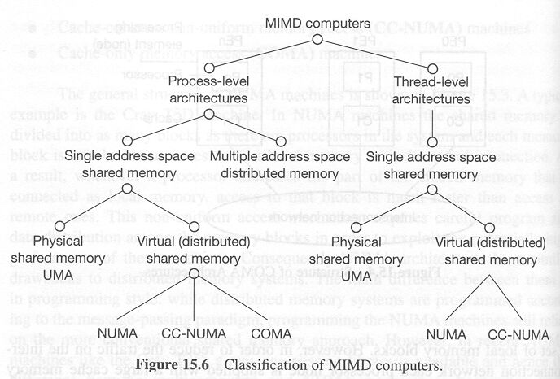
Classification of MIMD computers

