Slide 1
Computational Models
The concept of a computational model
Basic computational models
The von Neumann computational model
Key concepts relating to computational models
TECH
Computer Science
CH01

Slide 2
The concept of a computational model
Model: Foundation or paradigm
Level of abstraction
Computational Model
  Computer architecture
  Computer language

Slide 3
Interpretation of concept of a computational model
Computational Model
  (1) Basic items of computation
  (2) Problem description model
  (3) Execution model

Slide 4
(1) Basic items of computation
  e.g. data, object, argument and functions, element of sets and the predicates

Slide 5
(2) Problem description model
Problem description model
  Style
  Method
Problem description style
  Procedural
  Declarative
Procedure style
    (algorithm for solving the problem is stated)
Declarative style
    (all the facts and relationships relevant to the given problem is stated)

Slide 6
Problem description style (e.g.)
    Calculate n factorial, n!
Procedural style
int nfac (int n) {
  int fac = 1;
  if (n > 0)
  for ( int i = 2; i <= n; i++ )
  fac = fac * i;
  return fac; }
Declarative style
  fac (0) = 1;
  fac ( n>0 ) = n * fac ( n-1 );

Slide 7
Declarative style
Using functions
  in a model called applicative, (Pure Lisp)
Using predicates
  in a model called predicate logic-based, (Prolog)

Slide 8
Problem description method
Procedural method
  how a solution of the given problem has to be described
  e.g. sequence of instructions
Declarative method
  how the problem itself has to be described
  e.g. set of functions

Slide 9
(3) Execution Model
Interpretation of how to perform the computation
    related to the problem description method
Execution semantics
    rule that prescribes how a single execution step is to be performed
Control of the execution sequence
    ordering of execution sequence

Slide 10
Execution semantic
State transition semantics
    Turing model
    von Neumann model
    object-based model
Dataflow semantics
    dataflow model
Reduction semantics
    applicative model (Pure Lisp)
SLD-resolution
    Predicate logic-based model (Prolog)

Slide 11
Control of the execution sequence
Control driven
  assumed that there exists a program consisting of sequence of instructions
    execution sequence is then implicitly given by the order of the instruction
    explicit control instructions to change the order
Data driven
  an operation is activated as soon as all the needed input data is available (eager evaluation)
Demand driven
  an operation is activated only when execution is needed to achieve the final result

Slide 12
Concepts of computational model, programming language, and architecture
Computational model
Implementation tool
Specification tool
Execution
Programming Language
Computer Architecture

Slide 13
Typical Evolution
Computation model
Corresponding programming language
Corresponding architecture

Slide 14
Basic computational models
Turing
von Neumann
object based
dataflow
applicative
predicate logic based

Slide 15
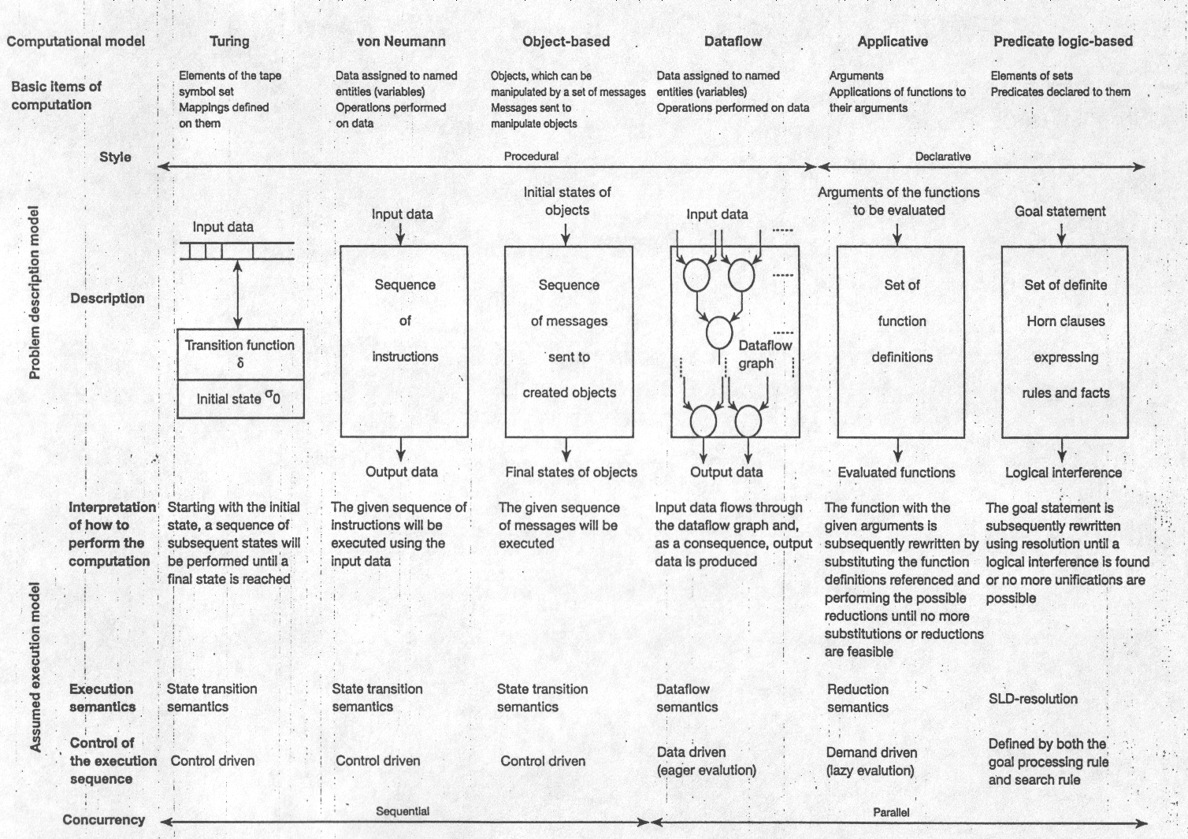
Key features of basic computational models

Slide 16
The von Neumann computational model
Basic items of computation are data
  variables (named data entities)
  memory or register locations whose addresses correspond to the names of the variables
  data container
  multiple assignments of data to variables are allowed
Problem description model is procedural (sequence of instructions)
Execution model is state transition semantics
  Finite State Machine

Slide 17
von Neumann model vs. finite state machine
  As far as execution is concerned the von Neumann model behaves like a finite state machine (FSM)
FSM = { I, G, δ, G₀, G_{f} }
I: the input alphabet, given as the set of the instructions
G: the set of the state (global), data state space D, control state space C, flags state space F, G = D x C x F
δ: the transition function: δ: I x G → G
G₀ : the initial state
G_{f} : the final state

Slide 18
Key characteristics of the von Neumann model
Consequences of multiple assignments of data
  history sensitive
  side effects
Consequences of control-driven execution
  computation is basically a sequential one
++ easily be implemented
Related language
  allow declaration of variables with multiple assignments
  provide a proper set of control statements to implement the control-driven mode of execution

Slide 19
Extensions of the von Neumann computational model
new abstraction of parallel execution
communication mechanism allows the transfer of data between executable units
  unprotected shared (global) variables
  shared variables protected by modules or monitors
  message passing, and
  rendezvous
synchronization mechanism
  semaphores
  signals
  events
  queues
  barrier synchronization

Slide 20
Key concepts relating to computational models
Granularity
  complexity of the items of computation
  size
  fine-grained
  middle-grained
  coarse-grained
Typing
  data based type ~ Tagged
  object based type (object classes)

