Slide 1
Instruction-Level Parallel Processors
{Objective:
executing two or more instructions in parallel}
4.1 Evolution and overview of ILP-processors
4.2 Dependencies between instructions
4.3 Instruction scheduling
4.4 Preserving sequential consistency
4.5 The speed-up potential of ILP-processing
TECH
Computer Science
CH04

Slide 2
Improve CPU performance by
increasing clock rates
  (CPU running at 2GHz!)
increasing the number of instructions to be executed in parallel
  (executing 6 instructions at the same time)

Slide 3

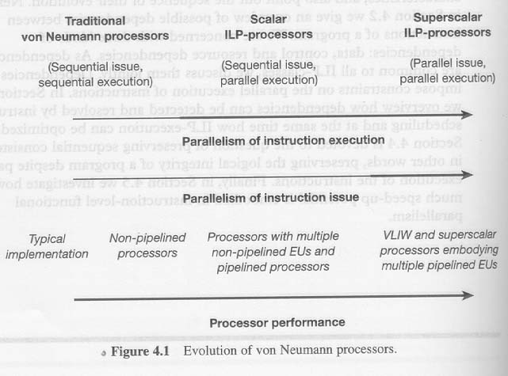
How do we increase the number of instructions to be executed?

Slide 4
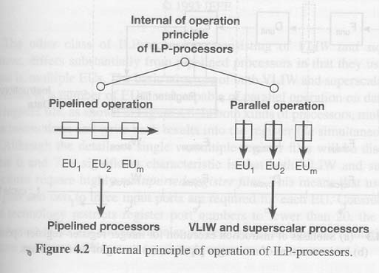
Time and Space parallelism

Slide 5
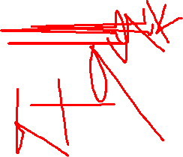
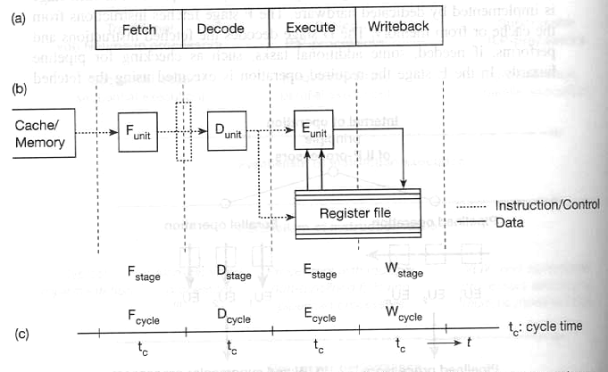
Pipeline (assembly line)

Slide 6
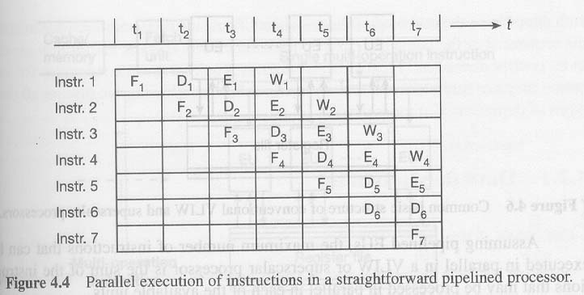
Result of pipeline (e.g.)

Slide 7

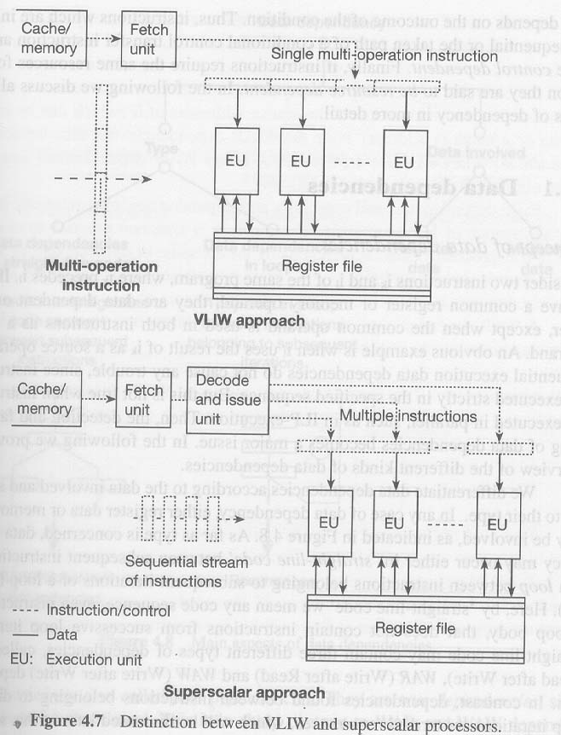
VLIW
(very long instruction word,1024 bits!)

Slide 8
Superscalar
(sequential stream of instructions)

Slide 9
From Sequential instructions to parallel execution
Dependencies between instructions
Instruction scheduling
Preserving sequential consistency

Slide 10
4.2 Dependencies between instructions
  Instructions often depend on each other in such a way that a particular instruction cannot be executed until a preceding instruction or even two or three preceding instructions have been executed.
1 Data dependencies
2 Control dependencies
3 Resource dependencies

Slide 11
4.2.1 Data dependencies
Read after Write
Write after Read
Write after Write
Recurrences

Slide 12
Data dependencies in straight-line code (RAW)
RAW dependencies
  i1: load r1, a
  r2: add r2, r1, r1
flow dependencies
true dependencies
cannot be abandoned

Slide 13
Data dependencies in straight-line code (WAR)
WAR dependencies
  i1: mul r1, r2, r3
  r2: add r2, r4, r5
anti-dependencies
false dependencies
can be eliminated through register renaming
  i1: mul r1, r2, r3
  r2: add r6, r4, r5
  by using compiler or ILP-processor

Slide 14
Data dependencies in straight-line code (WAW)
WAW dependencies
  i1: mul r1, r2, r3
  r2: add r1, r4, r5
output dependencies
false dependencies
can be eliminated through register renaming
  i1: mul r1, r2, r3
  r2: add r6, r4, r5
  by using compiler or ILP-processor

Slide 15
Data dependencies in loops
for (int i=2; i<10; i++) {
  x[i] = a*x[i-1] + b
}
cannot be executed in parallel

Slide 16
Data dependency graphs
i1: load r1, a
i2: load r2, b
i3: load r3, r1, r2
i4: mul r1, r2, r4;
i5: div r1, r2, r4

Slide 17
4.2.2 Control dependencies
mul r1, r2, r3
jz zproc
:
zproc: load r1, x
:
actual path of execution depends on the outcome of multiplication
impose dependencies on the logical subsequent instructions

Slide 18
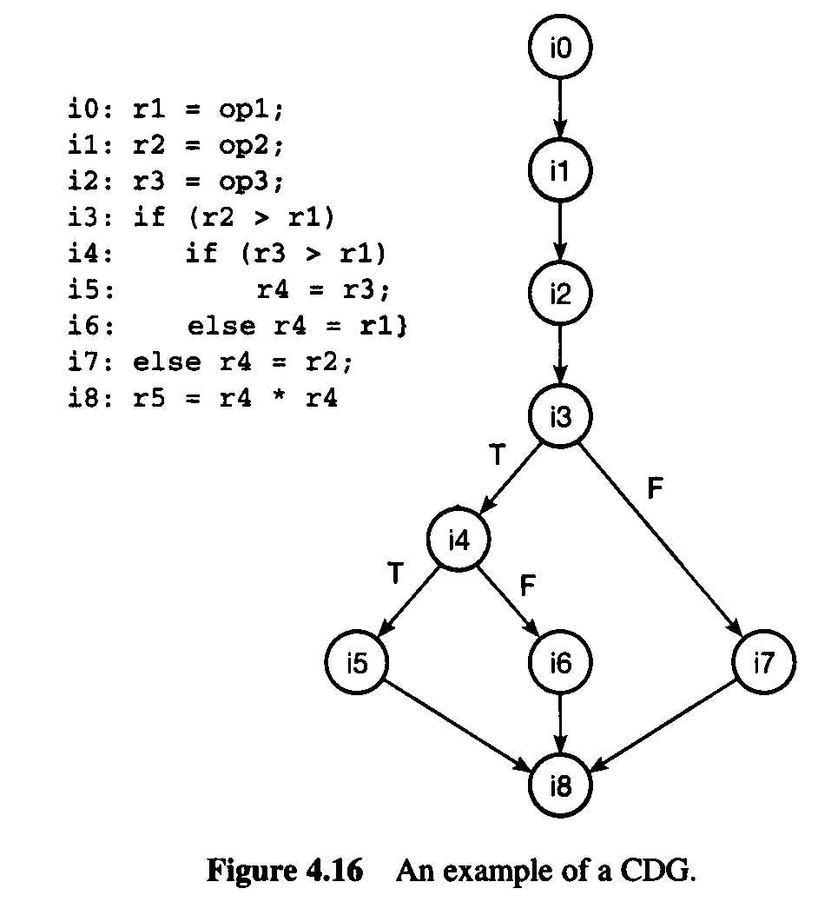
Control Dependency Graph

Slide 19
Branches?
Frequency and branch distance
Expected frequency of (all) branch
  general-purpose programs (non scientific): 20-30%
  scientific programs: 5-10%
Expected frequency of conditional branch
  general-purpose programs: 20%
  scientific programs: 5-10%
Expected branch distance (between two branch)
  general-purpose programs: every 3rd-5th instruction, on average, to be a conditional branch
  scientific programs: every 10th-20th instruction, on average, to be a conditional branch

Slide 20
Impact of Branch on instruction issue
fig. 4.14

Slide 21
4.2.3 Resource dependencies
An instruction is resource-dependent on a previously issued instruction if it requires a hardware resource which is still being used by a previously issued instruction.
e.g.
  div r1, r2, r3
  div r4, r2, r5

Slide 22
4.3 Instruction scheduling
scheduling or arranging two or more instruction to be executed in parallel
  Need to detect code dependency (detection)
  Need to remove false dependency (resolution)
a means to extract parallelism
  instruction-level parallelism which is implicit, is made explicit
Two basic approaches
  Static: done by compiler
  Dynamic: done by processor

Slide 23
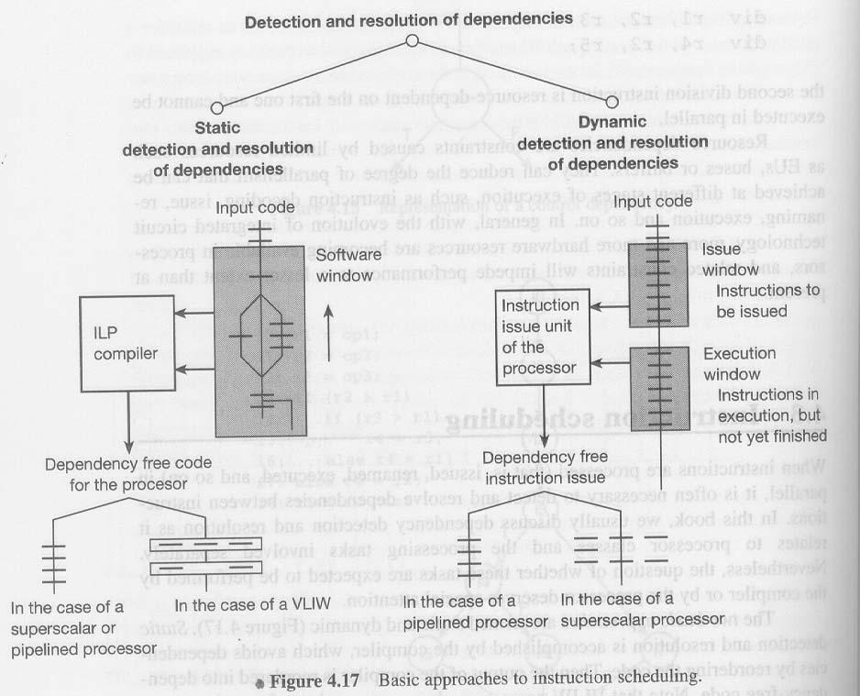
Instruction Scheduling:

Slide 24
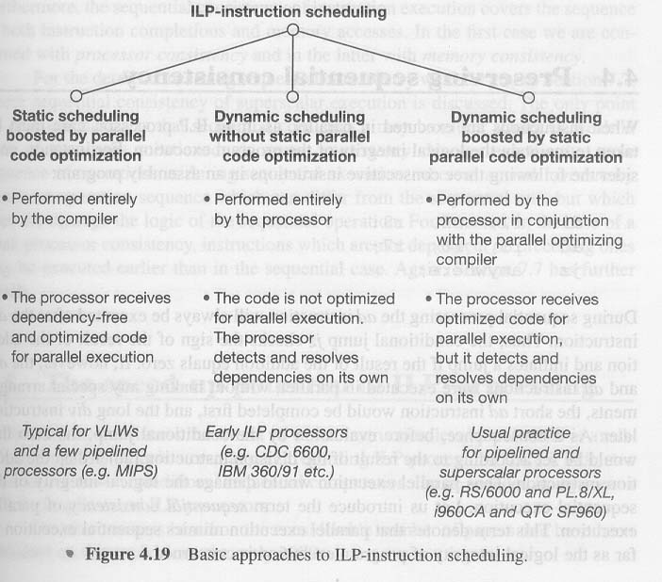
ILP-instruction scheduling

Slide 25
4.4 Preserving sequential consistency
care must be taken to maintain the logical integrity of the program execution
parallel execution mimics sequential execution as far as the logical integrity of program execution is concerned
e.g.
  add r5, r6, r7
  div r1, r2, r3
  jz somewhere

Slide 26
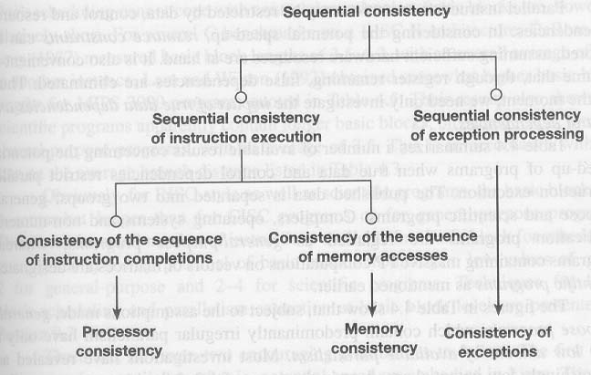
Concept sequential consistency

Slide 27
4.5 The speed-up potential of
ILP-processing
Parallel instruction execution may be restricted by data, control and resource dependencies.
Potential speed-up when parallel instruction execution is restricted by true data and control dependencies:
  general purpose programs: about 2
  scientific programs: about 2-4
Why are the speed-up figures so low?
  basic block (a low-efficiency method used to extract parallelism)

Slide 28
Basic Block
is a straight-line code sequence that can only be entered at the beginning and left at its end.
i1: calc: add r3, r1, r2
i2: sub r4, r1, r2
i3: mul r4, r3, r4
i4: jn negproc
Basic block lengths of 3.5-6.3, with an overall average of 4.9
(RISC: general 7.8 and scientific 31.6 )
Conditional Branch → control dependencies

Slide 29
Two other methods for speed up
Potential speed-up embodied in loops
  amount to a figure of 50 (on average speed up)
    unlimited resources (about 50 processors, and about 400 registers)
    ideal schedule
appropriate handling of control dependencies
  amount to 10 to 100 times speed up
    assuming perfect oracles that always pick the right path for conditional branch
  → control dependencies are the real obstacle in utilizing instruction-level parallelism!

Slide 30
What do we do without a perfect oracle?
execute all possible paths in conditional branch
  there are 2^N paths for N conditional branches
  pursuing an exponential increasing number of paths would be an unrealistic approach.
Make your Best Guess
  branch prediction
  pursuing both possible paths but restrict the number of subsequent conditional branches
  (more more CH. 8)

Slide 31
How close real systems can come to the upper limits of speed-up?
ambitious processor can expect to achieve speed-up figures of about
  4 for general purpose programs
  10-20 for scientific programs
an ambitious processor:
  predicts conditional branches
  has 256 integer and 256 FP register
  eliminates false data dependencies through register renaming,
  performs a perfect memory disambiguation
  maintains a gliding instruction window of 64 items

