Slide 1
5 Pipelined Processor
  temporal overlapping of processing, assembly line
5.1 Basic concept
5.2 Design space of pipelines
5.3 Overview of pipelined instruction processing
5.4 Pipelined execution of integer and Boolean instructions
5.5 Pipelined processing of loads and stores
TECH
Computer Science
CH01

Slide 2
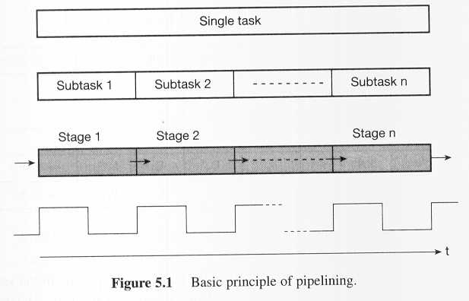
5.1.1 Principle of pipelining

Slide 3
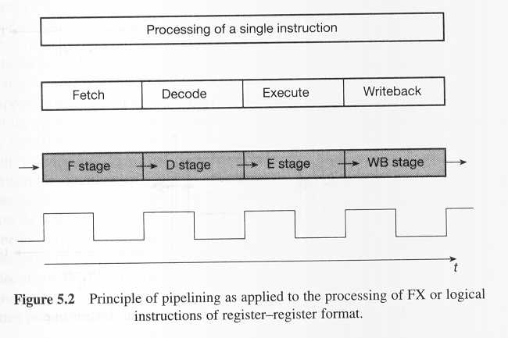
Principle of pipelining e.g.

Slide 4
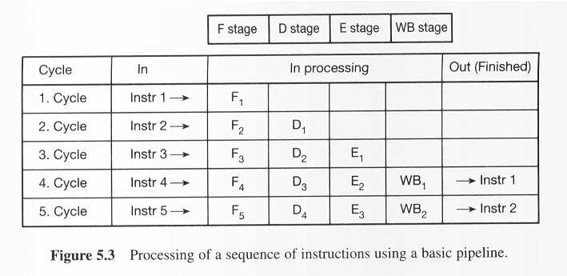
Processing of a sequence of instructions using a basic pipeline

Slide 5
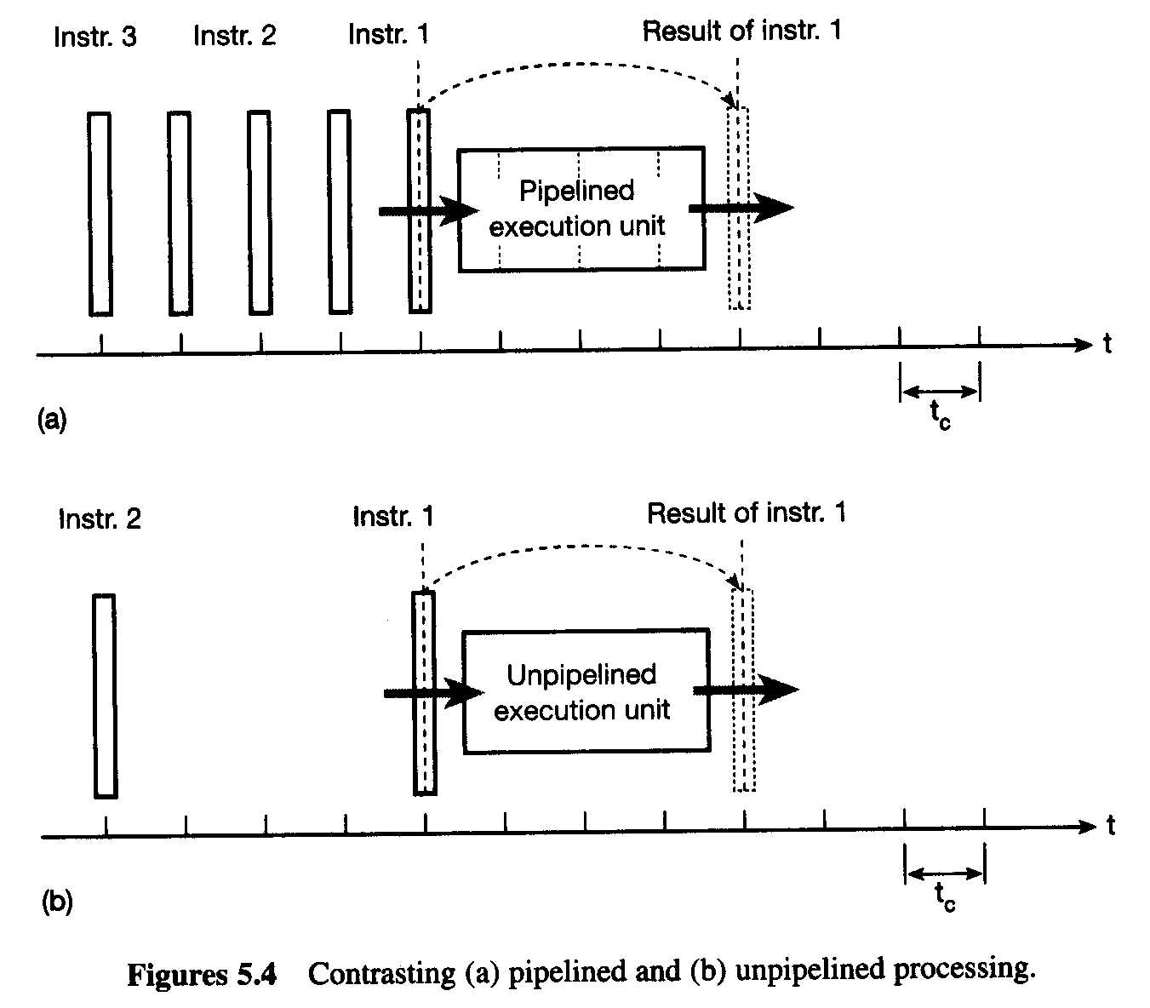
Pipelined and unpipelined processing

Slide 6
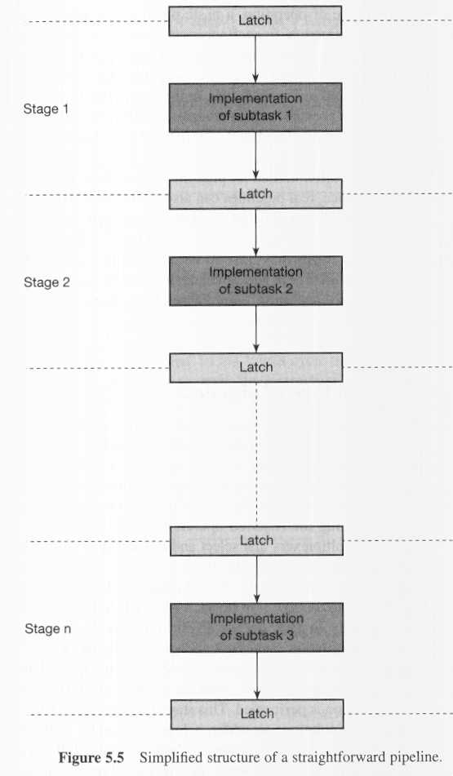
5.1.2 General structure of pipelines

Slide 7
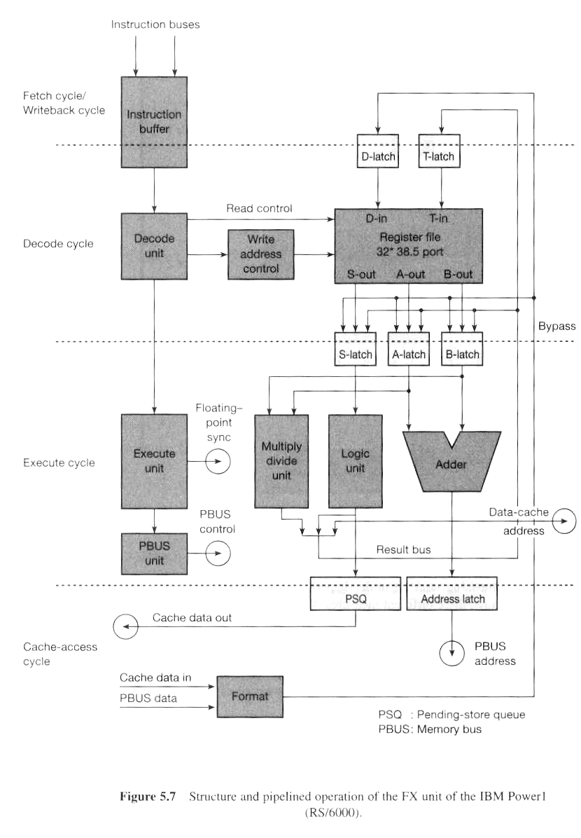
Structure and pipelined operation of the Fx unit of the IBM Power1

Slide 8
Pipeline Performance Measures
Cycle time: t_{c}
  is determined by the worst-case processing time of the longest stage
Repetition Rate: R
  the shortest possible time interval between subsequent independent instructions in the pipeline
Performance potential of a pipeline: P
P = 1/(R * t_{c})
PowerPC603 FP double Mul. e.g. R = 2, t_{c} = 12 nsec
P = 1/(R * t_{c}) = 1/(2*12nec) = 44.6 MFLOPS

Slide 9
Performance: RAW-dependent
Latency:
  specifies the amount of time that the result of a particular instruction takes to become available in the pipeline for a subsequent dependent instruction.
Define-use latency (10 to 100 cycles)
  mul r1, r2, r3
  add r5, r1, r4
Load-use latency (1 to 3 cycles)
  load r1, x
  add r5, r1, r2
Stalled: the immediately following RAW-dependent instruction has to be stalled in the pipeline for n-1 cycle

Slide 10
Improve Performance
Multiple-operation instructions
HP PA 7100
  FMPYADD RM1, RM2, RM3, RA1, RA2
    RM3←RM1*RM2 RA2←RA1+RA2
PowerPC
  FMA for performing (A*C) + B

Slide 11
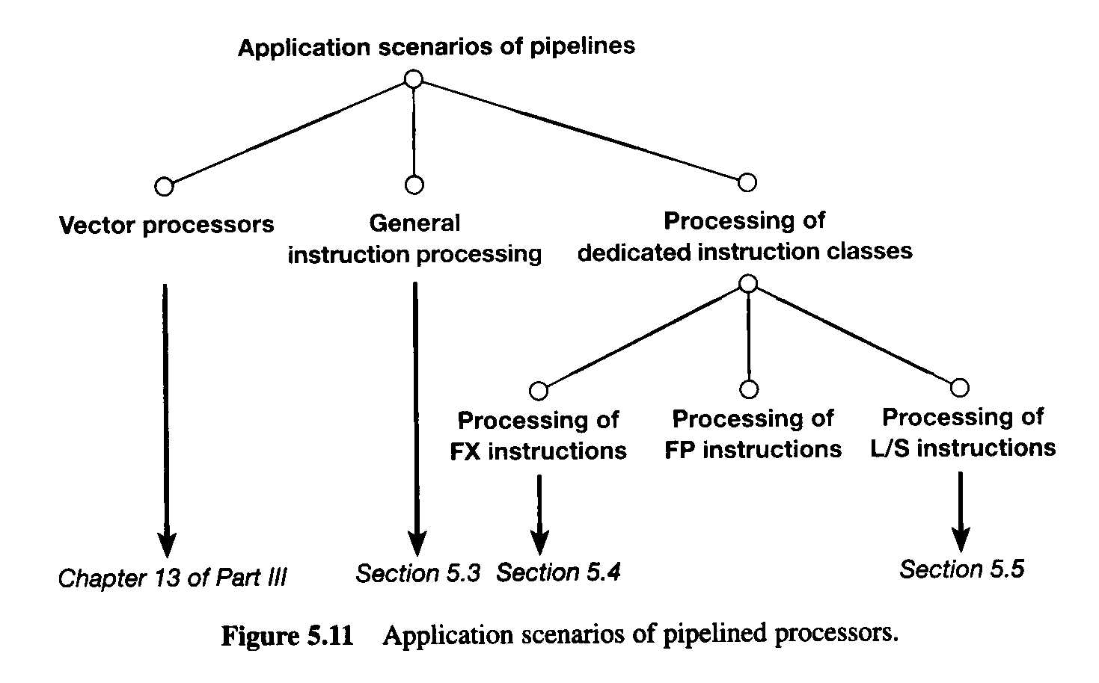
5.1.4 Application scenarios of pipelines

Slide 12
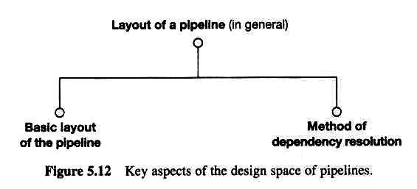
5.2 Design space of pipelines
key aspect of the design space of pipeline

Slide 13
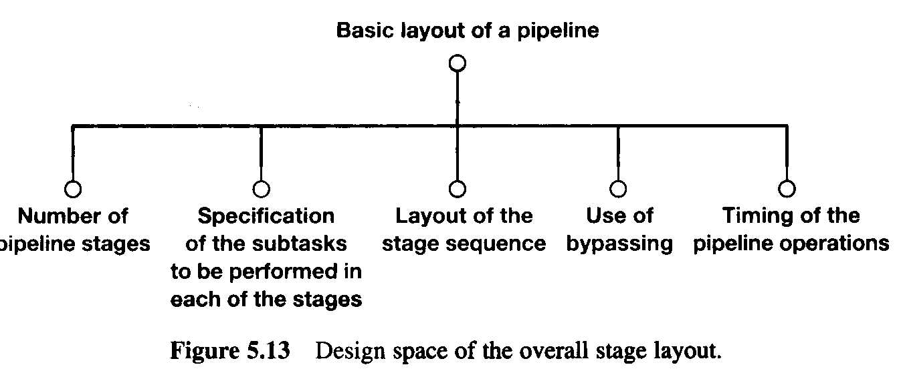
5.2.2 Basic layout of a pipeline
Design space of the overall stage layout

Slide 14
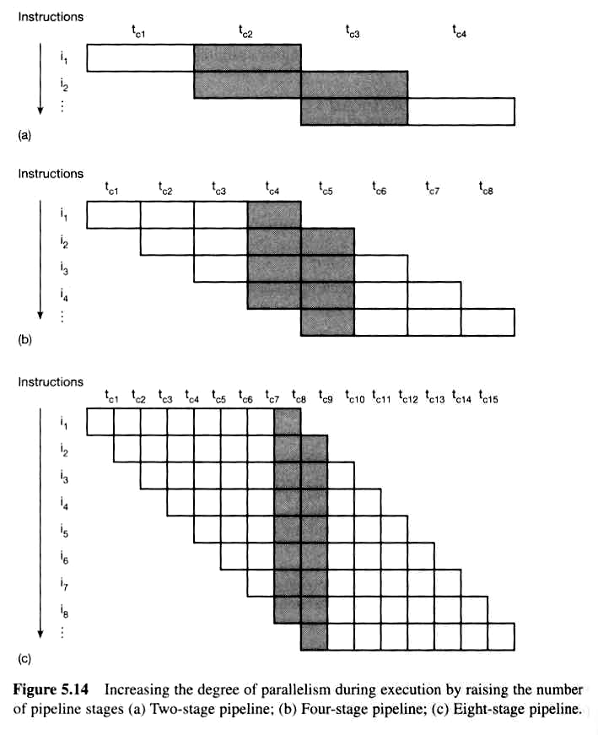
Increasing parellelism by raising the number of pipeline stages

Slide 15
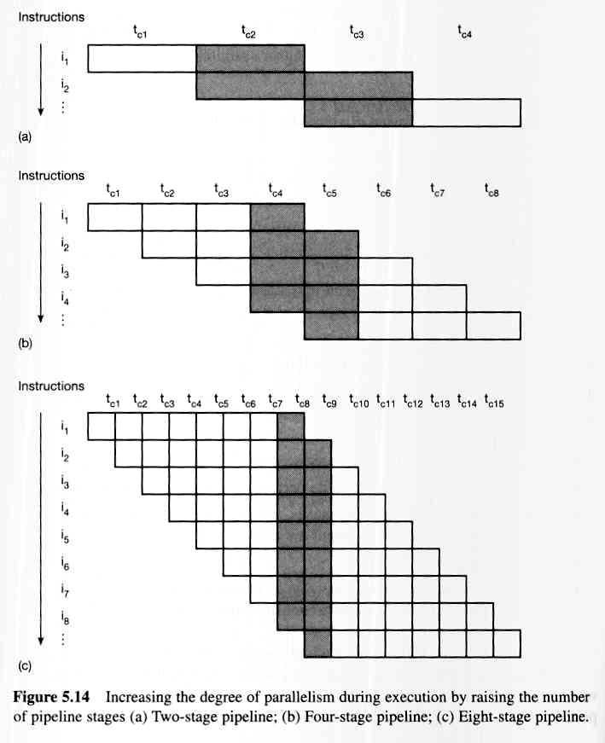
Eight -stage pipeline

Slide 16
Problems arise for more stages
data and control dependencies occur more frequently
  stalled and wait for data
  reload pipe in case of branch
subtask becomes less balances (in execution time)
  cycle time is determined by the worst-case processing time of the longest stage
In most case
  5-10 stages

Slide 17
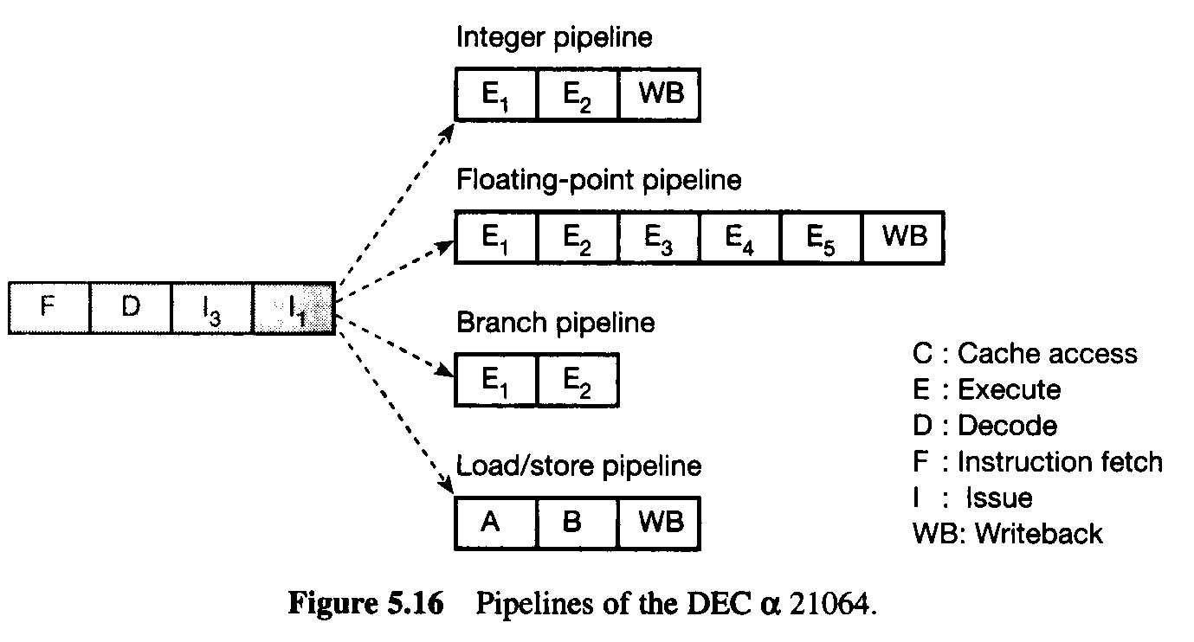
Pipelines e.g. DEC α 21064

Slide 18
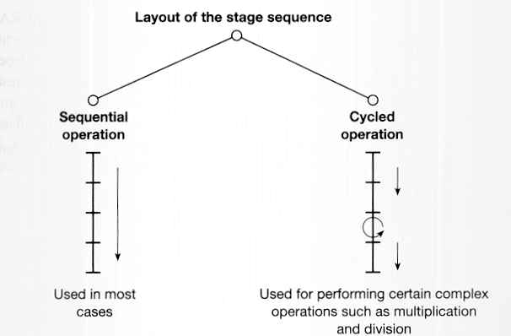
Layout of the stage sequence

Slide 19
Bypasses (data forwarding in RAW)
Unless special arrangements are made,
the results of the operation instruction is written into the register file, or into the memory,
and then it is fetched from there as a source operand.

Slide 20
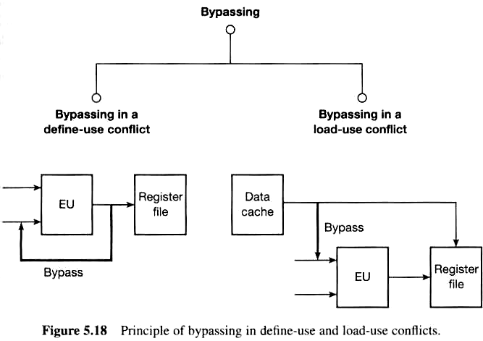
Principle of bypassing in define-use and load-use conflicts

Slide 21
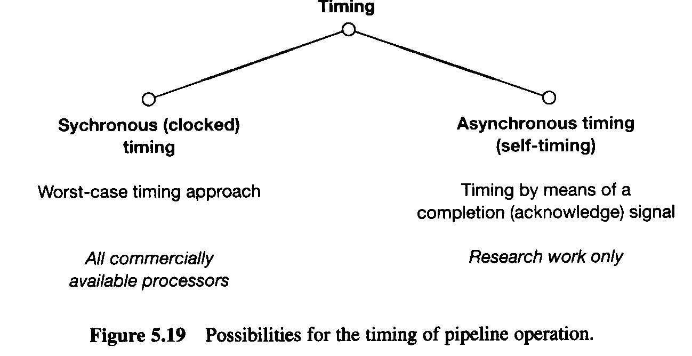
Possibilities for the timing of pipeline operation

Slide 22
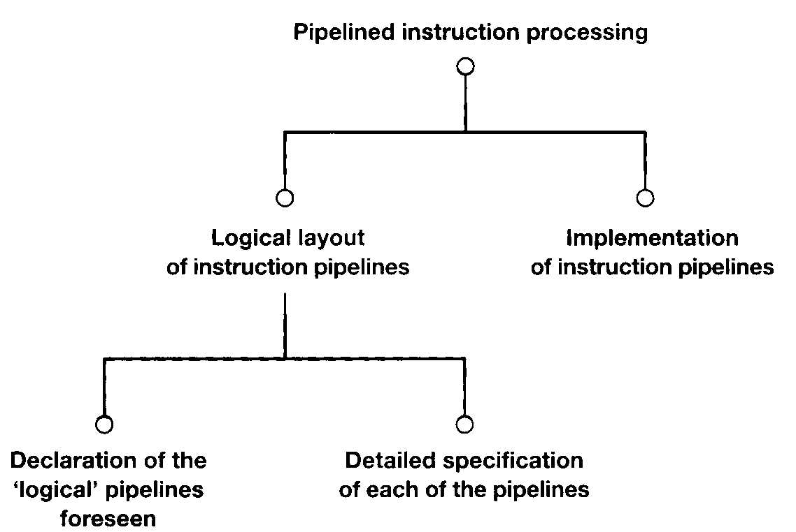
5.3 Overview: pipelined instruction processing

Slide 23
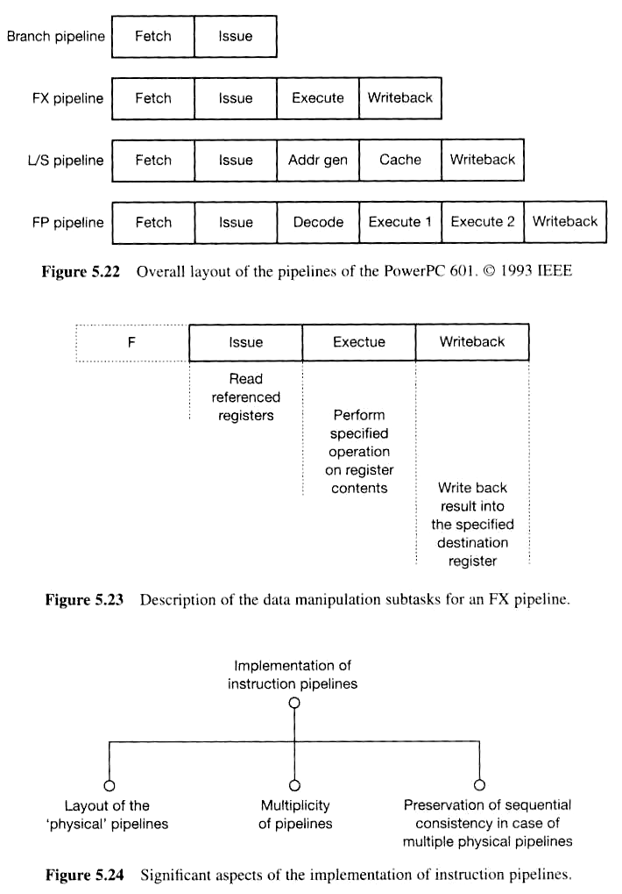
Declaration of Logical Pipeline: e.g. Powerpc 601

Slide 24
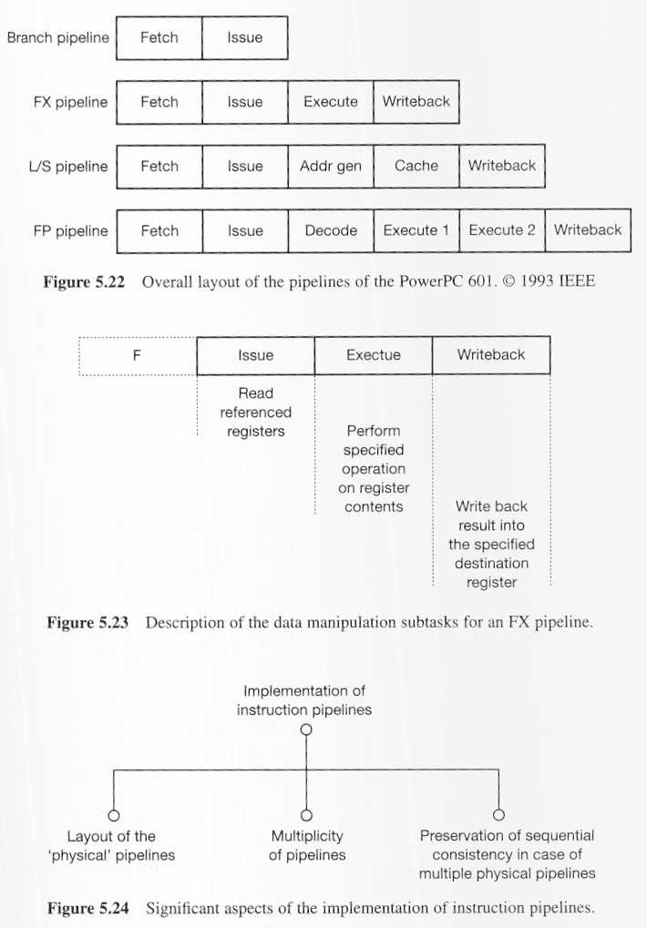
Detailed Specification of each of the pipeline: e.g. //

Slide 25

Implementation of instruction pipelines
(v.s. logical)

Slide 26
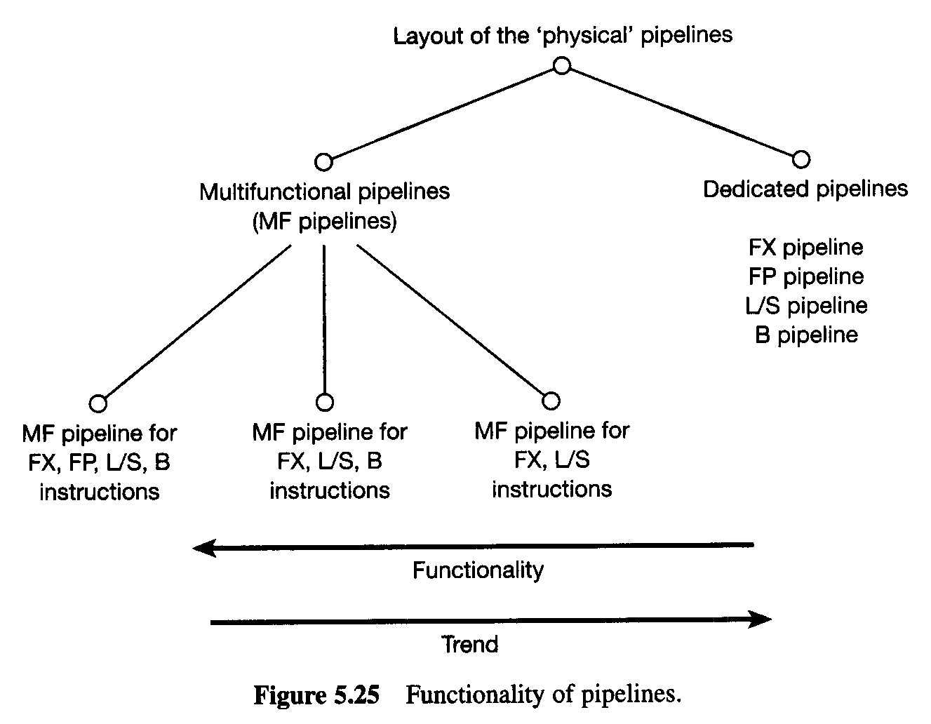
Layout of physical pipelines

Slide 27
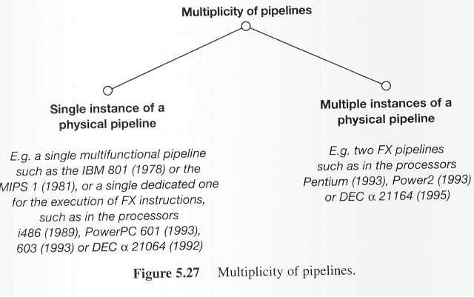
Multiplicity of pipelines

Slide 28
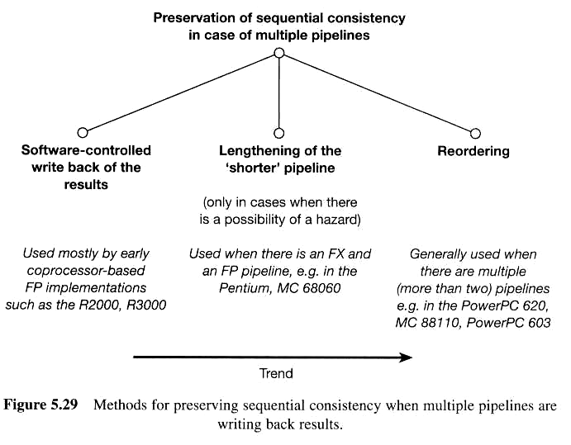
Preserveing sequential consistency

Slide 29
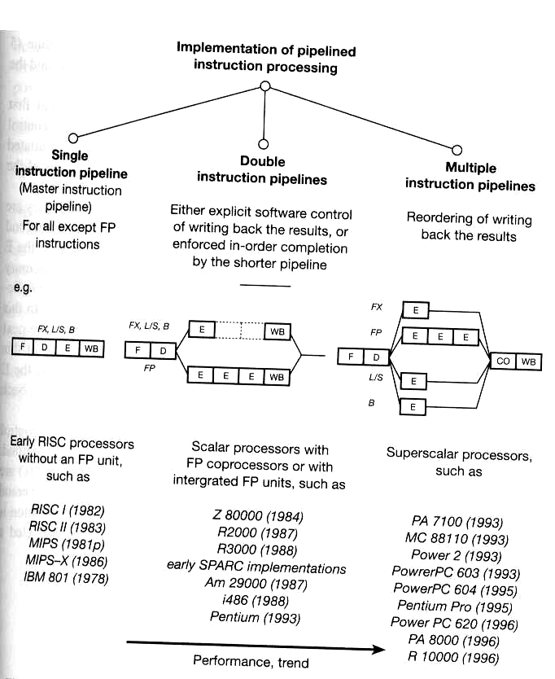
Preserveing sequential consistency, implementation e.g.

Slide 30
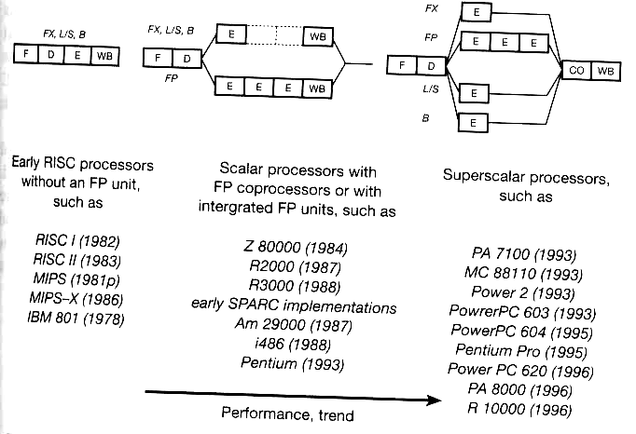
Preserveing sequential consistency, e.g.

Slide 31
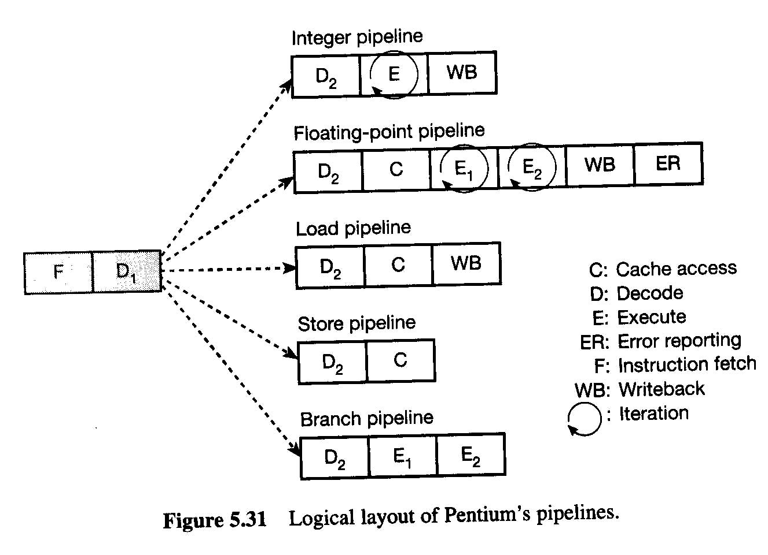
Case studies: Pentium
Logic layout of Pentium’s pipelines

Slide 32
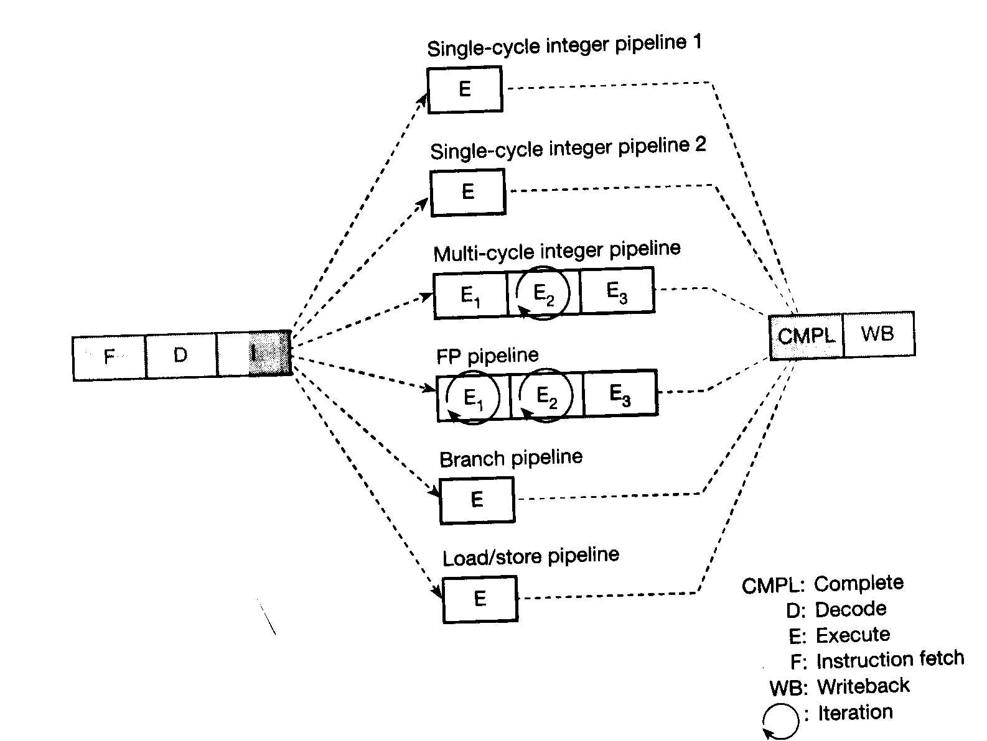
Case studies: PowerPC 604

Slide 33
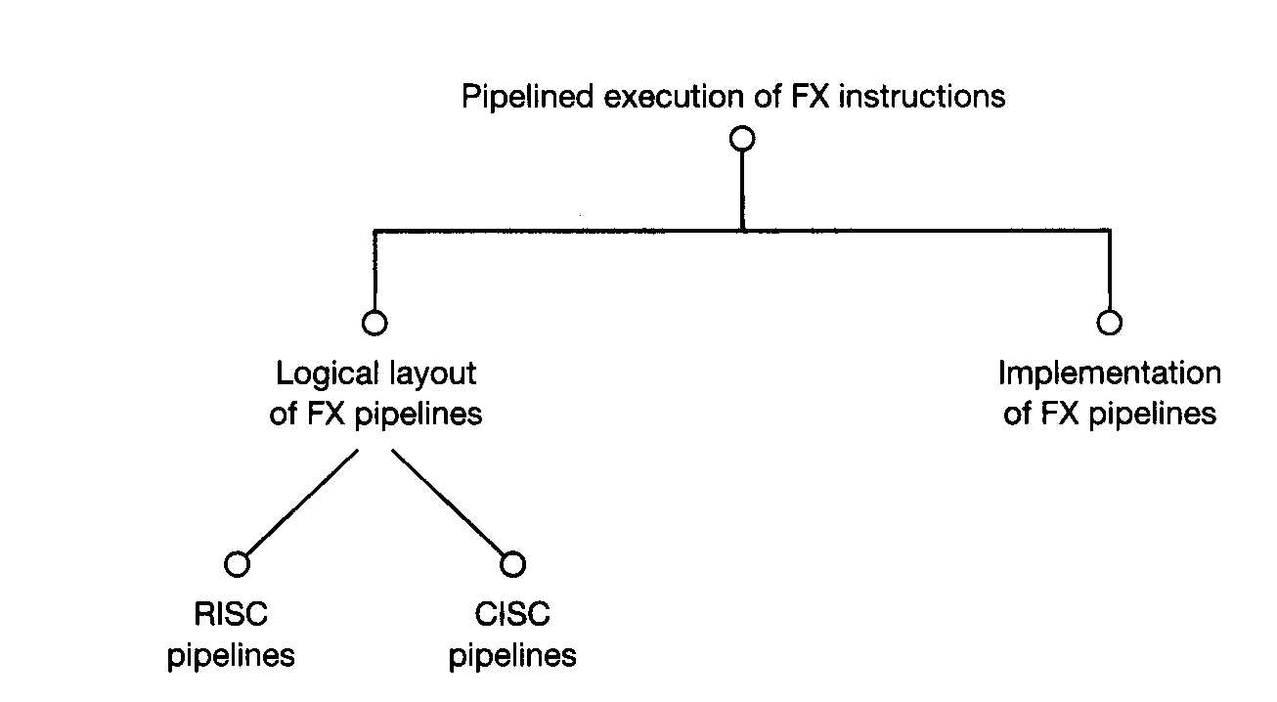
5.4 (Specific) Pipelines execution:
Integer and Boolean instructions (FX)

Slide 34
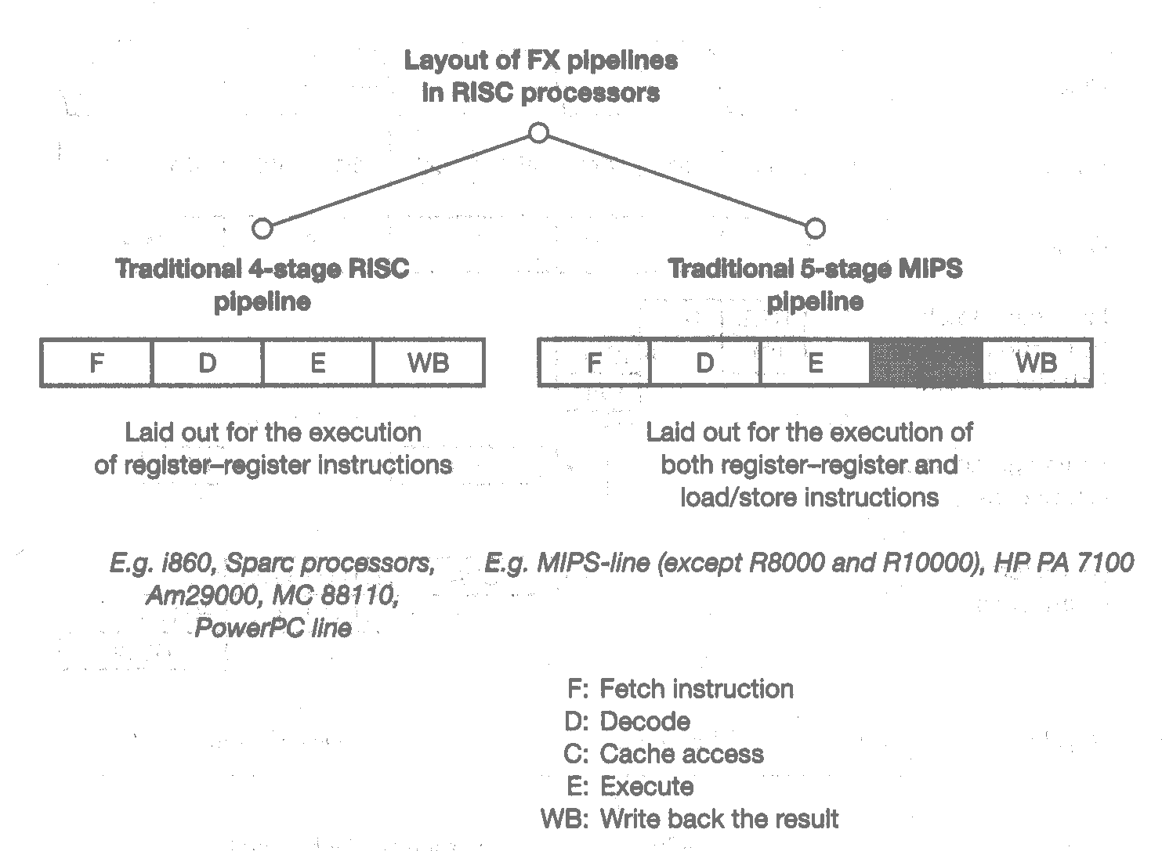
RISC pipelines 4 or 5 stages

Slide 35
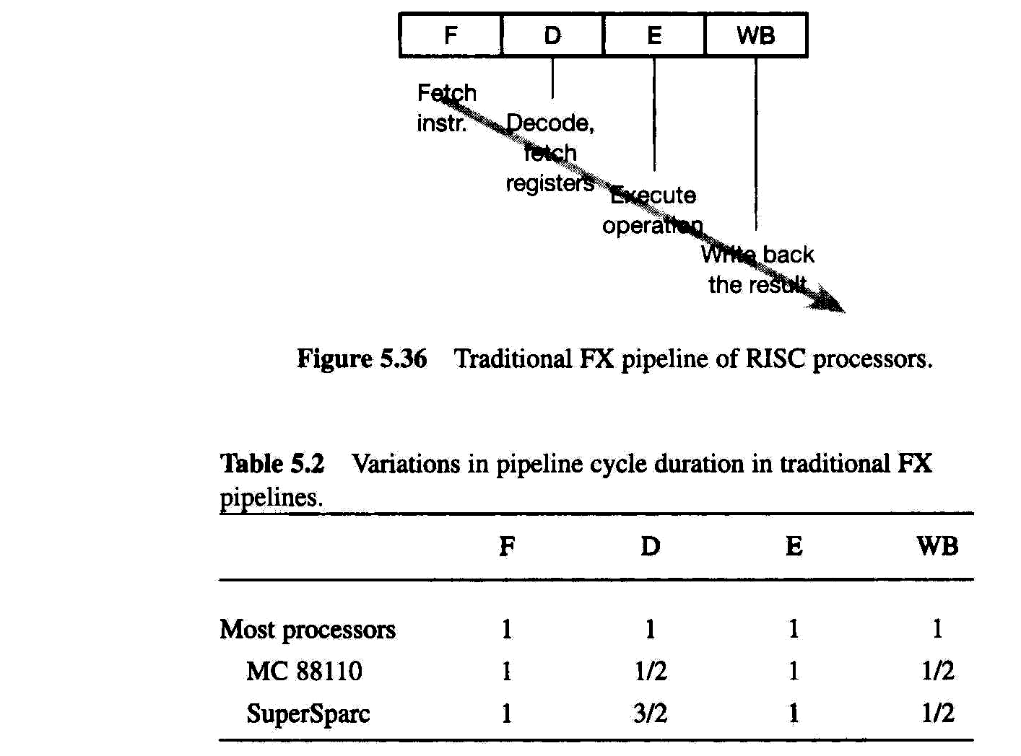
Tradictrional FX pipeline of RISC processors

Slide 36
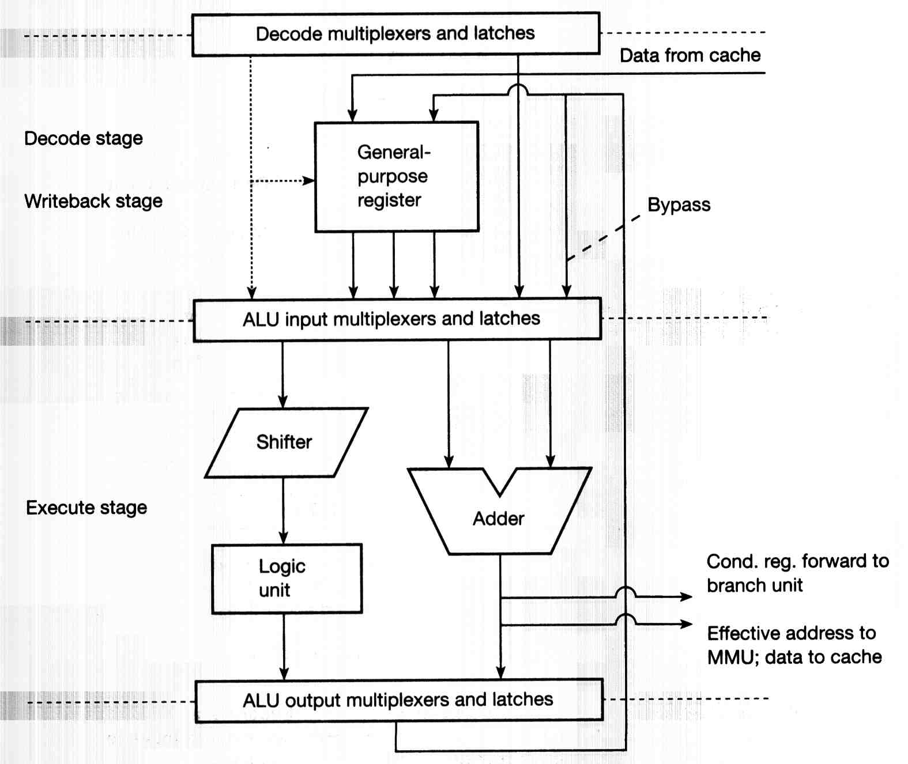
Logical to Physical: e.g.
PowerPC601 using a single universal FX unit

Slide 37
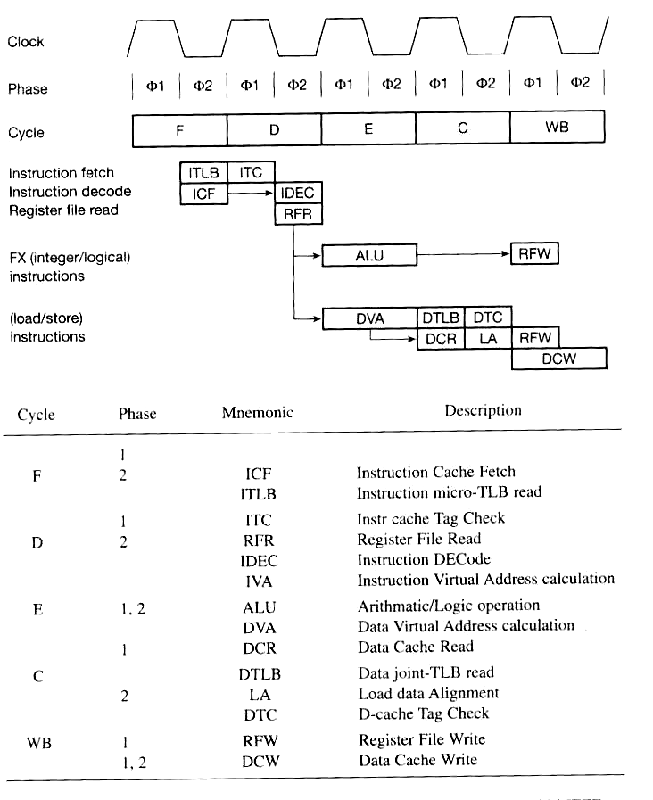
Layout 5 stages e.g. :
FX and L/S pipelines in the MIPS R4200

Slide 38
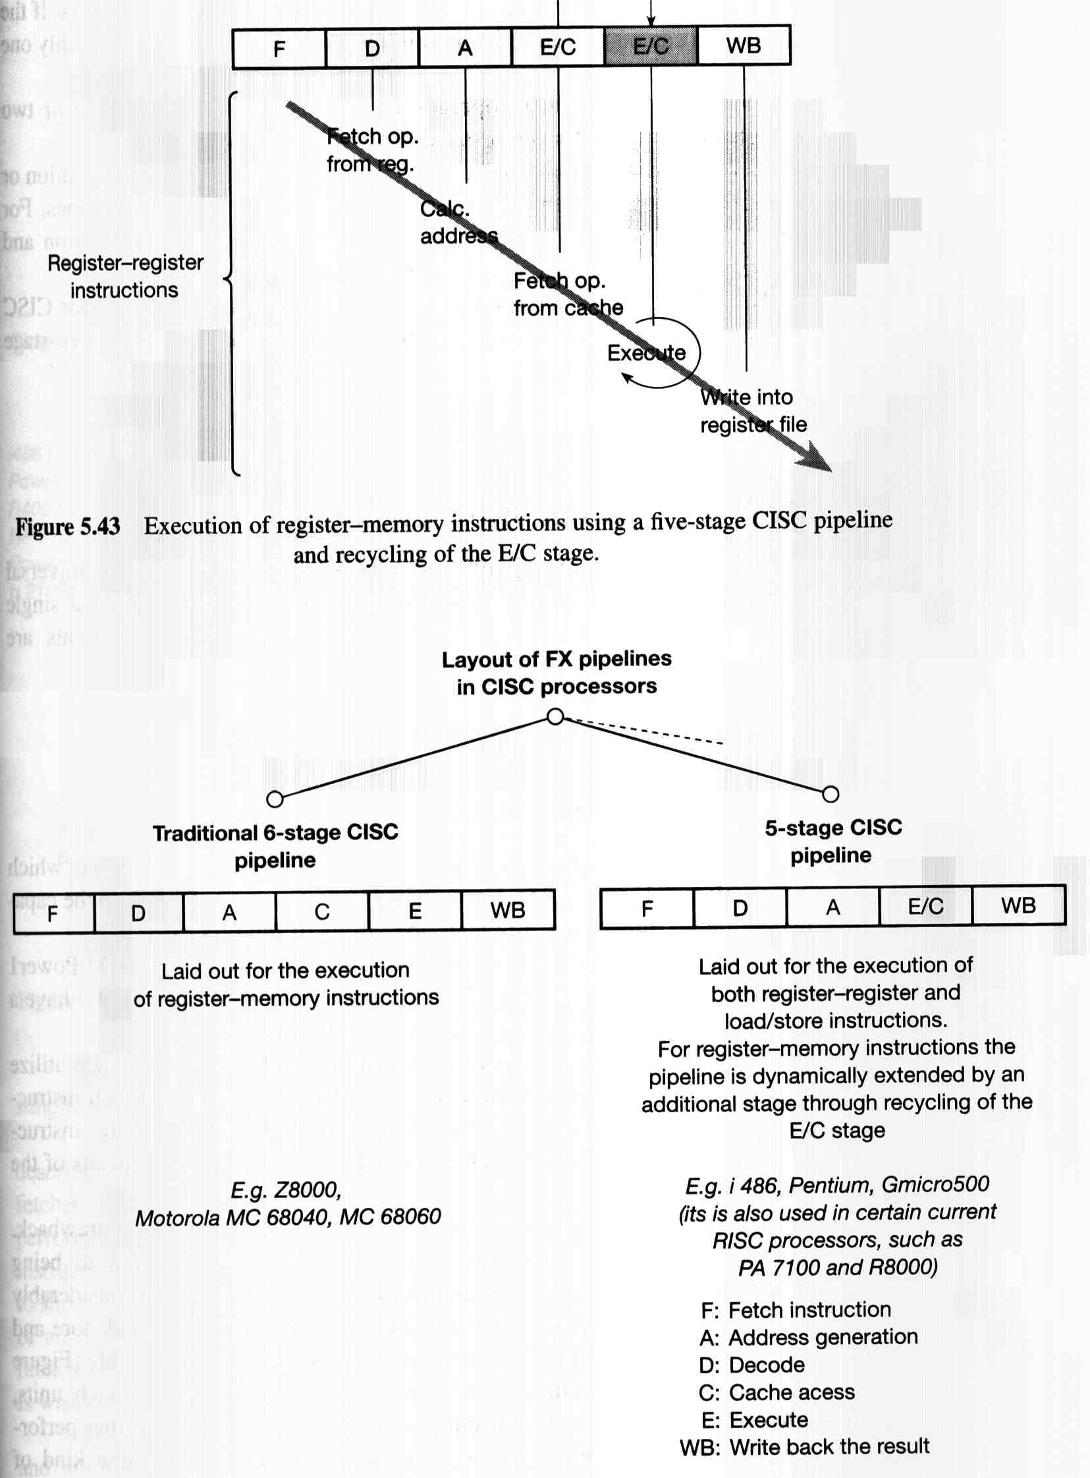
CISC pipeline 6 or 5 stages

Slide 39
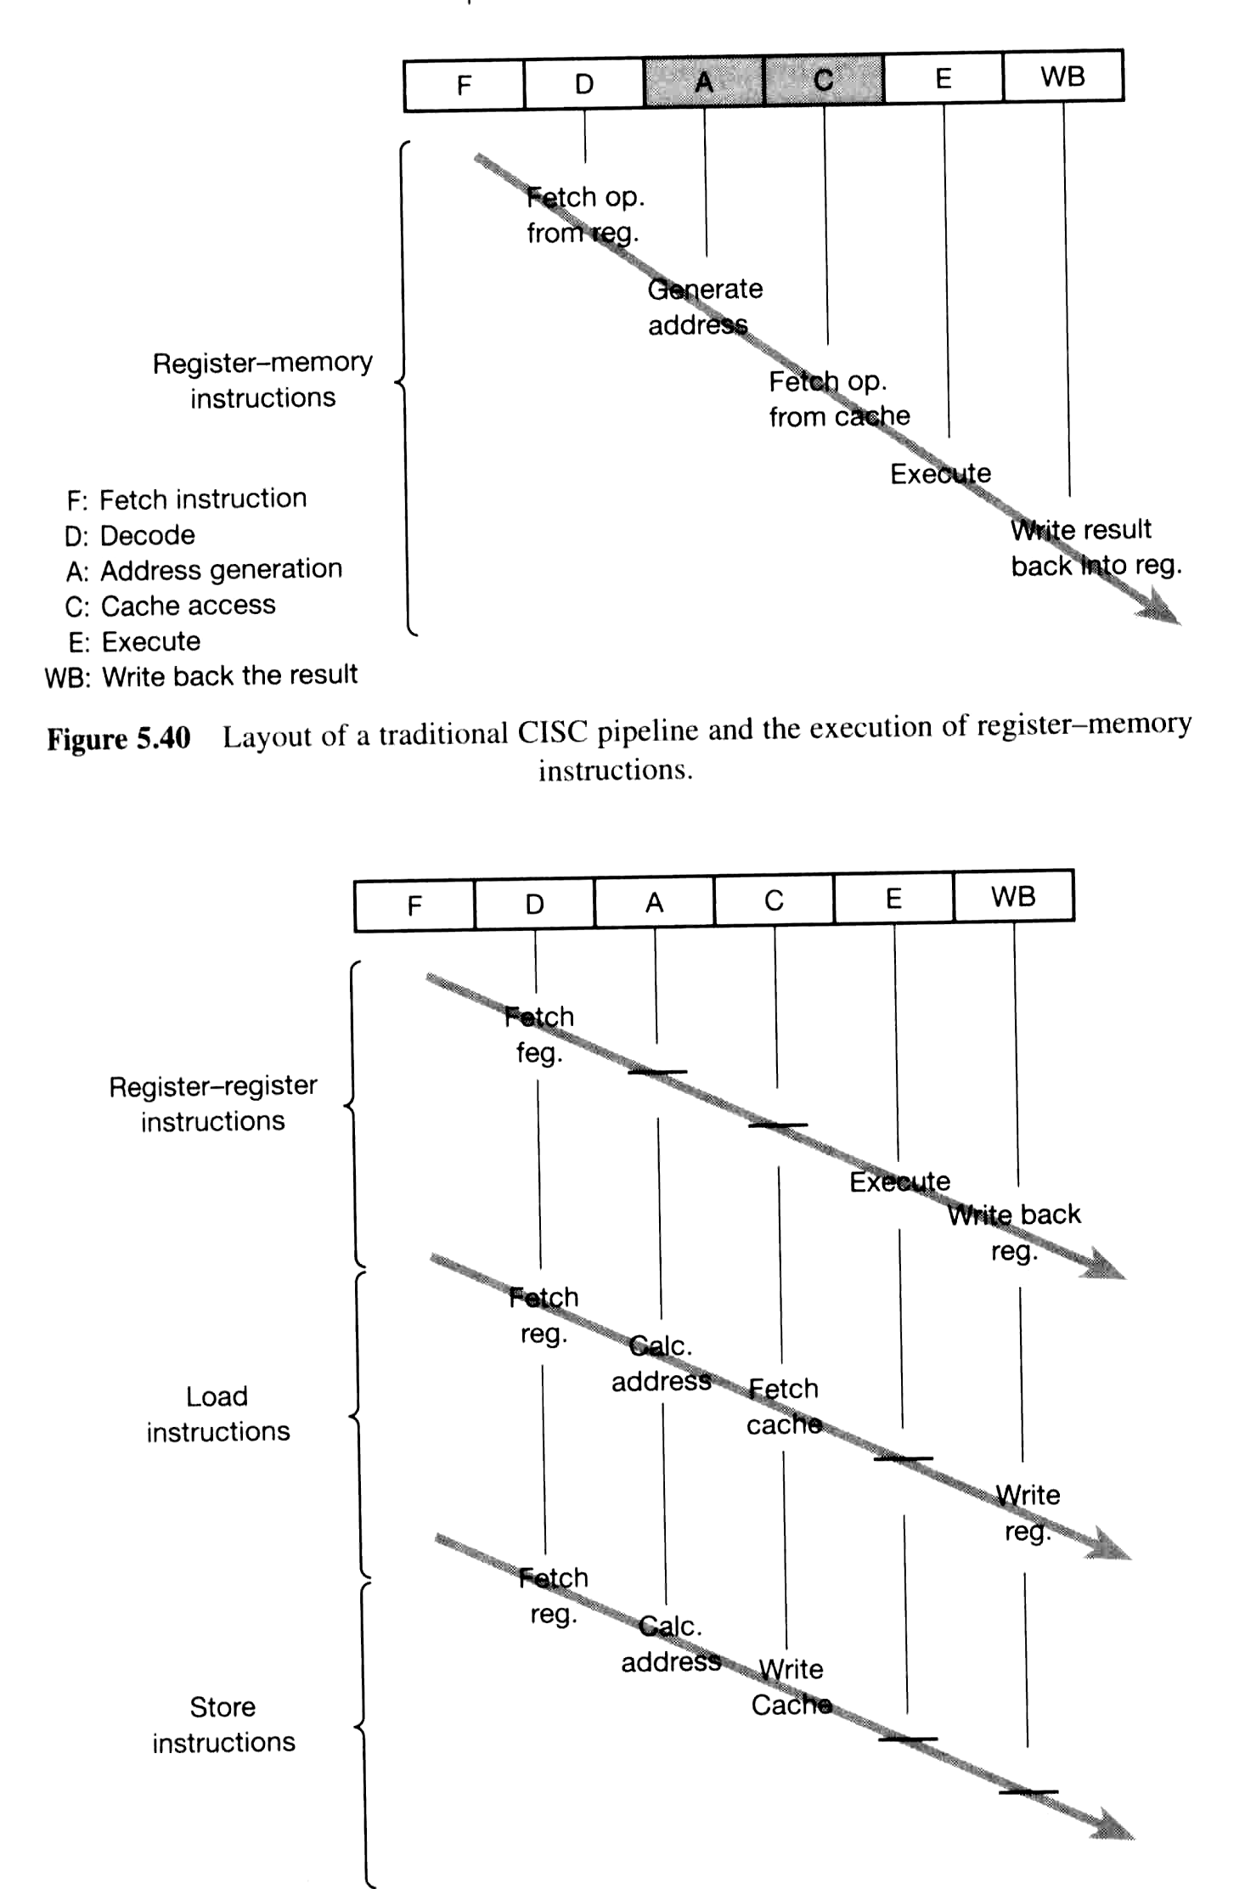
Traditional CISC pipeline:
The execution of reister-memory instruction

Slide 40

CISC pipeline:
Execution of register-register and load/store instructions

Slide 41
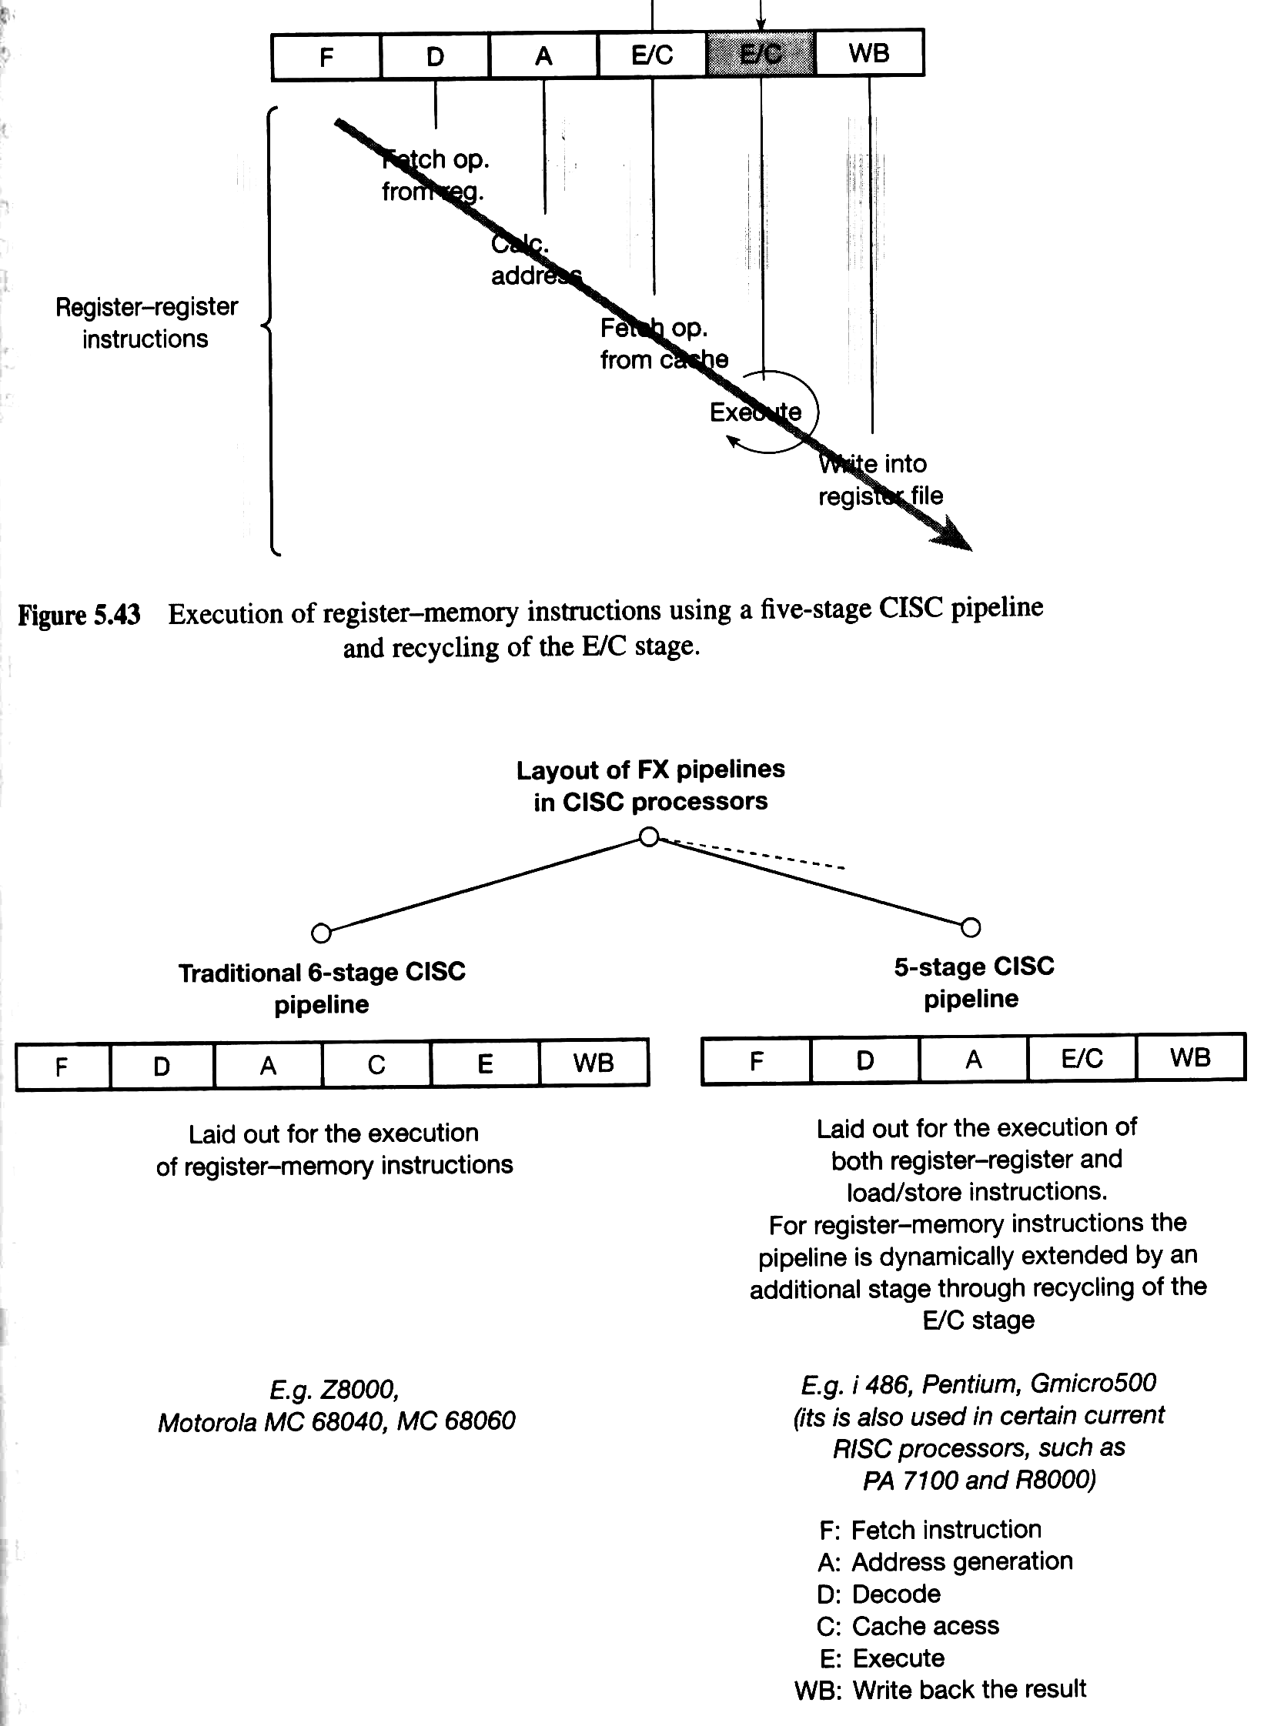
CISC pipeline 5 stage: recycling E/C stage

Slide 42
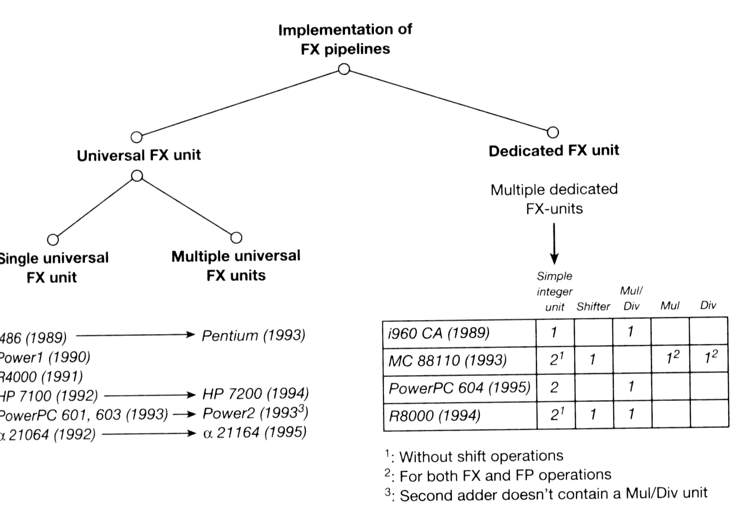
Implementation of FX units: how many

Slide 43
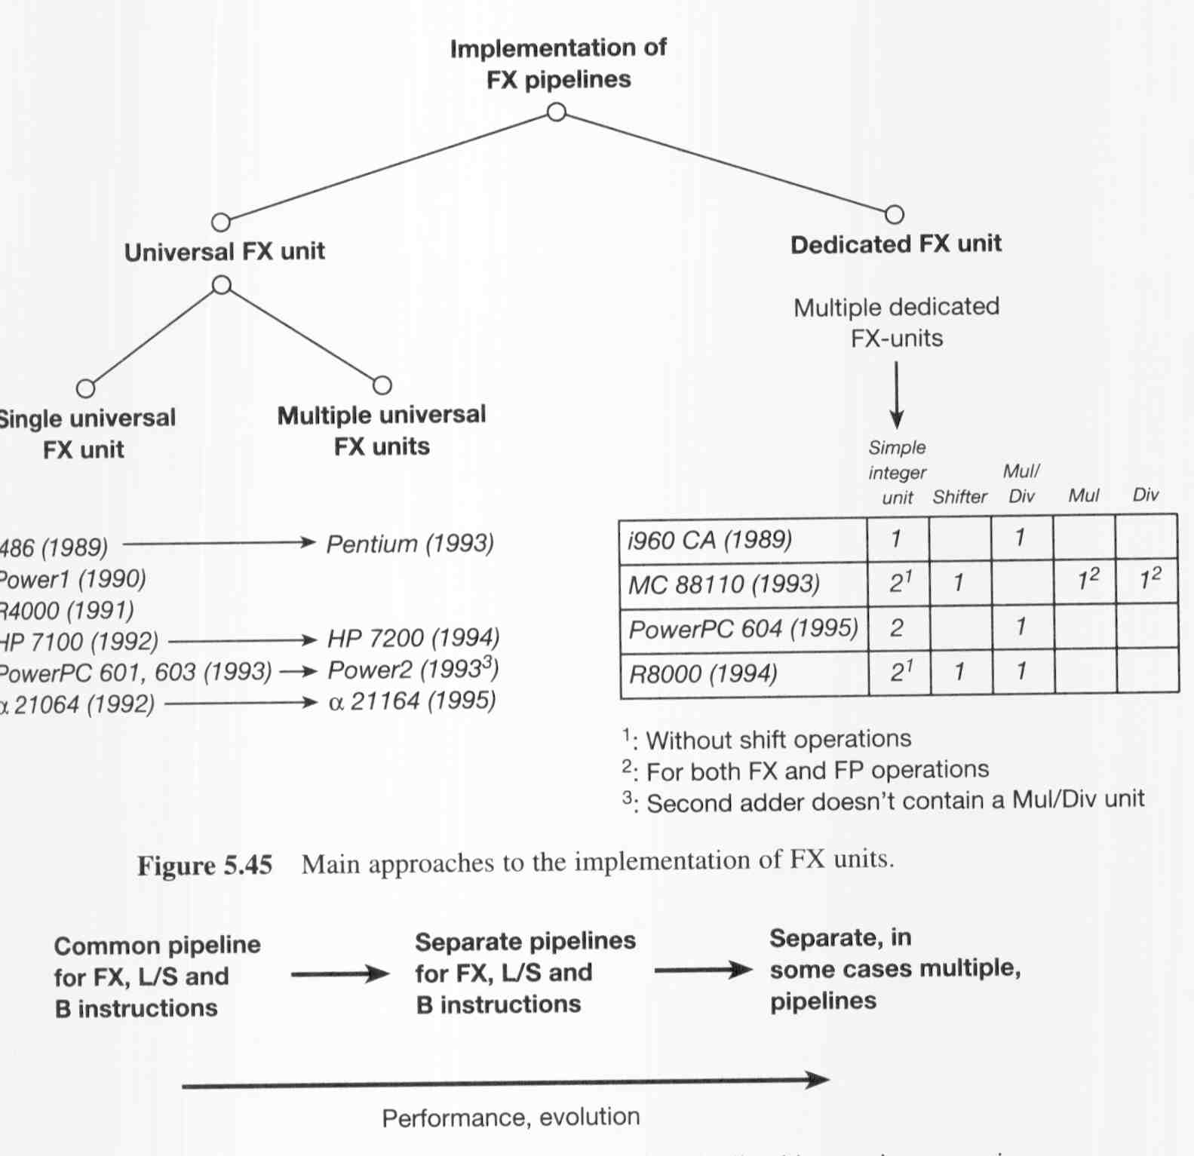
Trend in increasing the performance

Slide 44
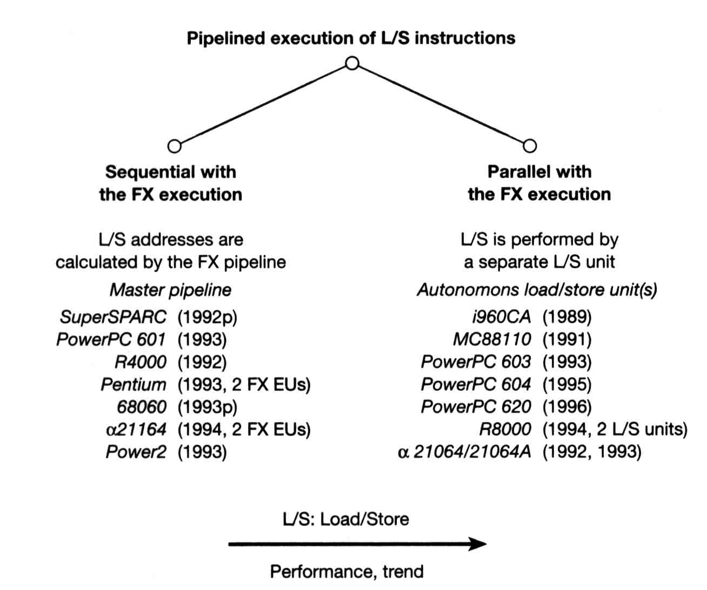
5.5 (Specific) Pipelines execution: loads and stores

Slide 45
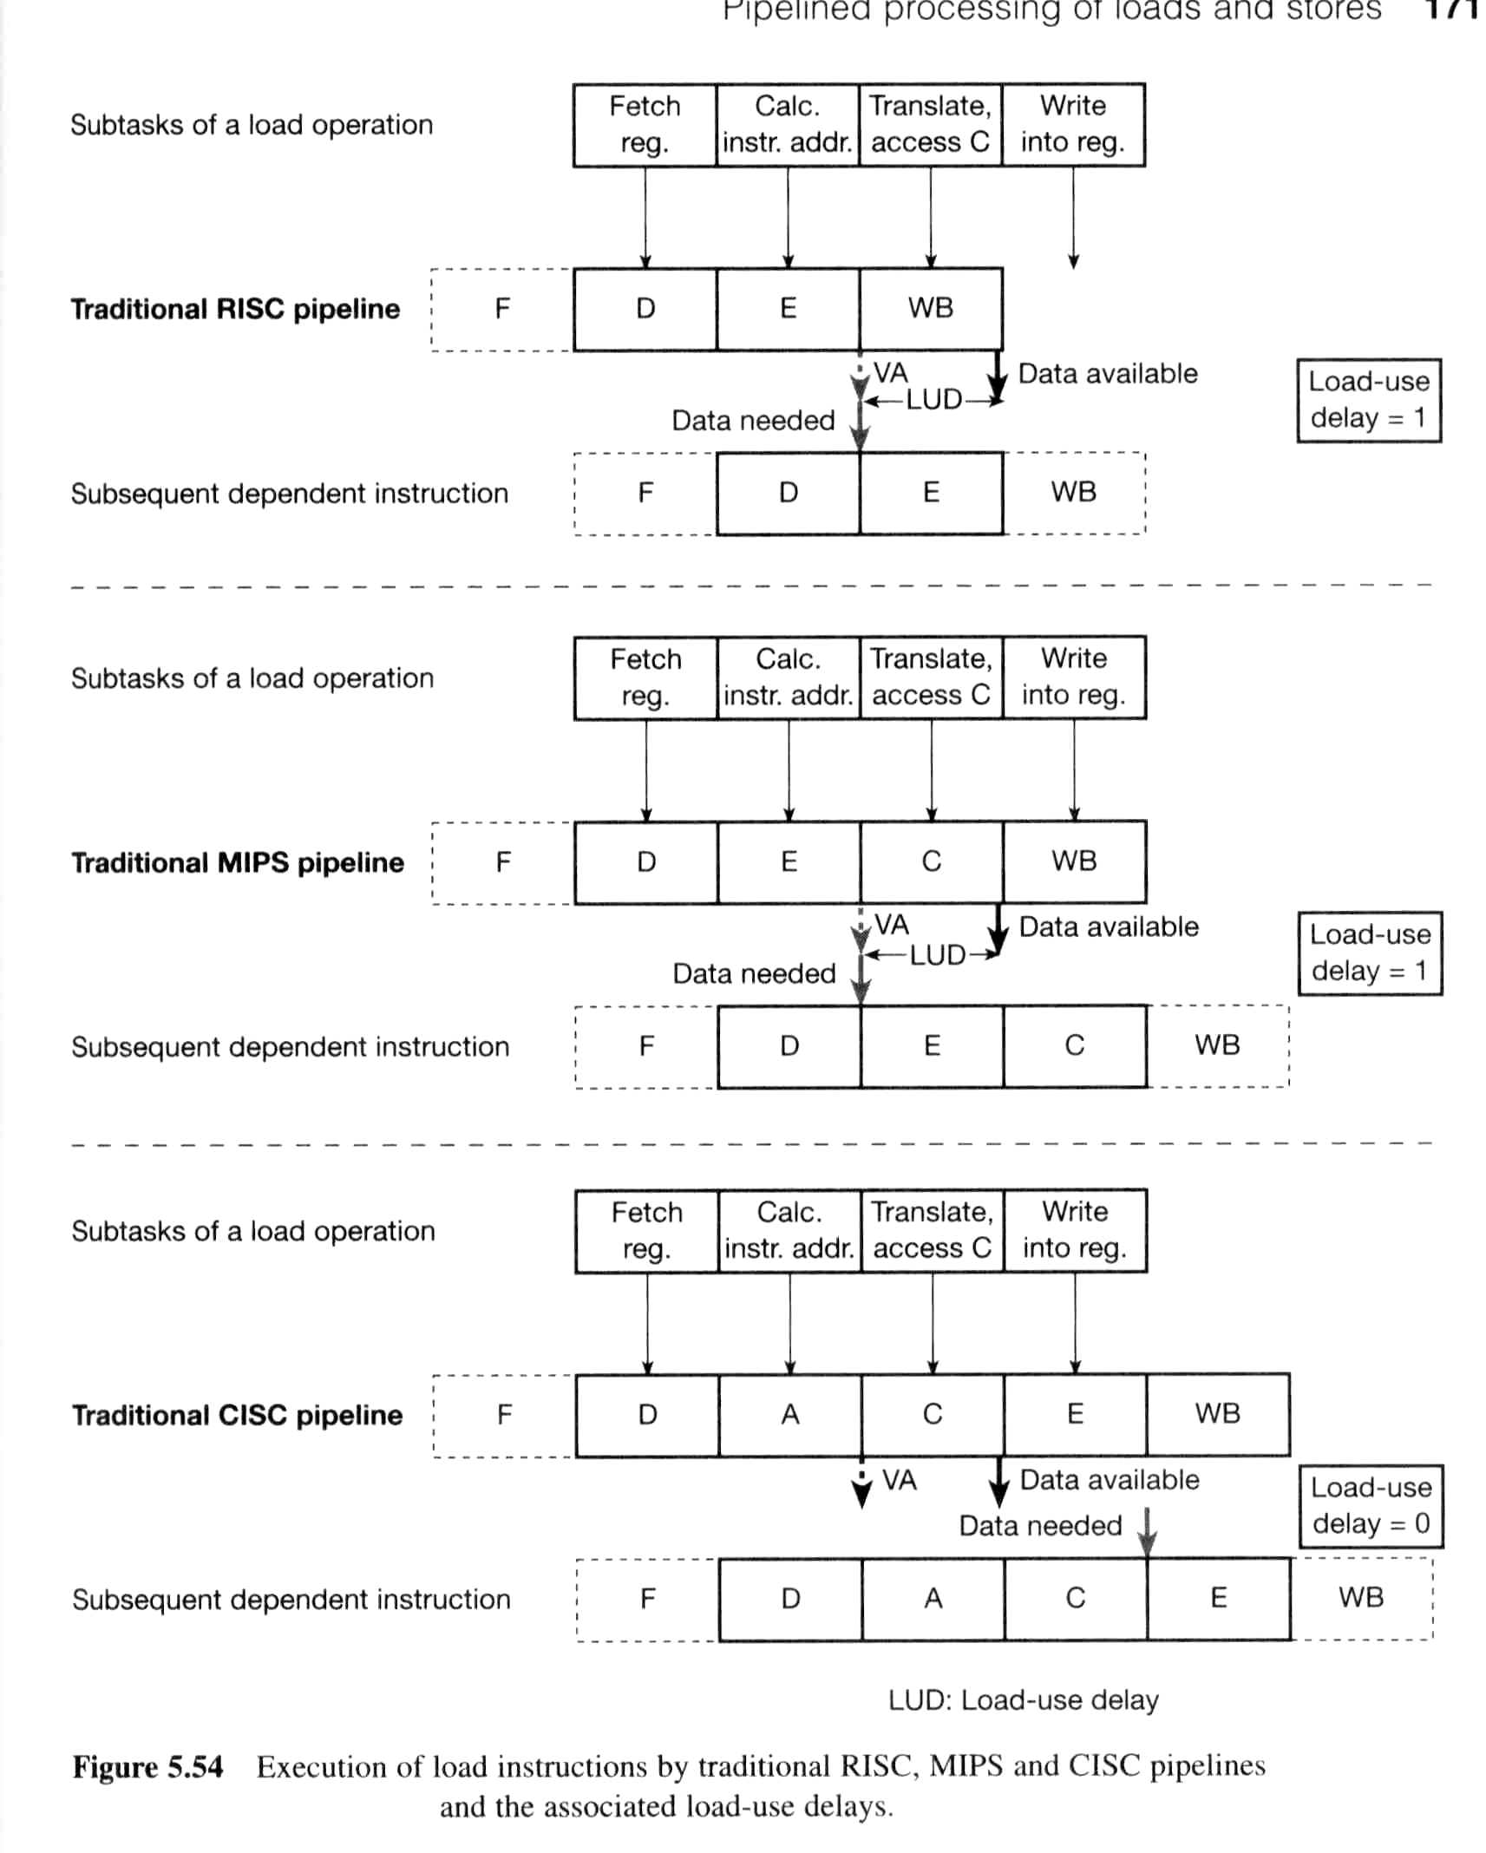
5.5.3 Load-use delay: RICS pipelines

Slide 46
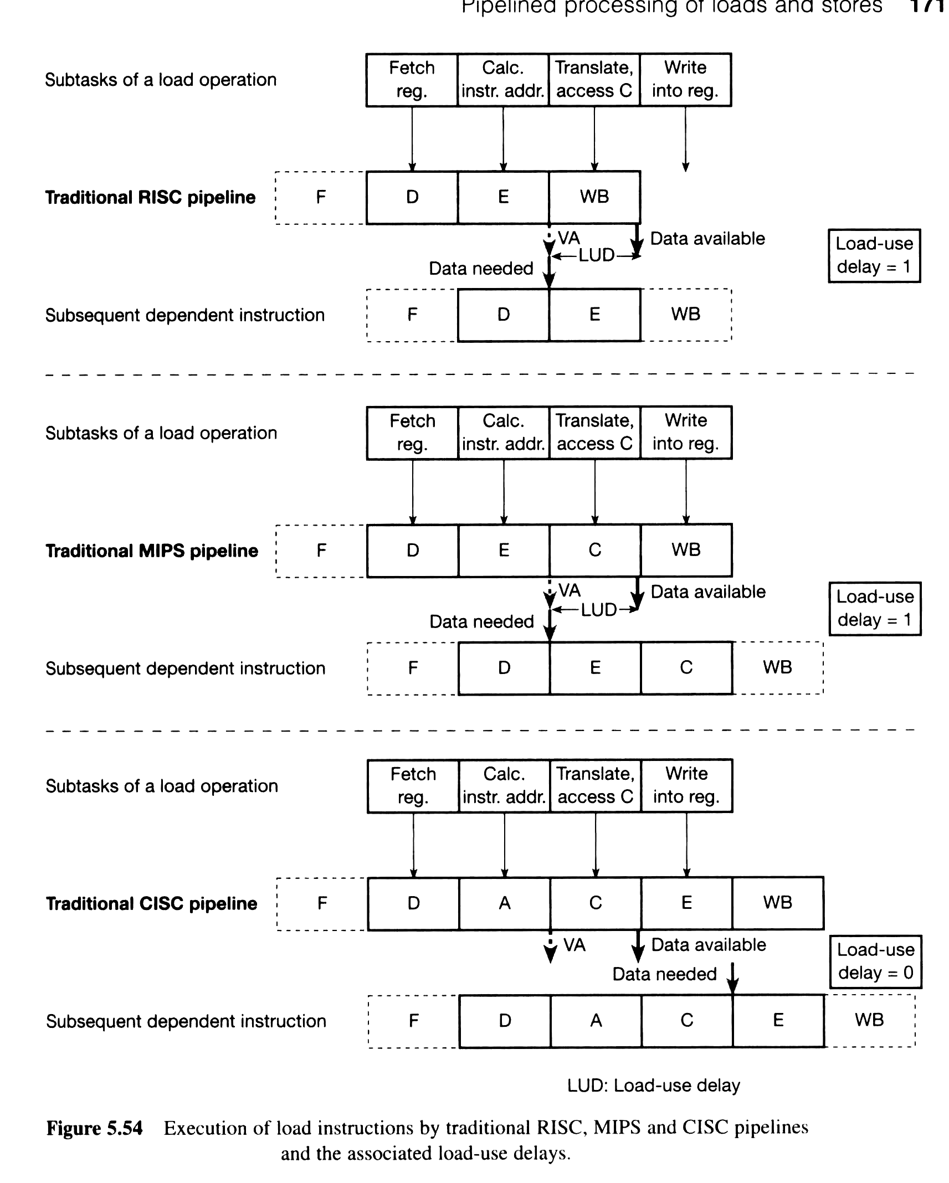
Load-use delay: MIPS

Slide 47
Load-use delay: CISC

Slide 48
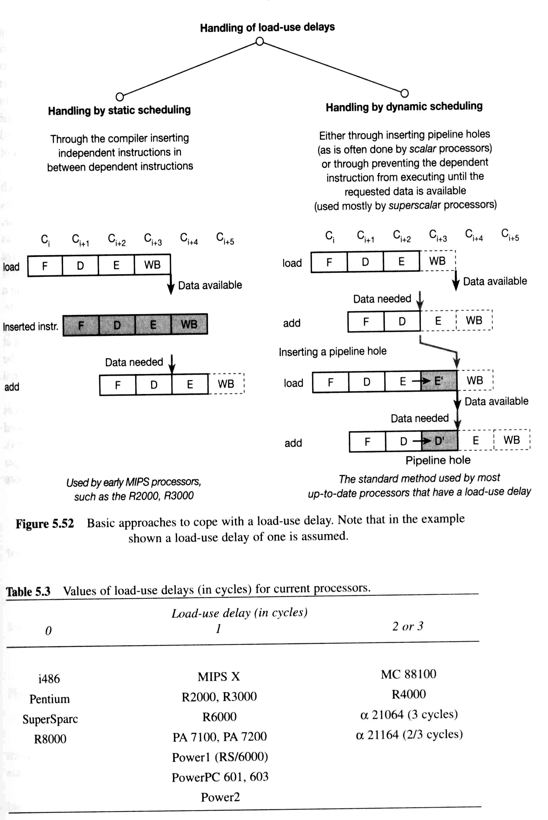
Handling Load-use delay
Basic approaches to cope with a load-use delay

Slide 49
Remove Load-use delay

Slide 50
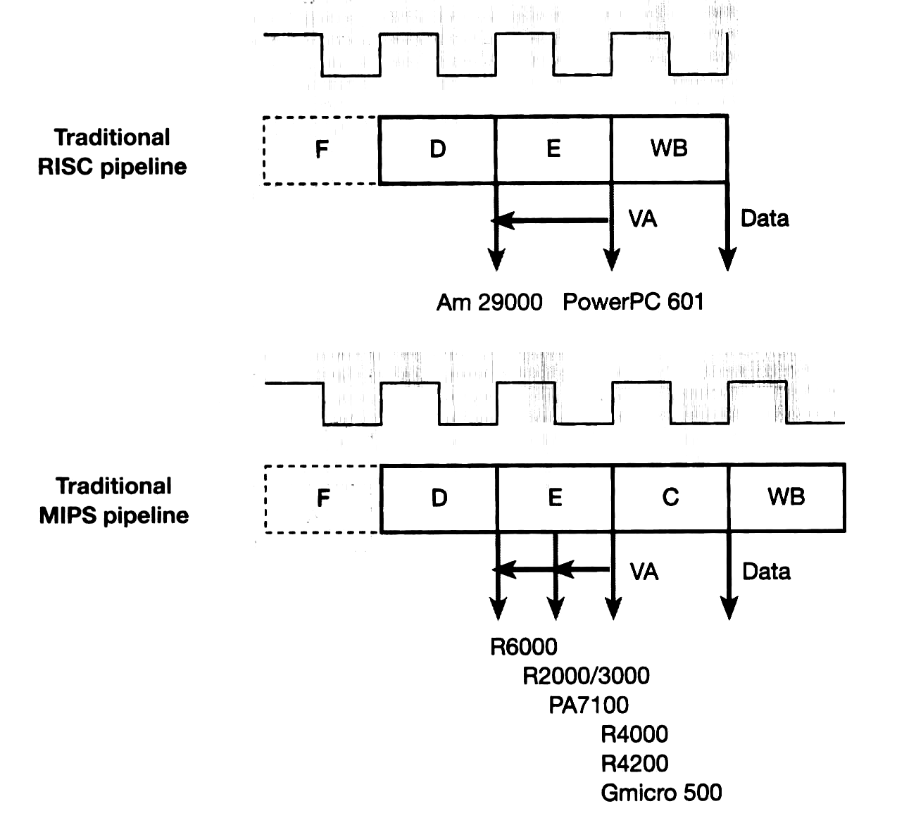
Remove Load-use delay: bringing forward the claculation of virtual address: for slow cache

