Slide 1
6 VLIW Architectures
{Very Long Instruction Word}
{EPIC: Explicit Parallel Instruction-set Computer}
{CISC → RISC →EPIC}
6.1 Basic principles
6.2 Overview of proposed and commercial VLIW architectures
6.3 Case study: The Trace 200 family
TECH
Computer Science
CH01

Slide 2
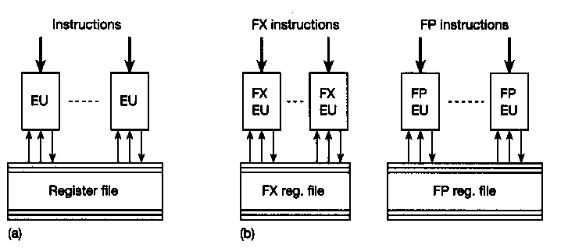
Basic Structure of VLIW Architecture

Slide 3
Basic principle of VLIW
Controlled by very long instruction words
  comprising a control field for each of the execution units
Length of instruction depends on
  the number of execution units (5-30 EU)
  the code lengths required for controlling each EU (16-32 bits)
  256 to 1024 bits
Disadvantages: on average only some of the control fields will actually be used
  waste memory space and memory bandwidth
  e.g. Fortran code is 3 times larger for VLIW (Trace processor)

Slide 4
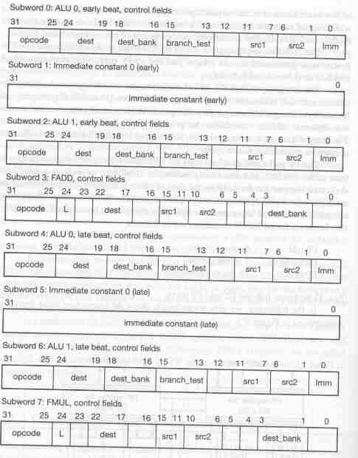
Instruction word format: Trace 7/200

Slide 5
VLIW: Static Scheduling of instructions/
Instruction scheduling done entirely by [software] compiler
Lesser Hardware complexity translate to
  increase the clock rate
  raise the degree of parallelism (more EU);
  {Can this be utilized?}
Higher Software (compiler) complexity
  compiler needs to aware hardware detail
    number of EU, their latencies, repetition rates, memory load-use delay, and so on
    cache misses: compiler has to take into account worst-case delay value
  this hardware dependency restricts the use of the same compiler for a family of VLIW processors

Slide 6
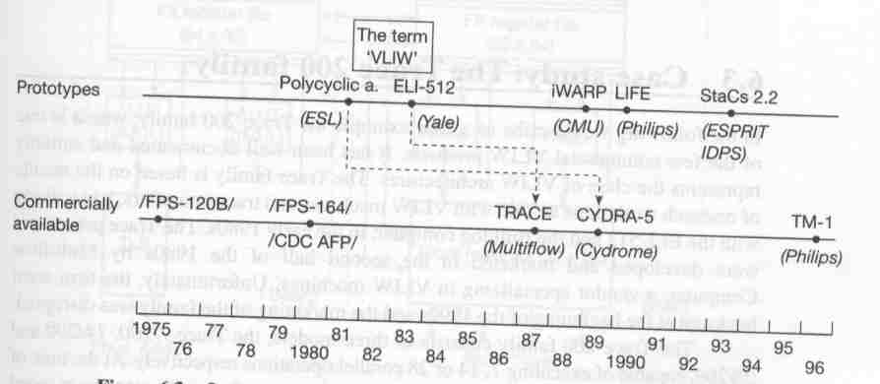
6.2 overview of proposed and commercial VLIW architectures

Slide 7
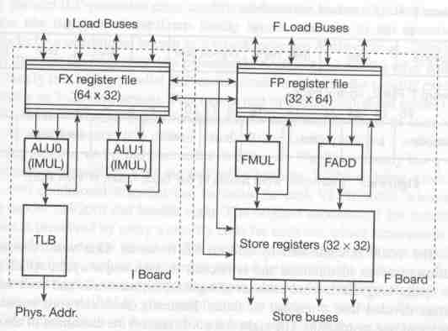
6.3 Case study: Trace 200

Slide 8
Trace 7/200
256-bit VLIW words
Capable of executing 7 instructions/cycle
  4 integer operations
  2 FP
  1 Conditional branch
Found that every 5th to 8th operation on average is a conditional branch
Use sophisticated branching scheme: multi-way branching capability
  executing multi-paths
  assign priority code corresponds to its relative order

Slide 9
Trace 28/200: storing long instructions
1024 bit per instruction
a number of 32-bit fields maybe empty
Storing scheme to save space
  32-bit mask indicating each sub-field is empty or not
  followed by all sub-fields that are not empty
  resulting still 3 time larger memory space required to store Fortran code (vs. VAX object code)
  very complex hardware for cache fill and refill
Performance data is Impressive indeed!

Slide 10
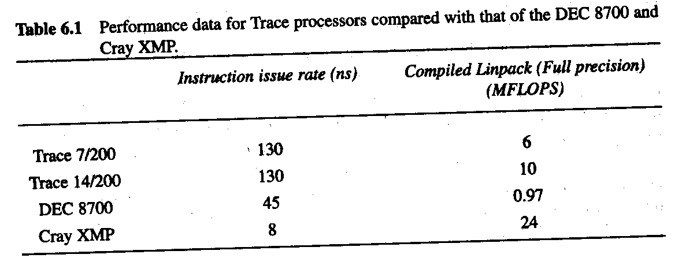
Trace: Performance data

Slide 11
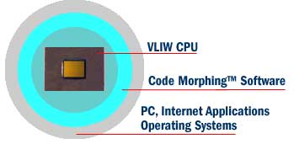
Transmeta: Crusoe
Full x86-compatible: by dynamic code translation
High performance: 700MHz in mobile platforms

Slide 12
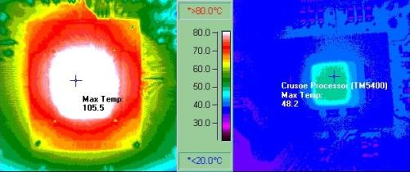
Crusoe
“Remarkably low power consumption”
  “A full day of web browsing on a single battery charge”
  (333-400Mhz TM3120 in production now, running Linux! TM5400 runs Windows, production mid 2000)
Playing DVD: Conventional? 105 C vs. Crusoe: 48 C

Slide 13
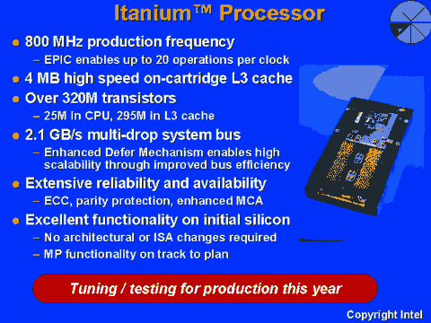
Intel: Itanium (VLIW) {EPIC} Processor

