Slide 1
10.Introduction to Data-Parallel architectures
SIMD {Single Instruction Multiple Data}
10.1 Introduction
10.2 Connectivity
10.3 Alternative architecture
e.g. add: (c1=a1+b1), (c2=a2+b2), (c3=a3+b3)
TECH
Computer Science
CH01

Slide 2
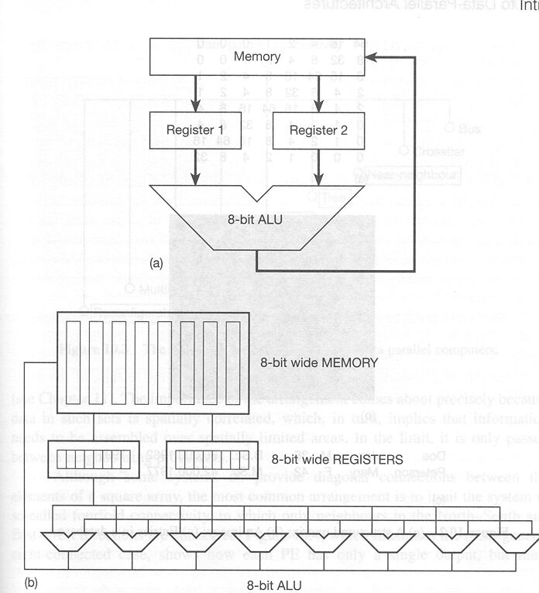
Data-parallel computation (bit parallel)

Slide 3
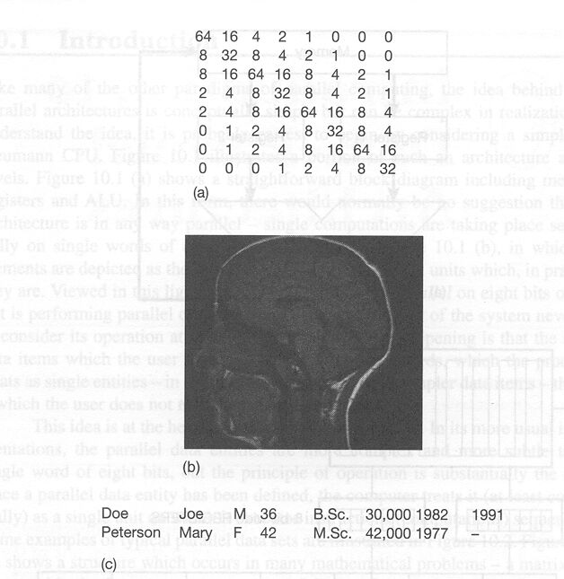
Application of Data-parallel Architectures:
One data entity processed by one PE

Slide 4
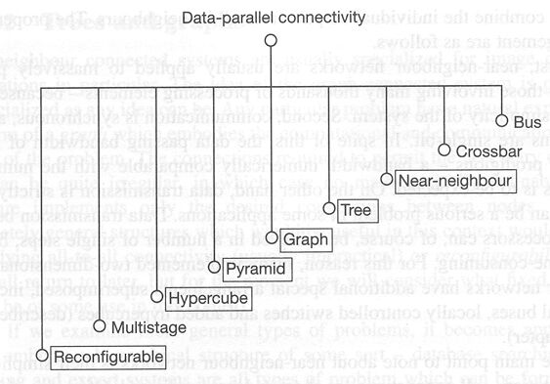
Mapping Problem space into Architectural Space:
Data entity onto PE (1-to-1 mapping)

Slide 5
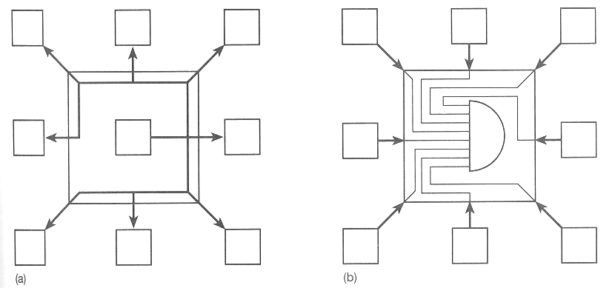
Near-neighbor connectivity (2-D: Mesh)

Slide 6
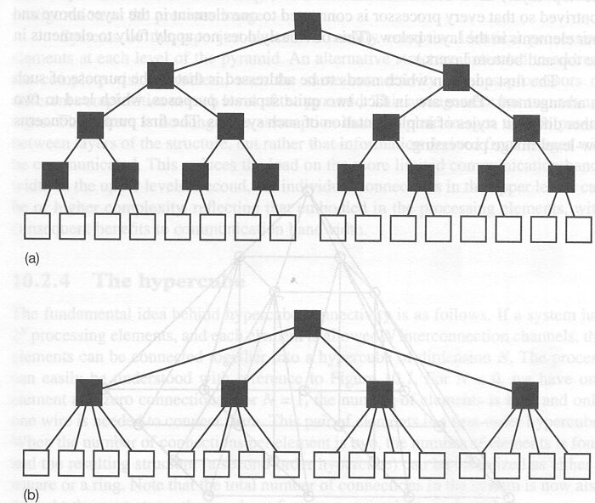
Tree: 2-D hierarchy

Slide 7
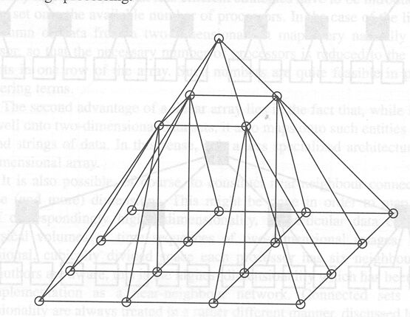
Pyramid: 3-D hierarchy

Slide 8
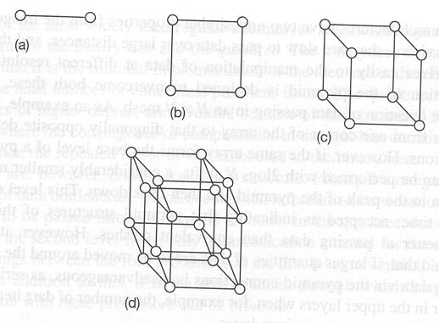
Hypercube: 2^N nodes in N dimension

Slide 9
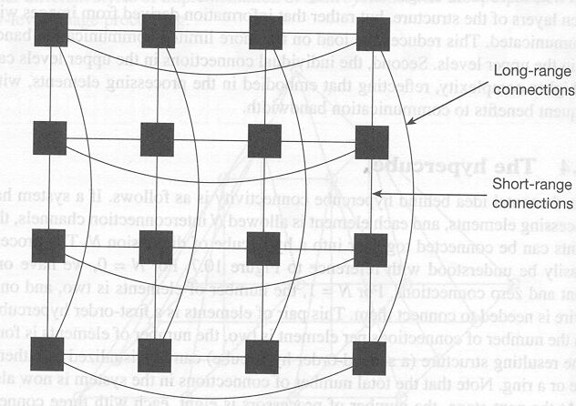
Hypercube: 4-D
Long and short-range connections

Slide 10
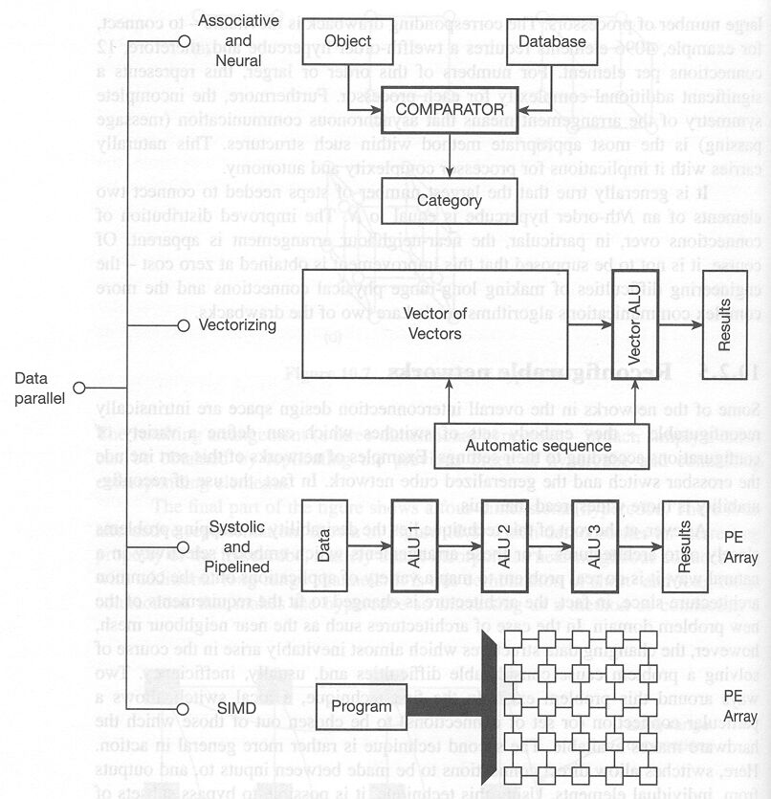
Data-parallel approaches

Slide 11
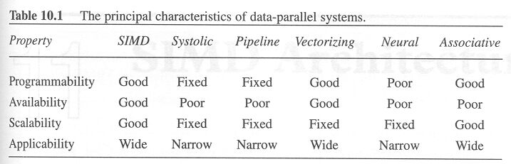
Principal characteristics of data-parallel systems

