Slide 1
19 Outlook *
19.1 Introduction
19.2 Semiconductor technology
19.3 Intreconnection technology
19.4 Optical computing
19.5 Bio-electronic computing
19.6 Final remarks
19.7 References
TECH
Computer Science
CH01

Slide 2
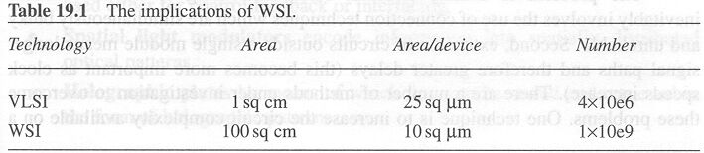
Semiconductor technology: Go Big
Wafer Scale Integration

Slide 3
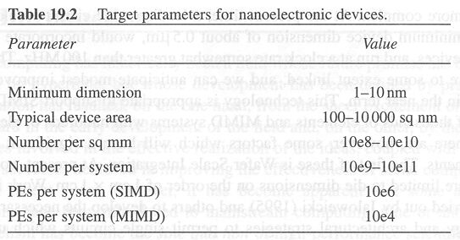
Semiconductor technology: Go Small
Nano-Electronic devices
Nano-Electronic Micro-Structures

Slide 4
Optical Computing
The guiding light to future computing

Slide 5
Bio-electronic Computing
Cyborg
  neuron and silicon connections
Chemical-computing
  involves the generation of highly parallel ordered structures from solution
DNA Computing
  mutation

Slide 6
Quantum Computing
Probably

Slide 7
Final Remarks
“Parallel Computing has historically been a field
  whose future promise has been characterized by hyperbole, but
  whose development has been defined by pragmatism.”
“It is worth noting that even the advent of nanotechnology is unlikely
  to raise the number of computing elements in a single system
  to anywhere near the number of neurons in the human brain.”

