Slide 1
8 Processing of control transfer instructions
8.1 Introduction
8.2 Basic approaches to branch handling
8.3 Delayed branching
8.4 Branch processing
8.5 Multiway branching
8.6 Guarded execution
TECH
Computer Science
CH01

Slide 2
8.1 Intro to Branch
Branches modify, conditionally or unconditionally,
the value of the PC.
To transfer control
To alter the sequence of instructions

Slide 3
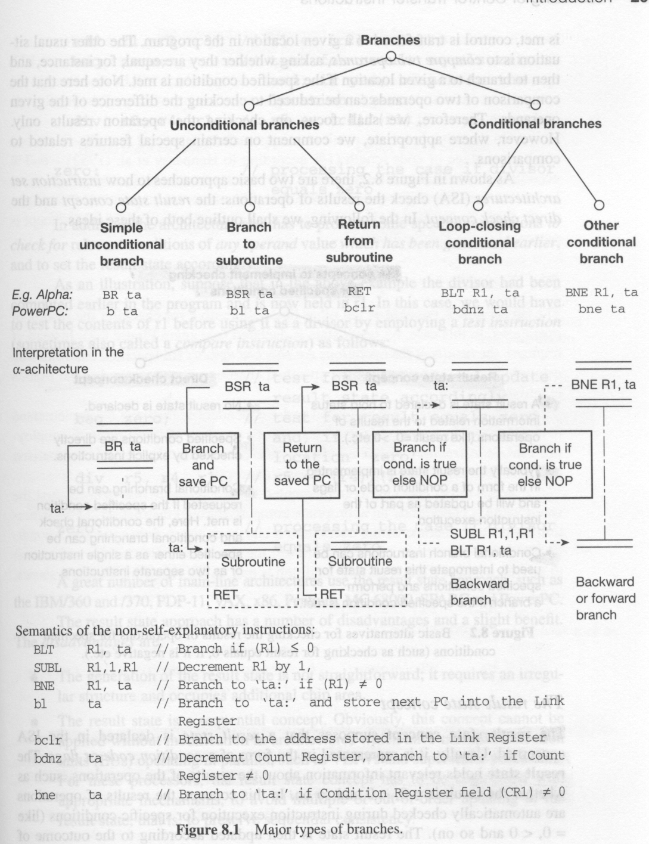
Major types of branches

Slide 4
Branch: To transfer control

Slide 5
Branch: e.g.

Slide 6
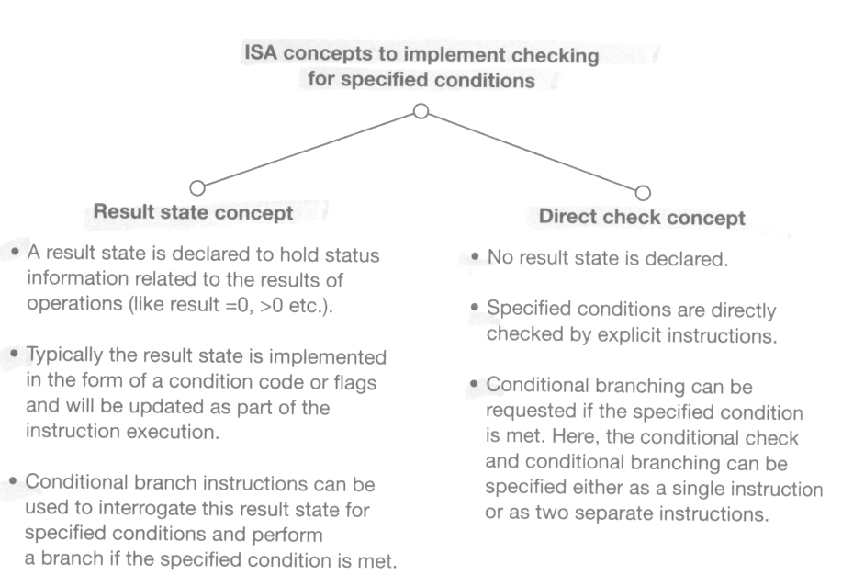
8.1.2 How to check the results of operations for specified conditions {branch} (e.g. equals 0, negative, and so on)

Slide 7
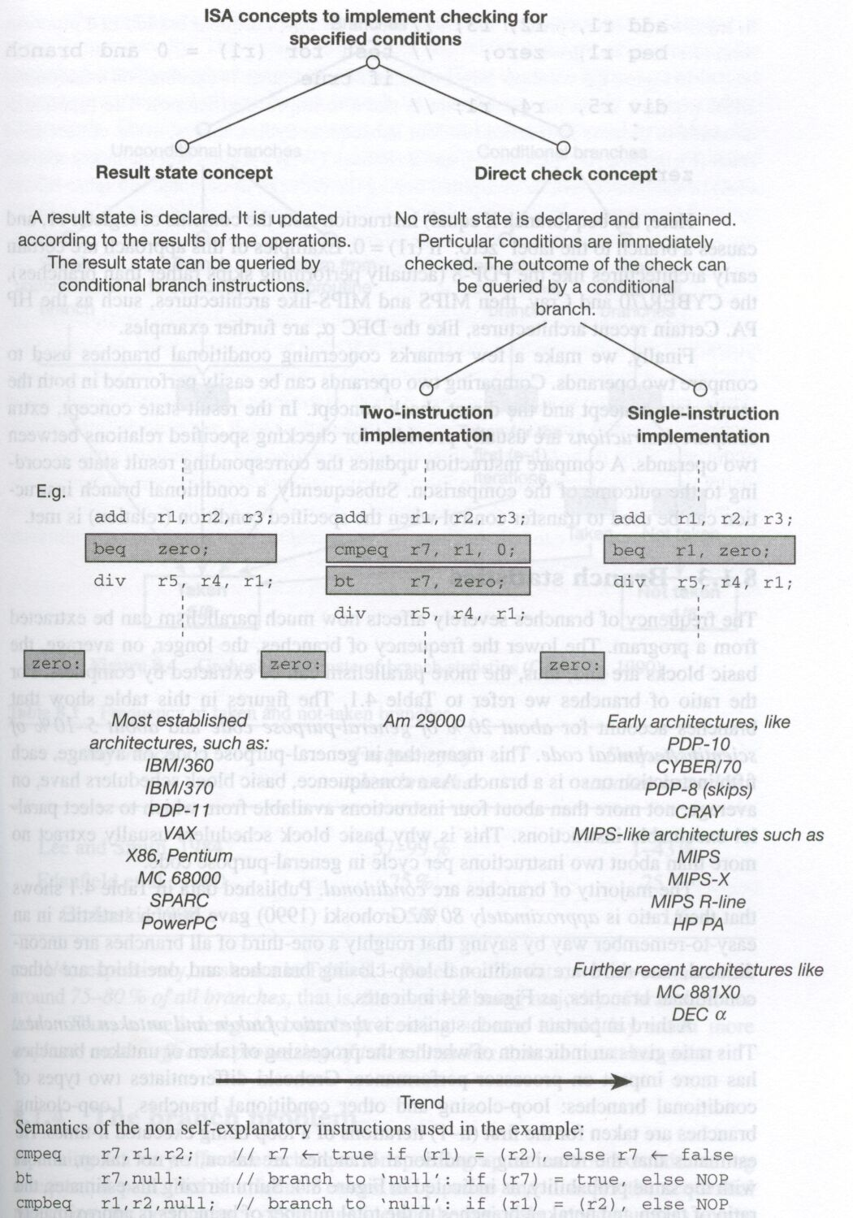
Alternatives for checking the operation results

Slide 8
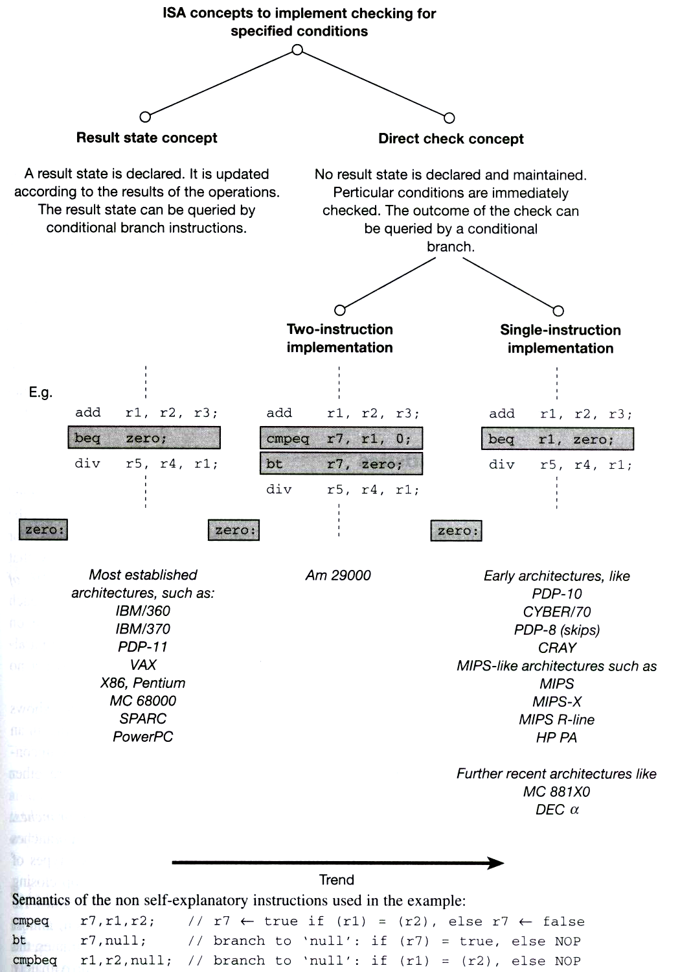
Result State vs. Direct Check, e.g.

Slide 9
Result state approach: Disadvantage
The generation of the result state is not straightforward
  It requires an irregular structure and occupies additional chip area
The result state is a sequential concept.
  It cannot be applied without modification in architectures which have multiple execution units.

Slide 10
Retaining sequential consistency for condition checking (in VLIW or Superscalar)
Use multiple sets of condition codes or flags
  It relies on programmer or compiler to use
  different sets condition codes or flags for
  different outcome generated by different EUs.
Use Direct Check approach.

Slide 11
Branch Statistics
20% of general-purpose code are branch
  on average, each fifth instruction is a branch
5-10% of scientific code are branch
The Majority of branches are conditional (80%)
75-80% of all branches are taken

Slide 12
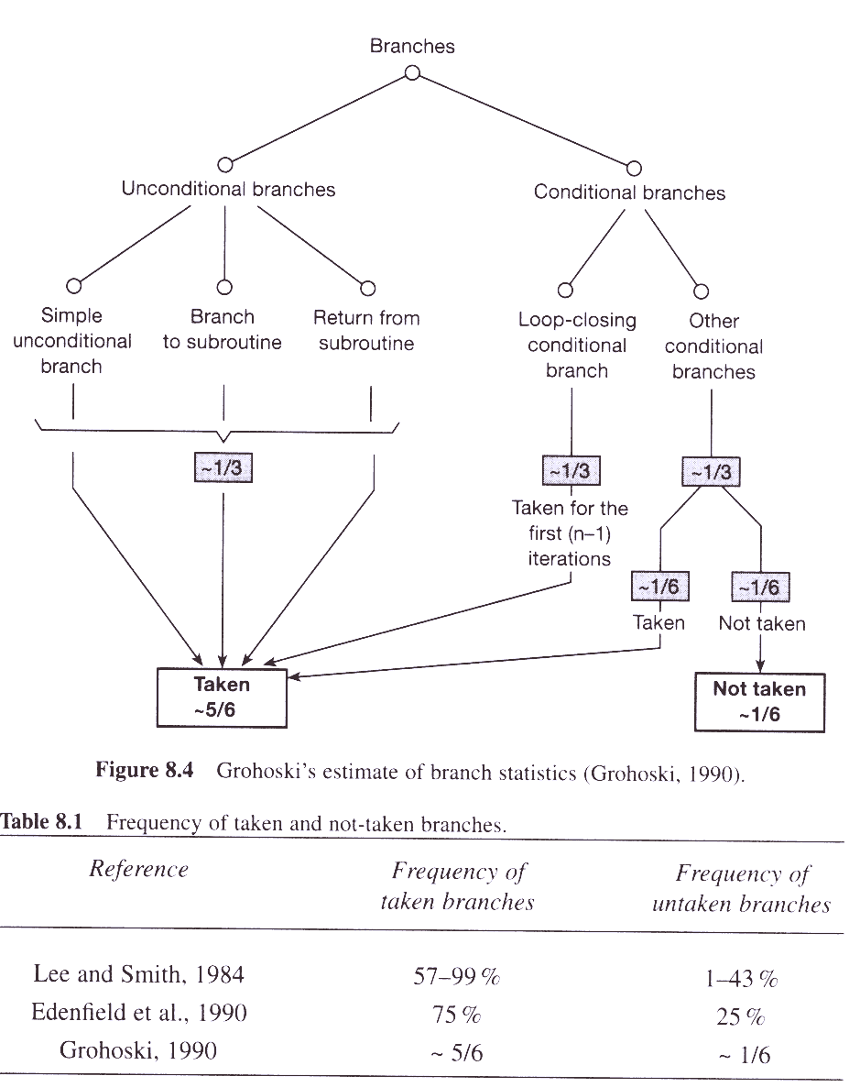
Branch statistics: Taken or not Taken

Slide 13
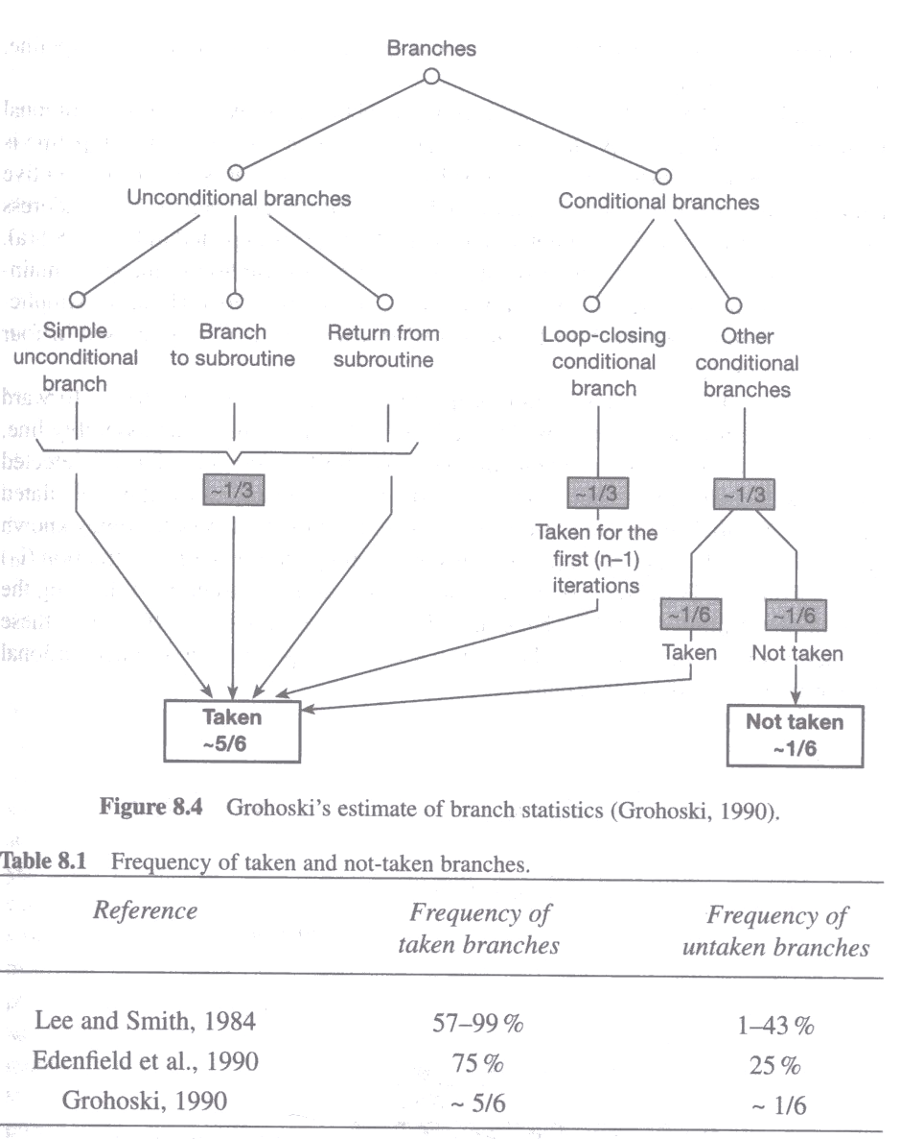
Frequency of taken and not-taken branches

Slide 14
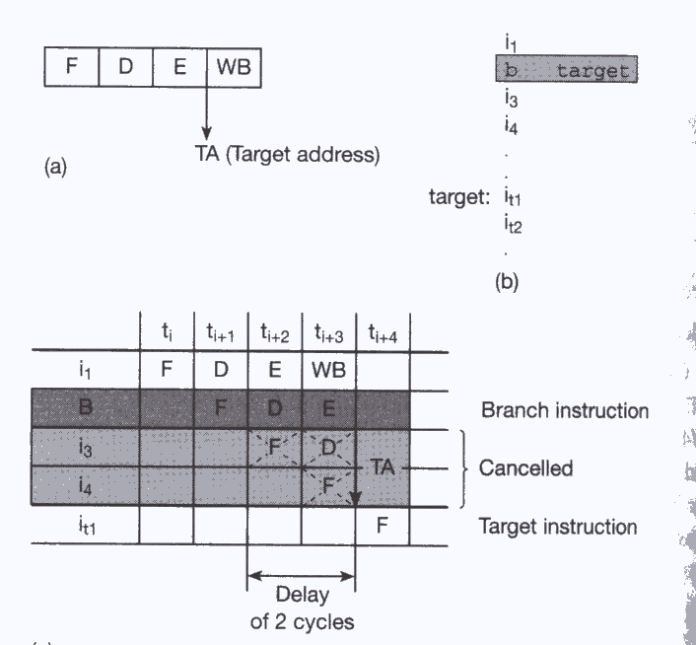
8.1.4 The branch problem:
The delay caused in pipelining

Slide 15
More branch problems
Conditional branch could cause an even longer penalty
  evaluation of the specified condition needs an extra cycle
  waiting for unresolved condition (the result is not yet ready)
    e.g. wait for the result of FDIV may take 10-50 cycles
Pipelines became more stages than 4
  each branch would result in a yet larger number of wasted cycles (called bubbles)

Slide 16
8.1.5 Performance measures of branch processing
  Pt : branch penalties for taken
  Pnt : branch penalties for not-taken
  ft : frequencies of taken
  fnt : frequencies for not-taken
  P : effective penalty of branch processing
P = ft * Pt + fnt * Pnt
  e.g. 80386:: P = 0.75 * 8 + 0.25 * 2 = 6.5 cycles
  e.g. i486:: P = 0.75 * 2 + 0.25 * 0 = 1.5 cycles
Branch prediction correctly or mispredicted
P = fc * Pc + fm * Pm
  e.g. Pentium:: P = 0.9 * 0 + 0.1 * 3.5 = 0.35 cycles

Slide 17
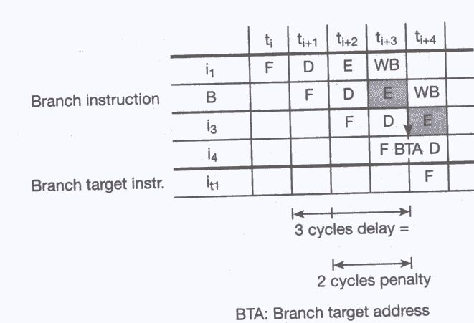
Interpretation of the concept of branch penalty

Slide 18
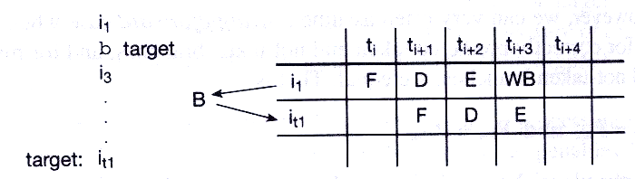
Zero-cycle branching {in no time}

Slide 19
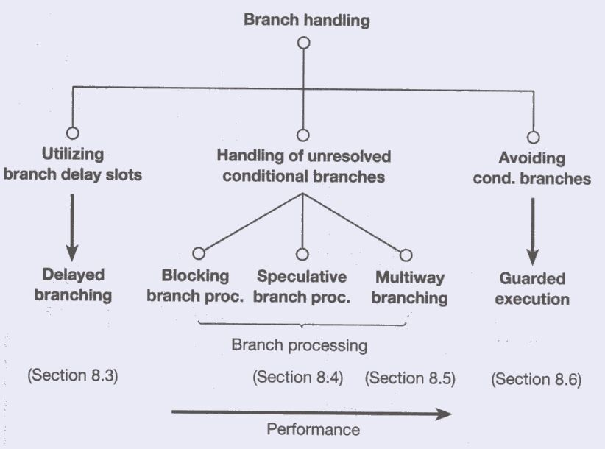
8.2 Basic approaches to branch handling

Slide 20
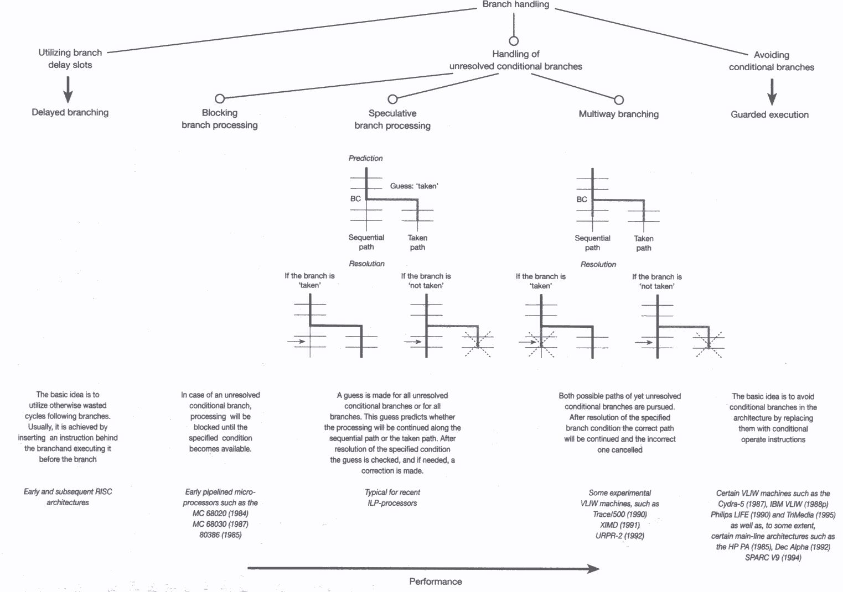
Review of the basic approaches to branch handling

Slide 21
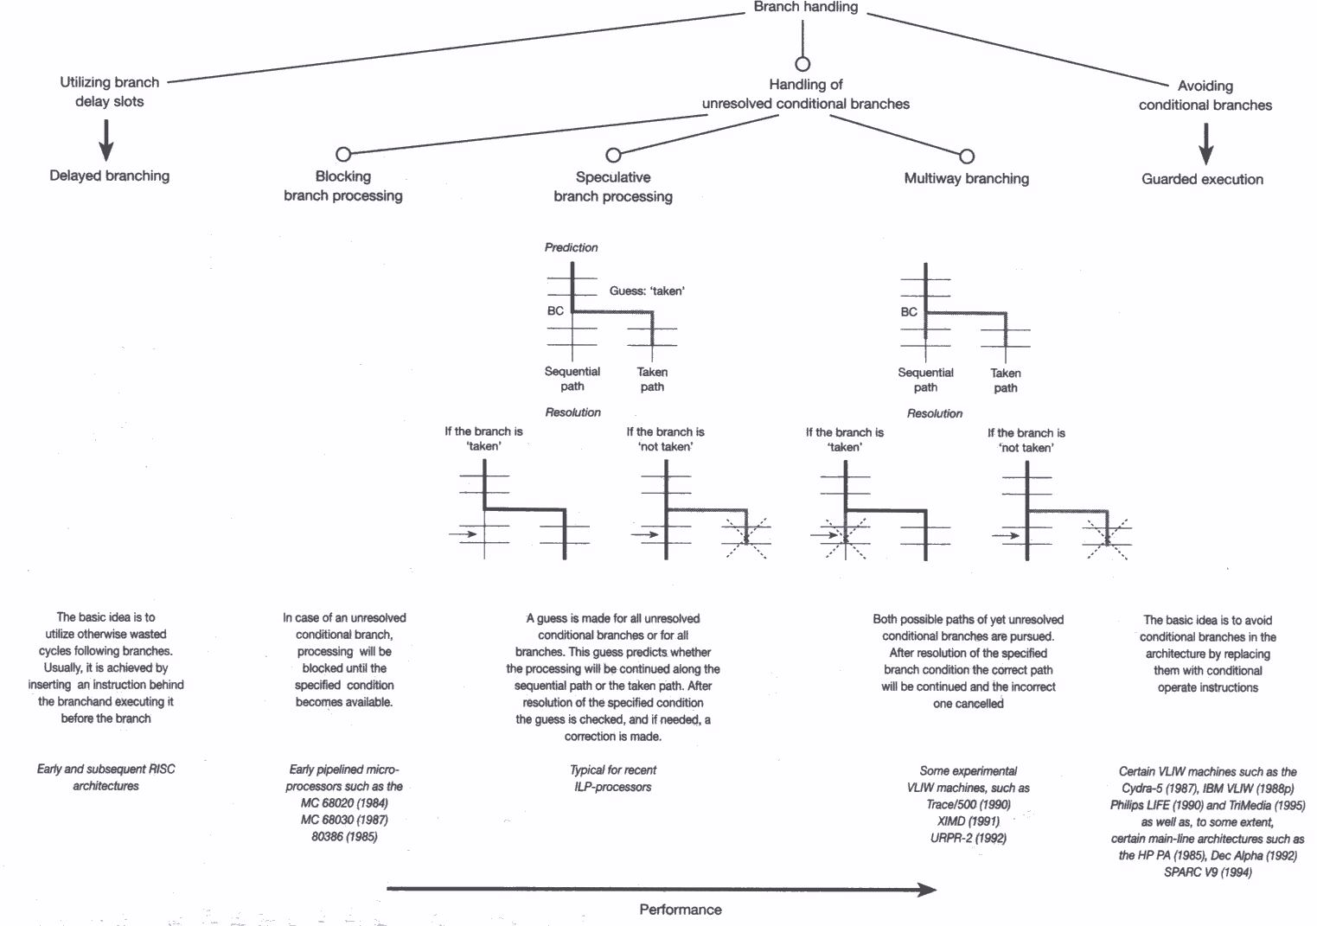
Speculative vs. Multiway branching

Slide 22
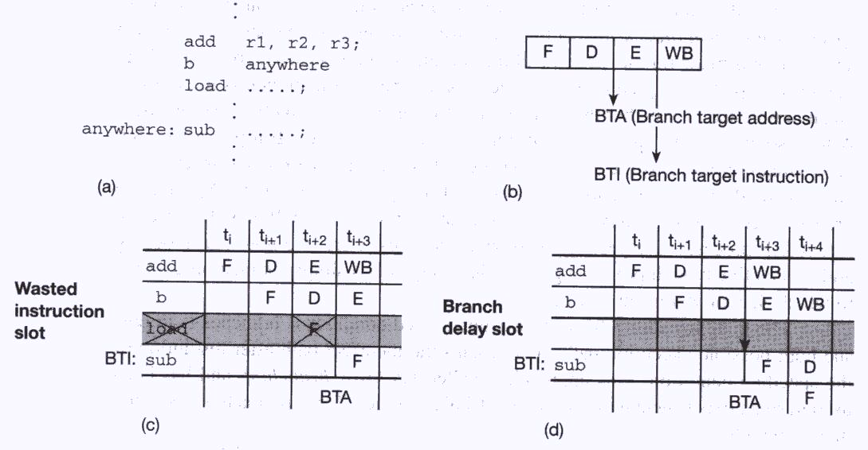
-Delayed Branching: Occurrence of an unused instruction slot (unconditional branch)

Slide 23
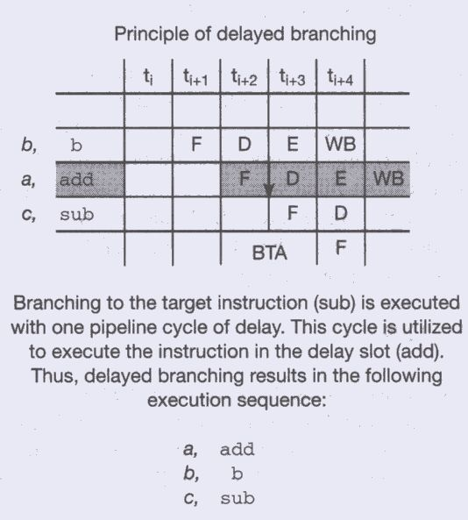
Basic scheme of delayed branching

Slide 24
Delayed branching: Performance Gain
Ratio of the delay slots that can be filled with useful instructions:: f_{f}
  60-70% of the delay slot can be fill with useful instruction
    fill only with: instruction that can be put in the delay slot but does not violate data dependency
    fill only with: instruction that can be executed in single pipeline cycle
Frequency of branches:: f_{b}
  20-30% for general-propose program
  5-10% for scientific program
100 instructions have 100* f_{b} delay slots,
100*f_{b} * f_{f} can be utilized.
Performance Gain = (100*f_{b} * f_{f})/100 = f_{b} * f_{f}

Slide 25
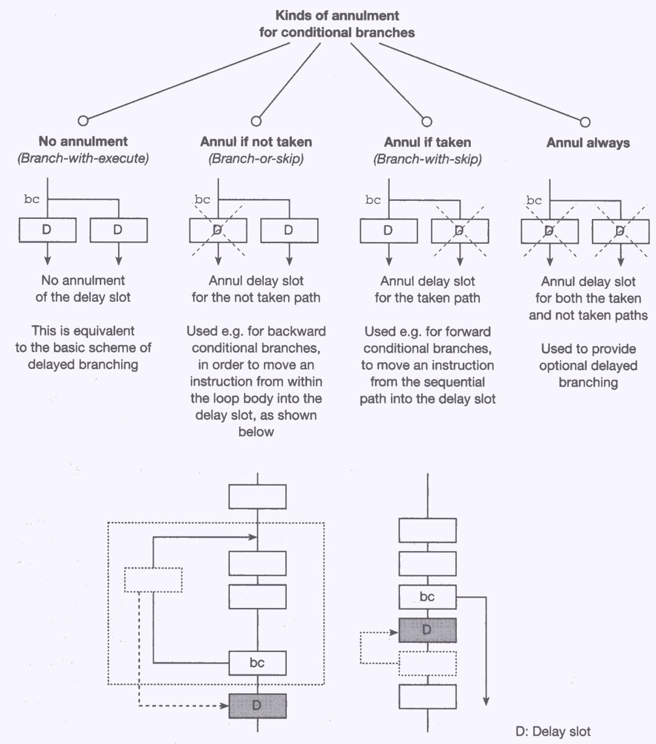
Delayed branching: for conditional branches {Can be cancel or not}

Slide 26
Where to find the instruction to fill delay slot

Slide 27
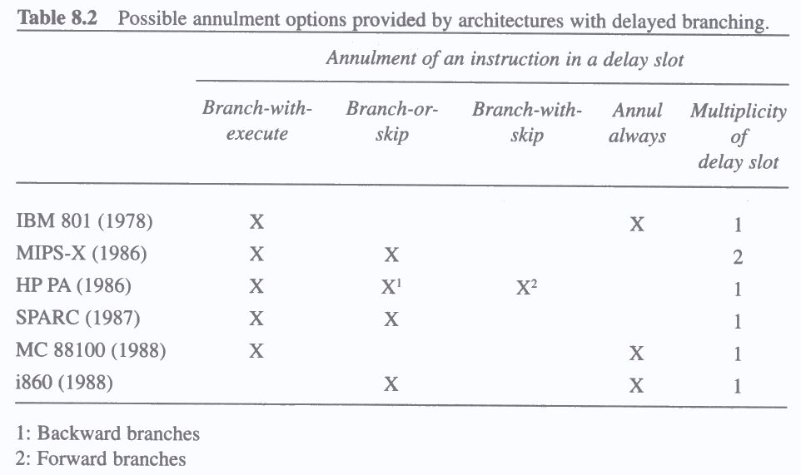
Possible annulment options provided by architectures (use special instructions) with delayed branching {Scalar only}//

Slide 28
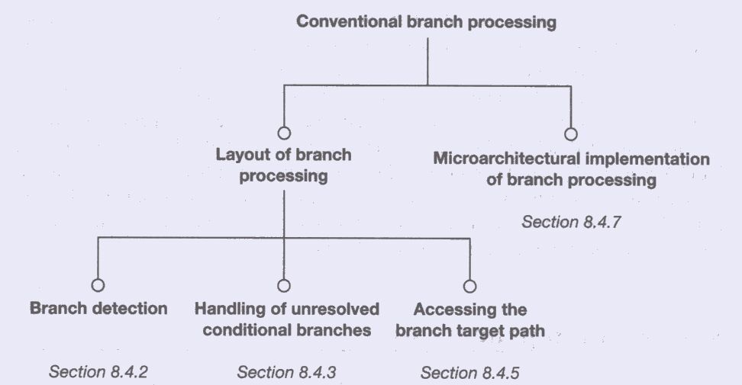
8.4 Branch Processing: design space

Slide 29
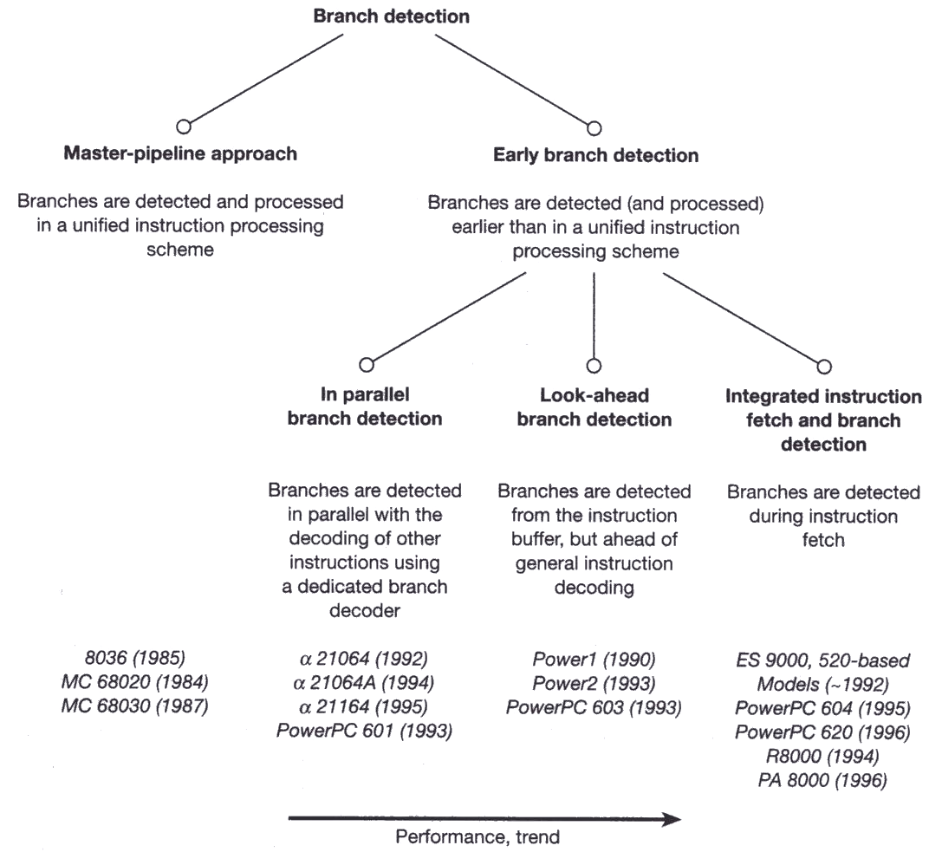
Branch detection schemes
{early detection, better handling}

Slide 30
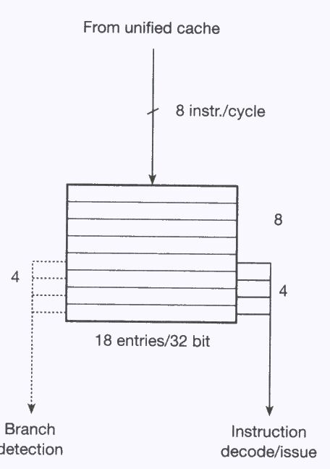
Branch detection in parallel with decoding/issuing of other instructions (in I-Buffer)

Slide 31
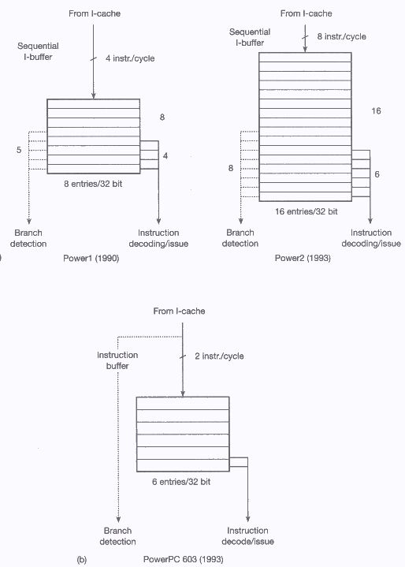
Early detection of branches by
Looking ahead

Slide 32
Early detection of branches by inspection of instruction that inputs to I-buffer

Slide 33
Early branch detection: {for scalar Processor}
Integrated instruction fetch and branch detection
Detect branch instruction during fetching
Guess taken or not taken
Fetch next sequential instruction or target instruction

Slide 34
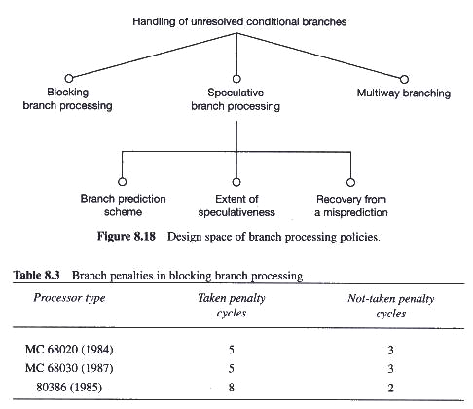
Handling of unresolved conditional branches

Slide 35
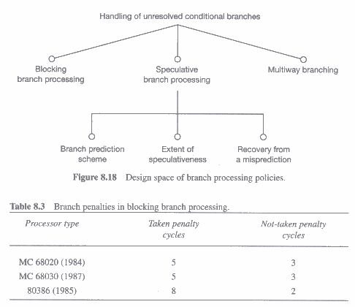
-Blocking branch processing
Simply stalled (stopped and waited) until the specified condition can be resolved

Slide 36
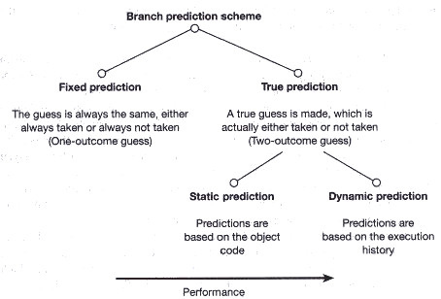
-Basic kinds of branch predictions

Slide 37
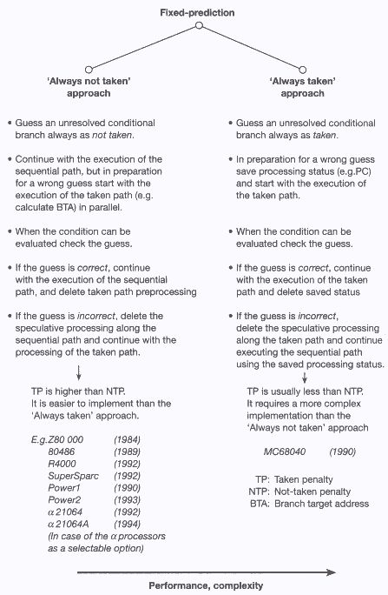
-The fixed prediction approach

Slide 38
Always not taken vs. Always Taken

Slide 39
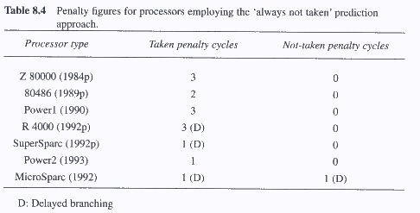
Always not taken: Penalty figures

Slide 40
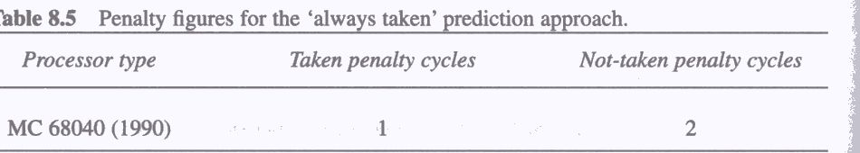
Penalty figures for the always taken prediction approach

Slide 41
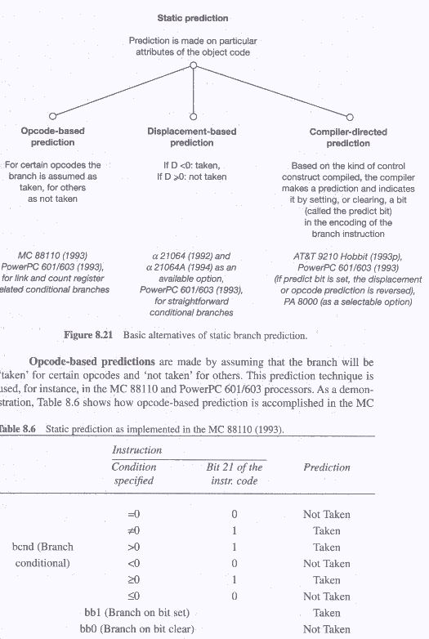
-Static branch prediction

Slide 42
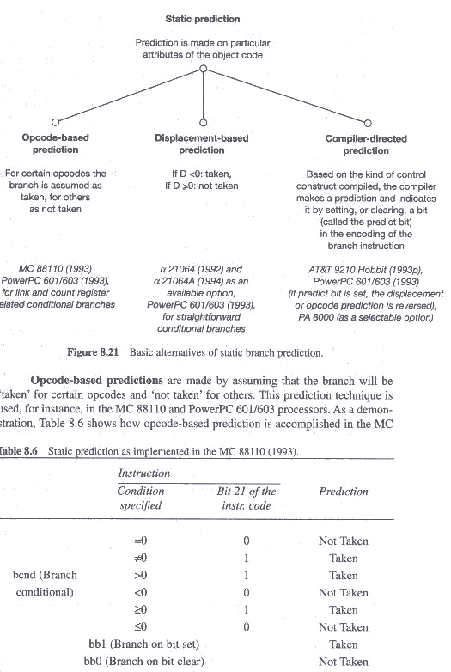
Static prediction: opcode based e.g. implemented in the MC88110

Slide 43
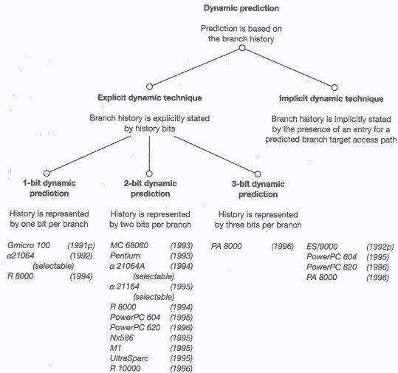
-Dynamic branch prediction: branch taken in the last n occurrences is likely to be taken next

Slide 44
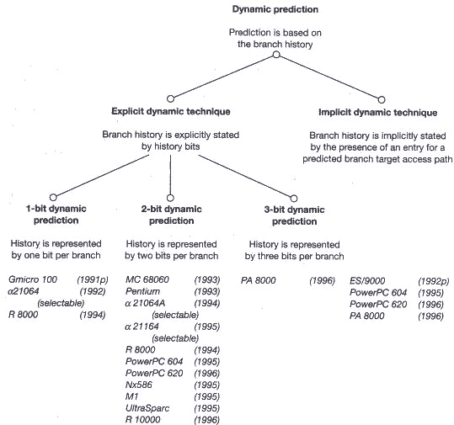
Dynamic branch prediction: e.g.

Slide 45
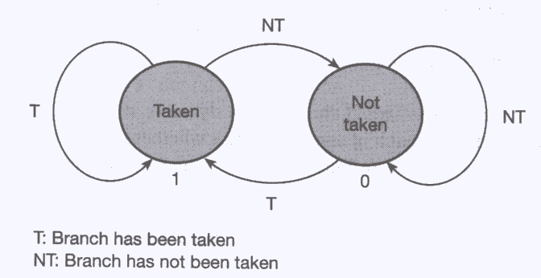
1-bit dynamic prediction: state transition diagram

Slide 46
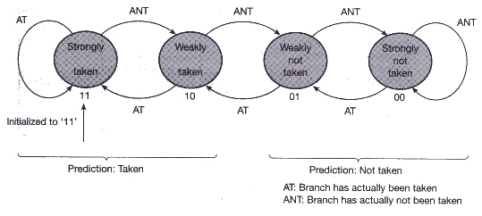
2-bit dynamic prediction: state transition diagram

Slide 47
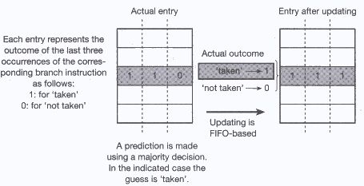
3-bit prediction

Slide 48
Implicit dynamic technique
Schemes for accessing the branch target path also used for branch prediction
Branch Target Access Cache (BTAC)
  holds the most recently used branch addresses
Branch Target Instruction Cache (BTIC)
  holds the most recently used target instructions
BTAC or BTIC holds entries only
for the taken branches
The existence of an entry means that
  the corresponding branch was taken at its last occurrence
  so its next occurrence is also guessed as taken

Slide 49
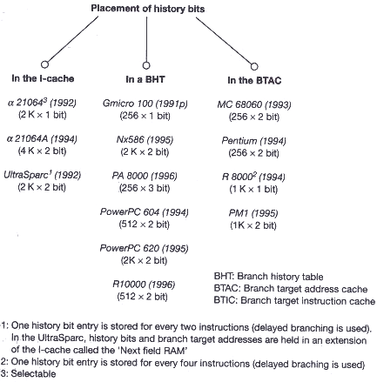
=Implementation alternatives of history bits

Slide 50
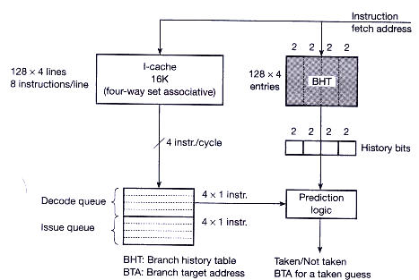
Example of the implementation of the BHT

Slide 51
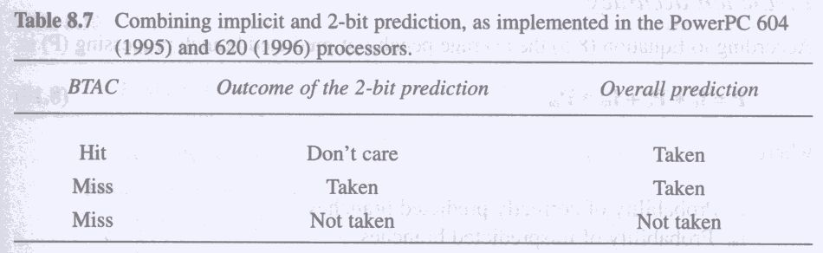
=Combining implicit and 2bit prediction

Slide 52
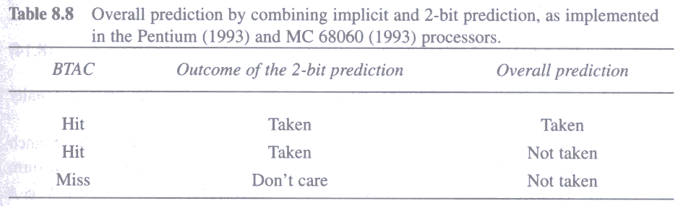
Combining implicit and 2bit prediction..
Not

Slide 53
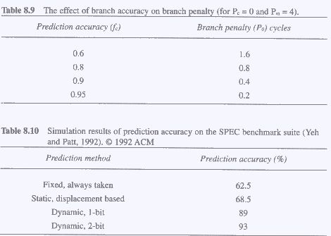
=The effect of branch accuracy on branch penalty

Slide 54
Simulation results of prediction accuracy on the SPEC

Slide 55
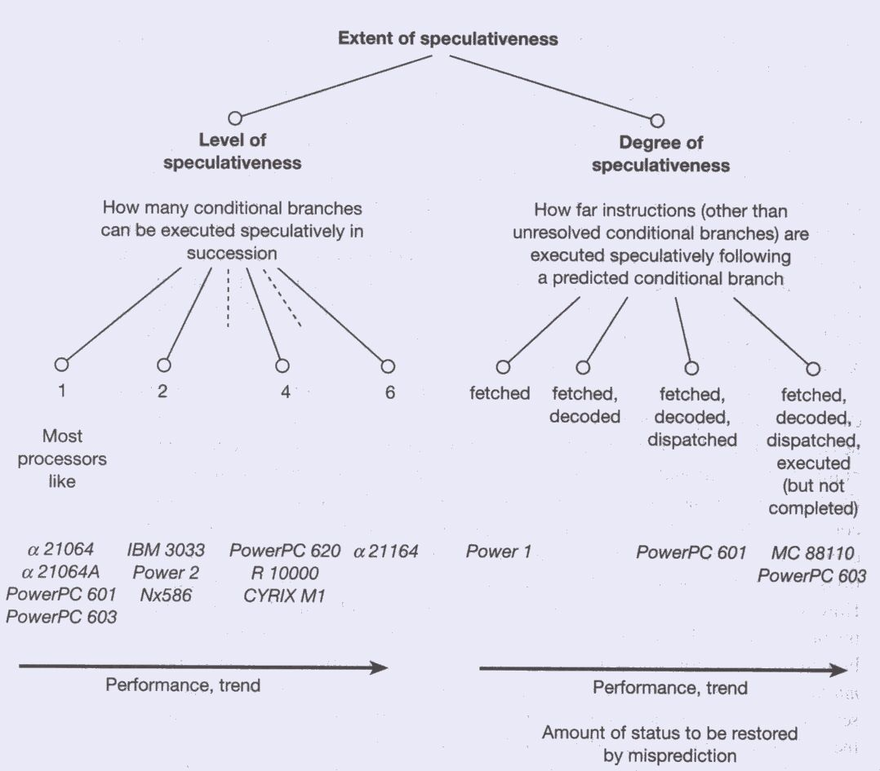
=Extent of speculative processing

Slide 56
Extent of speculative processing: e.g.

Slide 57
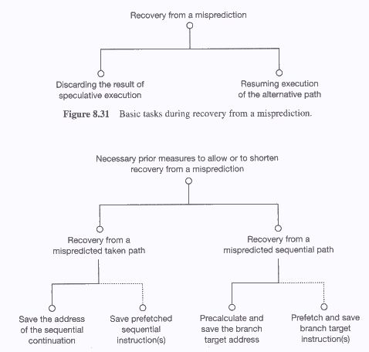
=Recovery from a misprediction: Basic Tasks

Slide 58
Necessary activities to allow of to shorten recovery from a misprediction

Slide 59
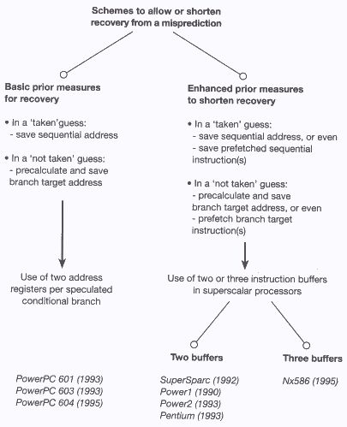
Frequently employed schemes for shortening recovery from a misprediction

Slide 60
shortening recovery from a misprediction: needs

Slide 61
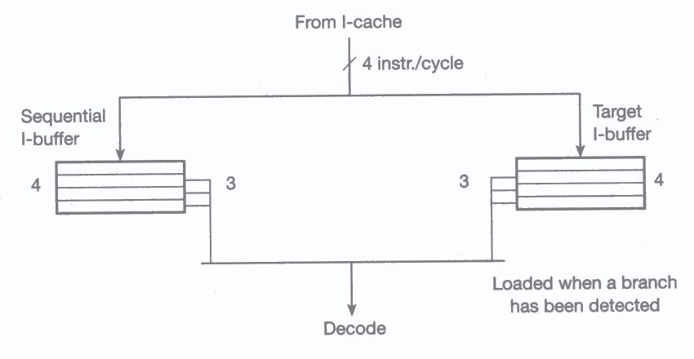
Using two instruction buffers in the supersparc to shorten recovery from a misprediction: e.g.

Slide 62
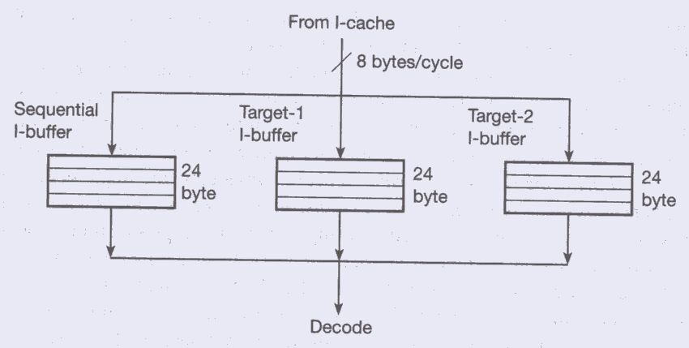
Using three instruction buffers in the Nx586 to shorten recovery from a misprediction: e.g.

Slide 63
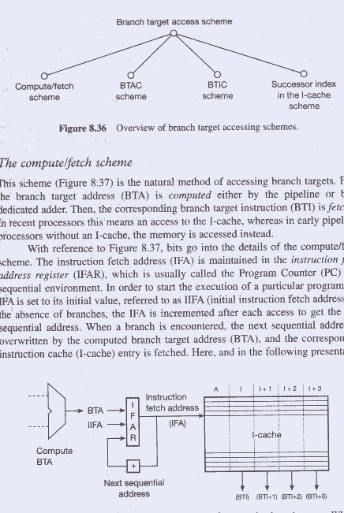
8.4.5 Branch penalty for taken guesses depends on branch target accessing schemes

Slide 64
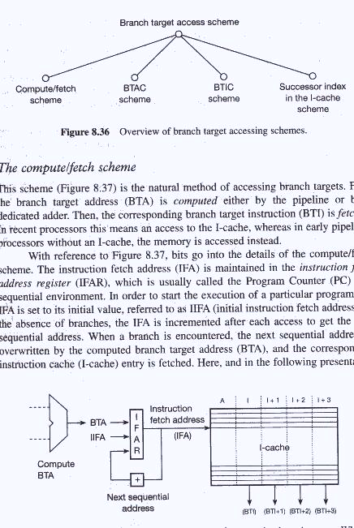
-Compute/fetch scheme for accessing branch targets {IFAR vs. PC}

Slide 65
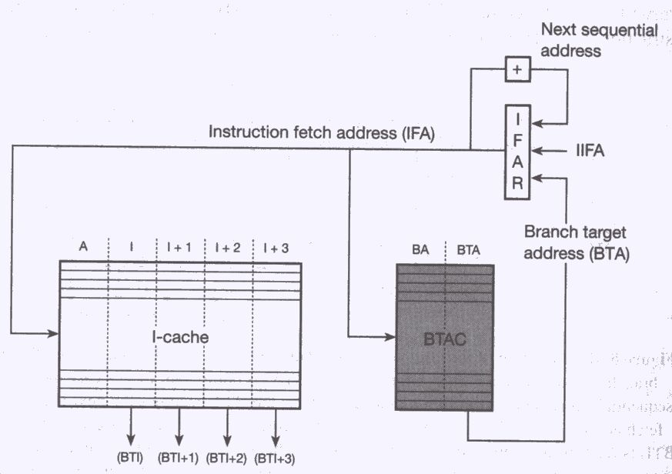
-BTAC scheme for accessing branch targets {associative search for BA, if found get BTA} {0-cycle branch: BA=BA-4}

Slide 66
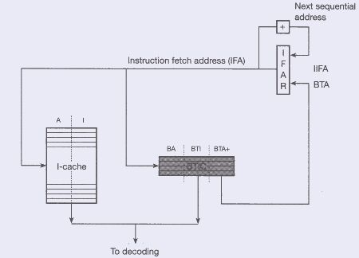
-BTIC scheme: store next BTA

Slide 67
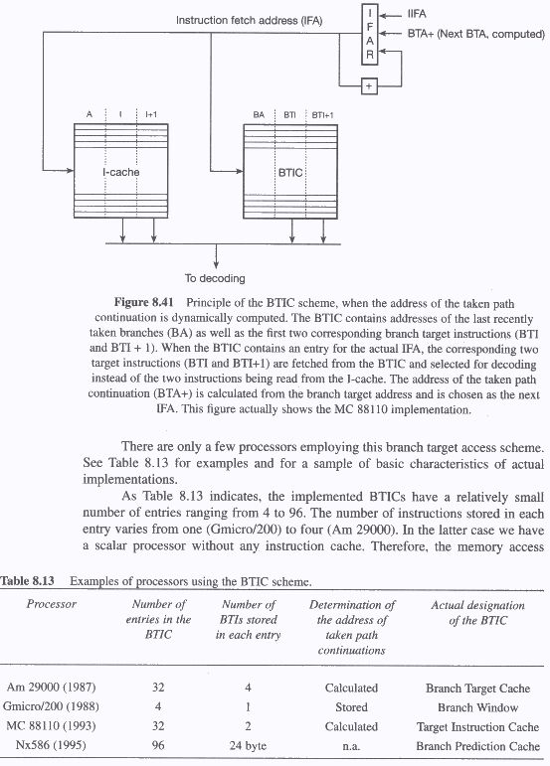
-BTIC scheme: calculate next BTA

Slide 68
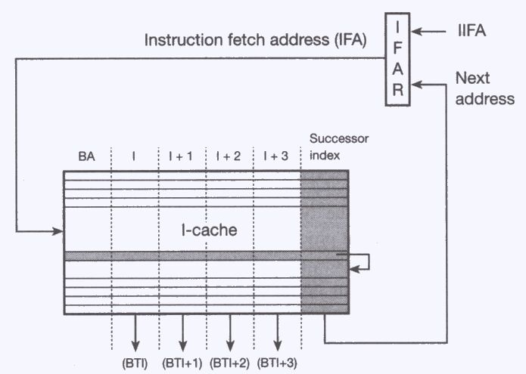
-Successor index in the I-cache scheme to access the branch target path {index: next I, or target I}

Slide 69
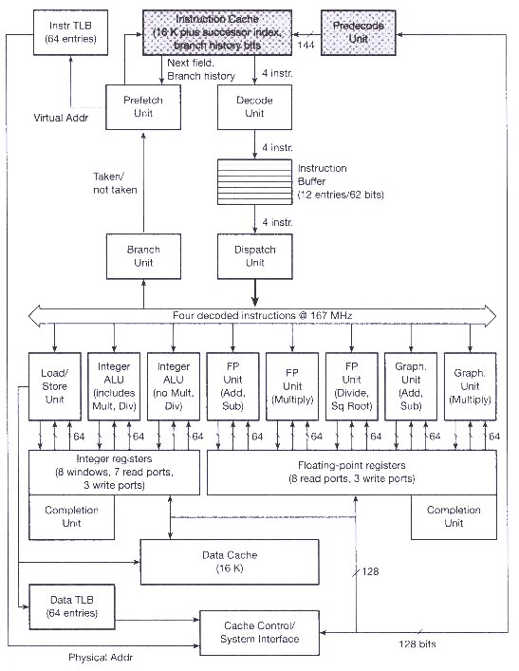
Successor index in the I-cache scheme: e.g.
The microachitecture of the UltraSparc

Slide 70

Predecode unit: detects branches, BTA, make predictions (based on compiler’s hint bit), set up I-cache Next address

Slide 71

=Branch target accessing trends //

Slide 72

8.5 Multiway branching: {two IFA’s or PC’s}

Slide 73

Threefold multiway branching: only one correct path!

Slide 74
8.6 Guarded Execution
a means to eliminate branches
by conditional operate instructions
  IF the condition associated with the instruction is met,
  THEN perform the specified operation
  ELSE do not perform the operation
e.g. original
  beg r1, label // if (r1) = 0 branch to label
  move r2, r3 // move (r2) into r3
  label: …
e.g. guarded
  cmovne r1, r2, r3 // if (r1) != 0, move (r2) into r3
  …
Convert control dependencies into data dependencies

Slide 75

Eliminated branches by full and restricted guarding
{full: all instruction guarded, restricted: ALU inst guarded}

Slide 76
Guarded Execution: Disadvantages
guarding transforms instructions from both the taken and the not-taken paths into guard instruction
  increase number of instructions
  by 33% for full guarding
  by 8% for restricted guarding
  {more instructions more time and space}
guarding requires additional hardware resources
if an increase in processing time is to be avoided
  VLIW

