Slide 1
Network Subnetting
Chapter 4
Dr. Majd Tahat

Slide 2
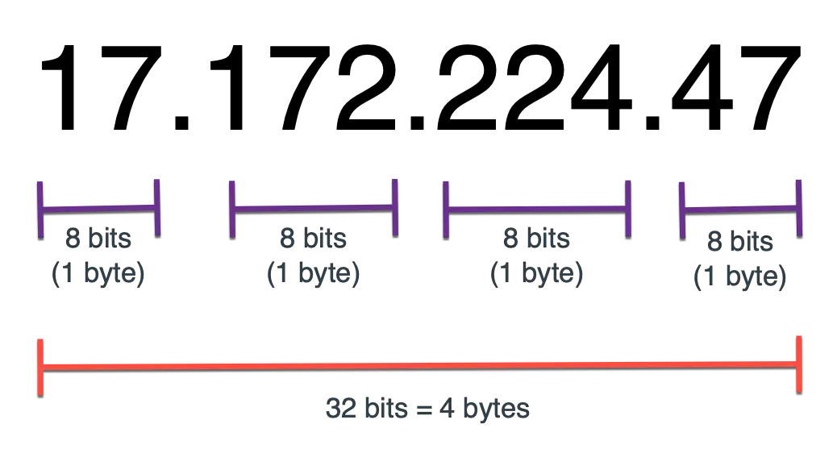
IPv4 (Review)
IPv4, is a unique address used by devices for identification and communication
consists of 32bits and is divided into 4 octets separated by periods, where 1 octet = 8 bits

Slide 3
IP Address Class
IPv4 (Review)
Classes | range
A | 0 to 127
B | 128 to 191
C | 192 to 223
D | 224 to 239
E | 240 to 255
To find the class of the given IP address, look at the first octet. The range of each class is given in the following table.
Example: If the IP address given is 64.19.23.0 then the first octet is 64 which is in the range of 0 to 127, so the given IP address belongs to class A.

Slide 4
Binary (Review) Convert to decimal
1 Octet 8 bit Rang 0-255 0 if it’s all 0’s, 255 if 1’s
positional values/ weights--
128 | 64 | 32 | 16 | 8 | 4 | 2 | 1
1 | 1 | 1 | 1 | 1 | 1 | 1 | 1
255
binary number --
128 | 64 | 32 | 16 | 8 | 4 | 2 | 1
1 | 1 | 0 | 0 | 0 | 0 | 0 | 0
192
The IP address in decimal--
192 | 168 | 1 | 0
11000000 | 10101000 | 00000001 | 00000000
IP address in binary--
255 | 255 | 255 | 0
11111111 | 11111111 | 11111111 | 00000000

Slide 5
Network Subnetting
A subnet is a logical subdivision of an IP Network into smaller networks
Subnetting improves overall performance and security.
Also, it reduces congestion in networks
by reducing broadcast traffic and better network management.

Slide 6
Network ID and Host ID
The IP address is divided into two parts: a network ID and a host ID
A subnet mask is used so devices can determine which part of an IP address is
the network ID and which part is the host ID
  The number of 1s in the subnet mask determines the number of bits in the IP address belong to the network ID
  All devices within the same network share the same network ID. Not changing part of the IP
  a host ID distinguishes one device from another within the same network. Changing
  Think about it as your address the street is not changing but the houses numbers on it are changing
My computer subnet mask is: 255.255.255.0
In binary, this looks like this: 11111111.11111111.11111111.00000000 (Shorthand /24)
Network ID
Host ID

Slide 7
Subnet Masks
  For Ex the following classful IP address 192.168.123.132 in binary:
  11000000.10101000.01111011.10000100
  Subnet mask 255.255.255.0 in binary:
  11111111.111111111.111111111.00000000
  Network ID: 192.168.123.0
  Host ID: 0.0.0.132
CIDR:
So, what is /8 =
11111111.00000000.00000000.00000000 = 255.0.0.0
So, what is /16 =
11111111.11111111.00000000.00000000 = 255.255.0.0
So, what is /5 =
11111000.00000000.00000000.00000000 = 248.0.0.0
So, what is /20 =
11111111. 11111111.11110000.00000000 = 255.255.240.0

Slide 8
Default Mask
Classes | Default mask
A | 255.0.0.0
B | 255.255.0.0
C | 255.255.255.0
D | –
E | –
There is default mask value for each class, the default mask value for each class is given in the table below

Slide 9
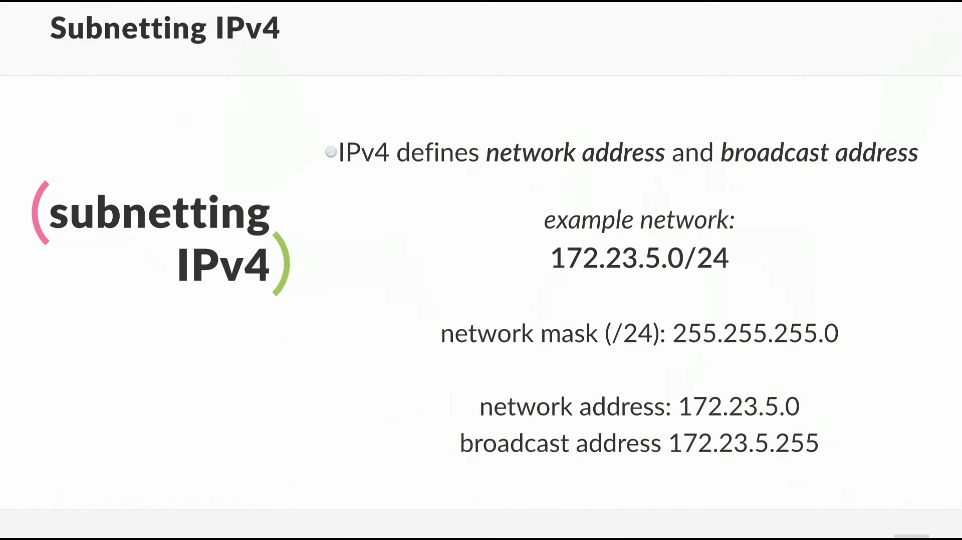
Network Address and Broadcast Address
  Reserved hosts ” not counted with rang of IP’s”.
  the network address where the host portion all 0’s
  and the broadcast address where host portion all 1’s

Slide 10
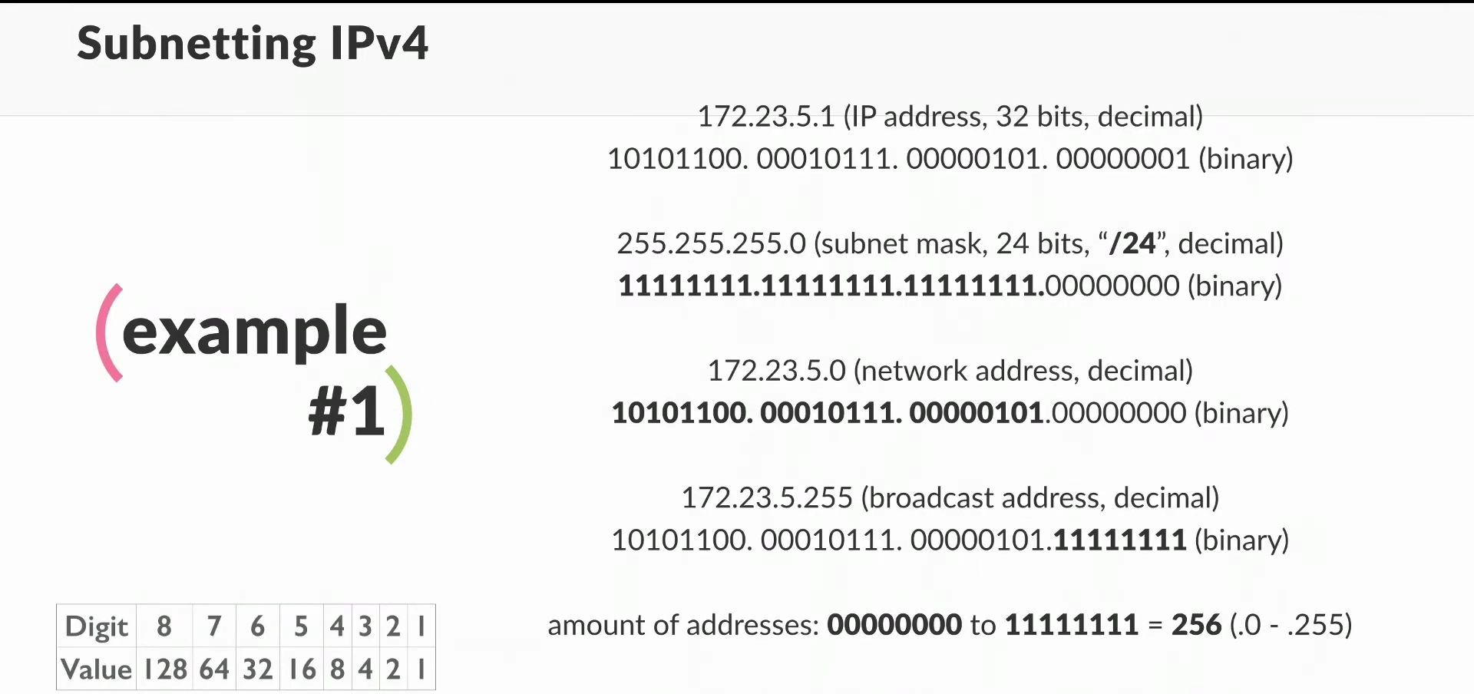

Slide 11
Subnetting Questions on Exams
You are likely to see two types of subnet calculation problems:
  Given certain network requirements (such as required number of hosts or subnets), calculate possible subnets and host IP address ranges
  Given an IP address, determine its subnet’s network ID, broadcast address, and first/last host addresses

Slide 12
Subnet Calculation
Example: Create two subnet of network ID: 192.168.89.0 with an original subnet mask of 255.255.255.0
Steps to subnet:
  1. Borrow from host bits
  2. Determine the subnet mask
  3. Determine the network IDs
  4. Determine the ranges of IP addresses for hosts in the subnet

Slide 13
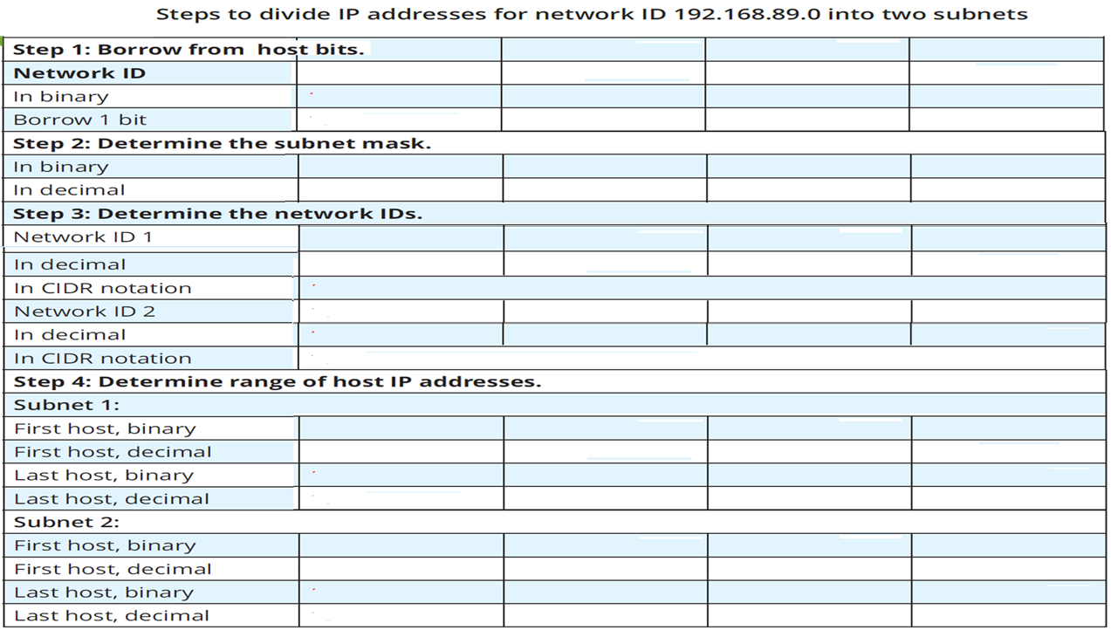

Slide 14
Skip-Counting
The first three octets of the network ID (192.168.89.0) are the same for all possible subnets.
The network IDs differ only in the last octet (192.168.89.0).
skip-counting: add the same number over and over.

Slide 15
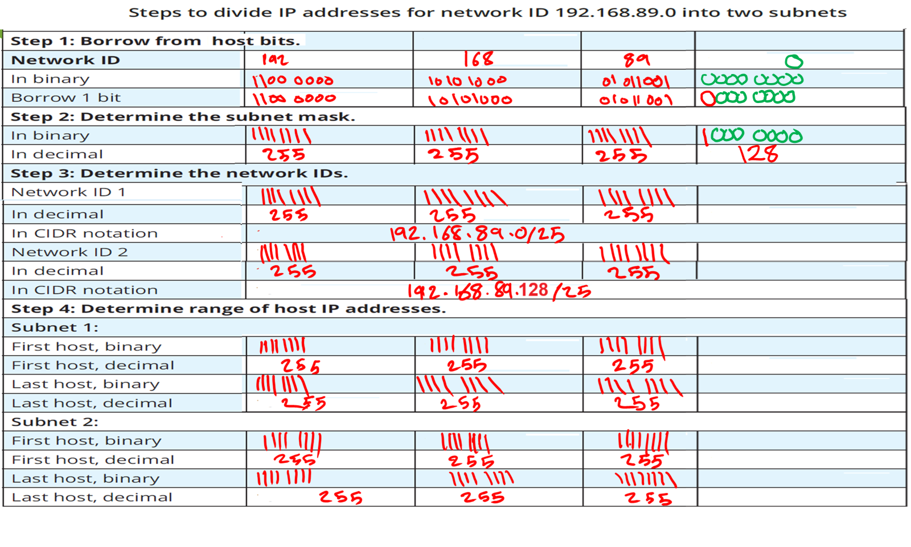


Slide 16
