Slide 1
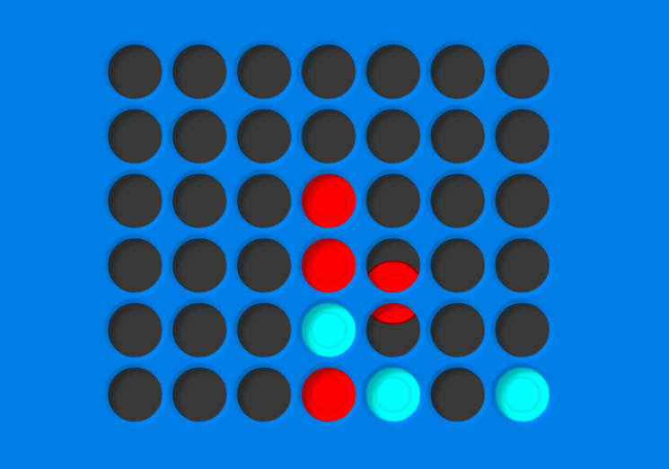
Connect 4 AI
Group 7 – 方治欣 曹松晖 任怡静

Slide 2
Proposal Introduction
Motivation
Algorithm
Optimization Approaches
Implementation plan & Current status of the project

Slide 3
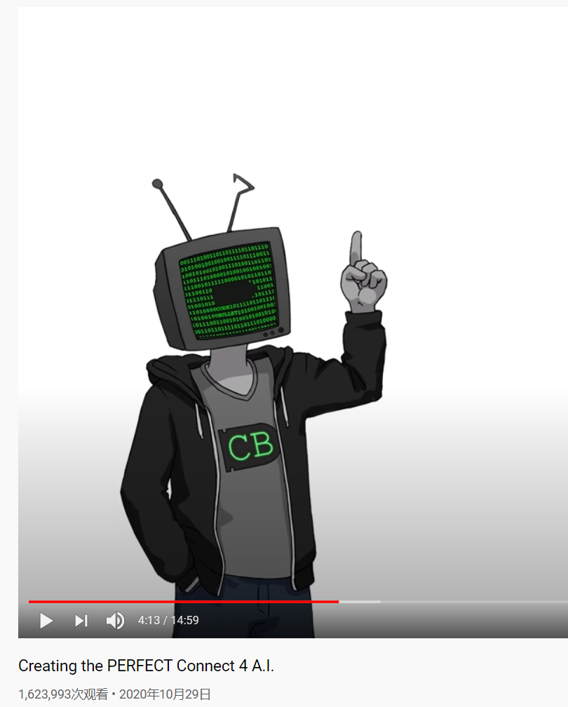
Motivation
Youtube Channel “Code Bullet” posted a Connect-4 Video
1.62M views, but for entertainment mainly
His AI eventually beat World 1st Connect-4 player in an online session

Slide 4

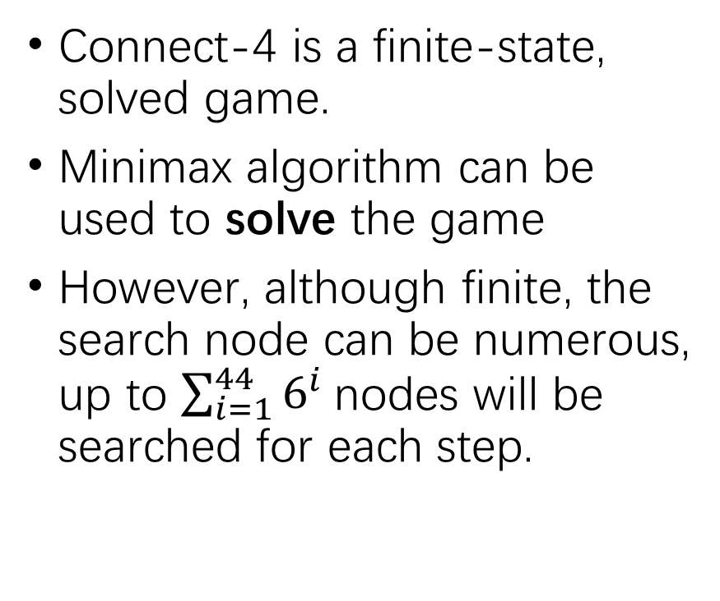
Algorithm
Connect-4 is a finite-state, solved game.
Minimax algorithm can be used to solve the game
However, although finite, the search node can be numerous, up to ${\sum_{i=1}^{44}{6^{i}}}^{ }$nodes will be searched for each step.

Slide 5
Optimization Approach
Alpha-beta Pruning
Transposition Table
Limit-depth Heuristic

Slide 6
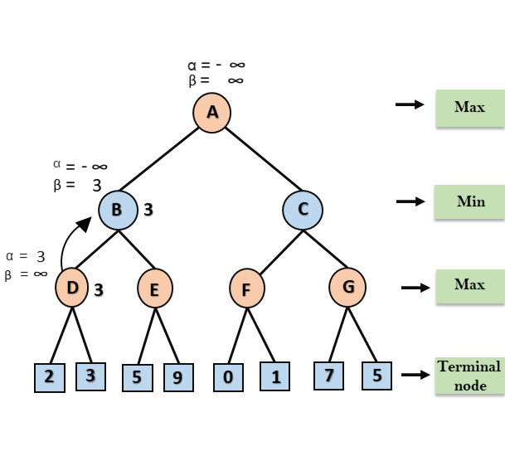
Alpha-beta Pruning
Remove unnecessary searches within the process
Covered in class
Main challenge: Depth of the search tree can be still pretty big even pruned.

Slide 7
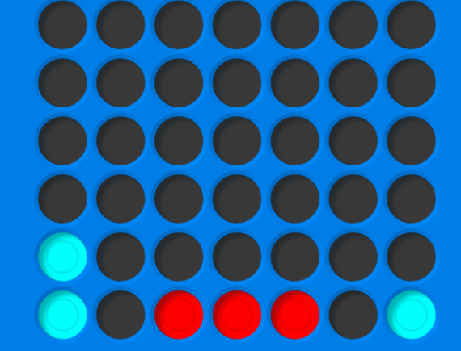
Transposition Table
The order of actions does not matter.
Hash the field(as a 42-digit number) to the dictionary
Once encounter a complete same state in the same search tree depth, all the remaining computation can be saved
2
1
2
3
1
3
=
3
1
3
2
1
2

Slide 8
Depth-Limit Heuristic
Even if we have the optimization, the computational cost is still very high for a real-time application
Solution: Apply depth limit, use heuristic to estimate non-terminal states’ value
Good for blue
Good for red

Slide 9
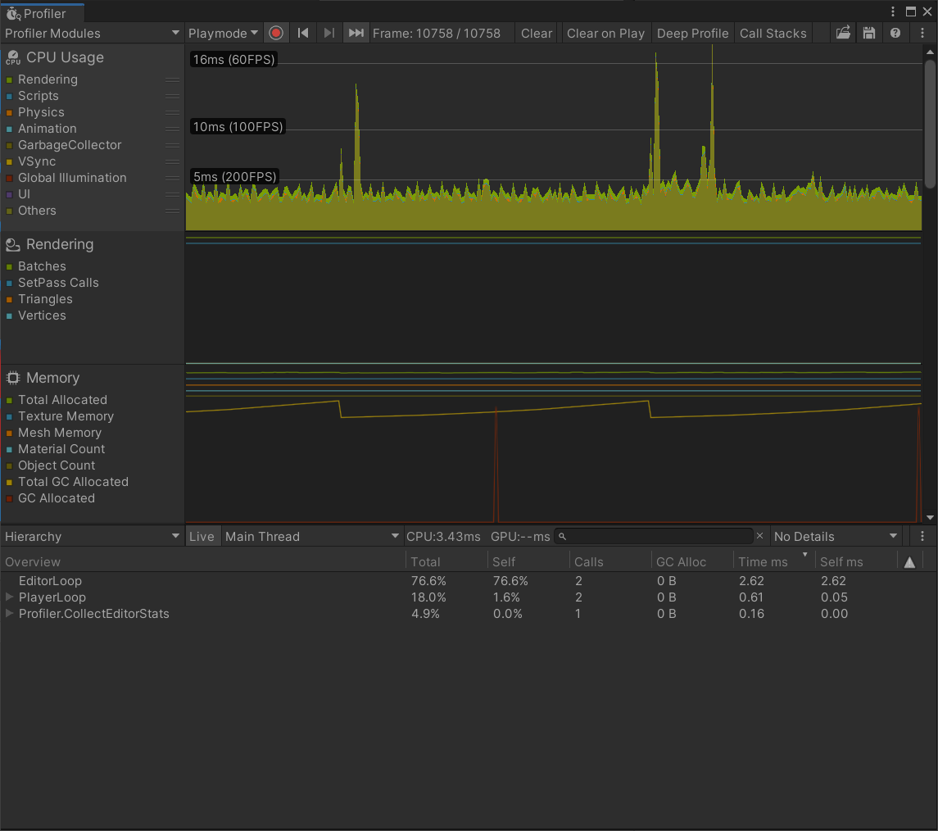
Implementation Plan
Base game programming and optimization is done
AI and Heuristic base class are ready to use
The game itself was made in unity, it uses Physic engine Raycasting to judge the game state, thus consuming little CPU computational power.
When no AI is involved, the game itself costs about 5% on an I7-6820HK laptop.

Slide 10
Status of the Project
Remaining Tasks:
Transposition Table: No effort, can be done using C# builtin Dictionary
Minimax
Alpha-Beta Pruning
Refinement Heuristic
Requirement:
An reliable AI which wins/draws most of the time against a human player
At most 500ms considering time each AI round

