Slide 1
Color sensor project
Suong Luong N01195561
Humber College

Slide 2
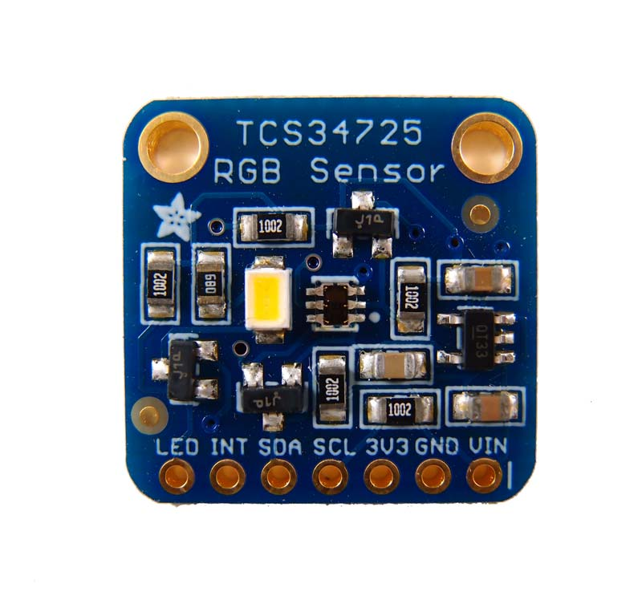
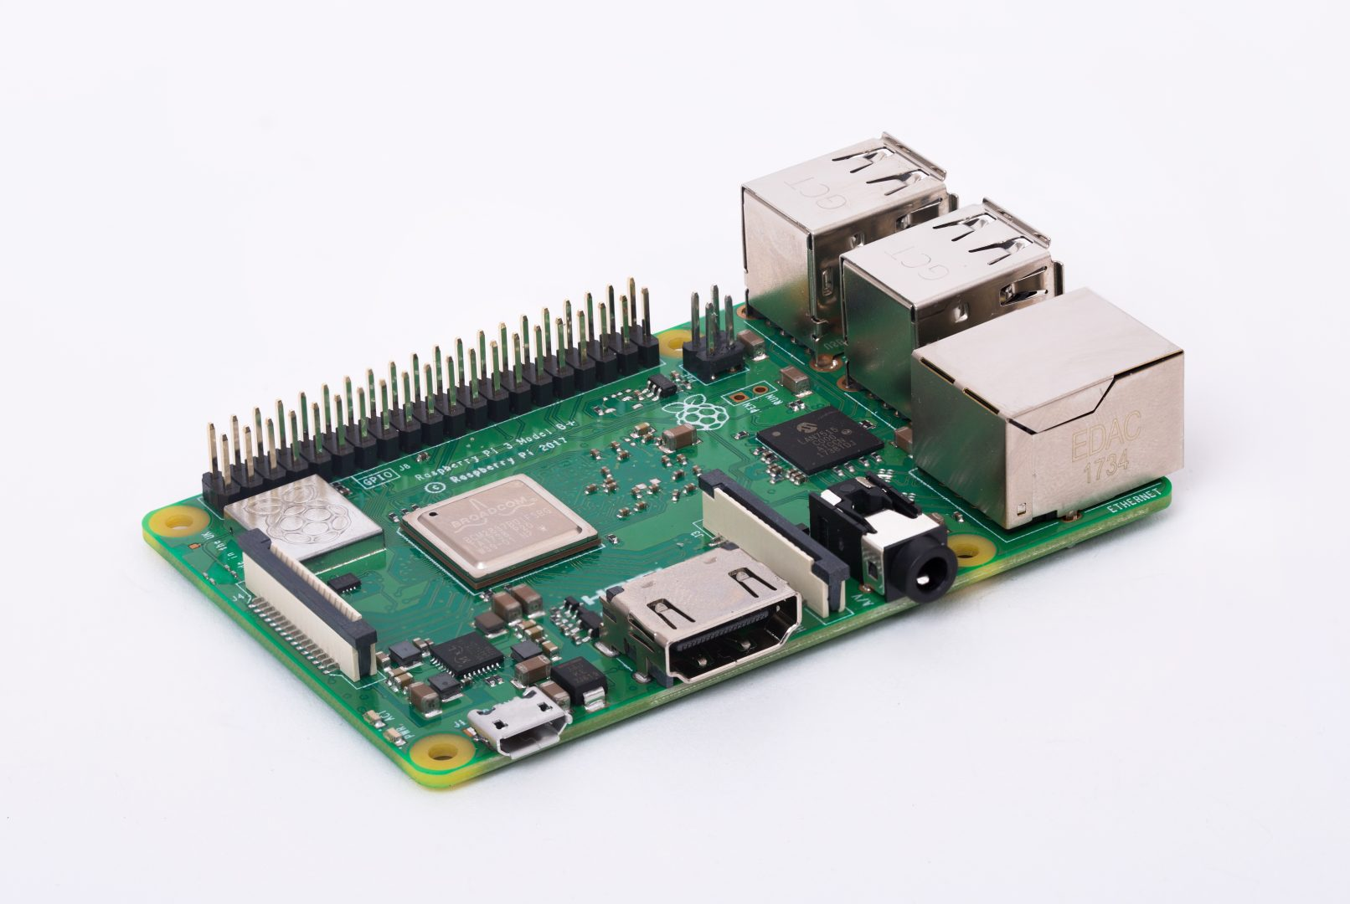
Introduction
TCS34725 color sensor (0x29) with
RGB and Clear light sensing elements
Raspberry Pi 3 B+
With this sensor, I will work with my partners to design a Portable
Color Detector device
Github link: https://github.com/SuongLuong/Portable-Color-Dectection-Device

Slide 3
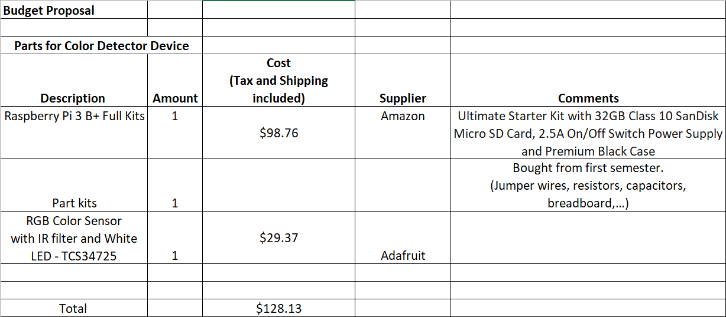
Budget

Slide 4
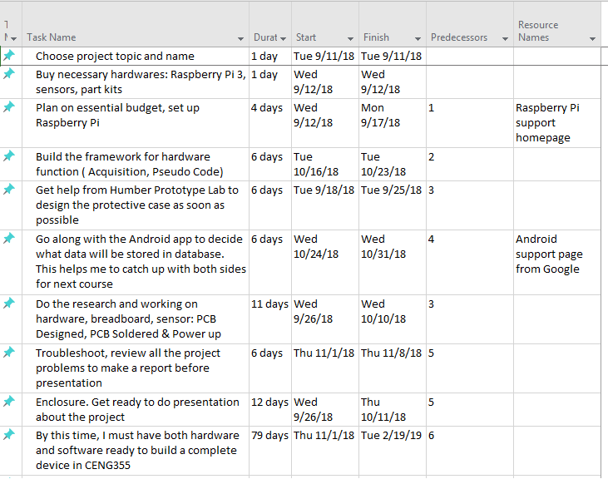
Schedule
For first 13 weeks: I learned how to order necessary parts and steps by steps connect them together: Circuit, PCB, Soldering, Enclosed case for hardware platform.
I need to complete Readme.md on Github to cover all the step I made for my Project.
Next semester: combine hardware and software application with my partners.

Slide 5
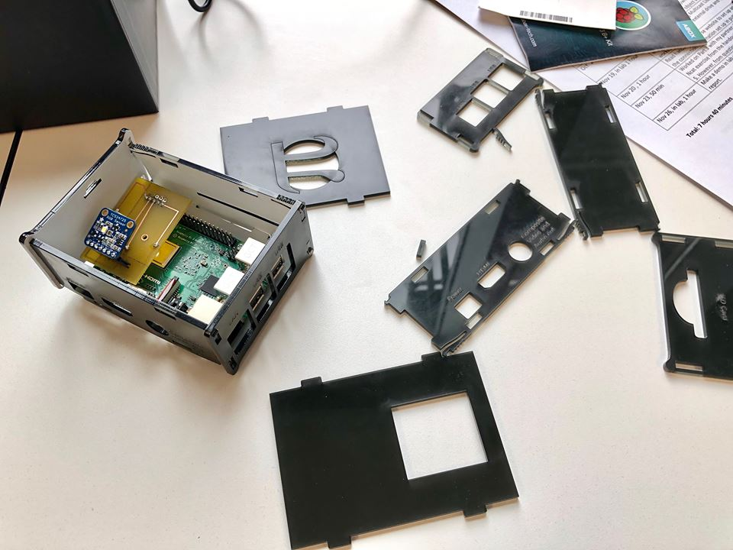
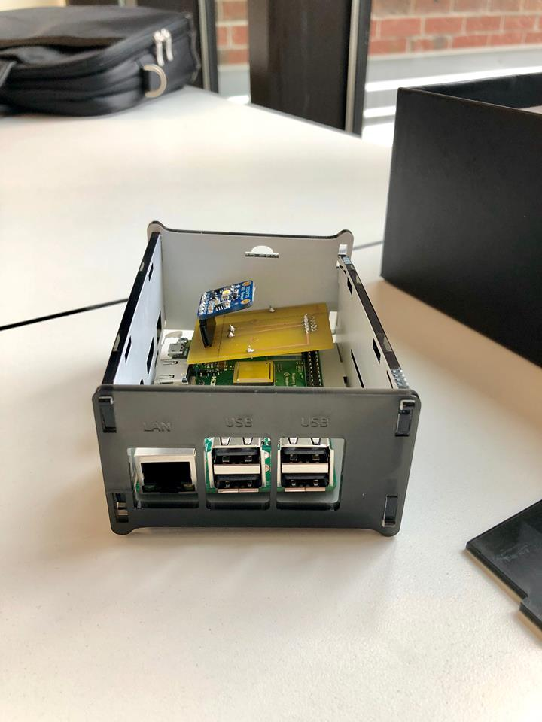
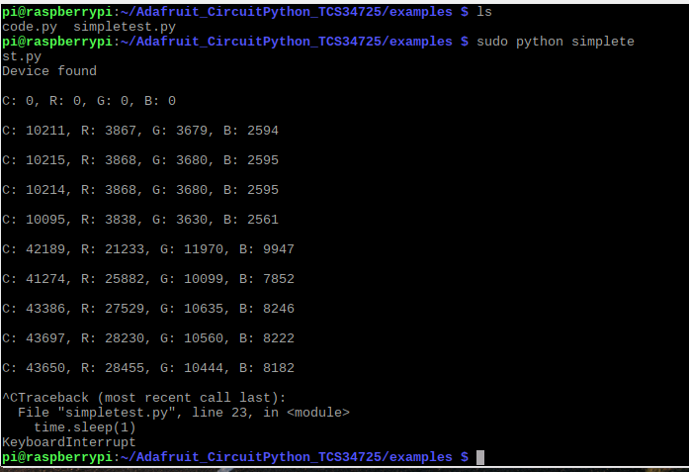
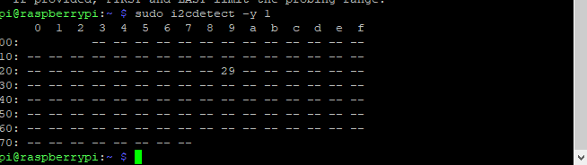
What I discover?
Image of enclosed hardware
screen capture of address
reading/writing to sensor/effector

Slide 6
Course knowledge utilized from previous courses
Technical Reading and Writing Skills: Writing status report for every activities and whole project.
Electric Circuits: Learning about circuit design and connection with Part Kits.
Embedded Systems & Micro Assembly Language Programming: Learning about Raspberry Pi and pseudo codes from previous project (Green House Controller, Microwave Oven,…).
Unix Internal: Learning about Unix and Linux System, how to transfer files between Windows and Linux.
Database with Java: Learning about storing data on server which related to Color data for this course and CENG319- Software Project

