Slide 3
pyco:bytes
exploring the magic of Python, week by week >>>

Slide 4
pyco:bytes
exploring the magic of Python, week by week
>>>

Slide 5
pyco:bytes

Slide 6
INTRODUCING
pyco:bytes
exploring the magic of Python, week by week
>>>

Slide 7
WELCOME TO
pyco:bytes
exploring the magic of Python, week by week
>>>

Slide 8
class Pycobyte[Fun]:
__slots__ = ["_days"]
async def __aiter__(self, /, *, flavour: Fun = "Welcome to pycobytes!") -> Fun[Fun]:
'''You’ve never seen Python like this~'''
for i, day in enumerate(self._days):
yield (await post(i) async for post in self.start(day))
Looks scary, right? Don’t worry, we’ll be delving into all this deliciousness ;D

Slide 9
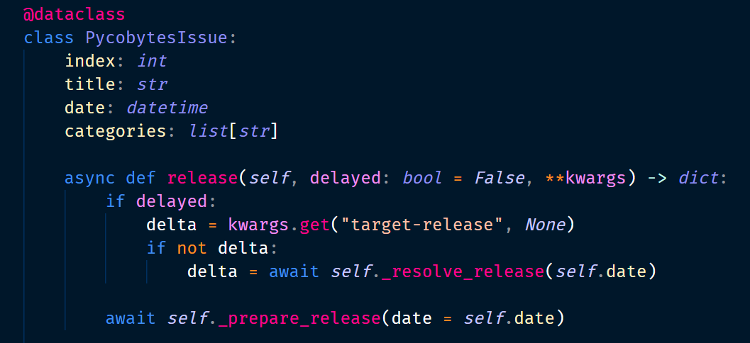

Slide 10
for x in numbers:
result.append(x ** 2)

