Slide 3
pyco:bytes
exploring the magic of Python, week by week >>>

Slide 4
pyco:bytes
exploring the magic of Python, week by week
>>>

Slide 5
pyco:bytes

Slide 6
INTRODUCING
pyco:bytes
exploring the magic of Python, week by week
>>>

Slide 7
WELCOME TO
pyco:bytes
exploring the magic of Python, week by week
>>>

Slide 8
class Pycobyte[Fun]:
__slots__ = ["_days"]
async def __aiter__(self, /, *, flavour: Fun = "Welcome to pycobytes!") -> Fun[Fun]:
'''You’ve never seen Python like this~'''
for i, day in enumerate(self._days):
yield (await post(i) async for post in self.start(day))
Looks scary, right? Don’t worry, we’ll be delving into all this deliciousness ;D

Slide 9
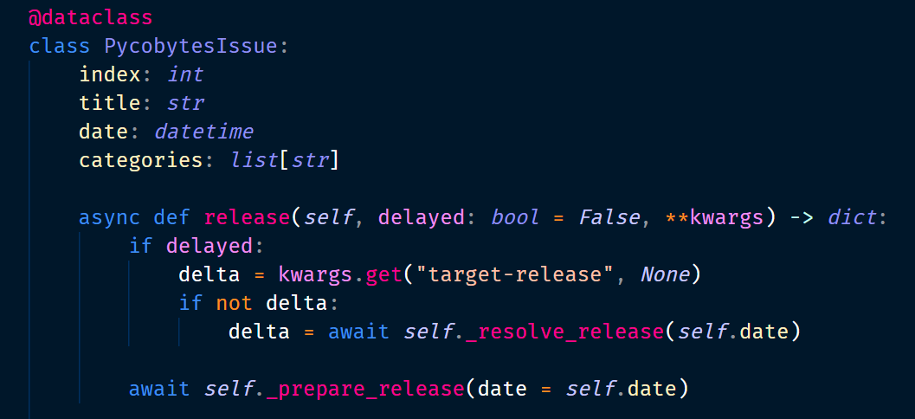

Slide 10
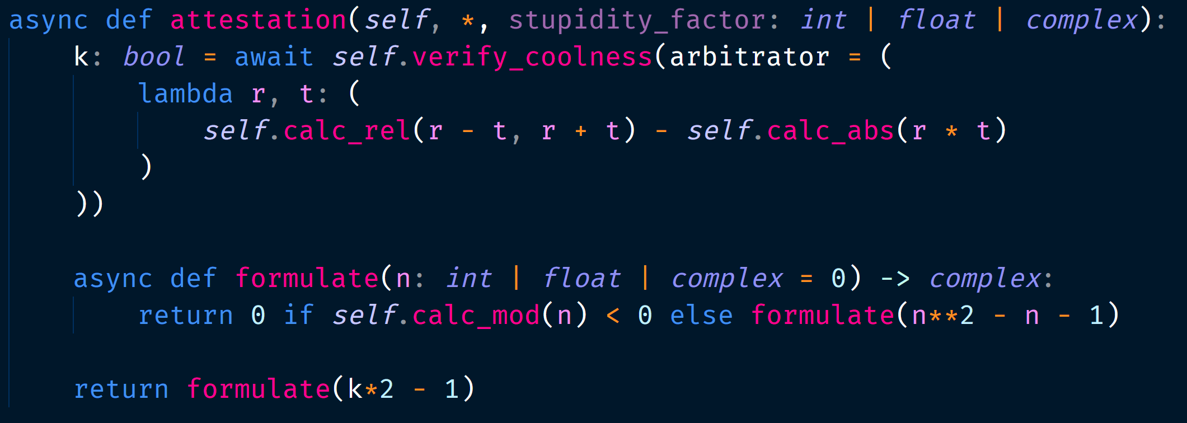

Slide 11
for x in numbers:
result.append(x ** 2)

Slide 12
if "truthy":
sup = 2.0
else:
sup = None

Slide 13
left if condition else right
returned if condition is falsy
returned if condition is truthy

Slide 14
1 if c else 2 if p else 3
conditional nested inside conditional!

Slide 15
x or y
x or y
x is truthy, so the whole
expression is truthy
what y is makes no difference!

Slide 16
x or y
x or y
if y is truthy, the whole
expression is truthy
if y is falsy, the whole
expression is falsy

Slide 17
x and y
if either expression is falsy,
the whole expression is falsy
x and y

Slide 18
0
1
2
3
4
[▯, ▯, ▯, ▯, ▯]
-5
-4
-3
-2
-1
← count backwards

Slide 19
iterable 1
iterable 2
zipped
a
b
c
d
e
p
q
r
s
t
(a, p)
(b, q)
(c, r)
(d, s)
(e, t)

Slide 20
{ key: value for each in iterable }
{ key1: value1
key2: value2
key3: value3 }
[ each1,
each2,
each3 ]

Slide 21
x = 🥕 🫧
y = 🫧 🥕

Slide 22
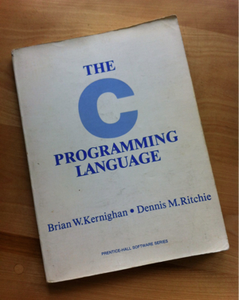
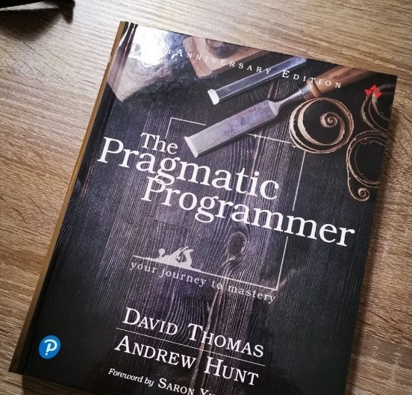
1
3
2

Slide 23
info = ["Stralian", 21, "Haven"]
*info = "Stralian", 21, "Haven"
create_student( "Stralian", 21, "Haven" )
NAME
AGE
HOUSE

Slide 24
config = {"data": False, "sanitise": True}
**config = "data" = False, "sanitise" = True
check( data = False, sanitise = True )

Slide 25
def decorate(func):
print("decorating")
func()
print("decorated")
def decorate(func):
def inner():
print("decorating")
func()
print("decorated")
return inner
returning a function
instead of executing

