Slide 1
OCC Task 1 Activity B

Slide 2

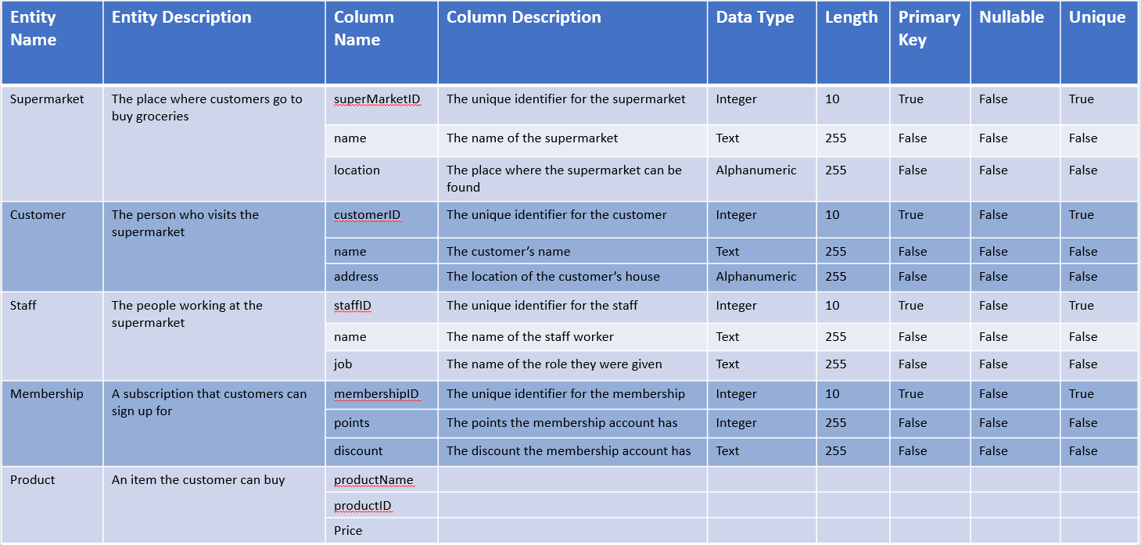
Data Dictionary Example

Slide 3
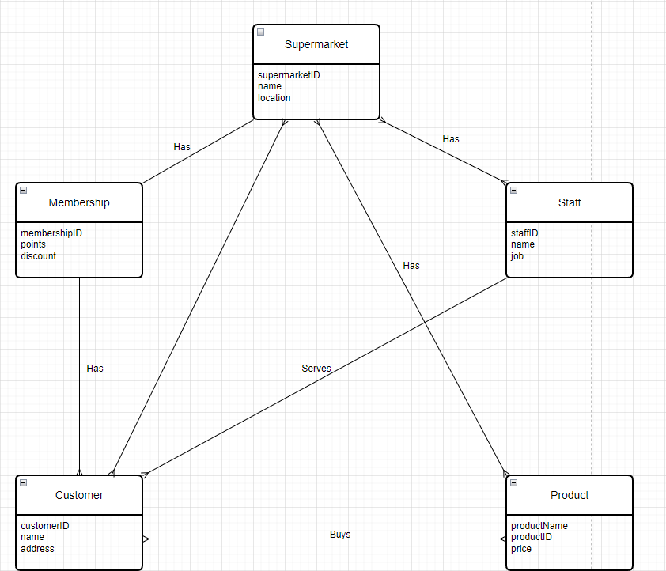
Entity Relationship Diagram Example

Slide 4
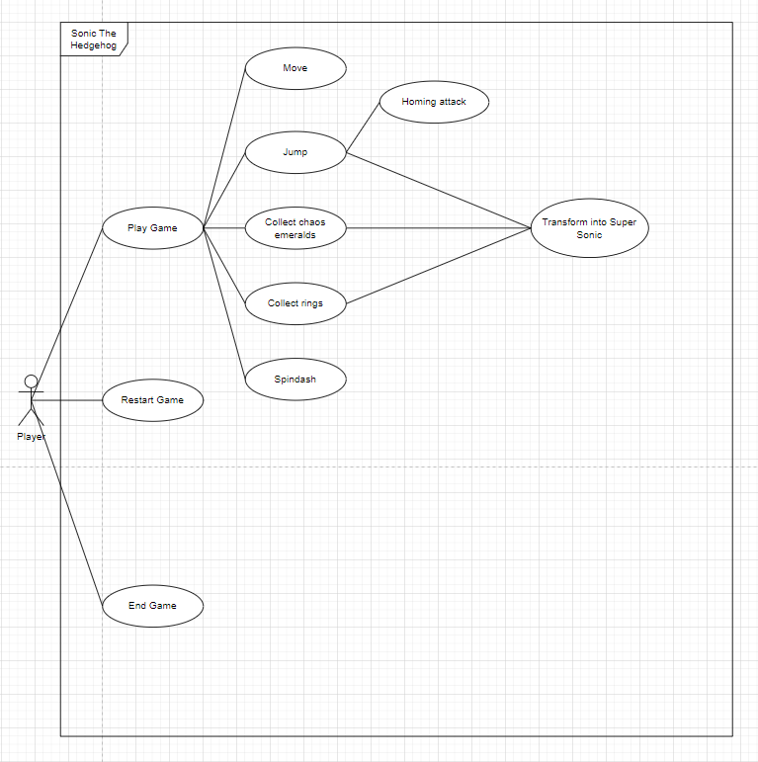
Use Case Diagram Example

Slide 5
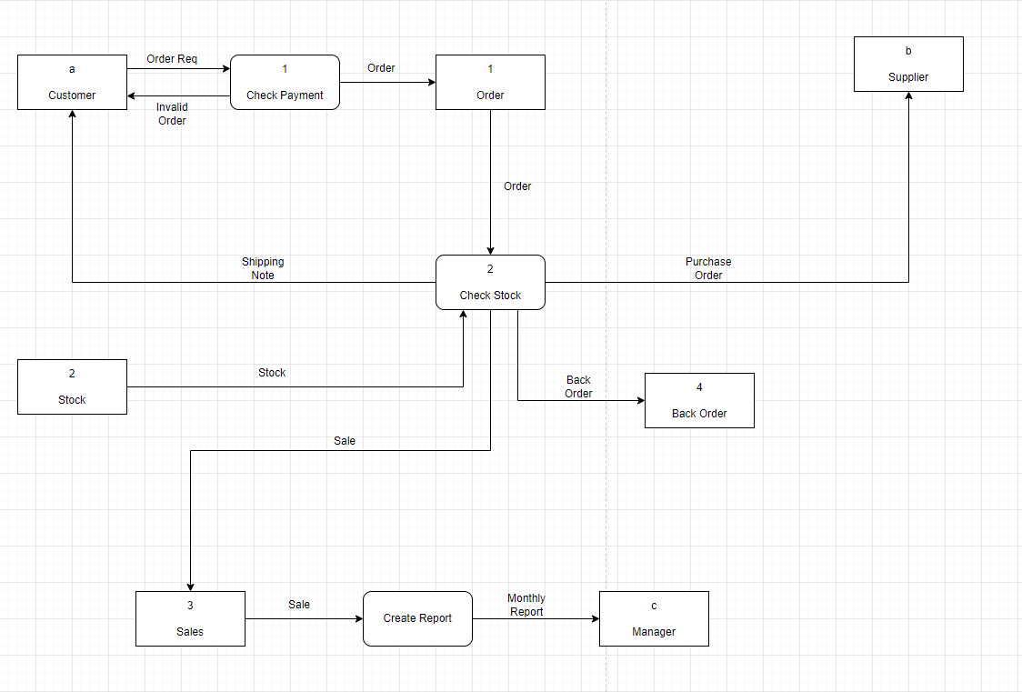
Data Flow Diagram Example

Slide 6
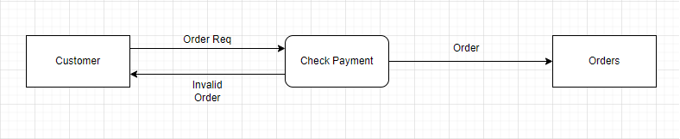
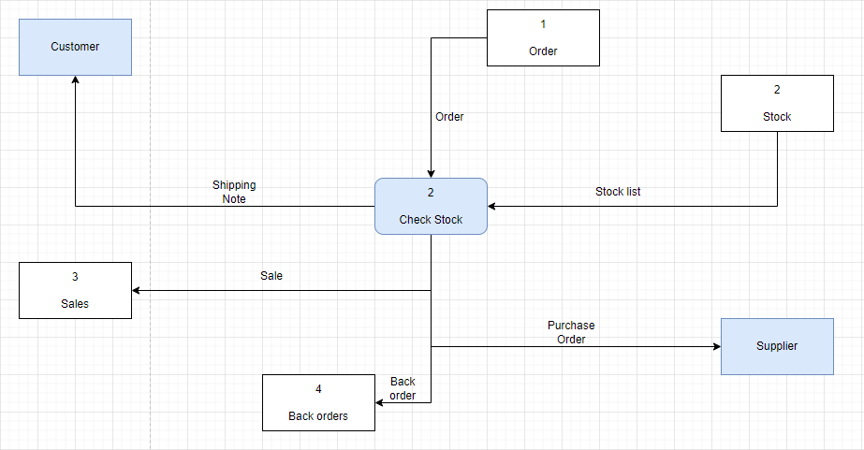
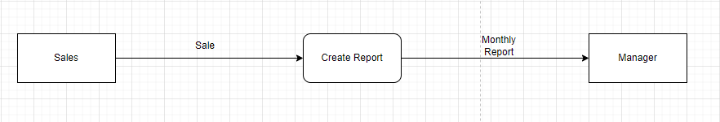
Breakdown of DFD

Slide 7
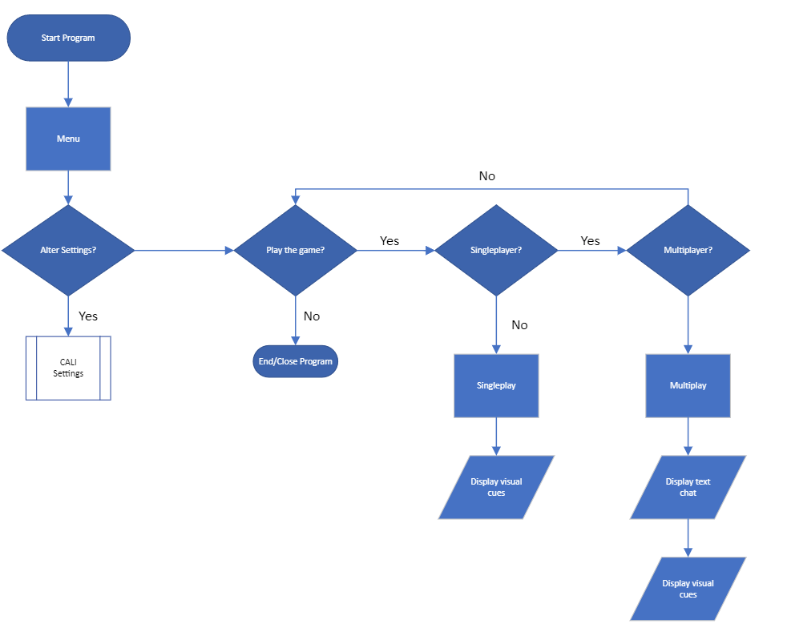
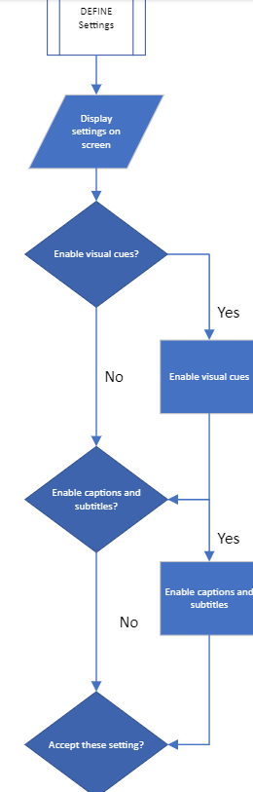
Flow Diagrams

Slide 8
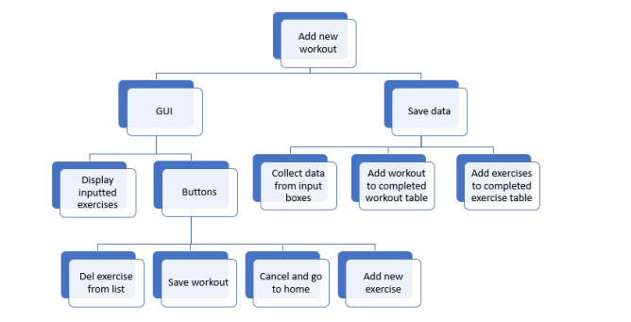
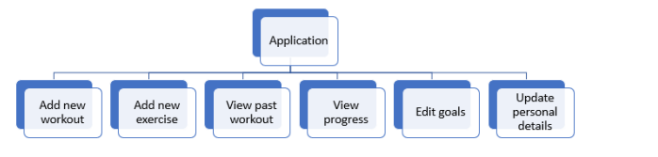
Other things:

Slide 9
Additional Notes:
Explain everything in detail
Detail
Detail
TOO MUCH DETAIL

