Slide 1

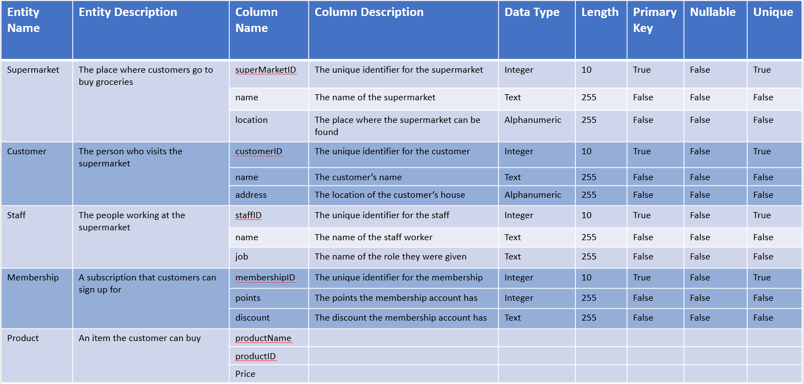
Data Dictionary Example

Slide 2
Data Dictionary Entities
Users | UserID, Name, CardDetails
Account | AccountID, Username, Password
Booking | BookingID, StartDate, EndDate, RoomID (FK)
Tickets | TicketID, StartTime, EndTime
Animals | Animal
Rooms
Facilities
Users
Account
Booking
Tickets
Animals
Rooms
Facilities

Slide 3
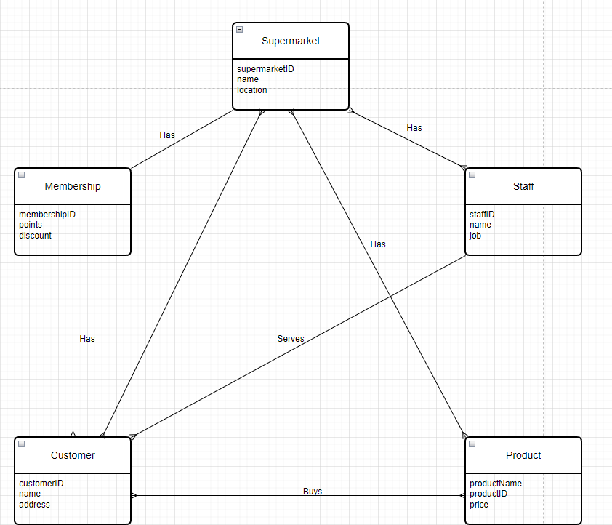
Entity Relationship Diagram Example

Slide 4
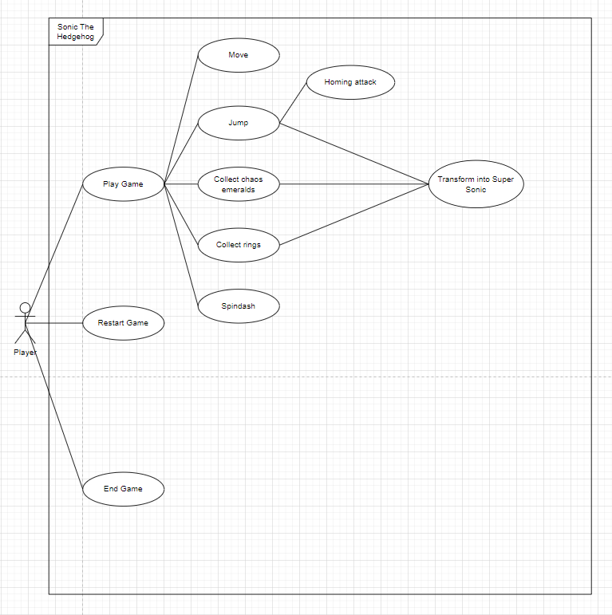
Use Case Diagram Example

Slide 5
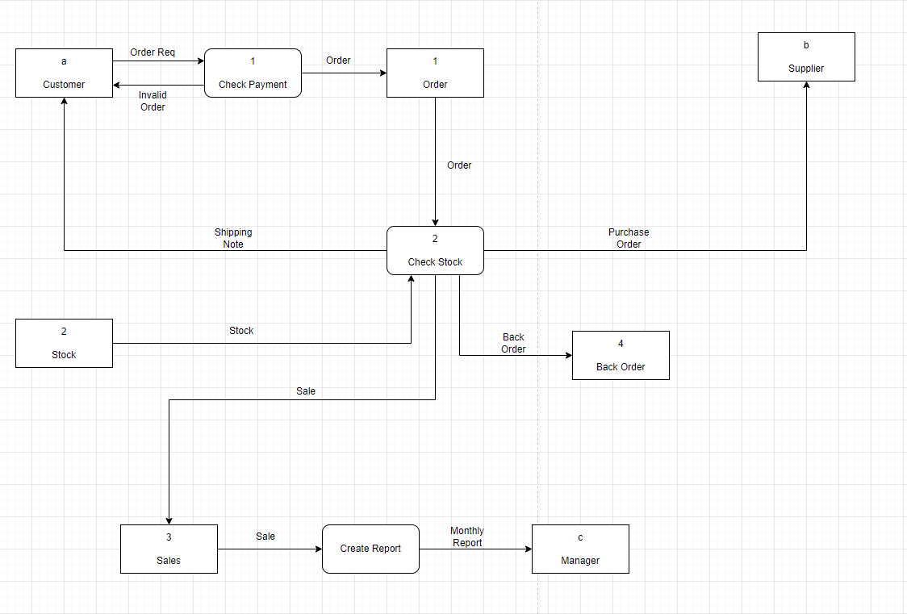
Data Flow Diagram Example

Slide 6
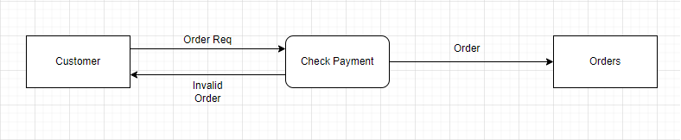
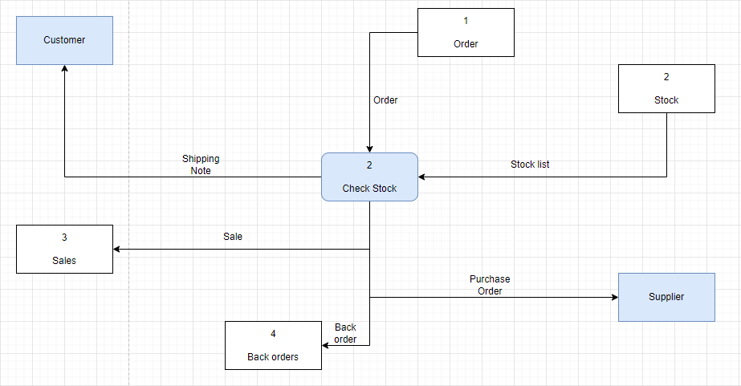
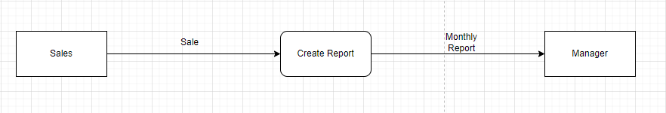
Breakdown of DFD

Slide 7
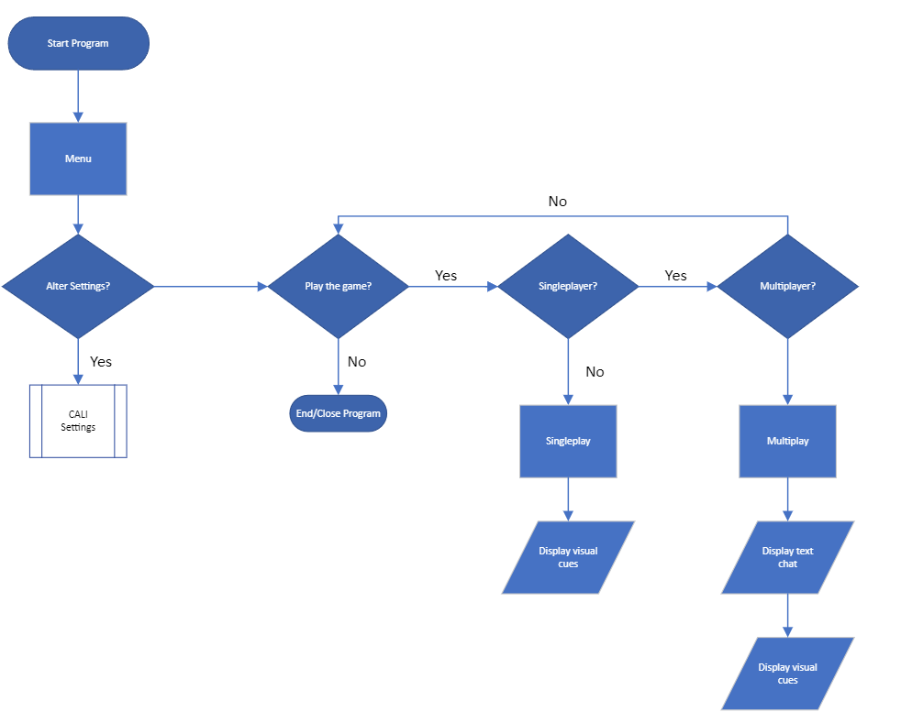
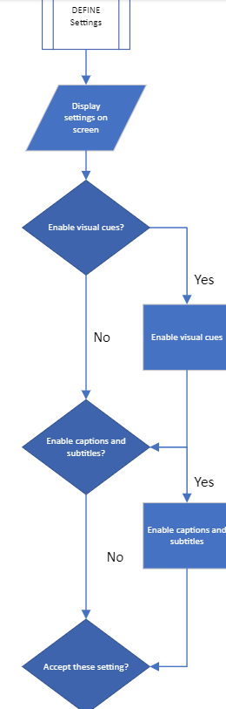
Flow Charts

Slide 8
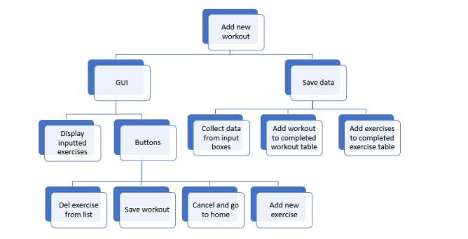
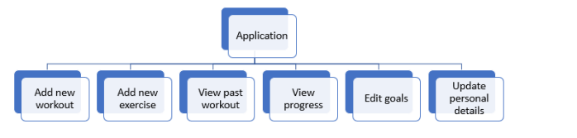
Hierarchies:

Slide 9
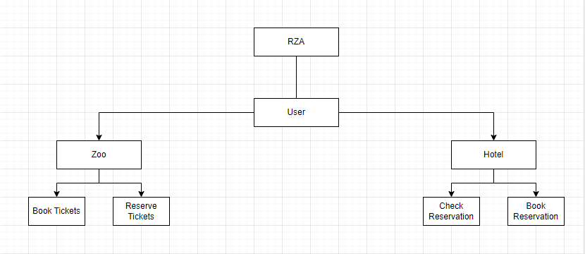
Self-Created Hierarchy:

Slide 10
Additional Notes:
Explain everything in detail
Detail
Detail
TOO MUCH DETAIL

