Slide 1
Voice Recognition and Pokémon™
By Supratik Chanda and Chris Higgs

Slide 6
Pokémon™ Introduction & Dataset
Elemental Type Parallels Biological Taxonomy
Predict Elemental Type from Measurements and Observations
“The Complete Pokemon Dataset” – Kaggle
“Pokemon for Data Mining and Machine Learning” – Kaggle
Stats for 721 Species
Merging Stat Values
Boolean Classification Attributes (28 New)

Slide 7
Pokémon™ Analysis Technique
Custom Taxonomy Matrices
Logistic Regression (OVR-like Approach)
SVM (Linear, Polynomial, and RBF Kerneling)
Comparing Stat Subsets’ Predictiveness

Slide 8
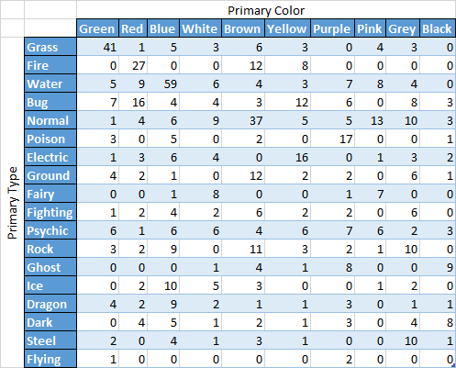
Pokémon™ Results
Green >>> Grass;
Black -> Ghost, Dark
What Does “Type” Really Mean?
Dragon Vs. Flying (Subset?)
Ground Vs Rock (Equivalence?)

Slide 9
Pokémon™ Results Cont.
Logistic Regression (OVR-like)
Typical Stats, Atypical Stats, & Color: Extremely Poor
Ag_* Stats: Average F1 = 0.842 (Secondary Types, Intra-type Correlations)
SVM (Linear & Polynomial) - Most: Non-Convergent
SVM (RBF, gamma=0.1 best)
Typical Stats: Average F1 = 0.99 (Clustering Equivalent?)
Color: Average F1 = 0.32 (Surprisingly Poor)
Ag_* Stats: Average F1 = 0.95 (Clustering?)

Slide 10
Questions?

