Slide 1
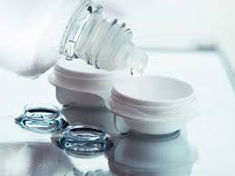
Physical Properties of Commercially Available Soft Contact Lens Care Solutions in Ghana; a study of osmolality
ANTHONY ARMAH
PS/OPT/16/0008

Slide 2
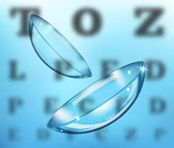
Introduction
Soft contact lenses and their care system are most patronized in Ghana.
66.7% of soft contact lens wearers in Ghana experience discomfort. Ilechie et al (2021).
Control of Contact lens discomfort – a new initiative by TFOS.
Surface Tension refers to the difference in surface energies between solvent molecules and polymer membrane surface.
Notes:
Rigid lens wearers make up the remainder of contact lens wear. Silicone hydrogels are rarely used in Ghana. The control of contact lens discomfort during contact lens wear is a new initiative launched by TFOS
One of the key priorities for control is assessing the physical properties of contact lens solutions.
In a liquid in contact with a gas one can distinguish between two types of molecules. The first one corresponds to the inner liquid molecules which are completely surrounded by other liquid molecules. In this case the cohesive forces among the inner molecule and the neighbors are balanced. The second case corresponds to the surface molecules, thus, the ones located in the boundary between the liquid and the gas. In this case the surface molecule is not completely surrounded by other like neighboring molecules, so it coheres more strongly with those found at the interface between the liquid and the gas, so each surface molecule is attracted by the inner molecules towards the center of the liquid. Therefore, the outer surface of the liquid stays under tension, thus behaving like an elastic thin film

Slide 3

Introduction
Previous studies have shown that surface tension of contact lens solutions play a role in patient comfort.
Higher surface tension values were associated with greater levels of discomfort (Dalton, et al., 2008; Jones, et al., 2013).
So, assessing surface tension of contact lens solutions is one of the key priorities for control by TFOS.

Slide 4
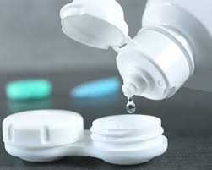
Statement of Problem
Many multipurpose solutions are used in care of contact lenses in Ghana.
Physical properties of these solutions influence both patient comfort and preference for one system over another.
To our knowledge, no published studies have been conducted to investigate the solution surface tension of contact lens care solution in Ghana.
Notes:
Many contact lens care solutions are used in Ghana and these include, OptiFree Replenish, Avizor All Clean, Freshlook, Trufresh, Refresh solution . It is possible that the physical properties of these solutions influence patient’s comfort.

Slide 5
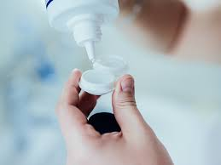
Purpose
To investigate the surface tension of commercially available contact lens solutions in Ghana.

Slide 6
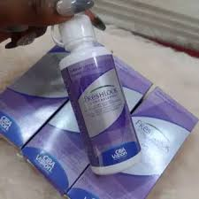
Research Questions
What is the average surface tension value of the various commercially available contact lens solutions in Ghana?
Does the surface tension value vary widely among the commercially available contact lens solutions in Ghana?
Which commercially available solutions used in Ghana have surface tension value that falls within the reported tolerable range for the ocular surface?

Slide 7

Significance of Study
A good in-depth understanding of the physical properties of contact lens care solutions available in Ghana is required for practitioners to use them to their fullest advantage.
Results of this study will serve as baseline for future studies on contact lens solutions.

Slide 8
Delimitations
The soft contact lens care solutions investigated in this study are those readily available in the market at the time of the research.
The instrument used for measuring surface tension is Tensiometer.

Slide 9
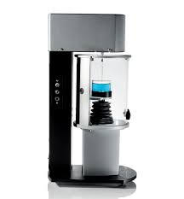
Limitations
The brand of tensiometer used for surface tension measurement is the Attention Sigma 701 tensiometer which works only under atmospheric pressure.
The probe of the instrument is very fragile and can easily be damaged.
However, pretest study indicates that the results of Attention Sigma 701 tensiometer are valid (accurate) and reliable (consistent).
Notes:
The validity test using water showed that the instrument was accurate. The repeatability test showed that Cronbach alpha was 0.87

Slide 10
Methods
Study area
The Petroleum Engineering, Fluid Mechanics Lab at KNUST
Instrument
Opti-Free Replenish, Avizor All Clean, Freshlook, Trufresh, and Refresh solution.
Sigma Tensiometer (One Attension Software).
Small Vessel
Du Noüy ring (probe)

Slide 11
Methods
Procedure
The surface tension measurement was performed using the Sigma Tensiometer.
The probe was hanged on the hook.
Small vessel containing the solution (distilled water) was placed on the stage.
One Attension software was opened on a laptop connected to the tensiometer.
Finally, the program was ran to start the measurement of the surface tension of the solution (distilled water).
Notes:
The Du Noüy ring was placed on the hook in the measuring chamber.
The measurement chamber was opened; the stage was lowered and the small vessel containing the solution (distilled water) was placed on the stage after which it was raised again for the Du Noüy ring to hang just above the surface of the solution.
The measurement chamber was closed and the One Attension software was opened on a laptop connected to the tensiometer.
On the One Attension software, surface tension was selected, the probe selected was with ring, the experiment name was typed, the vessel used in the tensiometer which was the small vessel was selected and the phase was selected for the surface tension experiment.
Finally, the program was ran to start the measurement of the surface tension of the solution (distilled water).

Slide 12
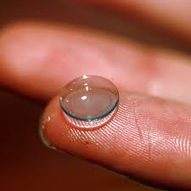
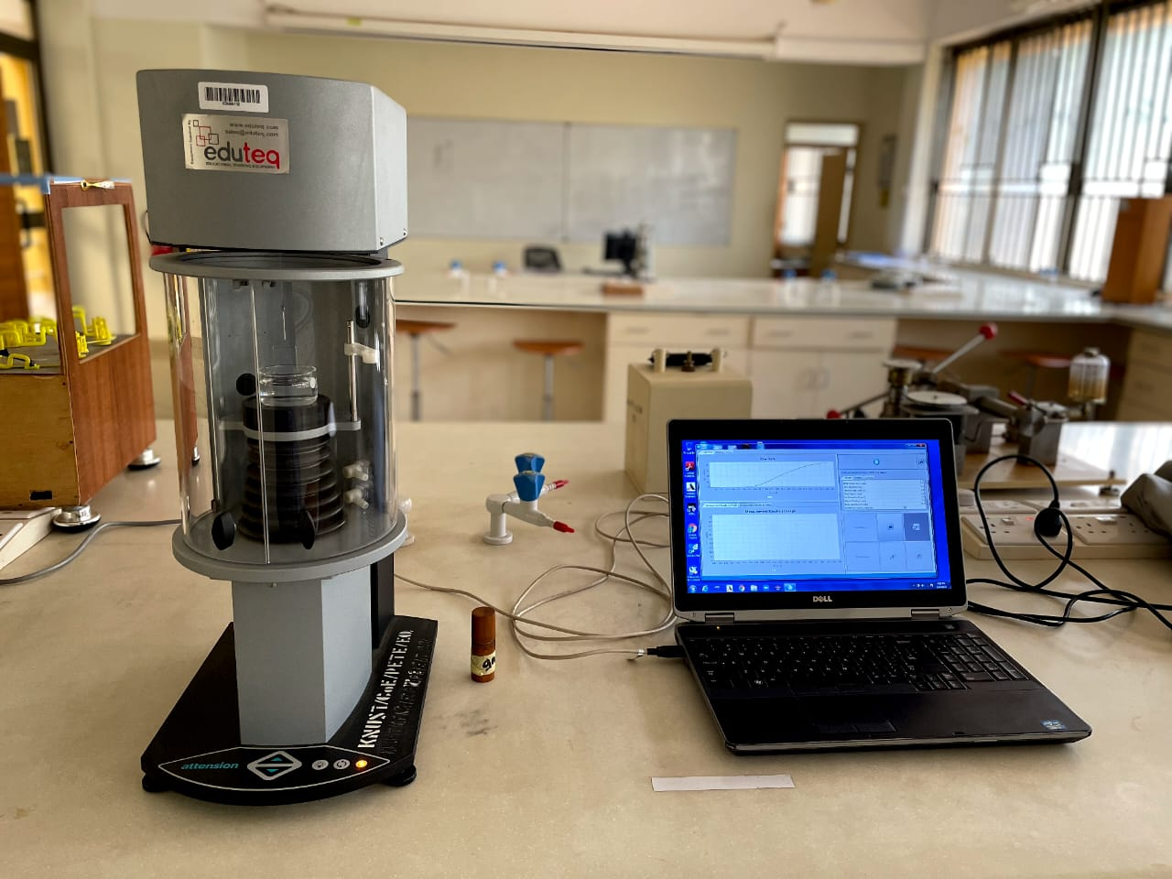
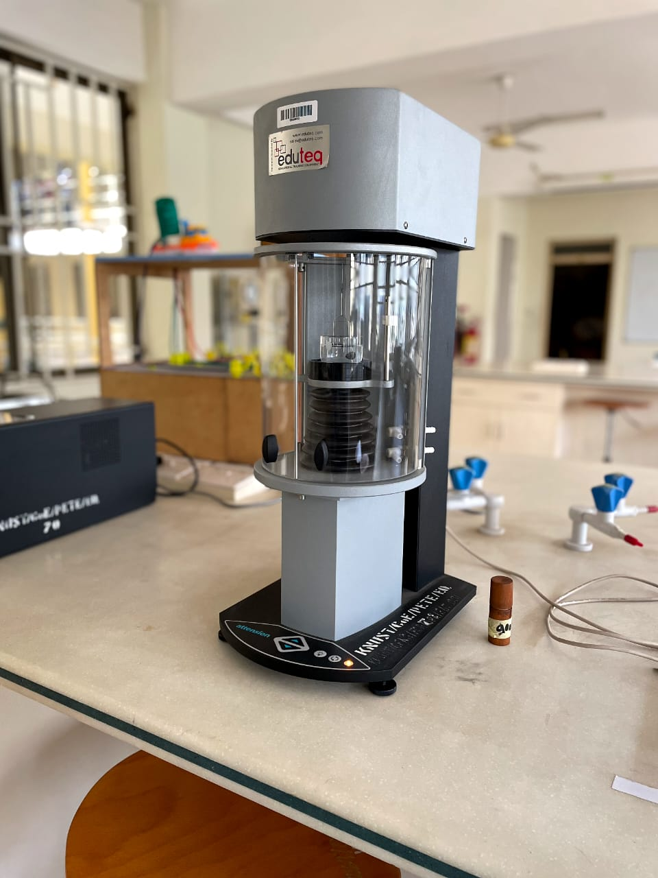
Methods
Sigma 700/701 Tensiometer with One Attension Software on a Laptop

Slide 13

Data Analyses
RQ 1: What is the average surface tension value of the various commercially available contact lens solutions in Ghana?
Descriptive statistics, means (± SD)
RQ 2: Does the surface tension value vary widely among the commercially available contact lens solutions in Ghana?
One way ANOVA to analyze significant differences (p<0.05) of surface tension values between individual solutions
Post hoc Tukey test to determine where there are significant differences (p<0.05) between individual solutions.
RQ 3: Which of the commercially available solutions have surface tension value that falls within the reported tolerable range for the ocular surface?
Compare surface tension of individual solutions to the standard (29-40mN/m)

Slide 14
Budget
Items | Price (GHȻ)
Solutions | 350.00
Tests Procedure | 600.00
Transportation | 350.00
Total | 1,300.00

Slide 15
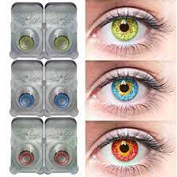
References
Ilechie, A. A., Danquah, D., Ntodie, M., Andoh, E., Addo, N. A., Odoi, D., . . . Assiamah, F. (2021). Contact Lens– and Patient-related Factors Associated with Contact Lens Discomfort among Contact Lens Wearers in an African Cohort. Optom Vis Sci, 00, 00-00.
Jones, L., Brennan, N. A., Gonz´alez-M´eijome, J., Lally, J., Maldonado-Codina, C., Schmidt, T. A., . . . Nichols, J. J. (2013). The TFOS International Workshop on Contact Lens Discomfort: Report of the Contact Lens Materials, Design, and Care Subcommittee. Invest Ophthalmol Vis Sci, 54(11), TFOS37–TFOS70.
Dalton, K., Lakshman, N. S., Ronan, R., & Lyndon, J. (2008). Physical Properties of Soft Contact Lens Solutions. Optometry and Vision Science, 85(2), 122-128.
Pandit, J. C., Nagyova, B., Bron, A. J., & Tiffany, J. M. (1999). Physical properties of stimulated and unstimulated tears. Exp Eye Res, 68, 247-53.
Ginn, M. E., Noyees, C. M., & Jungermann, E. (1968). The contact angle of water on viable human skin. J Colloid Interface Sci, 26, 146-151.

Slide 16
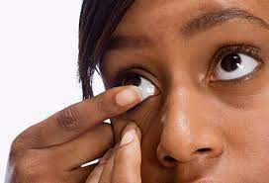
THANK YOU!

