Slide 1


Test Automation Framework– Sauce Demo
Labahang Limbu
Kenny Harvey
David Joyce
Dylan Cole

Slide 2

Agenda
Project Goals
Demonstration of test framework
Living Doc results
Issues reported
Read Me

Slide 3
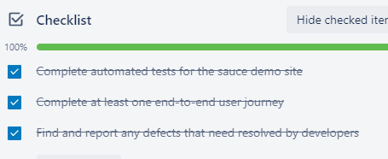
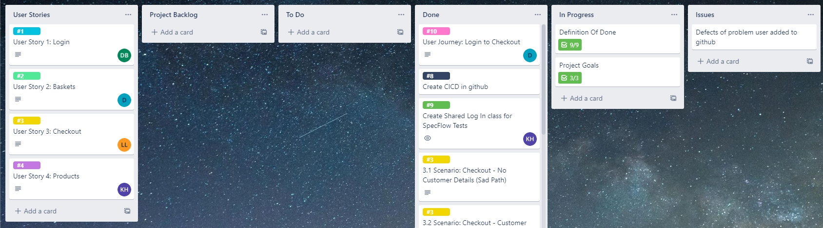
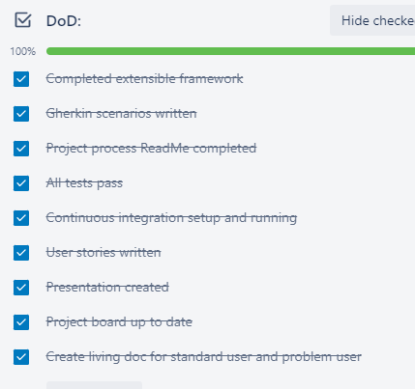
Project Goals
Complete automated tests for the sauce demo site
Complete at least one end-to-end user journey
Find and report any defects that need resolved by developers

Slide 4
Demonstration

Slide 5
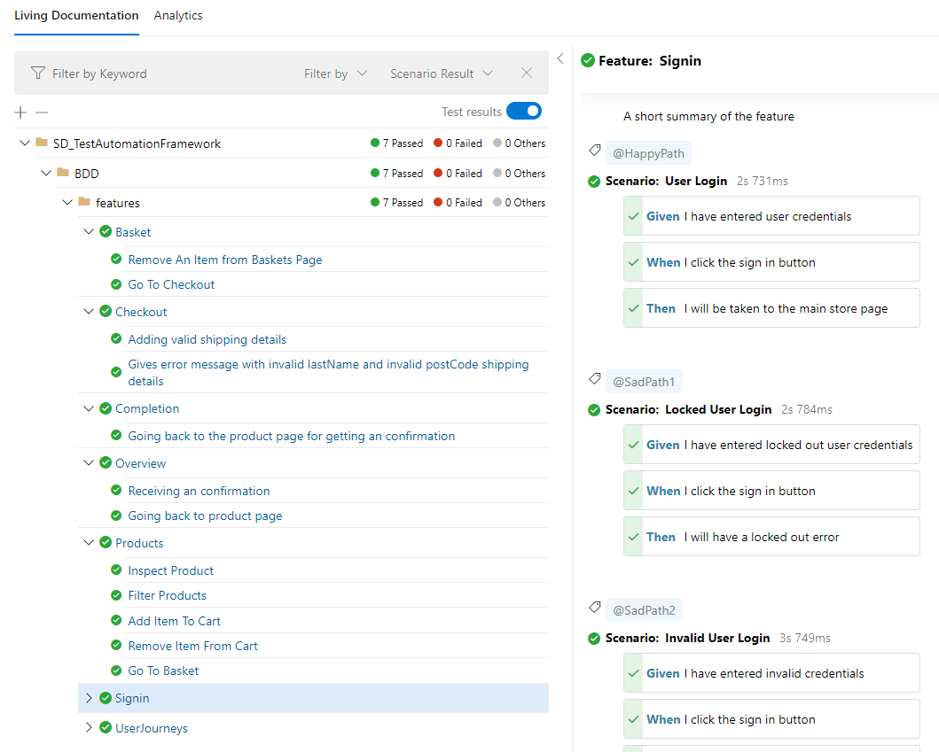
Living Docs

Slide 6
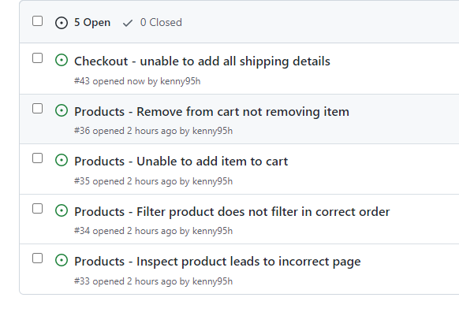
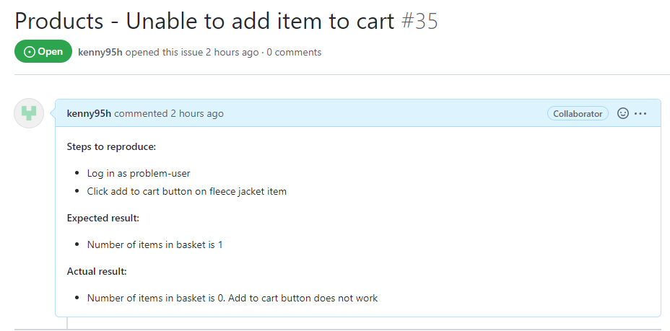
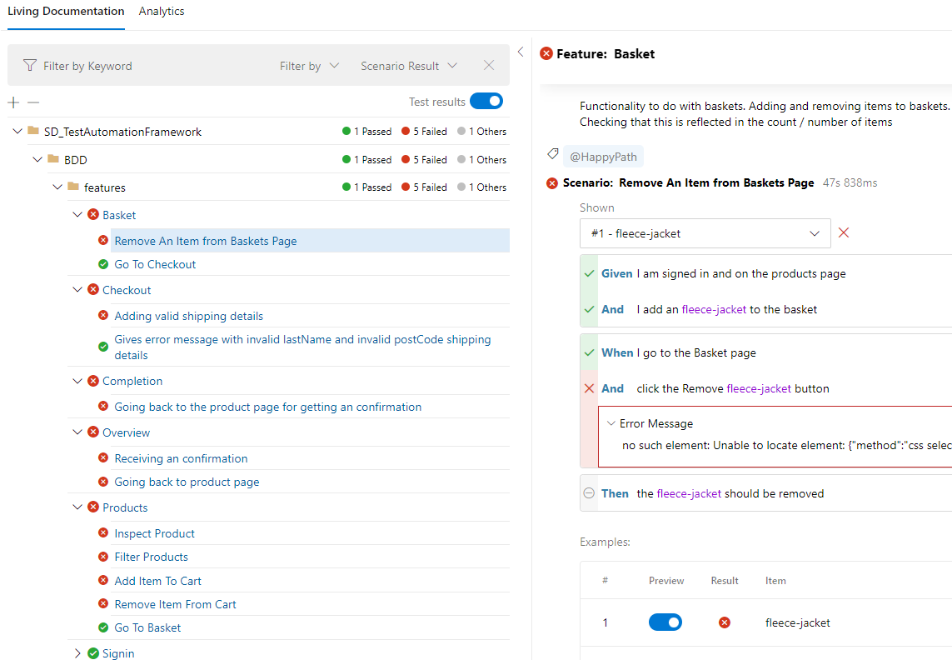
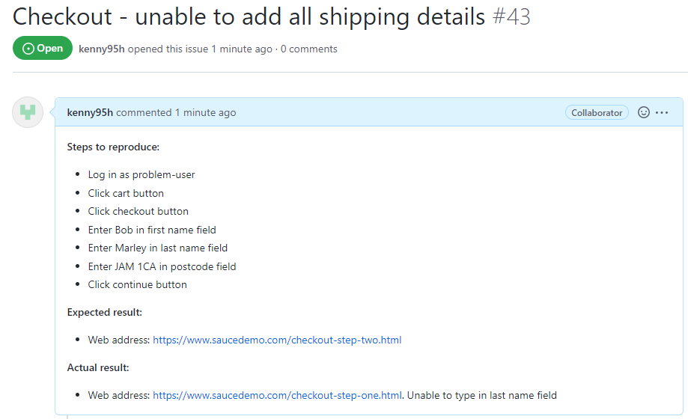
Issues

Slide 7
Read Me

Slide 8
Any Questions?
Thanks for listening

