Slide 1
CAI2100C | MACHINE LEARNING FOUNDATIONS
Assignment 9 | Learning to Navigate Safely
I use Q-Learning to find verified shortest routes on the official Cliff map.
I trained an agent rather than drawing a predefined route.
Juan Luna Santibanez | Miami Dade College
Juan Luna Santibanez | Professor Beth Muturi

Slide 2
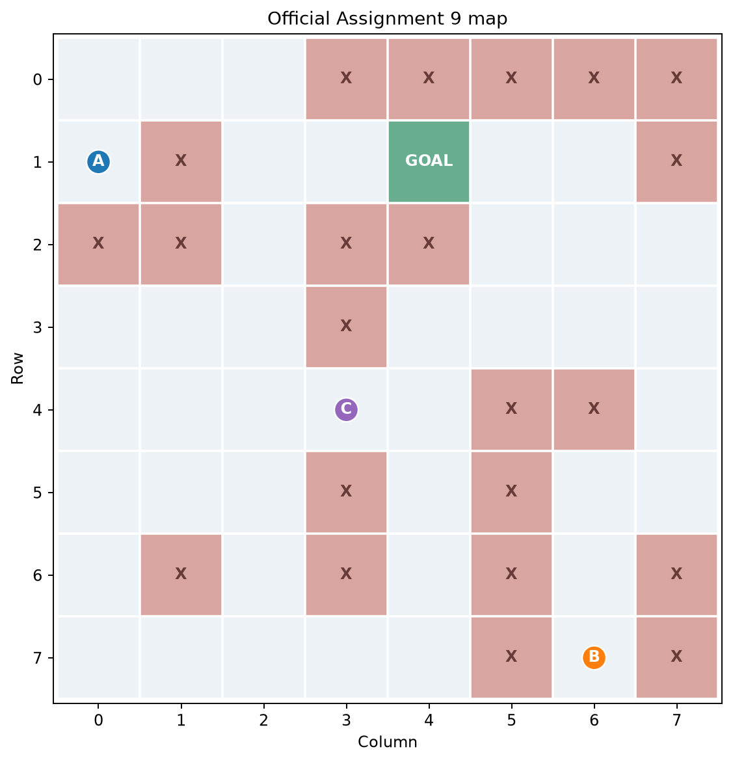
CAI2100C | MACHINE LEARNING FOUNDATIONS
My assignment and official environment
I reconstructed the exact 8 × 8 map with 22 Cliffs and Goal (1, 4).
Juan Luna Santibanez | Professor Beth Muturi

Slide 3
CAI2100C | MACHINE LEARNING FOUNDATIONS
How I trained the agent
I update state-action values from rewards and penalize entering a Cliff.
Rewards: Goal +100 | Cliff -100 | Normal move -1
I use 10,000 episodes, α = 0.30, γ = 0.96 and a reproducible seed (2026).
BFS does not teach the agent. I use it only afterward to check optimality.
Juan Luna Santibanez | Professor Beth Muturi

Slide 4
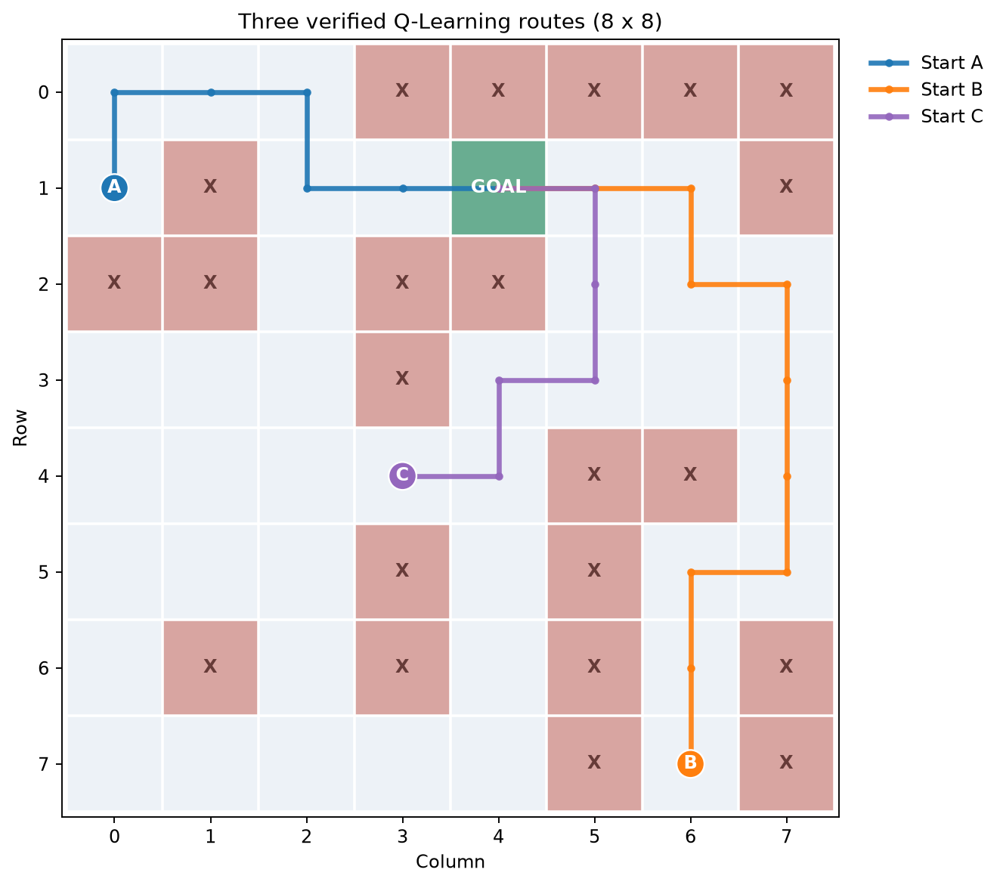
CAI2100C | MACHINE LEARNING FOUNDATIONS
Three required starting points
All three learned routes are safe and equal to independent BFS distances.
Juan Luna Santibanez | Professor Beth Muturi

Slide 5
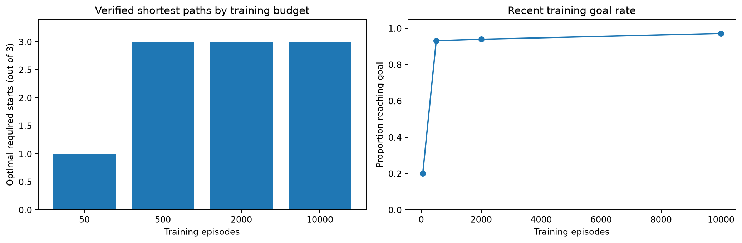
CAI2100C | MACHINE LEARNING FOUNDATIONS
Does training volume matter?
I compared four episode budgets under the same seed and parameters.
Juan Luna Santibanez | Professor Beth Muturi

Slide 6
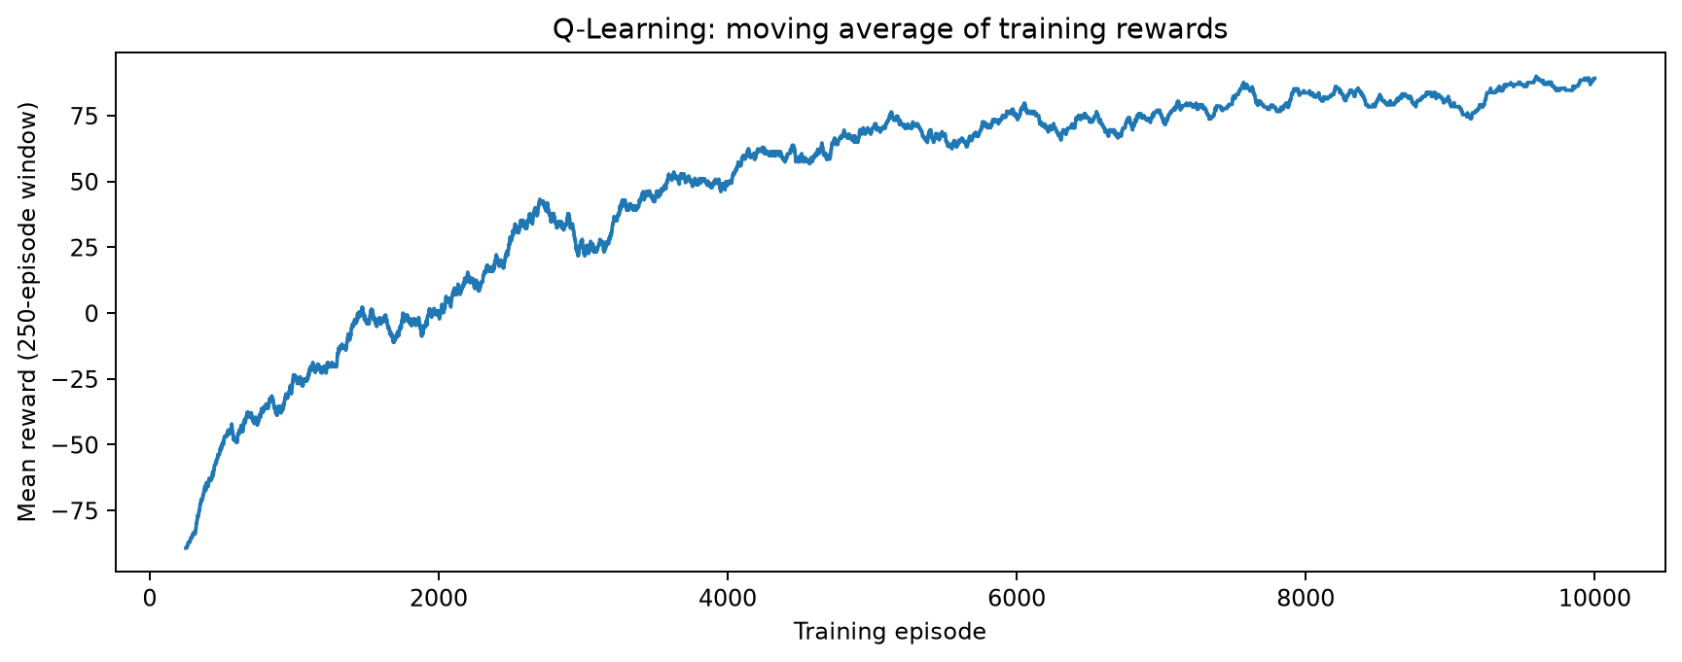
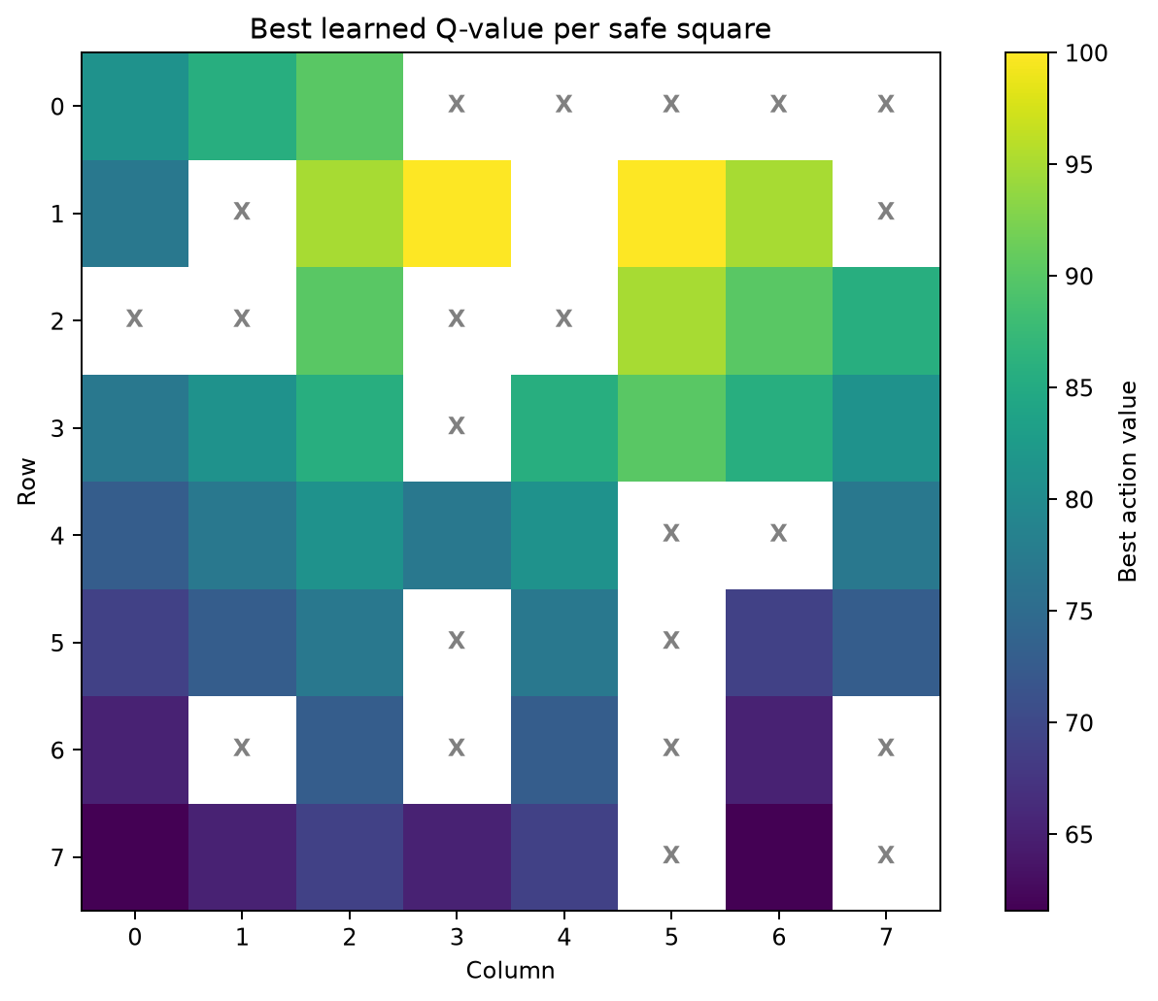
CAI2100C | MACHINE LEARNING FOUNDATIONS
Inspecting how the model learns
I distinguish training rewards from the quality of the final greedy policy.
Juan Luna Santibanez | Professor Beth Muturi

Slide 7
CAI2100C | MACHINE LEARNING FOUNDATIONS
My conclusion and academic verification
I confirmed each safe route using a separate shortest-path calculation.
(1, 0): 6 moves | (7, 6): 10 moves | (4, 3): 6 moves
I verified every movement, avoided all 22 Cliffs and evaluated the episode count and learning rate.
My result is a controlled classroom experiment, not a real autonomous-driving system.
Juan Luna Santibanez | Professor Beth Muturi

