Slide 1
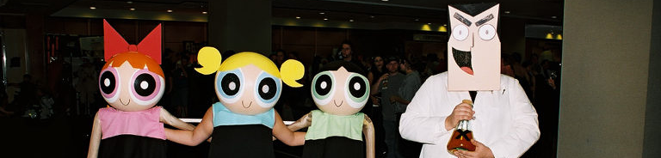
POWER PUFF GILRS
PRESENTATION WAT CHEDEE LUANG | 24.04.15

Slide 2
URS-03 : Admin can update temple history.

Slide 3
LET’S SEE A PROTOTYPE

Slide 4
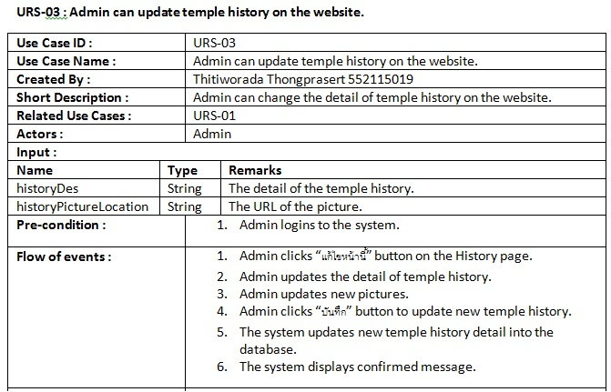
URS DESCRIPTION

Slide 5
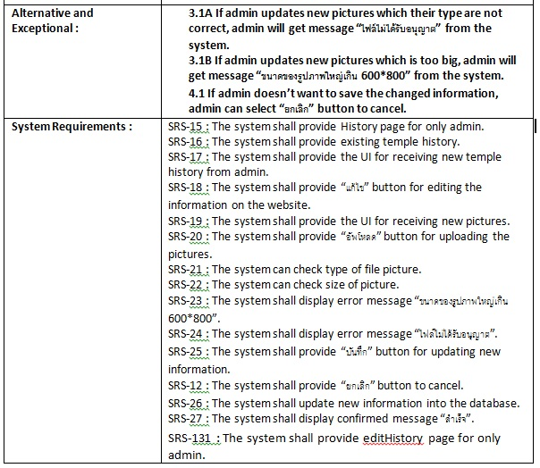
URS DESCRIPTION

Slide 6
INPUT/OUTPUT SPECIFICATION

Slide 7
EXECUTION FLOW

Slide 8
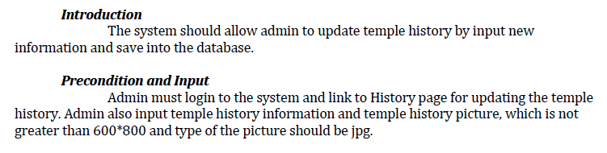
EXECUTION FLOW

Slide 9
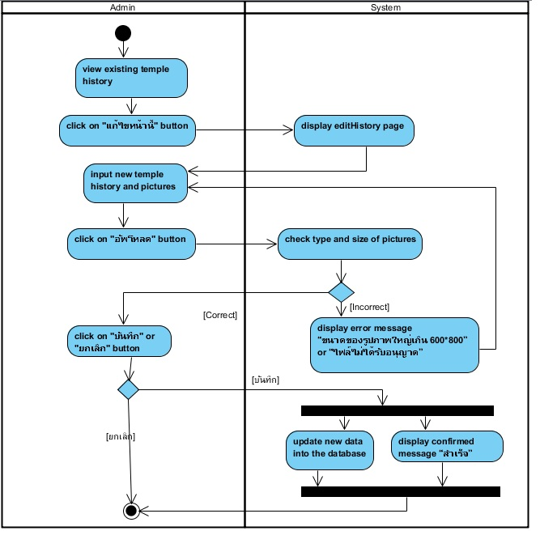

Slide 10
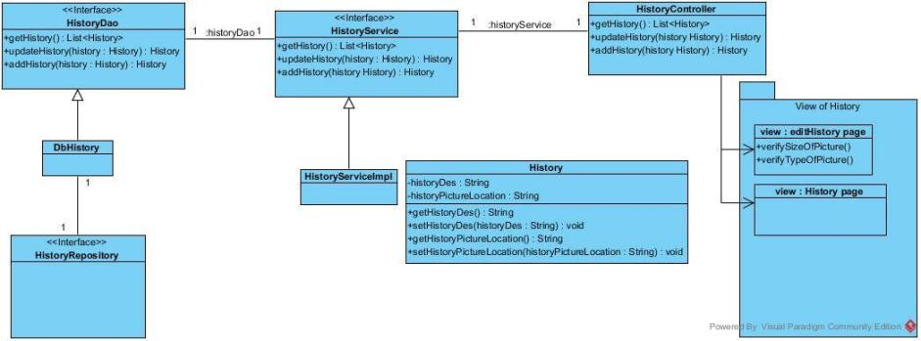
CLASS DIAGRAM

Slide 11
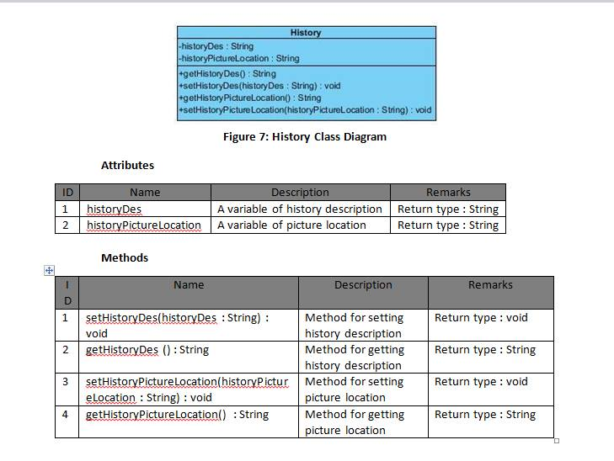
METHODS

Slide 12
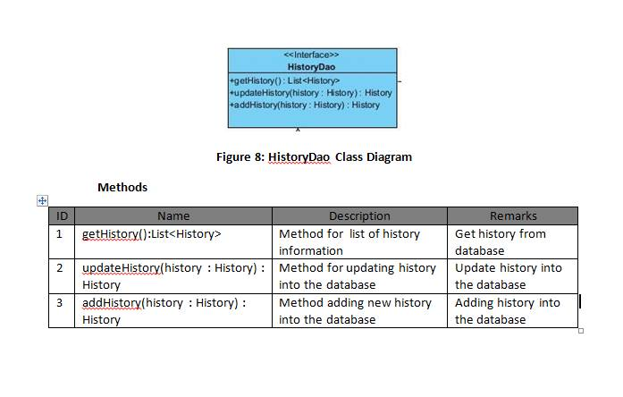
METHODS

Slide 13
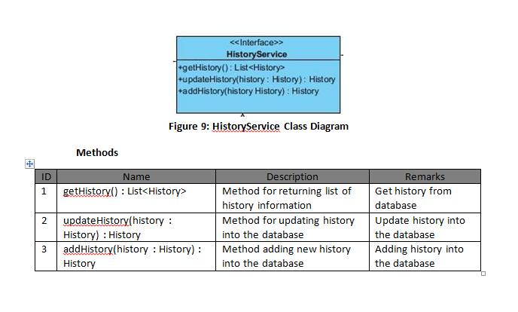
METHODS

Slide 14
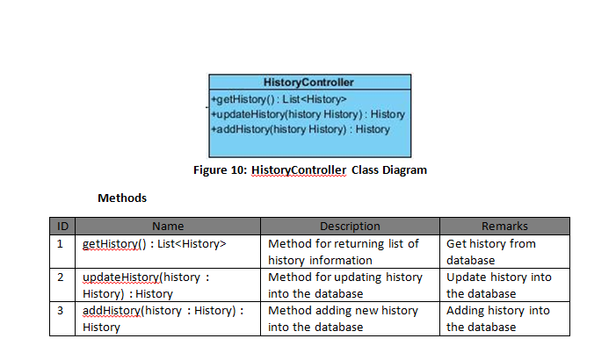
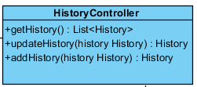
METHODS

Slide 15
SEQUENCE DIAGRAM

Slide 16
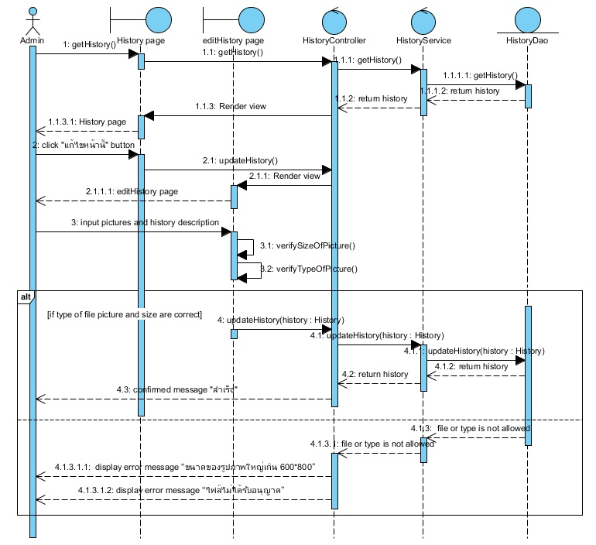

Slide 17
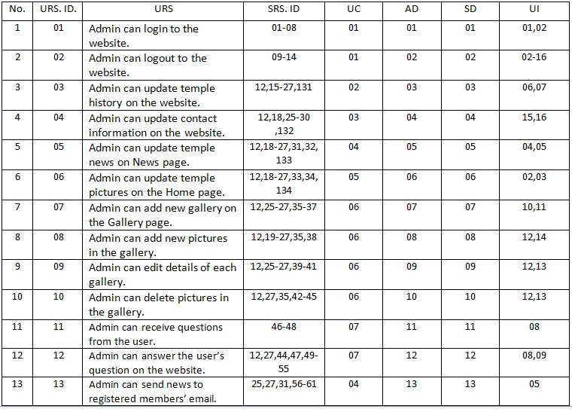
TRACEBILITY MATRIX

Slide 18
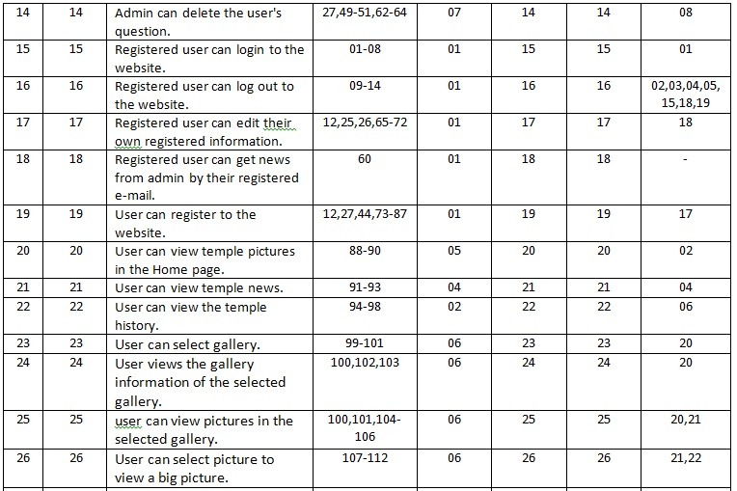
TRACEBILITY MATRIX

Slide 19
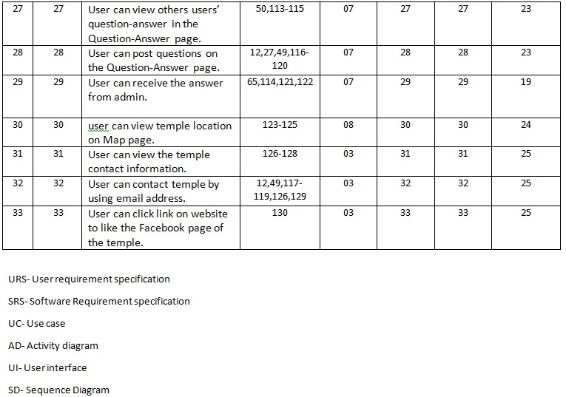
TRACEBILITY MATRIX

Slide 20
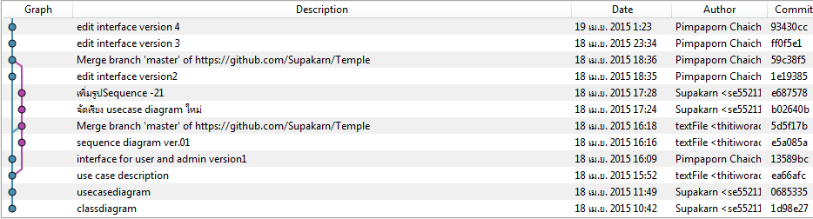
VERSION CONTROL

Slide 21
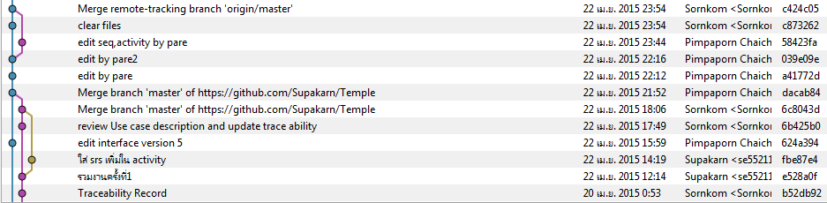
VERSION CONTROL

Slide 22
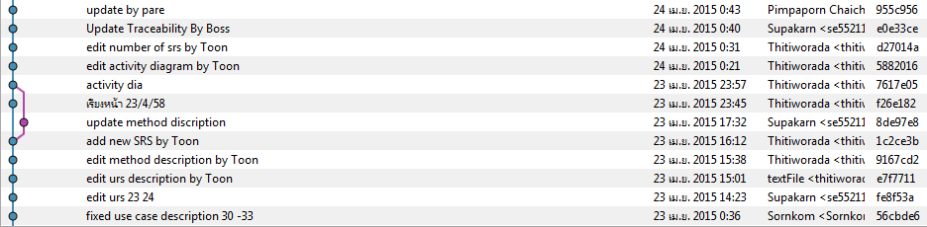
VERSION CONTROL

Slide 23
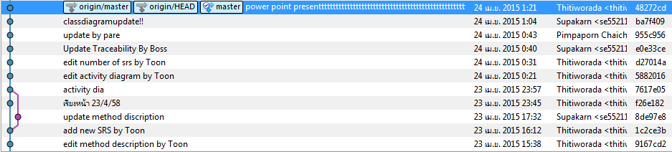
VERSION CONTROL

Slide 24
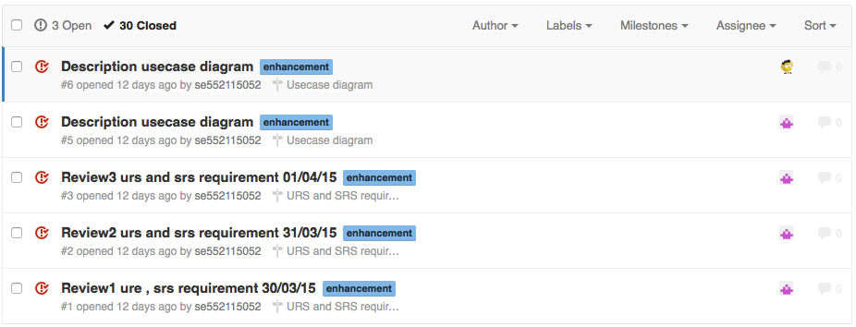
ISSUE TRACKING

Slide 25
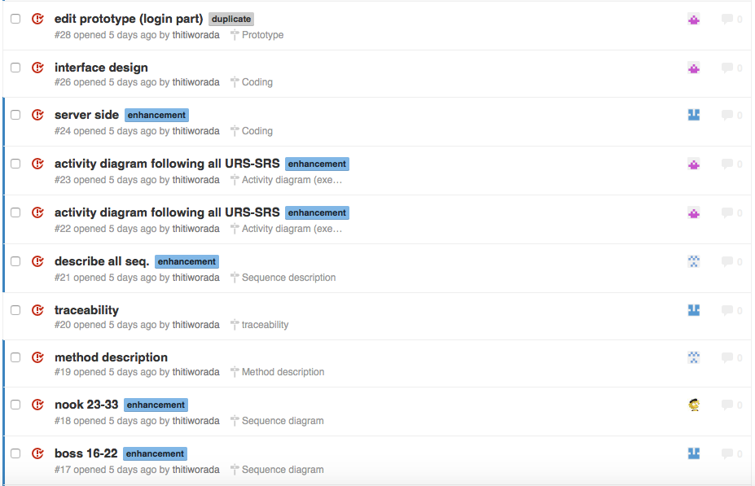
ISSUE TRACKING

Slide 26
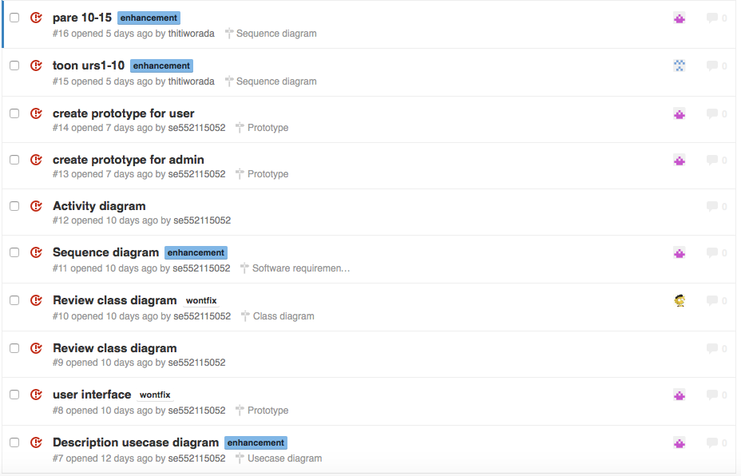
ISSUE TRACKING

Slide 27
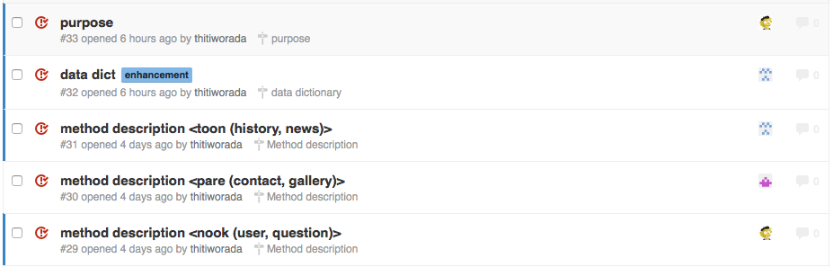
ISSUE TRACKING

Slide 28
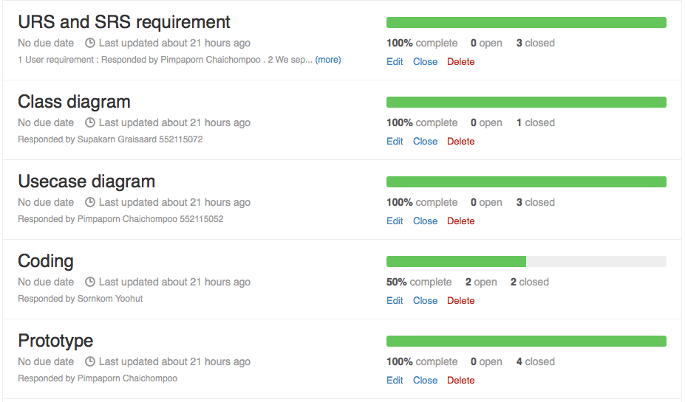
MILE STONE

Slide 29
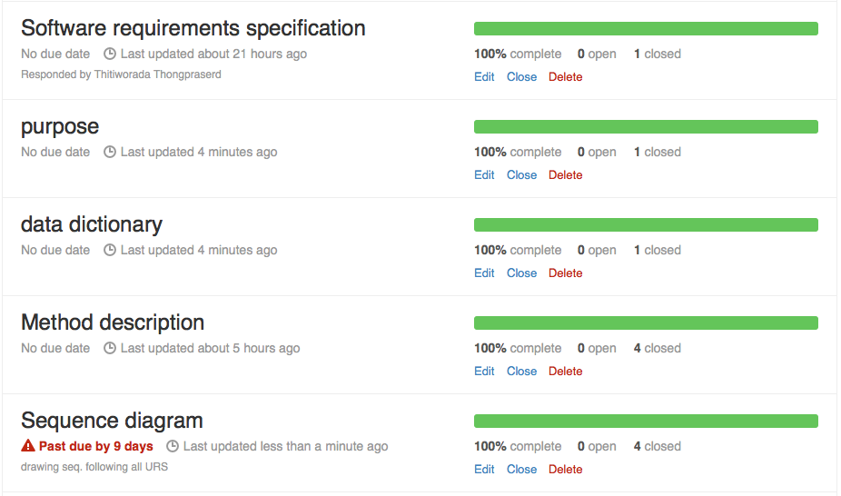
MILE STONE

Slide 30
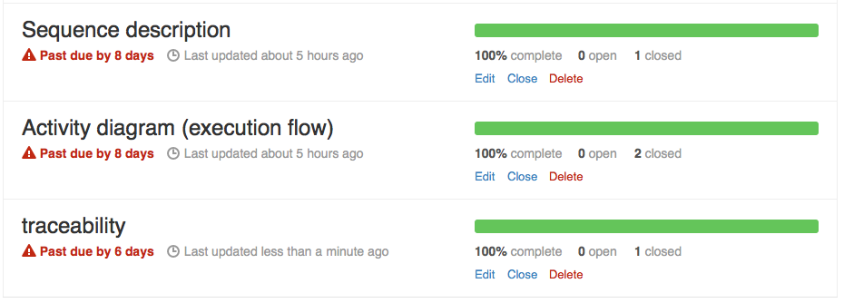
MILE STONE

