Slide 1

Interstellar Explorers
CSE523 ML Project End Sem Presentation
Title: Classification of Exoplanets
Team members:
Rudri Jani - AU2044002
Dhaval Deshkar - AU2044003
Riya Shah - AU2044004
Supan Shah -AU2044011
Guided by: Dr. Mehul Raval
TA: Jay Patel, Arpit Patel

Slide 2
Introduction
Throughout history, humanity has shared an eternal desire to explore the unknown.
The current search for a terrestrial, especially those in the Goldilocks (livable) zone where liquid water might exist, has been rejuvenated by technological advances in astronomy.
As Russian space pioneer Konstantin Tsiolkovsky said, "The Earth is the cradle of humanity, but one cannot live in a cradle forever."

Slide 3
Problem Definition
This project will aim to classify possible exoplanets from the data retrieved from NASA's Kepler mission that was aimed at exploring the structure and diversity of planetary systems.

Slide 4
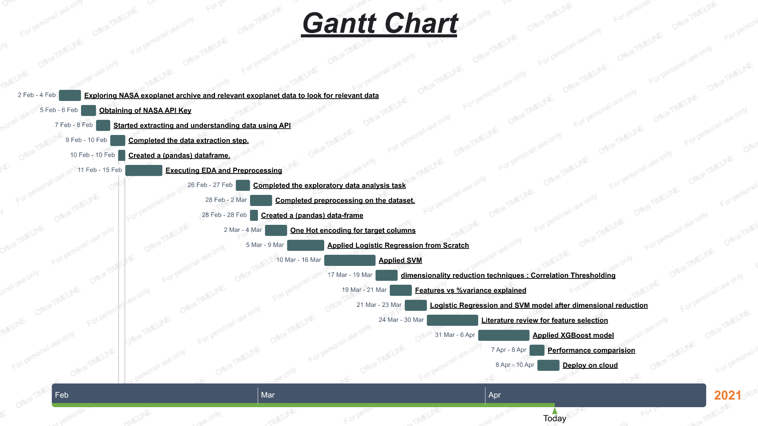

Slide 5
Existing Body of Work
A new era has unfolded in the chase for exoplanets in any case.The Modern generation of the new satellites, such as a Kepler have been launched in recent times with the objective of in partially automating logical perceptions and data generation with exoplanet identification proof.
Engineering of these satellites are not for only takes the picture but also do the process of those images using higher astronomical techniques to create such a huge collection of data with proper variety of features for identification of exoplanets.
The authors Sturrock & George Clayton describes in their paper titled“"Machine Learning Pipeline for Exoplanet Classification” The simulation of model deployment is apex of data pipeline, which prepares, train and test for machine learning model.
The final result of machine learning modeling is introduced and summarised to show the classification of the exoplanets dimensionally over the different models constructed in the study.

Slide 6
Approach
The dataset is taken from NASA’s exoplanet archives using its live API.
The data identifies the three categories of exoplanets like CONFIRMED, CANDIDATE and FALSE POSITIVES. The goal of the project is to identify this using classification algorithms.
After extracting the data, we did data preprocessing tasks and created a new column for target. We used dimensionality reduction and got 5 columns as features and applied Logistic Regression and SVM on it.
Image Source : https://exoplanetarchive.ipac.caltech.edu/docs/program_interfaces.html

Slide 7
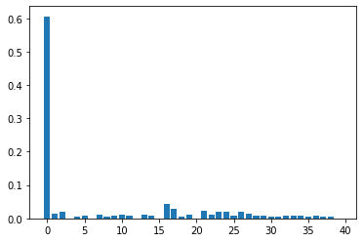
XGBoost
XGBoost is a decision-tree-based ensemble Machine Learning algorithm that uses a gradient boosting framework.
When it comes to small-to-medium structured/tabular data, decision tree based algorithms are considered best
Selected Features
disposition score,
planetary radius,
TEC planet number,
Stellar Temperature,
Transit Signal-to-noise ratio.
source: Google

Slide 8
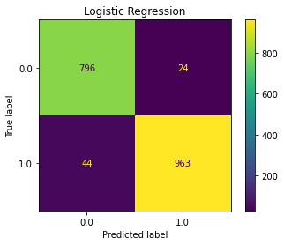
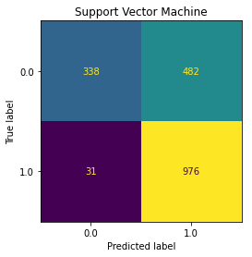
Confusion Matrix After Feature Selection Using XGBoost
Accuracy: 96.28% F1 Score: 96.59%
Accuracy: 71.92% F1 Score: 79.18%
Test
Test

Slide 9
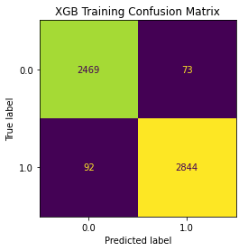

XGBoost Results
Accuracy: 96.98% F1 Score: 97.18%
Train
Accuracy: 96.16% F1 Score: 96.52%
Test

Slide 10
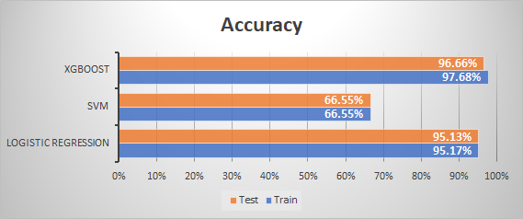
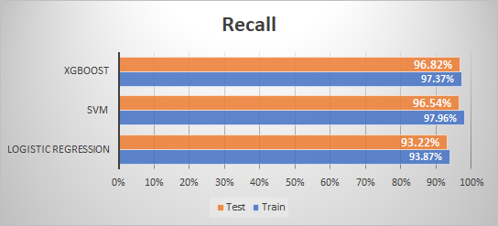
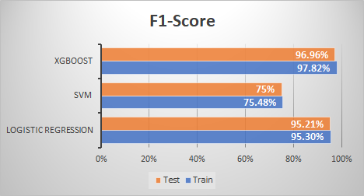
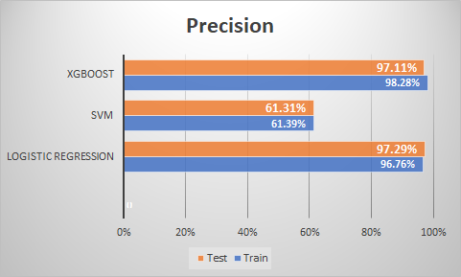
Performance Comparison

Slide 11
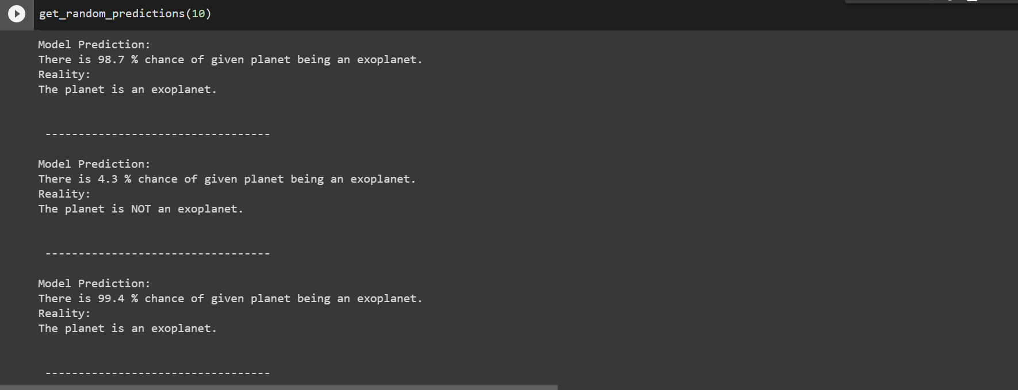
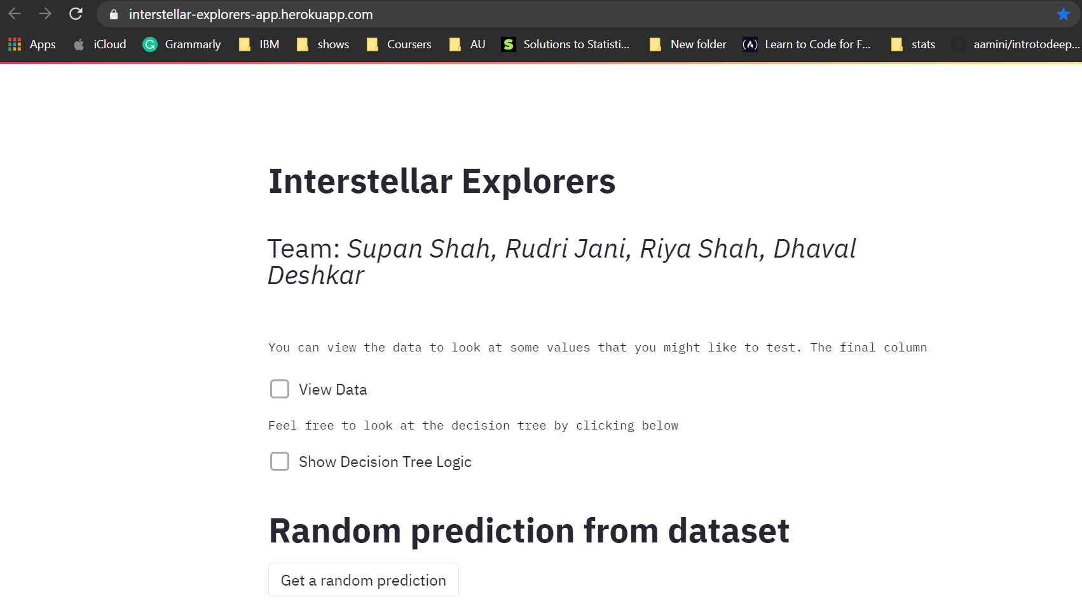
Final Result
After deploying the trained model on the IBM cloud, it returns the probability of any planet being an exoplanet and we constructed the final web based service.
https://interstellar-explorers-app.herokuapp.com/
https://youtu.be/mEqn2KPAOjg

Slide 12
Conclusion
In this project we used different models to get better accuracy and f1-score so we can achieve better results for classifying exoplanets.
To conclude, XGBoost model performs way better on unseen data as it gives 96.66% test accuracy and 96.96% test f1-score.
As final part, we deployed the model on IBM cloud. We generated deployed model through API inference and we constructed the final web based service.

Slide 13
Role of each member
Name | Task performed
Rudri Jani | EDA, Preprocessing, Support vector Machine, Literature Review, feature selection using xgboost, SVM with xgboost feature selection
Dhaval Deshkar | Dimensionality Reduction, Logistic Regression, Literature Review, Logistic Regression with Xgboost features, Decision Tree
Riya Shah | Exploratory Data Analysis , Preprocessing, Support vector Machine, Literature Review, XGboost modelling, Performance Comparison
Supan Shah | Data extraction, Dimensionality Reduction, Logistic Regression, Literature Review,Deployment on IBM cloud,herokuapp

Slide 14
References
API:
https://exoplanetarchive.ipac.caltech.edu/docs/program_interfaces.html
Dataset:
https://exoplanetarchive.ipac.caltech.edu/cgi-bin/TblView/nph-tblView?app=ExoTbls&config=cumulative
Documentation :
https://exoplanetarchive.ipac.caltech.edu/docs/API_kepcandidate_columns.html
Literature Review :
G. C. Sturrock, B. Manry, and S. Rafiqi, “Machine learning pipeline for exoplanet classification,” SMU Data Science Review, vol. 2, no.1,p. 9,2019

Slide 15
Thank you.

