Slide 1

Interstellar Explorers
CSE523 ML Project Mid Sem Presentation
Title: Classification of Exoplanets
Team members:
Rudri Jani - AU2044002
Dhaval Deshkar - AU2044003
Riya Shah - AU2044004
Supan Shah -AU2044011
Guided by: Dr. Mehul Raval
TA: Jay Patel, Arpit Patel

Slide 2
Problem Definition
This project will aim to classify possible exoplanets from the data retrieved from NASA's Kepler mission that was aimed at exploring the structure and diversity of planetary systems.

Slide 3
Background
Throughout history, humanity has shared an eternal desire to explore the unknown.
The current search for a terrestrial, especially those in the Goldilocks (livable) zone where liquid water might exist, has been rejuvenated by technological advances in astronomy.
As Russian space pioneer Konstantin Tsiolkovsky said, "The Earth is the cradle of humanity, but one cannot live in a cradle forever."

Slide 4
Road Map
Dimensionality Reduction
Data Extraction
Fetch data directly from Nasa’s API
Data Pre-Processing
Classification
Data Cleaning and renaming
Using Logistic Regression and SVM
API Service
EDA
Deploy classification model as a web based API service
Data understanding

Slide 5
Dataset
The dataset is taken from NASA’s exoplanet archives using its live API.
The data identifies the three categories of exoplanets like CONFIRMED, CANDIDATE and FALSE POSITIVES. The goal of the project is to identify this using classification algorithms.
Confirmed – The planet is exoplanet
Candidate - possibility of exoplanet
False Positive – Not an exoplanet
Image Source : https://exoplanetarchive.ipac.caltech.edu/docs/program_interfaces.html

Slide 6
Methodology
The project will use classical machine learning methods for the classification of planets as exoplanets or not using features extracted by the Kepler space telescope.
Around 8% of the data was null and hence removed.
Remove irrelevant columns from dataset
Normalize the data : Z-score normalization
One hot encoding of categorical data
Create a new column on the basis of candidate and confirmed planets which will be the target column.
Next, we apply dimensionality reduction techniques to reduce dimensions.

Slide 7
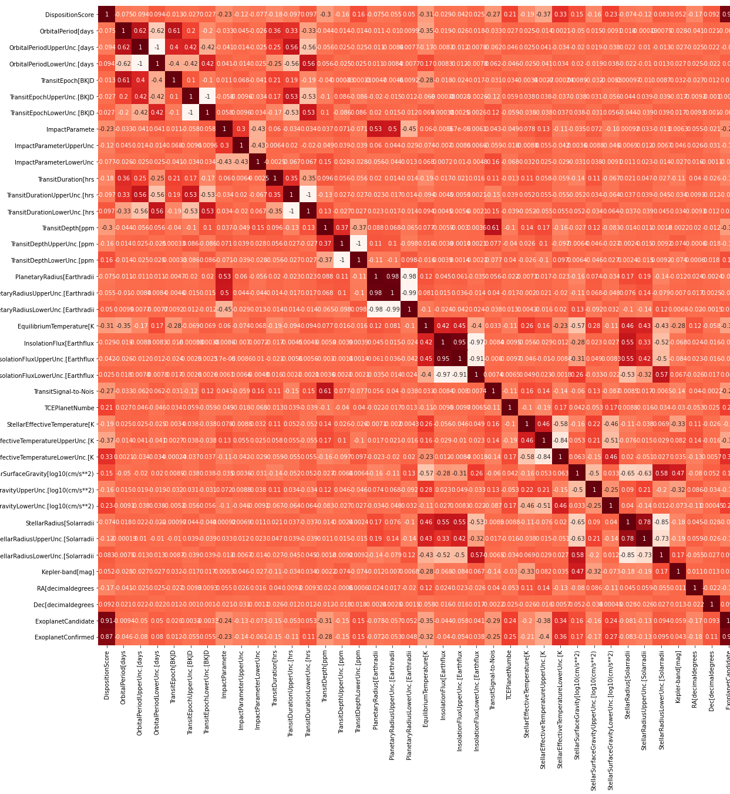
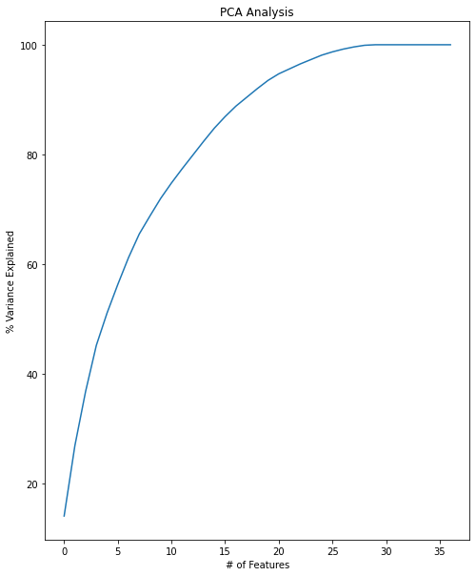
Dimensionality Reduction

Slide 8
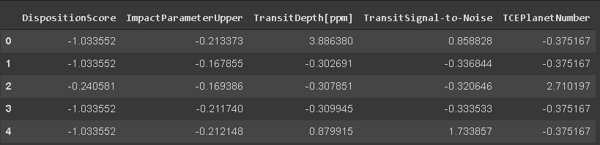
Process data for classification
After applying dimensionality reduction, we selected five best columns
Train-Test split : 80-20%
Final processed data :

Slide 9
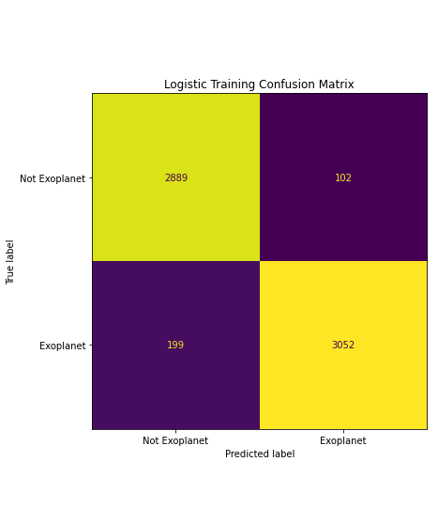
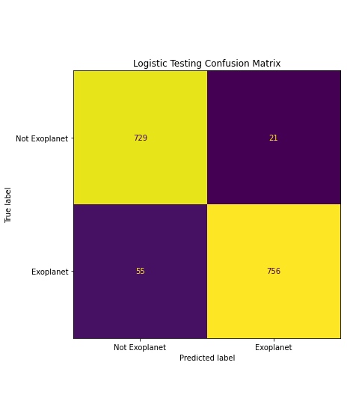
Logistic Regression Results
Accuracy: 95.17% F1 Score: 95.30%
Accuracy: 95.13% F1 Score: 95.21%
Train
Test

Slide 10
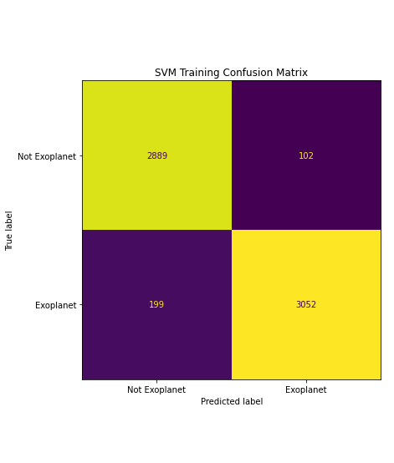

Support Vector Machine Results
Accuracy: 66.55% F1 Score: 75.48%
Accuracy: 66.55% F1 Score: 74.99%
Train
Test

Slide 11
Future Work
Create dashboard where user can key-in feature values and get instant predictions.

Slide 12
References
API:
https://exoplanetarchive.ipac.caltech.edu/docs/program_interfaces.html
Dataset:
https://exoplanetarchive.ipac.caltech.edu/cgi-bin/TblView/nph- tblView?app=ExoTbls&config=cumulative
Documentation
https://exoplanetarchive.ipac.caltech.edu/docs/API_kepcandidate_columns.html

Slide 13
Thank you.

