Slide 1

Time Card Application
● Attendance Service●
Developed by:
Suparna Arya &
Badveli Guru Aswitha

Slide 2
01
Context Level DFD
Wherever You Are Be All There
02
Application Flow
CONTENTS
Wherever You Are Be All There
Wherever You Are Be All There
Entity Database
03
Wherever You Are Be All There
04
Class Diagram
Wherever You Are Be All There

Slide 3
01
Context Level DFD
It provides an at-a-glance look at an information system and the ways it exchanges data with outside entities.

Slide 4
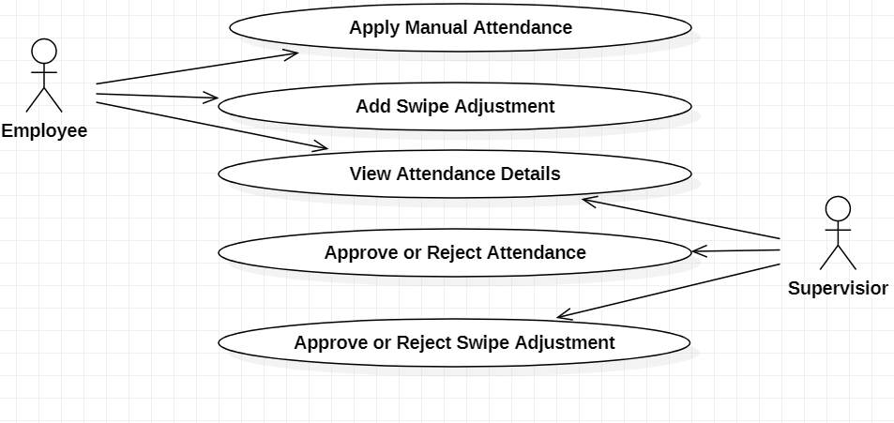
Attendance Service-Context Level DFD
Wherever You Are Be all There
T

Slide 5
02
Application Flow
It is a specific type of activity diagram that communicates a sequence of actions or movements within a complex system. or information.

Slide 6
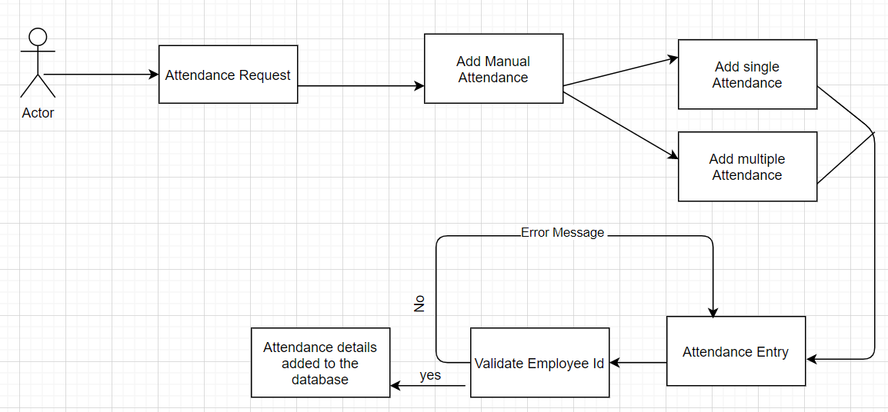
Attendance Service-Application Flow Diagram
Wherever You Are Be All There
Add Manual Attendance Flow

Slide 7
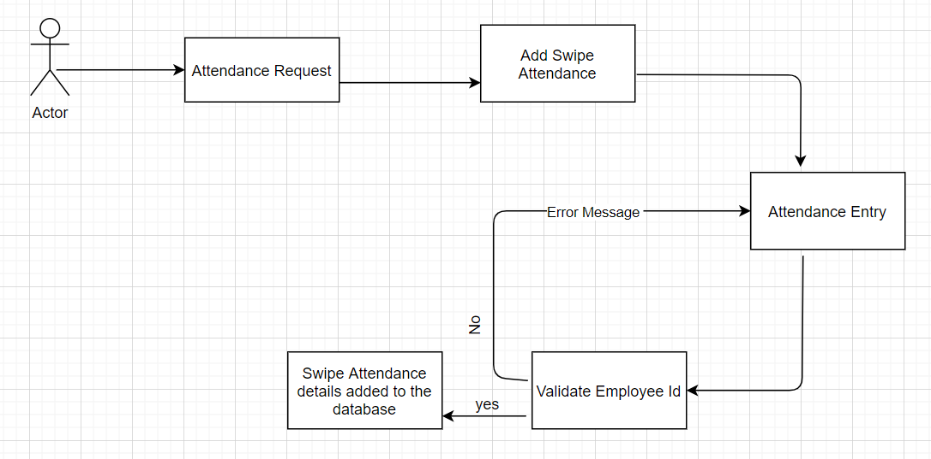
Attendance Service-Application Flow Diagram
Wherever You Are Be All There
Add Swipe Attendance Flow

Slide 8
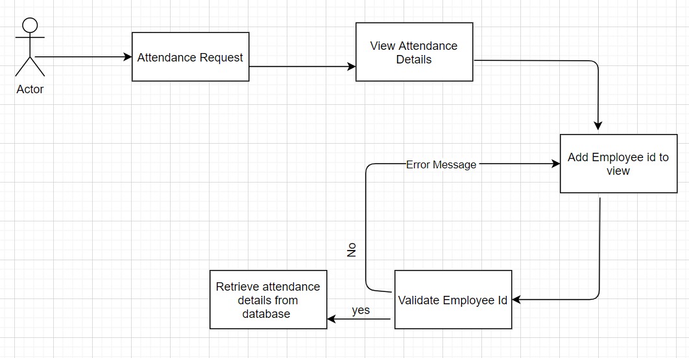
Attendance Service-Application Flow Diagram
Wherever You Are Be All There
View Attendance Detail Flow

Slide 9
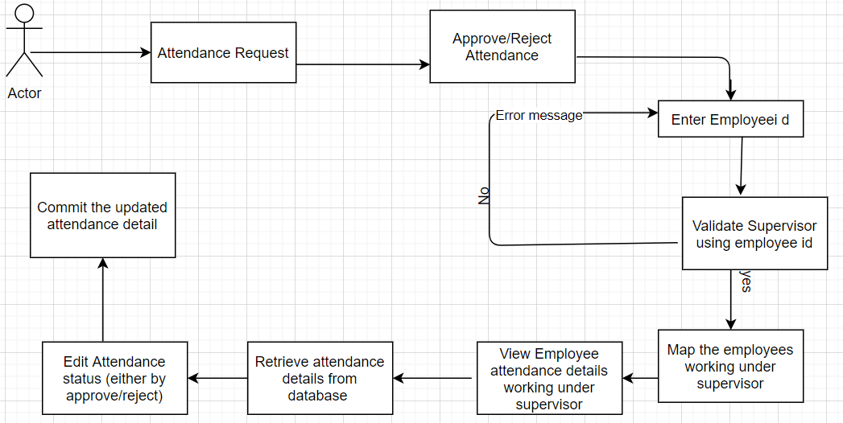
Attendance Service-Application Flow Diagram
Wherever You Are Be All There
Approve/ Reject Attendance Flow

Slide 10
03
Entity Database
Database entity is a thing, person, place, unit, object or any item about which the data should be captured and stored in the form of properties, workflow and tables.

Slide 11
Attendance Service-Entity Database
Wherever You Are Be All There
emp_id | emp_Name | phone_Number | emp_email | emp_Address
Employees Table
emp_id | in_time | out_time | date | reason | attendance_id | attendance_status
Attendance details Table
type_id | type_Description
emp_id | supervisor_id
Attendance Types Table
Admin Table

Slide 12
04
Class diagram
It contains all the data members and methods with its types and parameter list.

Slide 13
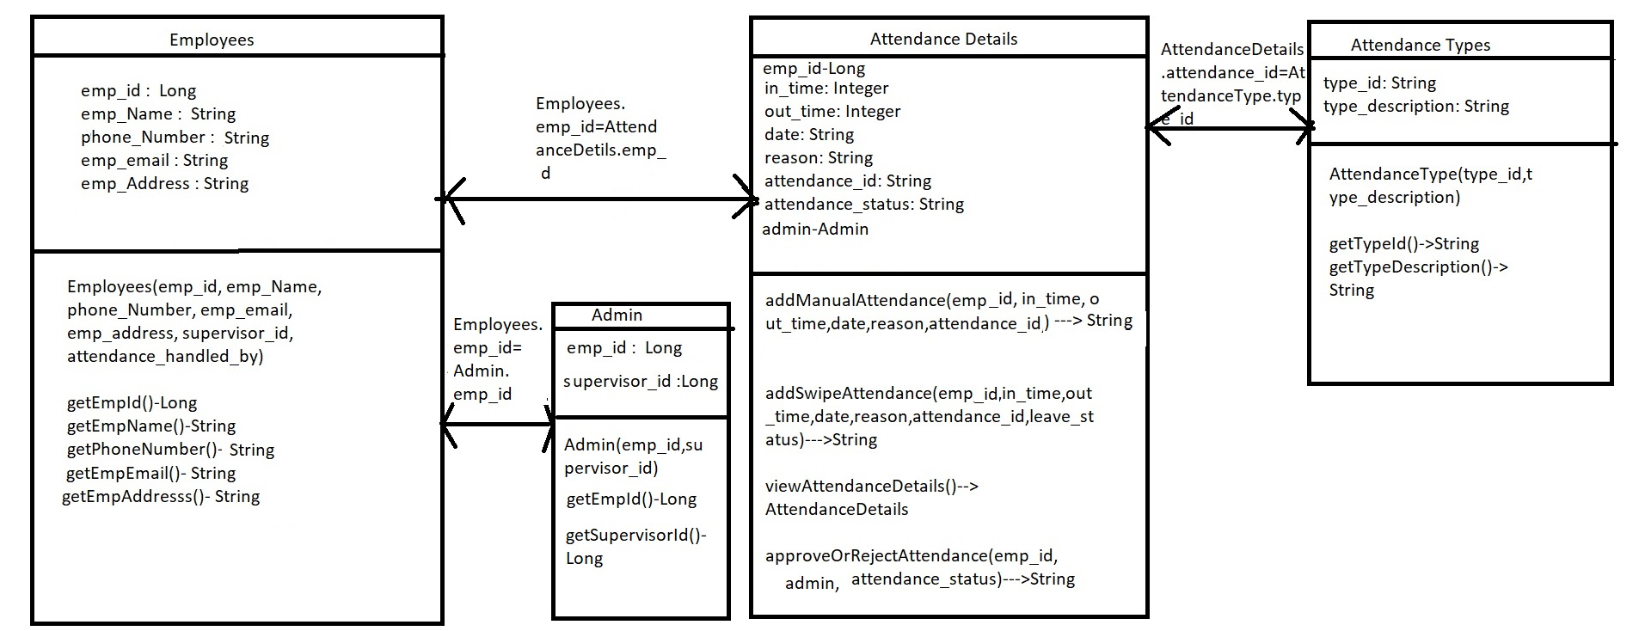
Attendance Service-Class Diagram
Wherever You Are Be All There

Slide 14
Thank you
Wherever You Are Be All There

