Slide 1







CAREER
SELECTION
Career decision are the most difficult if one is not aware of which field to select for better opportunities and future career advancement. Selection of career should be well researched and well discussed before taking the step ahead. Doubts and proper information should be collected and cleared as well so that one has a clear view of the path ahead.

Slide 2


OUR
TECH & CHANGES
TECHNICAL ADVANCEMENT
The next decade or so promises to be an exciting time for science and innovative technology. Ideas that were once the preserve of imaginative science fiction writers are moving closer to becoming reality, and if you thought the advancements made over the last couple of decades were impressive, they are likely to be put firmly in to the shade by upcoming innovations..
AI is taking the world by storm. While some of us are still trying to figure out the difference between artificial intelligence and machine learning, AI is fast progressing. This breakthrough technology has already become accessible for any software developer; tech giants are currently competing to dominate the field of artificial intelligence; China has taken serious steps to become the leader in AI; some jobs might soon be automated, and we’ve seen some unprecedented advances in deep neural networks.

Slide 3





DISCOVER
CAREER PATH
ROAD TO TECH
TECHNICAL PRESENTATION

Slide 5
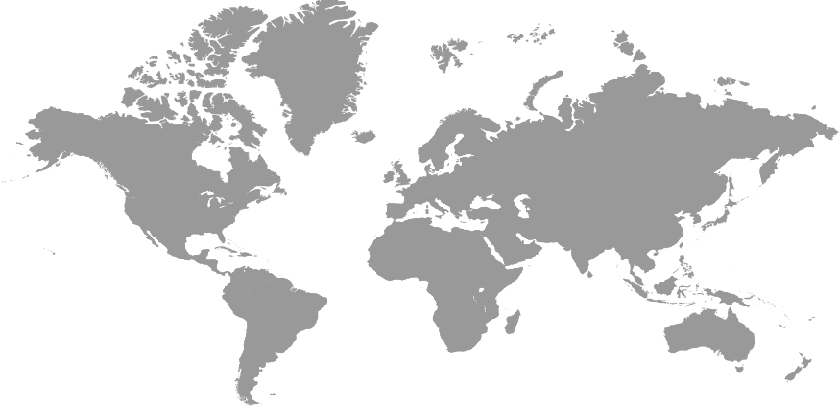
W O R K I N M A P
WEB DEVELOPMENT
Highly demanded for job opportunities for web developers
MACHINE LEARNING
Technological developer in Machine learning industry.
DIGITAL MARKETING
ANDROID APPLICATION
Requirement for marketing agents especially for social media advertising.
Android app developers for designing e-commerce apps
ARTIFICIAL INTELLIGENCE
AI is the latest trend in the technical development market demands.
DATA SCIENCE
Data Scientists are the next generation technical analyst.

Slide 6


Business Performance Indicators
BUSINESS ETIQUETTE
1
2
3
ARRIVE ON TIME
DRESS APPROPRIATELY
SPEAK KINDLY
This n the business world, it is best to observe the old rule, “Five minutes early is late.”
The adage, “Dress for the job you want, not the job you have,” is a good rule to follow.
Your good manners show that you acknowledge those around you and are considerate of their presence.
4
5
6
SHOW INTEREST
MINIMUM QUESTIONS IN MEETINGS.
LIMIT YOUR "THANKS YOUS."
Maintain friendly eye contact. Listen. People will remember how you make them feel, and nobody wants to feel as if they are ignored.
Limit yourself to the most important questions during the meeting and then follow up with an email if you still have more after it ends.
There's nothing wrong with showing appreciation, but if you're repetitive with your gratitude it begins to make you seem a little insecure. Instead, one confident and sincere thank you is enough.
7
8
9
INTRODUCE YOURSELF AND OTHERS
REPLY EMAILS
PLAY THE GAME BY THE RULES
Introduce or reintroduce yourself quickly if that seems to be the case. It helps to have a friendly person make you feel comfortable in the office.
As dangerous as the 'reply all' button can be, you need to be in the habit of using it when it comes to sharing important information.
I'm a big believer in the concept of paying it forward. Give and you'll get back, I promise.

