Slide 1

BRAVIS.COM
SUPARNO BHATTA
SRIVATS S RAMANUJAM
PRATIK MUKESH SAVLA
OYINDRILA SEN GUPTA
SWARN JAIN

Slide 2
TABLE OF CONTENTS
ABSTRACT
BUSINESS CASE SCENARIO
DEFINTIONS
PROPOSED SYSTEM
DATA SET
UTILS.PY
MODEL.PY
TRAIN.PY
TEST.PY
BRAVIS.COM WEBSITE LAYOUT
WORK FLOW
CONCLUSION
FUTURE WORK

Slide 3
ABSTRACT
Brevis (Latin meaning : short) is a text summarizer which can generate a summary of any article. It is a scalable Deep Learning model that has been trained specifically to summarize news articles(at the moment). BRAVIS.COM is an open-source website where anyone can view summarized day-to-day news articles and can also summarize any text file that is provided. TensorFlow has been used to build the Deep Learning model for summarizing the news articles. Text Mining has been used to summarize any article that has been provided to BRAVIS.COM.

Slide 4
BUSINESS CASE SCENARIO
Automated content creation.
A website has been deployed where the user can put any kind of text article, essays, news and get the summary of it.
The website also provides day-to-day news summaries for anyone to read on the fly.
Saves time for everyone and it also helps them to stay updated.
Students can use Bravis.com to summarize their exam materials and generate revision notes just before their exams.
Busy businessmen who do not have time to read all those long news will take just a minute to update themselves.

Slide 5
BUSINESS CASE SCENARIO (contd.)
Enables analysts to quickly understand everything the company has already done in a given subject.
Quickly assembles reports that incorporate different points of view.
Presents an opportunity to condense the continuous torrent of information into smaller pieces of information.
When modified to voice-to-text technology it continues to improve, people with hearing disabilities could benefit from summarization to keep up with content in a more efficient way.
Very helpful to a journalist to simplify information and identify the most important facts too.

Slide 6
DEFINITONS
Text mining: Text mining is the process of exploring and analyzing large amounts of unstructured text data and identify concepts, patterns, topics, keywords and other attributes in the data.
Machine Learning: Machine learning (ML) is the scientific study of algorithms and statistical models that computer systems use in order to perform a specific task effectively without using explicit instructions, relying on patterns and inference instead.
Deep Learning: Deep Learning is a subfield of machine learning concerned with algorithms inspired by the structure and function of the brain called artificial neural networks.
Text Summarizer: Text summarization refers to the technique of shortening long pieces of text. The intention is to create a coherent and fluent summary having only the main points outlined in the document.

Slide 7
PROPOSED SYSTEM
There are two main types of summarizer:
1. Extractive-based: The extractive text summarization technique involves pulling key phrases from the source document and combining them to make a summary. The extraction is made according to the defined metric without making any changes to the texts.
2. Abstraction-based: The abstraction technique entails paraphrasing and shortening parts of the source document. The abstractive text summarization algorithms create new phrases and sentences that relay the most useful information from the original text.
Our proposed model has results of both the types of summarizers.
Tensorflow has been used for the news summary generation and text mining is used for text articles that Bravis.com will be able to generate for its users.

Slide 8
DATA SET
GIGAWORD Dataset costs 3,000 USD.
Dataset used for training the model is subset of the original dataset provided by havardnlp.
Dataset contains 3,803,957 articles for Training.
189,651 articles has been used for Testing.
It contains two columns: Summary and the Article.

Slide 9
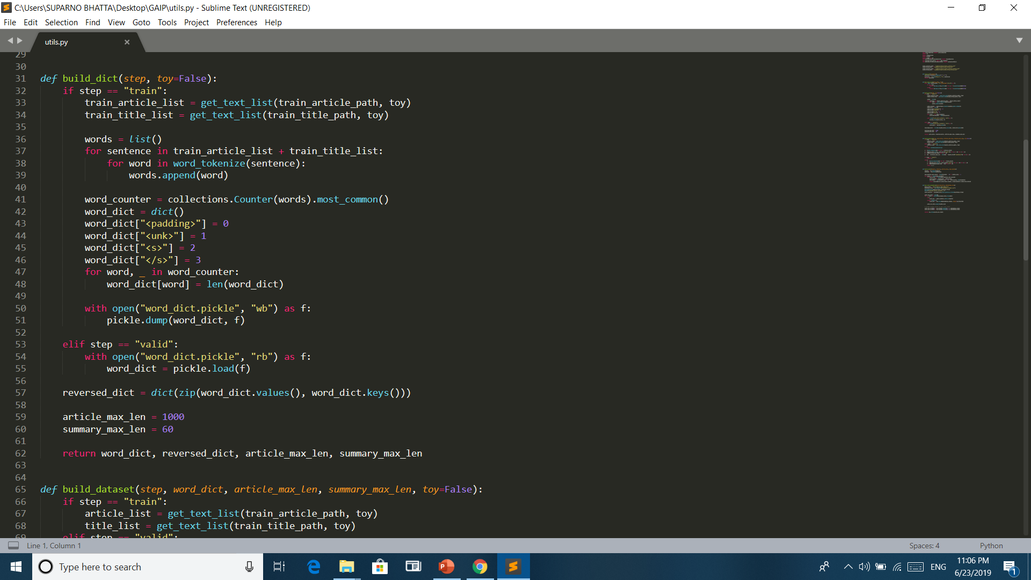
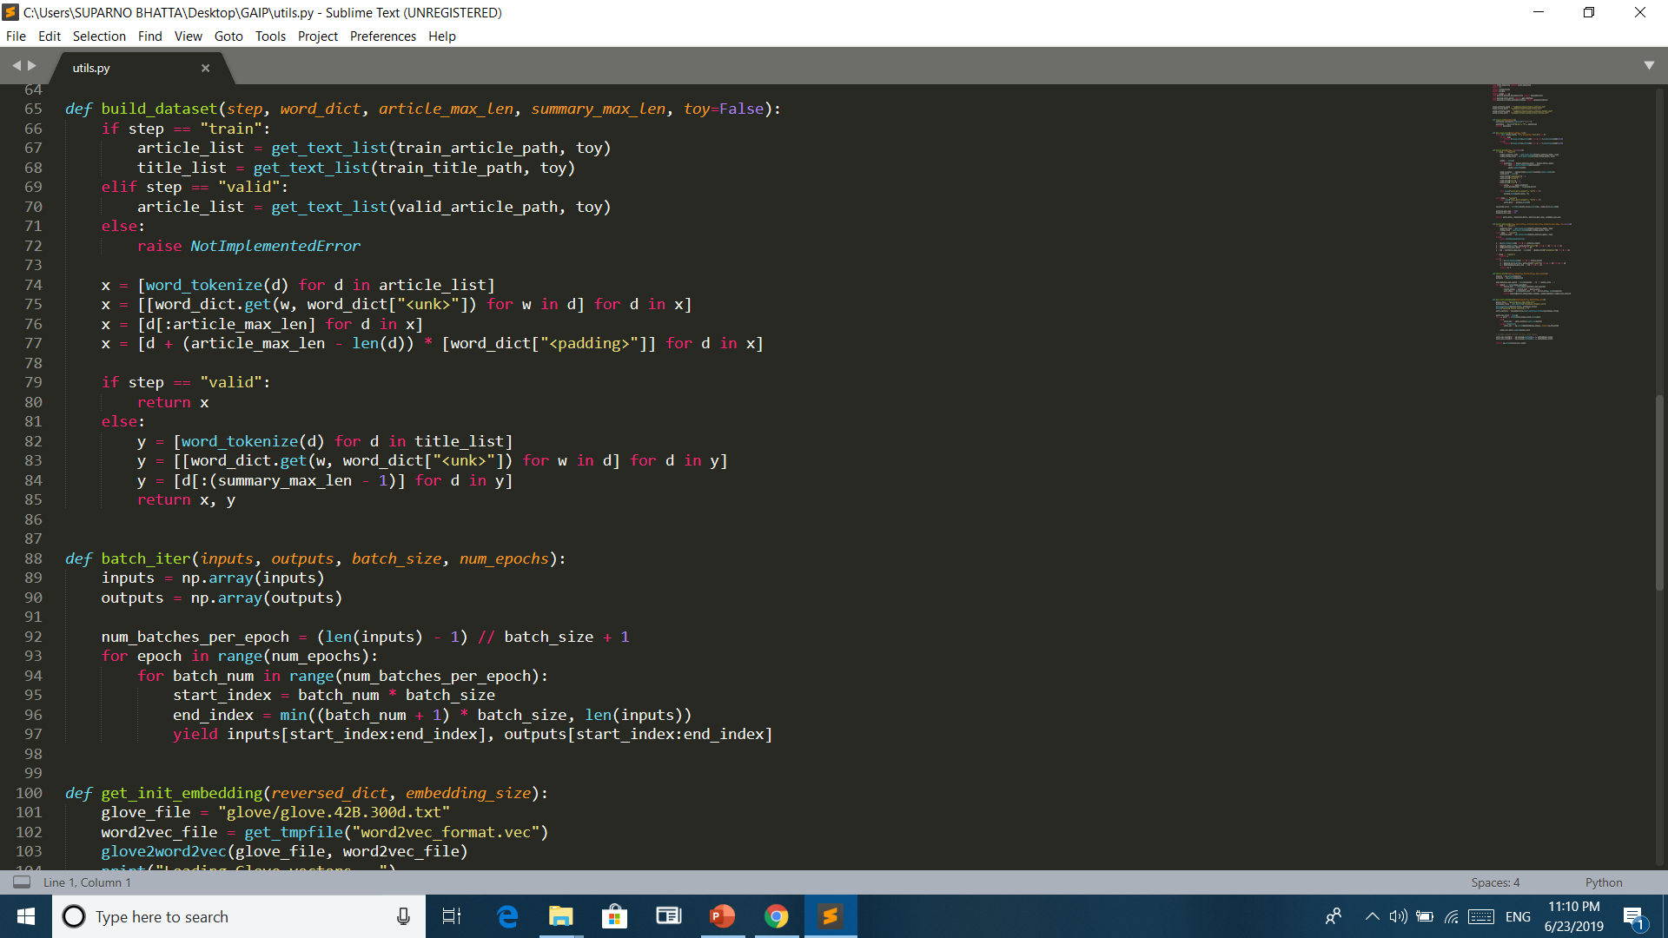
UTILS.PY
Python File for Preprocessing the Input Dataset.
Has 7 methods.
Clear_str() and get_text_list() will clean the text.
build_dict() is used to tokenize and add padding to make all the texts to same length.
We then save the data in a pickle file (.pkl).
build_dataset() is used to creates a matrix of the input articles that is to be given as input to the model.
batch_iter() and get_init_embedding() are 2 other methods that will preprocess the input dataset.

Slide 10
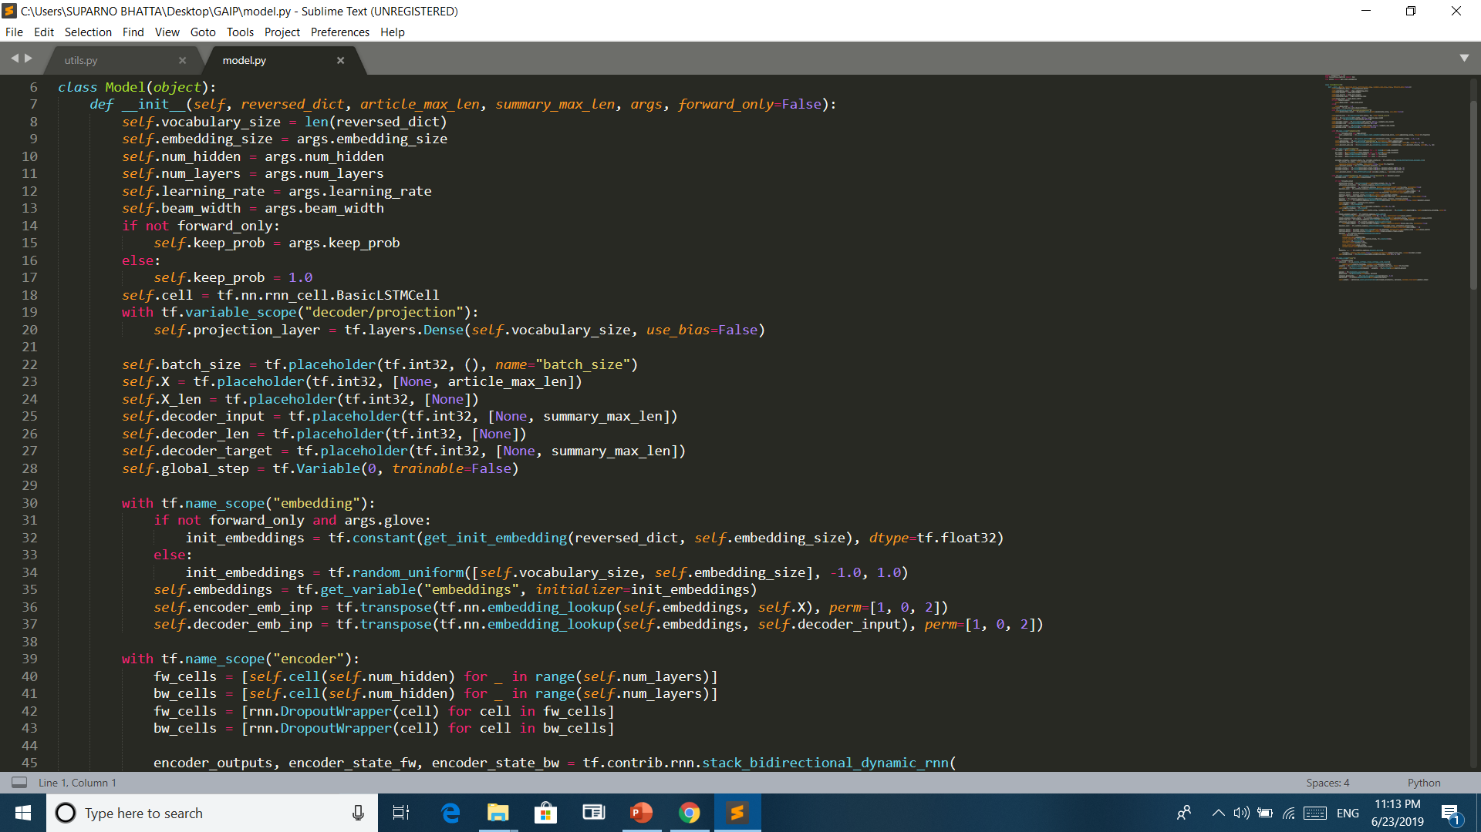
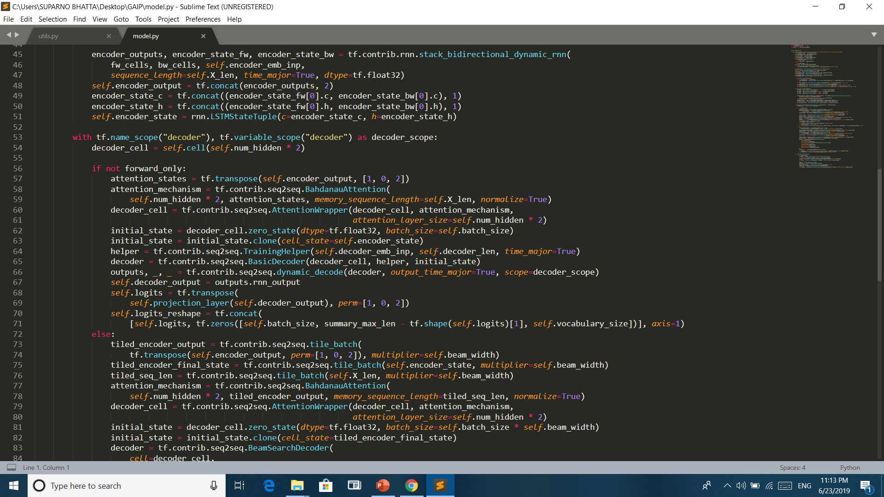
MODELS.PY
Tensorflow is used for making the model.
Models.py file stores the model architecture.
A seq2seq model has been built for training the data.
It is an encoder decoder model with attention mechanism.
Bidirectional LSTM has been used for feature generation.

Slide 11
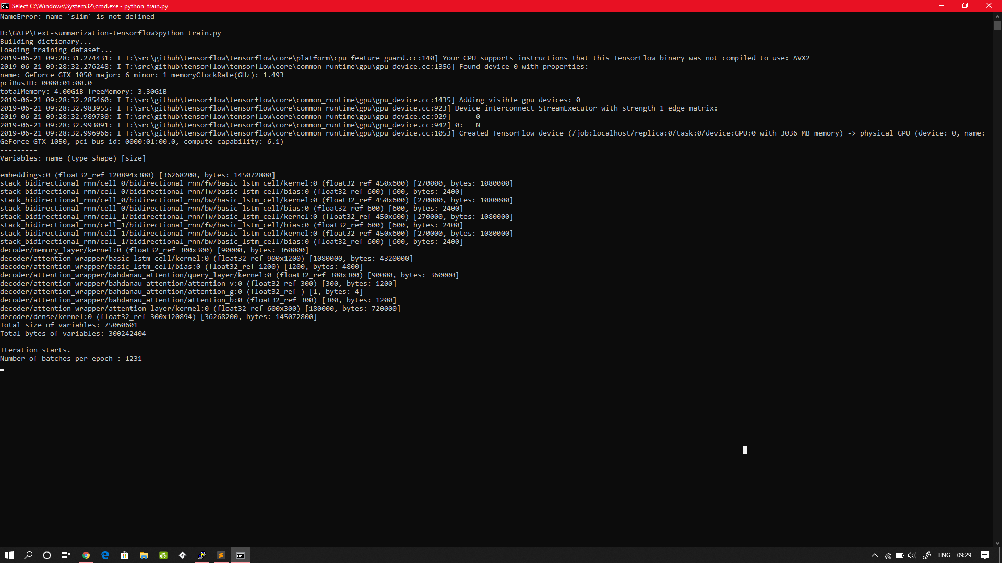
MODEL DETAILS
Encoder-Decoder model with attention mechanism.
Word Embedding: Used Glove pre-trained vectors to initialize word embedding.
Encoder: Used LSTM cell with stack_bidirectional_dynamic_rnn.
Decoder: Used LSTM BasicDecoder for training, and BeamSearchDecoder for inference.
Attention Mechanism: Used BahdanauAttention with weight normalization.

Slide 12
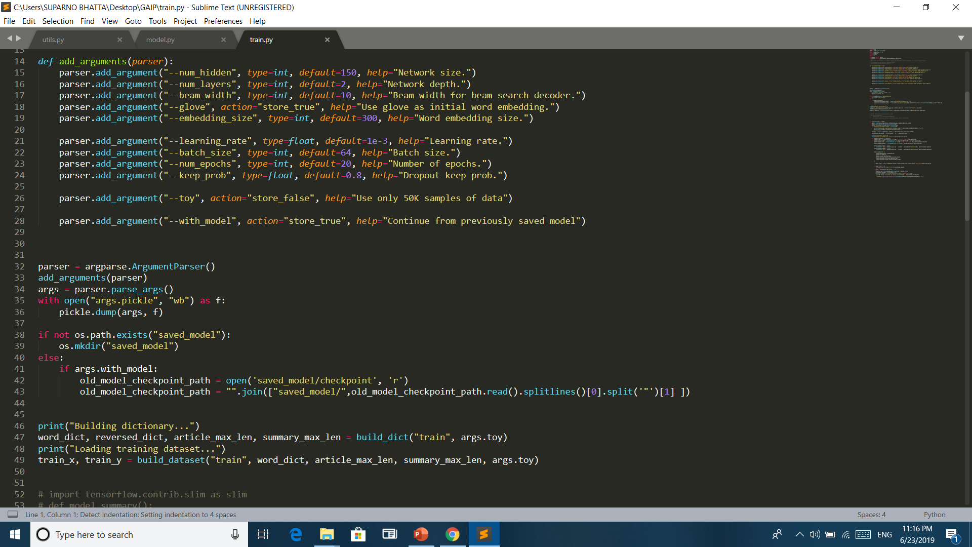
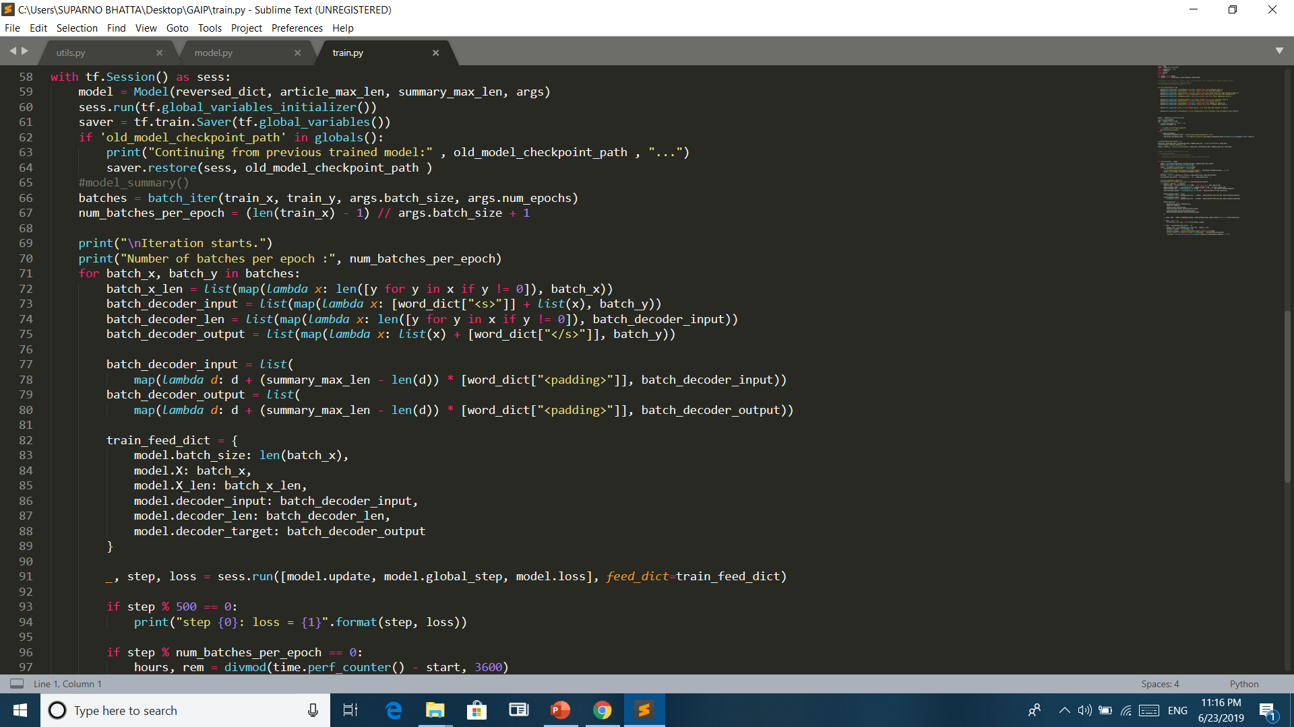
TRAIN.PY
All input parameters required for the model are initialized.
Model is saved/reloaded every time.
All the parameters are then fed to the model and the model is fitted.
Loss and Step counts are calculated and displayed.

Slide 13
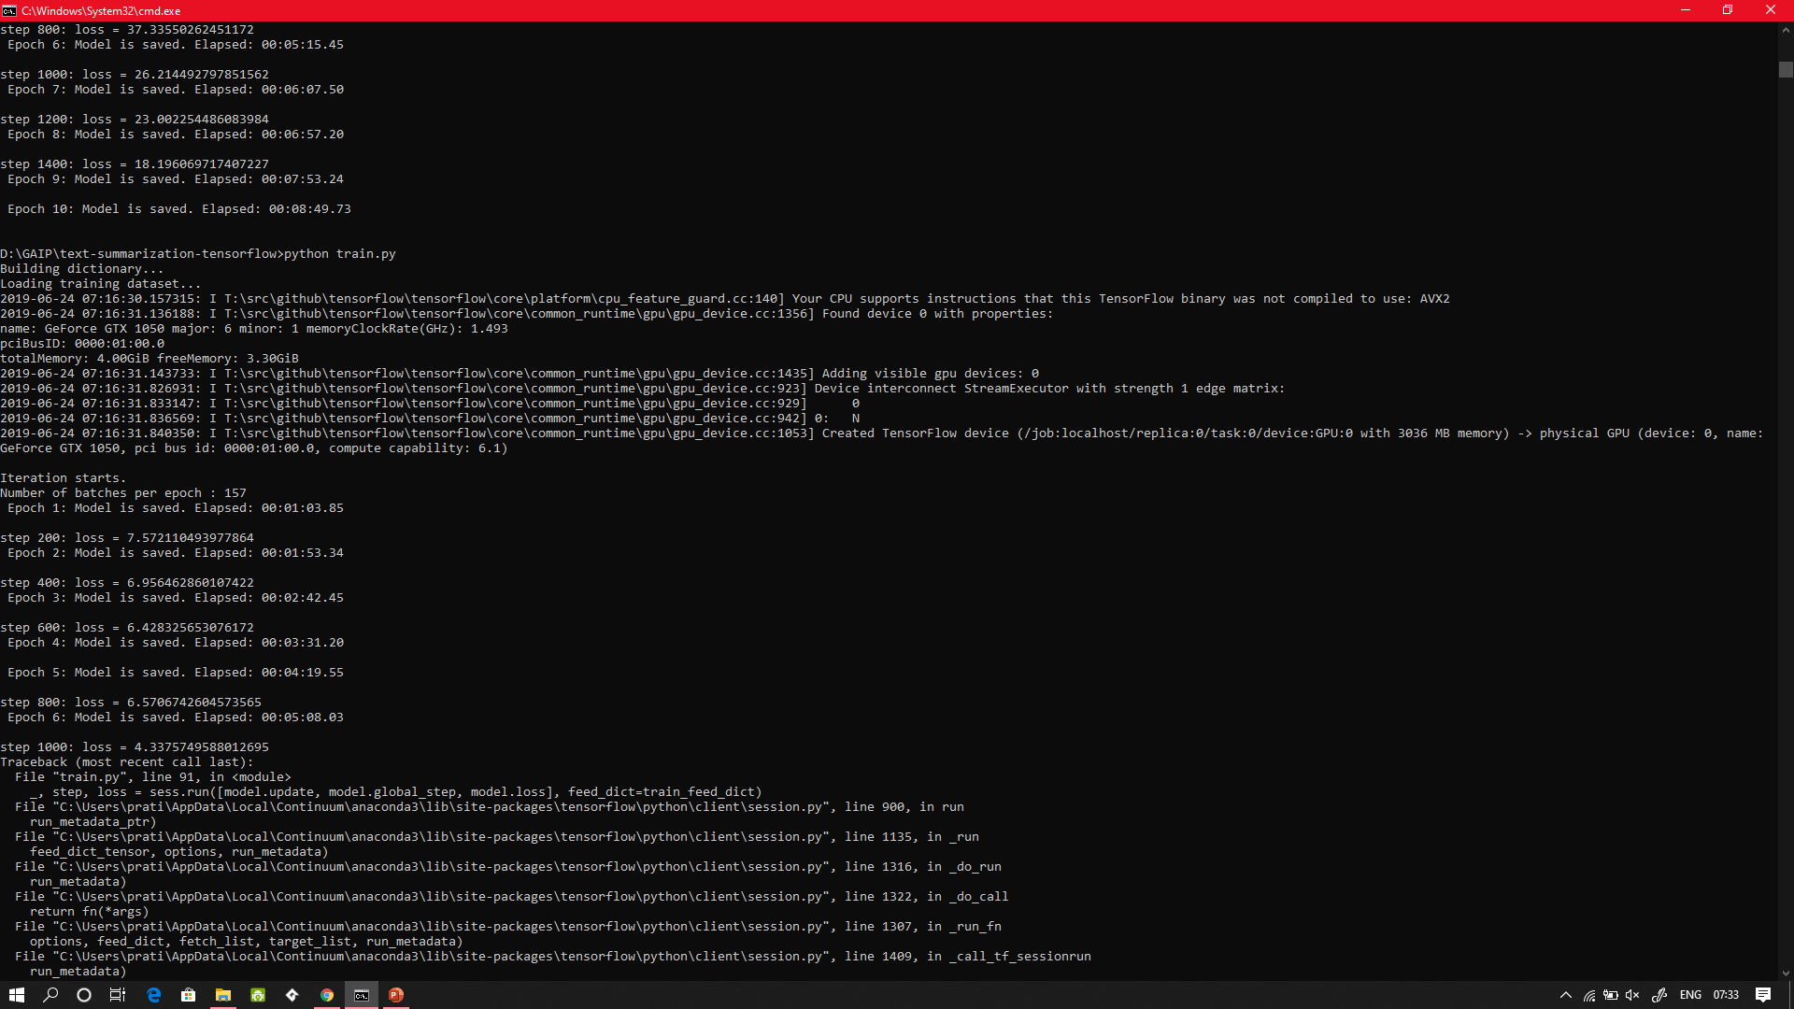
Training the model

Slide 14
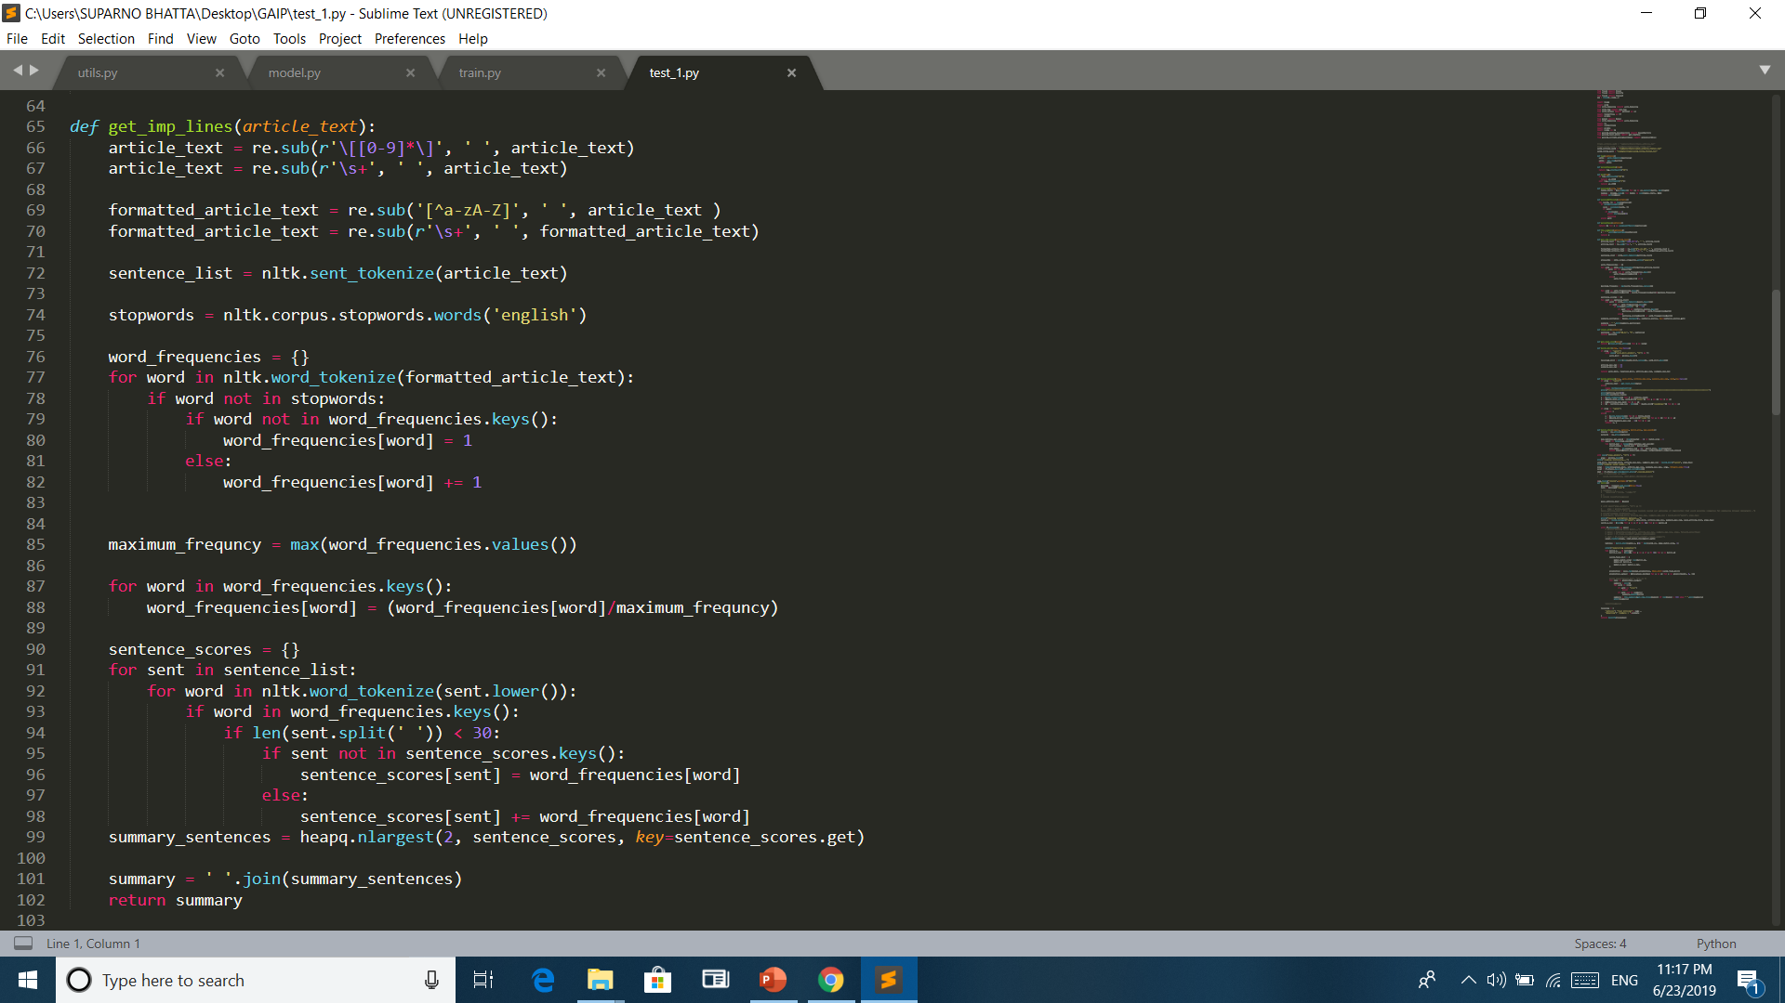
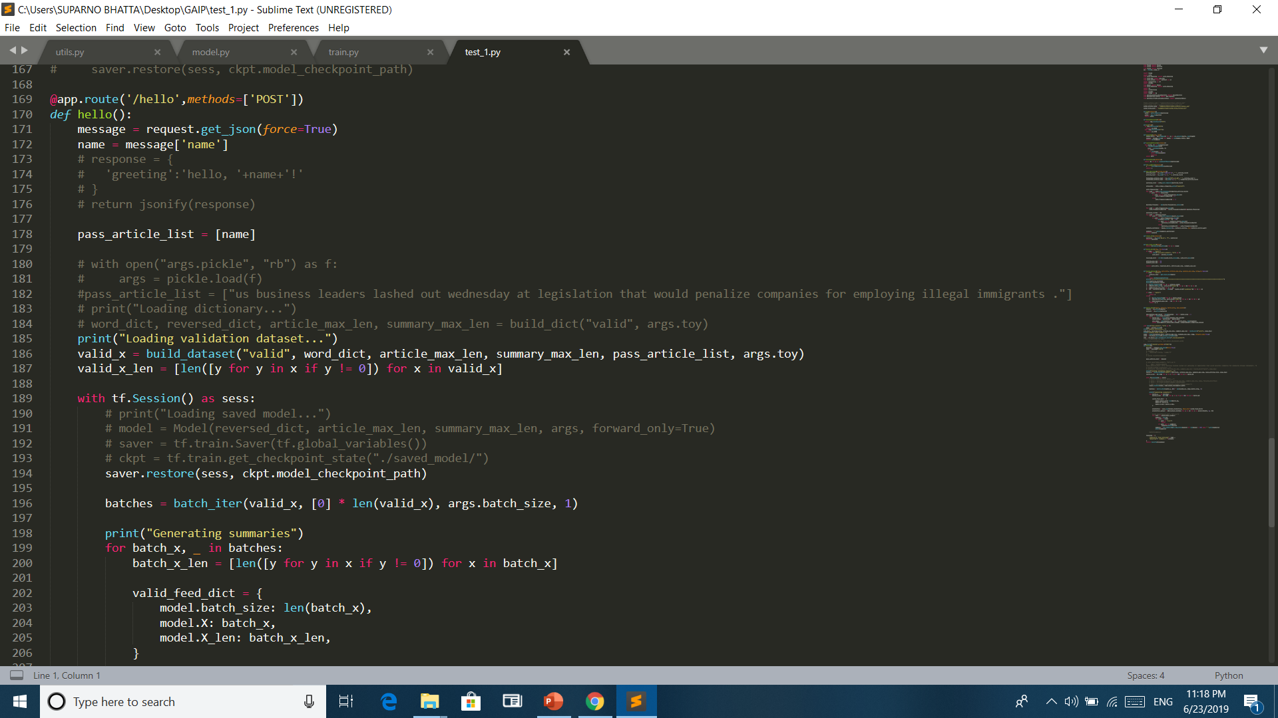
TEST_1.PY
This file is for the text summarizer that summarizes any text content.
The file takes the input text and first preprocesses it.
It then assigns weights to all words except stopwords.
The weights are used to find the important lines of the entire paragraph.
The lines are then extracted and paraphrased using the wordnet.
The output is given to the user.
FLASK is used to run the BRAVIS.com website and the text is sent to the server and the model is run on the server.
Any News Descriptions, essays, etc. can also be summarized in the text summarizer.

Slide 15
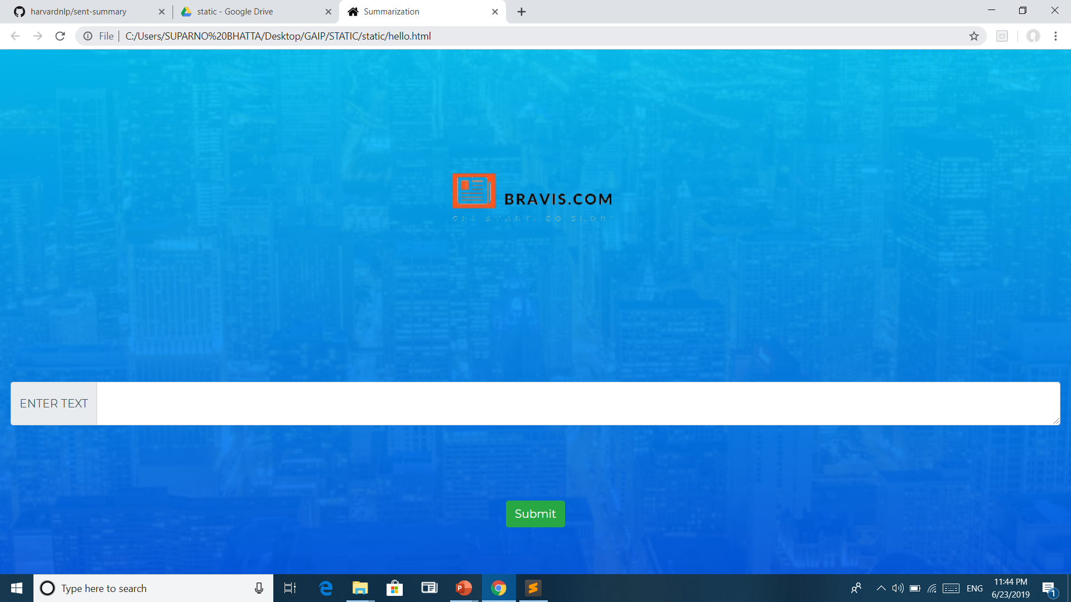
WEBSITE

Slide 16
WORK FLOW
Models.py contains model architecture and utils.py contain helper functions for train.py file.
All the hyper-parameters can be passed to the command-line. In case no parameters are passed, default parameters are assigned.
This Deep Learning model is done on TensorFlow and once the parameters are passed, the training data is preprocessed and the model starts to run.
The model has loss of 4.33757
The test dataset was then used to test the model.
The model is scalable and can be used to generate any number of words as summary for given text. The appropriate dataset must be provided beforehand for the model to be trained and predict the news summary.

Slide 17
WORK FLOW(contd.)
A website using FLASK is built to get input from the user.
The summary of the input text is then generated by sending the text back to webserver.
The model is loaded in the webserver and it will be used to process the input text.
The summary is generated for the input text and it is also paraphrased.
This summary is sent back to the user for he/she to work on it.

Slide 18
CONCLUSION
The state of the art summarization systems are all extractive in nature, but the community is gradually progressing towards abstractive summarization.
Although a complete abstractive summarization would require deeper natural language understanding and processing, a hybrid or shallow abstractive summarization can be achieved through sentence compression and textual entailment techniques.
With textual entailment we can produce more concise and shorter summaries.
Research in summarization continues to enhance the diversity and information richness, and strive to produce coherent and focused answers to users information need.

Slide 19
FUTURE WORK
Better representation of the summaries of the text content.
Better grammar accuracy.
Sentence compression is another very active domain which could be a promising scope of improvement for summarizing applications.
Production of more coherent texts.
The development of more focused summaries may lead to a more consistent evaluation and to a better convergence between human and automatic evaluation methods, which is highly desirable.
Using Markov Chain for better accuracy and prediction.

Slide 20
REFERENCES
https://github.com/harvardnlp/sent-summary (DATA SET)
https://nlp.stanford.edu/projects/glove (GLOVE EMBEDDING)
https://github.com/dongjun-Lee/text-summarization-tensorflow (MODEL ARCHITECHTURE)

Slide 21
QUESTIONS/ANSWERS

Slide 22
THANK YOU

