Slide 1
Capstone Project Battle of Neighbourhoods
By: Tushar Supe

Slide 2
Introduction
Introduction / Business Problem
Change is the only constant in today’s modern age. People move from place to place to find comfort in life whether it is due to safety reasons, transportation or better food availability or job opportunities.
In this project best and safest places to relocate in London are found out with analysis. The London crime data is obtained from Kaggle. Different boroughs in London are studied based on the total crimes, and neighbourhoods are explored for safest borough and analysed using k-mean clustering.
Interest
This project is targeted for people who are relocating to London considering safety as top priority.
For the safest borough, the neighbourhoods are clustered based on most common venues which are obtained from Foursquare API. Based on clusters a person can find best neighbourhood to relocate

Slide 3
Data Description
The data acquired from following data sources:
The dataset consisting of the crime statistics of each borough in London obtained from Kaggle
Co-ordinate of neighborhood obtained using Google Maps API geocoding
Most common venues obtained by Foursquare API

Slide 4
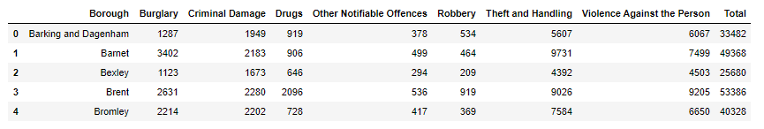
Data obtained from Kaggle after pre-processing
After processing it is found out that as per crime rate the Kingston upon Thames is the safest borough in London.

Slide 5
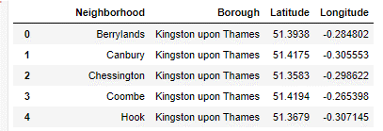
So the coordinates of the neighbourhood in Kingston upon Thames are obtained from Google API geocoder

Slide 6
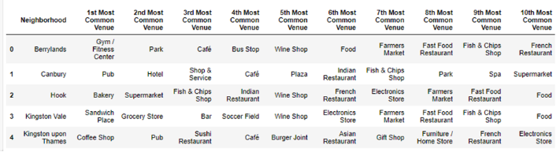
For the neighborhoods best 10 most common venues are obtained using the Foursquare API

Slide 7
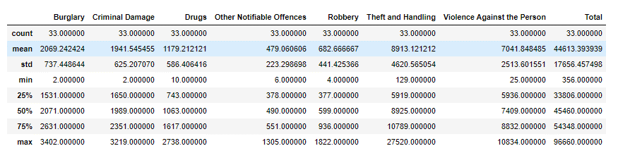
Methodology
The statistical summary

Slide 8
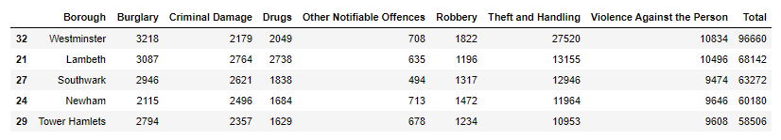
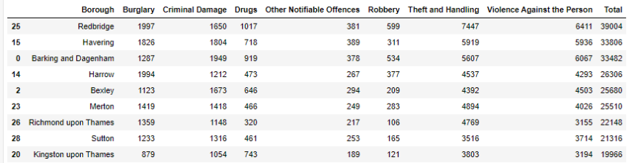
Top five boroughs with the highest crime rate are Westminster, Lambeth, Southwark, Newham, Tower Hamlets
Top low crime rate borough are Kingston upon Thames, Sutton, Richmond upon Thames and Merton

Slide 9
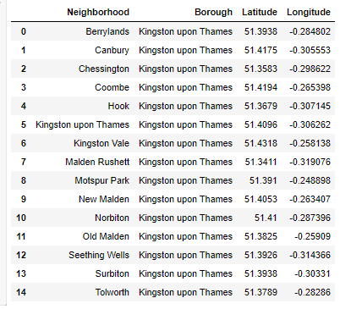
Considering the safest borough in London we can see that the Kingston upon Thames is having lowest crime rate and it will be considered for future neighbourhood data analysis.
Neighbourhoods to Kingston upon Thames are obtained from Wikipedia. And coordinates are from Google geocoder as shown

Slide 10
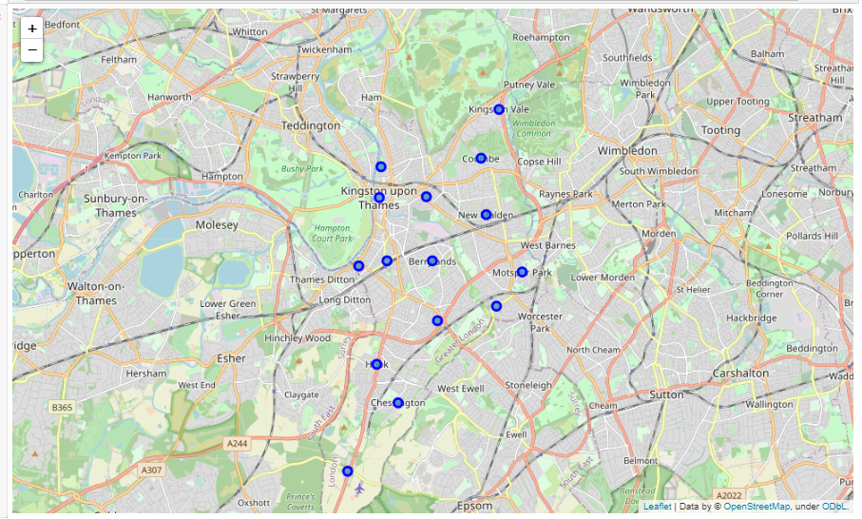
Neighborhoods in Kingston upon Thames are plotted using Folium

Slide 11
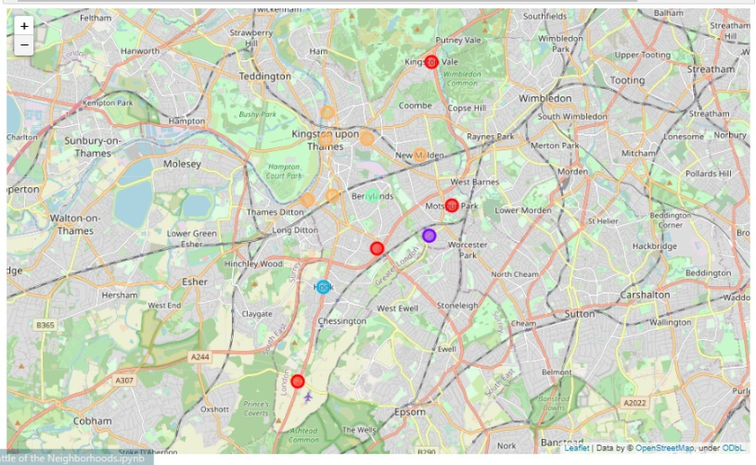
Results
Visualising the clustered neighborhoods on a map using the folium library

Slide 12
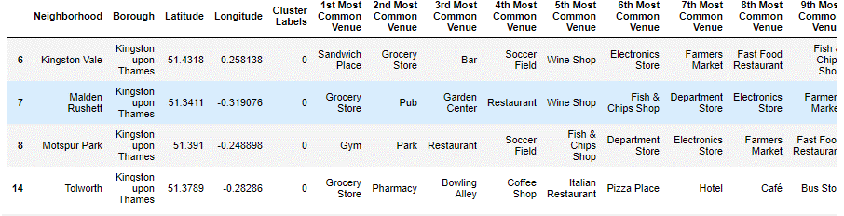
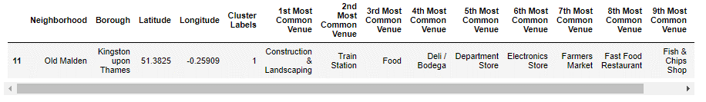
Cluster 1 :
Cluster 2 :

Slide 13
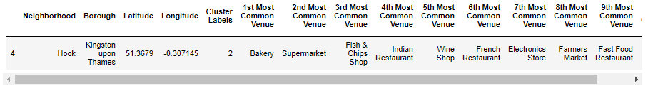
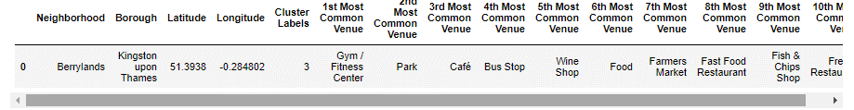
Cluster 3 :
Cluster 4 :

Slide 14
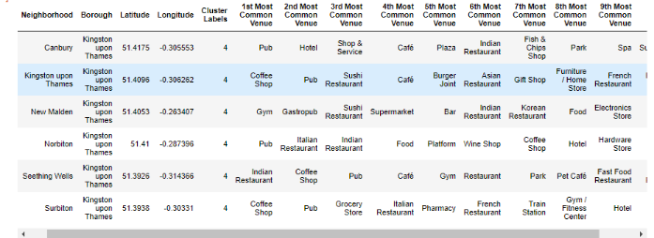
Cluster 5 :

Slide 15
Cluster analysis:
The 1st cluster has 4 of 15 neighborhoods in the borough Kingston upon Thames. The most common venues are Gym, sandwich place and grocery stores, pharmacy, park. .
The second cluster has one neighborhood with Construction & Landscaping as most common venue.
The third cluster has one neighborhood with Bakery as most common venue.
The fourth cluster has one neighborhood with Gym / Fitness Center as most common venue.
The fifth cluster is biggest cluster with 6/15 neighborhood which consists of Venues such as Pub, Coffee shop, gym, Indian restaurant

Slide 16
Discussion
The aim of this project is to find safest borough in London for people who are relocating to London. For the safest borough the neighborhood need to be analyzed so that person will be able to enjoy most common venues and could enjoy life along with safety. Most important venues include pharmacy, gym, restaurants, ease of transportation and grocery stores.
From the analysis of neighborhoods we can see that 1st cluster includes venues like Gym, sandwich place and grocery stores, pharmacy, park. 2nd cluster includes Construction & Landscaping, Train Station, Food, Deli / Bodega, Department Store, Electronics Store, Farmers Market. 3rd cluster includes Bakery, Supermarket, Fish & Chips Shop, Indian Restaurant, Wine Shop, French Restaurant, Electronics Store. 4th cluster includes Gym / Fitness Center, Park, Café, Bus Stop, Wine Shop, Food, Farmers Market. 5th cluster includes Pub, Coffee shop, gym, Indian restaurant, pharmacy, mostly restaurants and eatery.
For a family 1st cluster is more suitable dues to the common venues in that cluster includes most of the essential services. For a foodie person I think 5th cluster is more suitable.

Slide 17
Conclusion
Relocation is most difficult and hectic process and it involves moving to new unknown location where we don’t about food, transportation services and neighboring area and safety. so due to new techniques in data science we can analyze different neighborhoods as if we are virtually present there and we can choose best area to live which is safe for our family and also fulfills all necessary needs.
Here in this project we analyzed different borough of London based on crime rates and shortlisted some neighborhood of safe borough and finally categorized different clusters based on most common venues. this can be helpful for person relocating to London and choosing best neighborhood to live.

