Slide 1




Point2Sequence: Learning the Shape Representation of 3D Point Clouds with an Attention-based Sequence to Sequence Network
1
1, 2
1
2
Xinhai Liu
Zhizhong Han
Yu-Shen Liu
Matthias Zwicker
1
School of Software, Tsinghua University, Beijing, China
2
Department of Computer Science, University of Maryland, College Park, USA

Slide 2
Content
Introduction
Motivation
Technical details
Experiment
Contributions

Slide 3
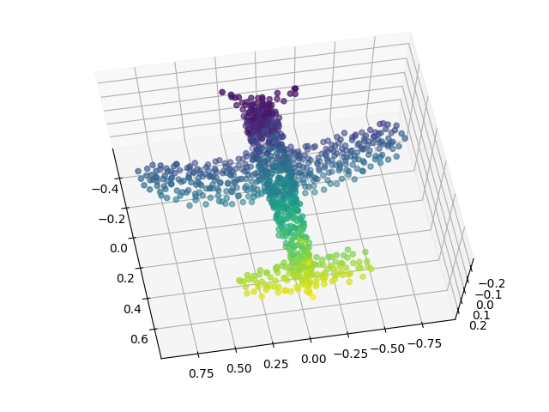
Introduction
Point cloud is considered as one of the simplest 3D shape representations
3D sensors: LiDAR, conventional cameras, or RGB-D cameras
Applications: 3D modeling, autonomous driving, indoor navigation and robotics

Slide 4
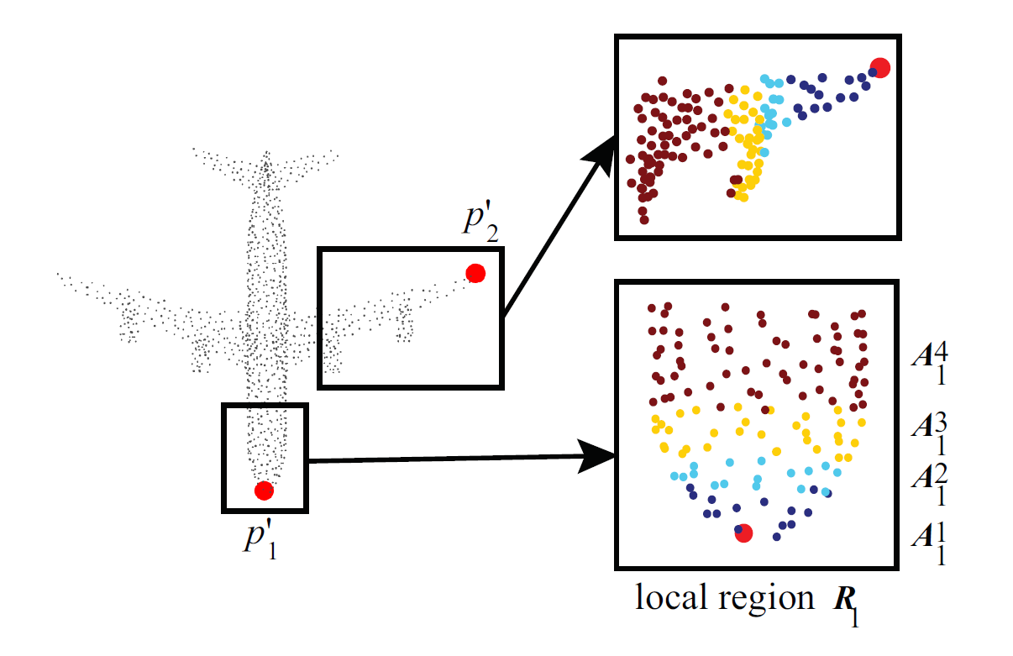
Motivation
Existing studies: encode contextual information of local regions in hand-crafted or explicit ways
Capture fine-grained contextual information, such as the correlation between different areas in a local region.
Point2Sequence: capture the correlations by aggregating multi-scale areas of each local region with attention

Slide 5
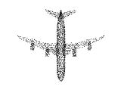
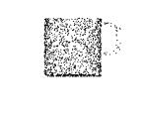
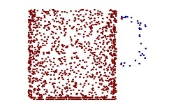
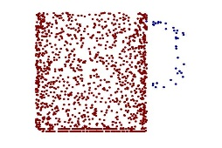
Technical details
Overview
focuses on capturing the contextual information of local regions
embeds the feature of multi-scale areas in each local region by RNN-based model
employs an attention mechanism to highlight the importance of different scale areas
has a wide range of applications, e.g.
3D shape classification
3D shape part segmentation
classify
“airplane”
part segmentation
ground truth
predict

Slide 6
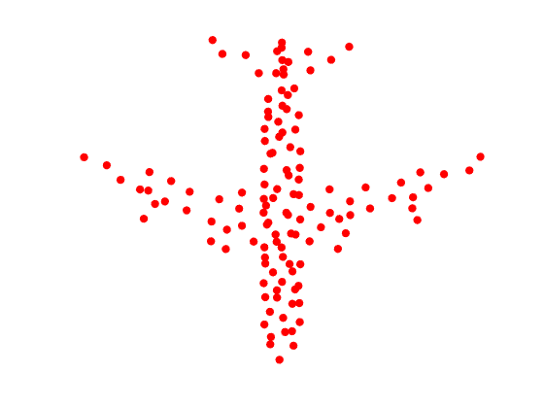
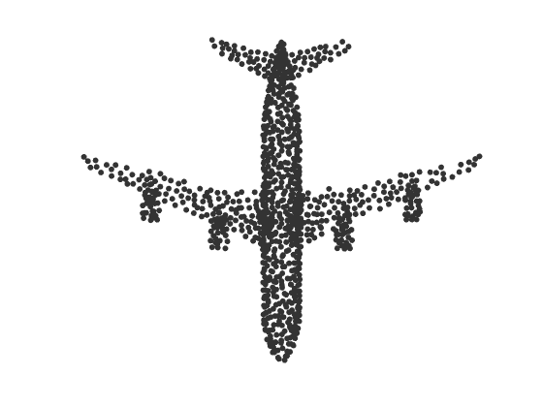








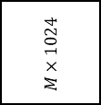




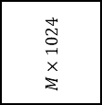




















Technical details
Framework
(a) Multi-scale area establishment
(b) Area feature extraction
(c) Encoder-decoder feature aggregation
(d) Local region feature aggregation
MLP (32,64,128)
max
pool
encoder
decoder
MLP (256, 512, 1024)
max
pool
$$P^{′}$$
$$M×K_{1}×3$$
$$M×K_{1}×128$$
$$M×128$$
$$h_{t}$$
context vector
$$M×128$$
$$M×1024$$
$$M×3$$
$$LSTM$$
$${\tilde{y}}_{1}$$
shared
$$c$$
$${\tilde{h}}_{1}$$
shared
$$1×1024$$
$$a$$
attention
$$g$$
$$P$$
sampling
$$r_{j}$$
$$N×3$$
input points
…
…
…
…
$${\overline{h}}_{1}$$
(e) Shape classification
MLP (128,128,128)
max
pool
$$M×K_{T}×3$$
$$M×K_{T}×128$$
$$M×128$$
$$LSTM$$
Classification scores
$$LSTM$$
$$h_{T}$$
$$1×40$$
$$FC 512$$
$$FC 256$$
shared
$$FC 40$$
$$R_{j}=\{A_{j}^{1},⋯,A_{j}^{t},⋯{,A}_{j}^{T}\}$$
$$S_{j}=\{s_{j}^{1},⋯,s_{j}^{t},⋯{,s}_{j}^{T}\}$$
(f) Shape part segmentation
Segmentation
scores
interpolating
MLP (256,128)
interpolating
$$kNN$$
$${[K}_{1},⋯,K_{t},⋯,K_{T}]$$
$$N×128$$
$$M×128$$
$$M×1024$$
$$FC 128$$
$$N×50$$
$$FC 128$$
shared
$$grouping$$

Slide 7
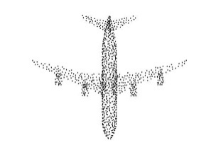
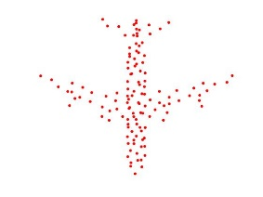
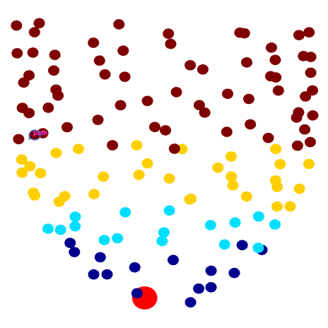
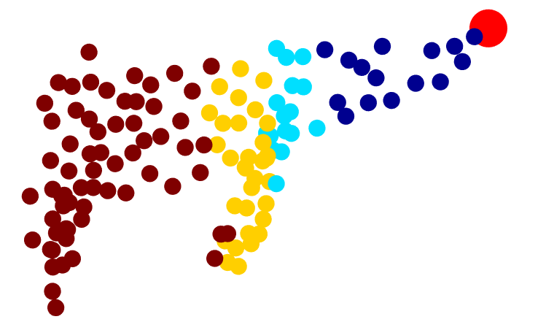
Technical details
Multi-scale area establishment
Input
points
farthest point sampling (FPS)
sampled
points
k-nearest neighbor (kNN)
searching
local
regions

Slide 8
























Technical details
Area feature extraction & Encoder-decoder feature aggregation
encoder
decoder
max
pool
$$h_{t}$$
context vector
$$\tilde{y}$$
$$A_{j}^{1}$$
$$MLP 1$$
$$s_{j}^{1}$$
$$LSTM$$
$$c$$
$$\tilde{h}$$
max
pool
$$a$$
$$A_{j}^{2}$$
$$MLP 2$$
$$s_{j}^{2}$$
$$LSTM$$
attention
$$\overline{h}$$
$$⋯$$
$$⋯$$
$$⋯$$
$$⋯$$
max
pool
$$LSTM$$
$$h_{T}$$
$$A_{j}^{T}$$
$$MLP T$$
$$s_{j}^{T}$$
$$LSTM$$

Slide 9







Technical details
Shape classification & shape part segmentation
max
pool
global feature
$$\tilde{y}$$
$$MLP$$
$$FC layers$$
airplane?
$$g$$
…
classification
wing?
$$MLP$$
$$interprolating$$
$$FC layers$$
…
part segmentation

Slide 10
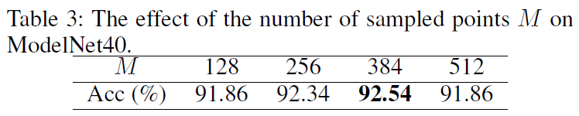
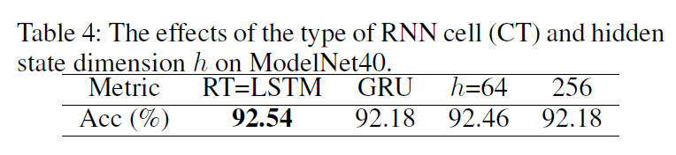
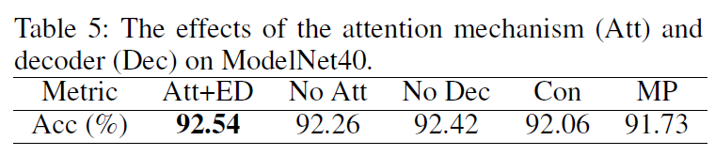
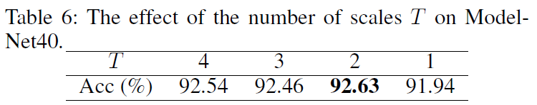
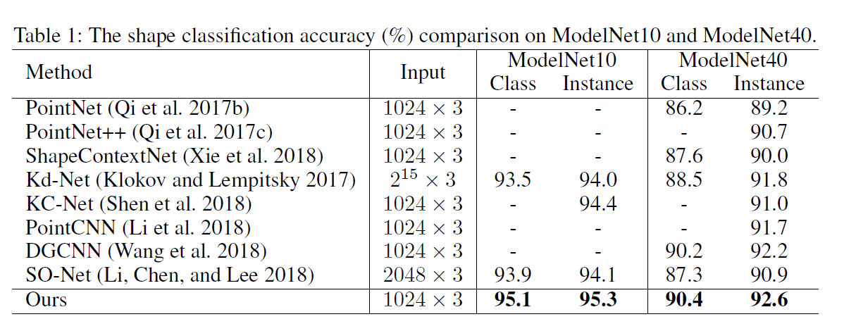
Experiments

Slide 11
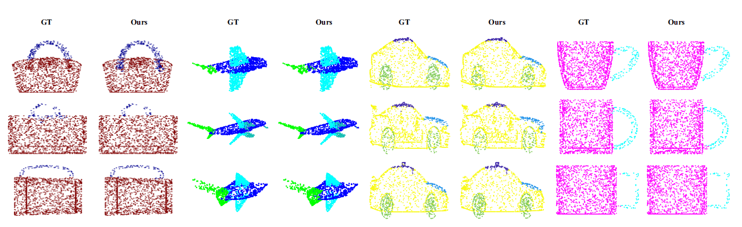
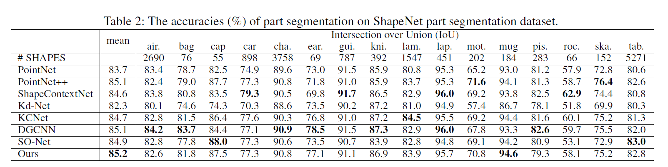
Experiments

Slide 12
Contributions
Capture the correlation between different areas in a local region
Introduce an attention mechanism to highlight the importance of different scale areas
Our outperforming results verify the feasibility of RNNs to effectively understand point clouds.

