Slide 1
Techvocate
Ai powered legal documentation generator

Slide 2
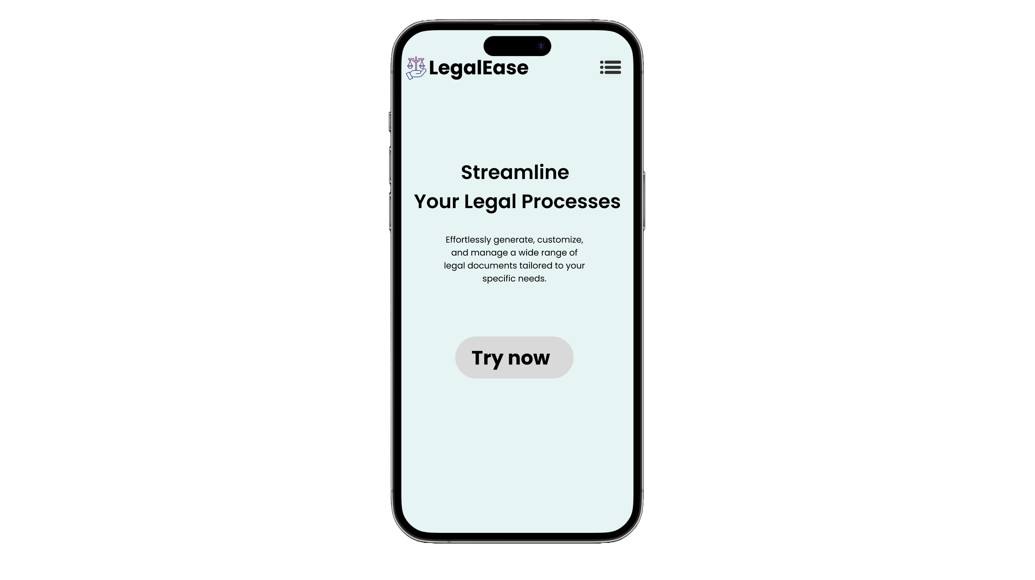
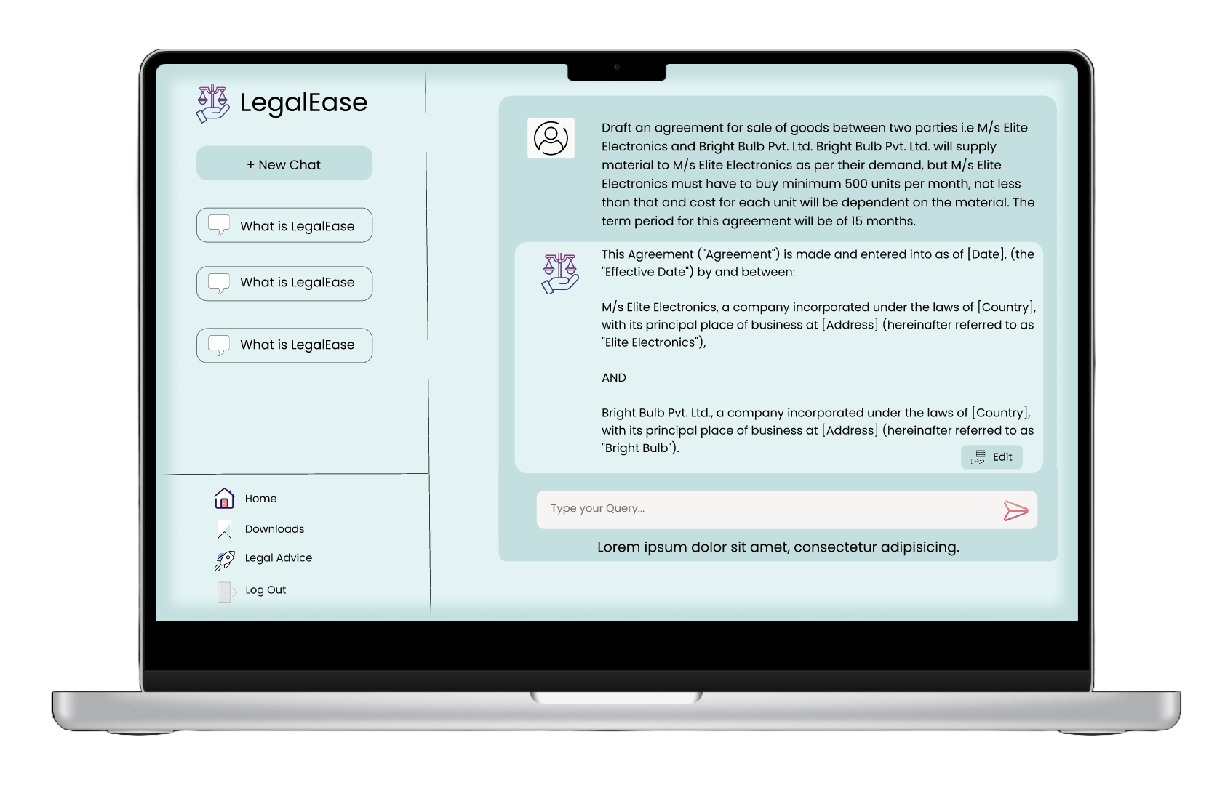
Introducing the Future of Legal Document Generation: Our AI-Powered Solution!
The user inputs their legal document requirements into our intuitive user interface with essential details such as parties involved, terms of the agreement, and other necessary information.
Using the provided LLM (Large Language Model) the platform analyzes the user's input, identifying key legal elements and requirements.
The LLM has access to all the relevant acts and documents that include the guidelines which are stored in the vector store in the form of embeddings, that must be present in the respective agreement.
Using Generative AI(Llama2) the platform automatically generates a precise comprehensive legal document in plain language and using easy-to-understand terms.
To meet individualized needs, users have the option to customize their legal documents. They can preview the generated document and make any additional edits or changes if necessary.
In case of complex legal issues or uncertainties, users have the option to seek guidance from legal experts directly through the platform.
Once satisfied, users receive the final legal document tailored to their needs that they can easily download and securely store.

Slide 3
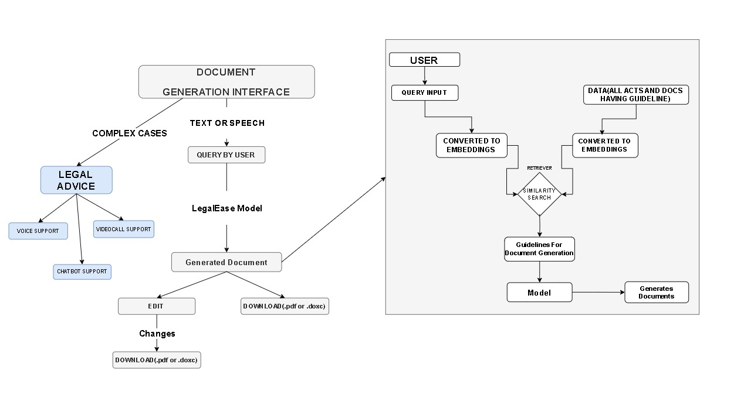

Slide 4
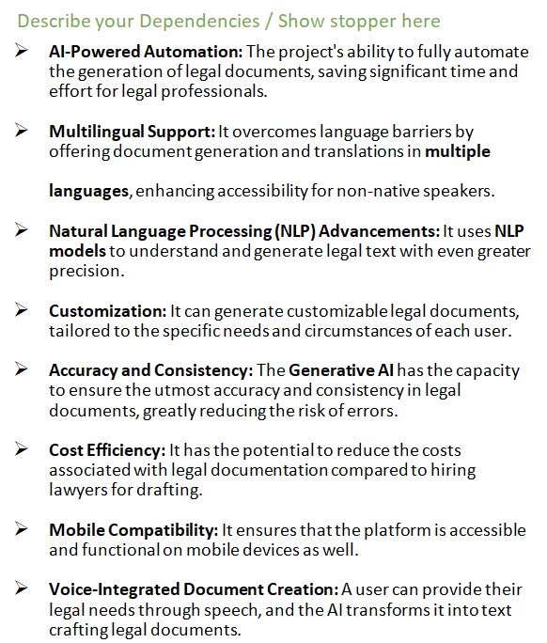
Team Member Details
Team Member 1 Name: Ashwin Tyagi
Branch: Btech Stream : CSE Year : II
Team Member 2 Name: Shreesh Shukla
Branch: Btech Stream : CSE Year : II
Team Member 3 Name: Devesh Mishra
Branch: Btech Stream : CSE Year : II

