Slide 1
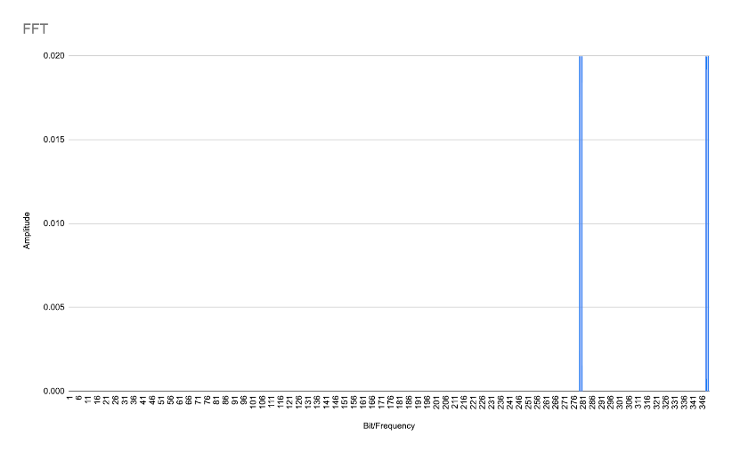
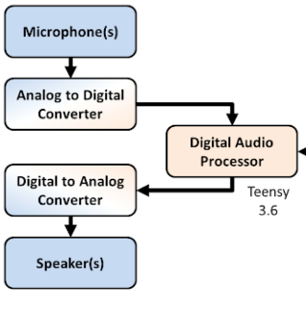
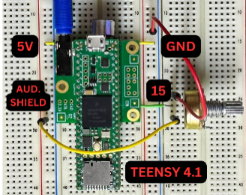
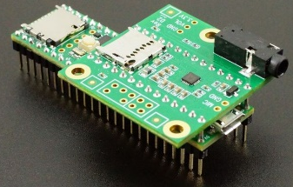
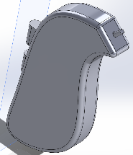

Adaptive Hearing Aid
Yael Alonso, Edward Chung, Abraham Ramirez-Sierra, Regina Yang, Zion Zapien, Department of Bioengineering
A b s t r a c t
R e s u l t s & D a t a
D i s c u s s i o n / F u t u r e W o r k
According to Wang and Puel¹, “approximately one third of people over 65 years of age are affected by disabling hearing loss. In 2025, there will be 1.2 billion people over 60 years of age worldwide, with more than 500 million individuals who will suffer significant impairment from presbycusis.” However, because the diagnosis and degree of hearing loss is independent of every presbycusis patient, hearing aids are not a perfect solution for all. Given these requirements, an Adaptive Hearing Aid would be the most appropriate solution to this medical problem, enabling the user the ability to choose the frequency that sounds best in their own comfort. The goal of this project is to implement nonlinear transposition, FFTs, and noise-filtering with the Teensy 4.1 Processor, Audio Shield, and Arduino to allow for patients to live a more comfortable life with the feature of user-friendly frequency transposition.
Fig. 3: Taken from experimental stages, plotted FFT graphs of sound output from the device.
Our most difficult task of the project is to be able to successfully perform Fast Fourier Transform on any audio data that the Teensy takes in and make it sound pleasant to the user. Our plans go as follows for the hearing aid:
Take in Audio Data (Audio Shield) Take samples in the time domain
Take FFT to convert to frequency domain (Teensy) Manipulate the frequency bins to do the frequency shifting
Take (Inverse)IFFT to convert back to time domain
Send samples back to the audio interface(Audio Shield)
Currently, we have completed the following, but when audio is heard by the user, it sounds very robotic and lacks some natural sound to it. We are currently working on making the sound of the hearing aid feel more natural to the user and allowing the person to be able to have the adaptability to change the filtering so that higher or lower frequencies can be shifted according to the user. Additionally, we will be working on adding more bins to the code so that instead of there being around 700 there is around 100, we believe that this will help the user hear more precise sounds and have natural flow to it.
The naturality of the sound can also be fixed by adding another microphone to the processor and combine the sounds so that the parts that cannot be heard seem a little clearer.
Also, we want to solder on a battery so that the device can be carried around by a user and be easily replaced when it runs out of battery, but of course, with this comes the case that has to be 3-D printed so the user can carry it around their neck or have it on their side.
C o m p o n e n t s & J u s t i f i c a t i o n s
Fig. 1: Taken from Source [7], a diagram flow chart showcasing the components of the device
Fig. 2: Taken during prototyping stages, the labelled components of the device
The goal of the device is to be user-friendly by giving the user the ability to control the frequency range. This is accomplished by the user’s input. Using the Teensy 4.1, the user’s dead regions can be targeted. Usually, a dead region would be accessed by an audiologist. With this information, the device can adapt to the targeted range. When initializing the device, frequency of the Dead Region (start and end) frequency can be selected.
This is preformed by converting the user’s frequencies into bins. Since the Teensy board has a sampling rate of 44,100 Hz and a 1024-point window, there is a limited representation of 1024 points of signal. Each point of signal is a bit and encompasses a range of about 43Hz. To speed up the processing of the teensy, only the first 512 points are shown. This is equivalent to frequencies up to 22kHz. A plot with the x-axis corresponding to the specific bit and the y-axis to the amplitude or power of the bit is shown in Figure 3.
Fig. 6: Finished, simplified image of device without power supply or extra wiring, sourced from [6]
Fig. 7: In-house generated SolidWorks model of 3D-printed casing BTE-style
The functionality of the device can be classified into 4 main components. The first component of the device is the microphone. Cylewet cylindrical electret condenser microphone was used since it was small, portable, and had a frequency range of 50Hz to 20kHhz (considering that humans can hear 1-20kHz).
The second component is the processor. The Teensy 4.1 Processor was chosen for its Arduino compatibility and capabilities of real-time use with the speed of 600 MHz. Real time capabilities are crucial for hearing aid as the goal is to have little to no delays in sound output for the user. Additionally, the processor comes with 1MB of RAM and 8MB of flash memory. Anticipating a memory problem with the code, a SD card was inserted.
The third component is the Audio Shield. The Teensy 4.0 Audio Shield (Rev D) is connected to the Teensy 4.1 using female pins. The shield allows the device to convert between analog and digital signals. The audio shield consists of a 16 bit with a 44.1 kHz sample rate and an audio jack for speakers to output sound.
The device runs on a Teensydiuno program. Teensydiuno is similar to the Arduino but particular to Teensy and the Audio Shield. The Teensy Audio library was utilized for communication between the Teensy processor and audio shield. It also allows the application of effects to sound converted by the audio shield. One effect is the amplification that is filtered from the high pass filter. The filter was used to focus on high frequencies. The library also allows data collection of FFTs. Shifting of bins that are made during Fast Fourier Transform (shift the frequencies from high to low) is applied to satisfy the hearing range.
Fig. 4: Screenshot from the Teensyduino code showcasing the user-interface after inputting their dead region, allowing the device to transpose accordingly
R e f e r e n c e s
M a r k e t V a l u e & R e g u l a t i o n s
[1] Wang, Jing, and Jean-Luc Puel. “Presbycusis: An Update on Cochlear Mechanisms and Therapies.” Journal of Clinical Medicine, vol. 9, no. 1, 2020, p. 218, https://doi.org/10.3390/jcm9010218. [2] “Product Classification.” U.S Food and Drug Administration,
https://www.accessdata.fda.gov/scripts/cdrh/cfdocs/cfPCD/classification.cfm?ID=OSM [3] “Hearing Aids Market Size, Share, And Trend Analysis Report By Product Type, By Technology Type, By Type of Hearing Loss, By Patient Type, By Sales Channel, By Region, And Segment Forecasts, 2022 - 2030.” Grand View Research,
https://www.grandviewresearch.com/industry-analysis/hearing-aids-market [4] “Hearing Aids Market Size, Share, and COVID-19 Impact Analysis.” Fortune Business Insights,
https://www.fortunebusinessinsights.com/industry-reports/hearing-aids-market-101573 [5]“How Many Californians Affected by Hearing Loss.” Hear Center,
https://www.hearcenter.org/how-many-californians-are-affected-by-hearing-loss/#:~:text=In%20California%20alone%2C%20the%20Office,and%20its%20surrounding%20counties%20home. [6] Michon, Romain, and Douglas McCausland. “Lab 2: Embedded Audio DSP with Faust and the Teensy.” Music 250a | Spring 2021 - Lab 2: Embedded Audio DSP with Faust and the Teensy, 2021, ccrma.stanford.edu/courses/250a-spring-2021/labs/2/. [7] Chip, Eric. “Open Audio: Explorations of Open-Source Audio Processing Hardware, Software, and Hacks!” A Teensy Hearing Aid, 2016, openaudio.blogspot.com/2016/11/a-teensy-hearing-aid.html.
The global market value for hearing devices was 10.1 billion dollars (USD) and has a compound growth rate of 4.9 percent from 2022 to 2030 ³.The largest revenue share is behind the ear hearing devices at 40 percent ³. The hearing aid that is being designed falls under Class II devices as set by the Food and Drug Administration (FDA) which is defined as hearing aid utilizing air conduction with wireless technology². The hearing aid device is exempt from both 510(K) and premarket review clearance². In order to satisfy the quality system regulations, set by the FDA, this hearing device will follow the consensus standards set through the American Standards National Institute (ANSI).
TAM: $10.1bil
Fig. 5: TAM/SAM/SOM visual ref sources [4] and [5]
SAM: $3.66bil
SOM: $251mil
A c k n o w l e d g m e n t s
This project is conducted by the University of California, Riverside, with guidance from faculty staff in the Department of Bioengineering. We would like to additionally thank Dr. James Sawyer, Department of Mechanical Engineering, Paul Stroffregen, Ryan Chang, and Joseph Chang for their continual expertise and support.

