Slide 1
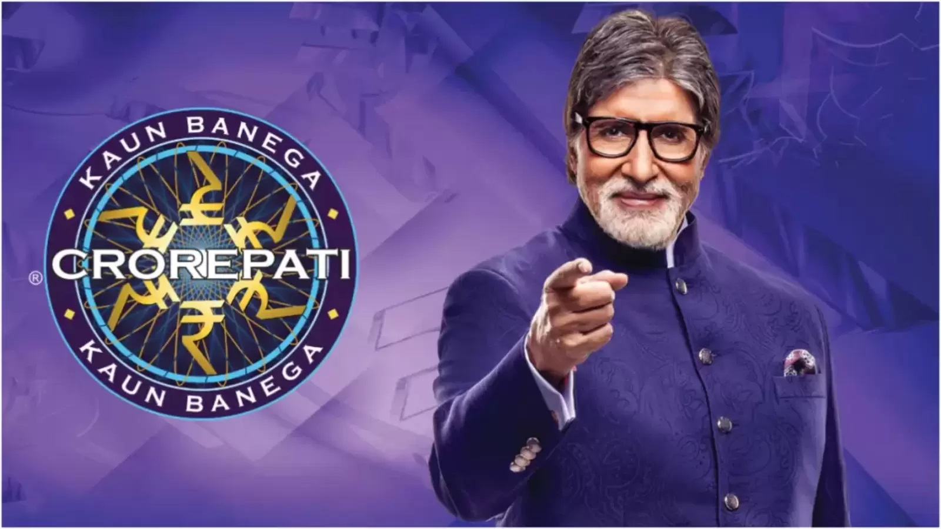
START

Slide 2


Q. CHOOSE YOUR SUBJECT.
A. GENERAL KNOWLEDGE
B. MATHEMATICS
START

Slide 3
1. What is the capital of Japan?
A. Beijing
B. Seoul
C. Tokyo
Bangkok

Slide 4
2. Which wrote the play “Romeo and Juliet”?
A. Charles Dickens
B. Mark Twain
C. William Shakespeare
Jane Austen

Slide 5
3. In which year did World War II end?
A. 1945
B. 1939
C. 1940
1950

Slide 6
4. Which famous scientist developed the Laws of motion and gravity?
A. Albert Einstein
B. Isaac Netwon
C. Galileo Galilei
Nikola Tesla

Slide 7
5. Who was the first President of the United States?
A. Abraham Lincoln
B. George Washington
C. Thomas Jefferson
John Adams

