Slide 1
Brain Power.

Slide 2
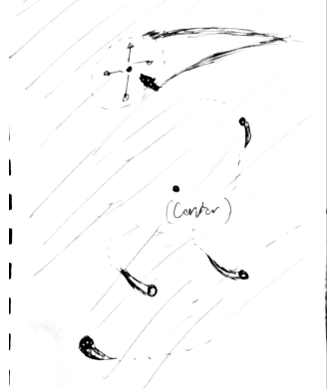
Initial Concept.

Slide 3
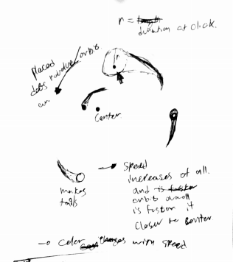
Initial Concept.

Slide 4
Nope. I don’t like this.

Slide 5
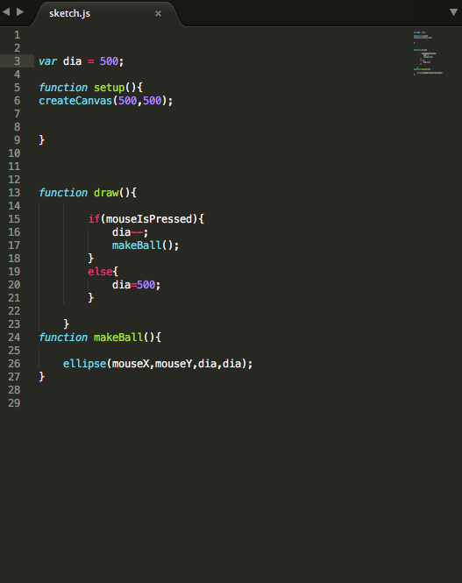
New Exploration.

Slide 6

New Exploration.

Slide 7
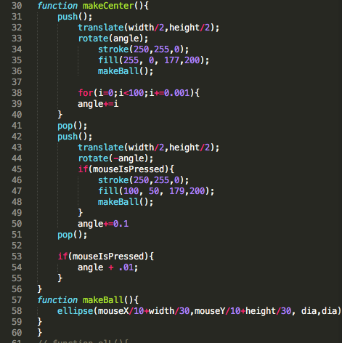
New Exploration.

Slide 8
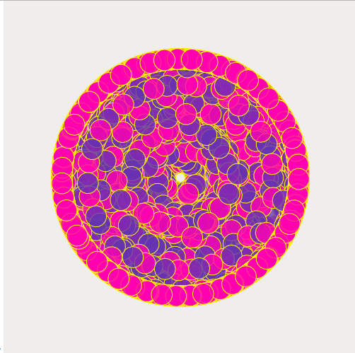
New Exploration.

Slide 9

New Exploration.

Slide 10
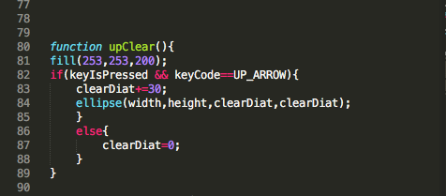
New Exploration.

Slide 11

New Exploration.

Slide 12
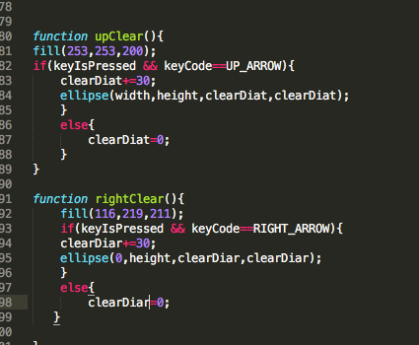
New Exploration.

Slide 13

New Exploration.

Slide 14
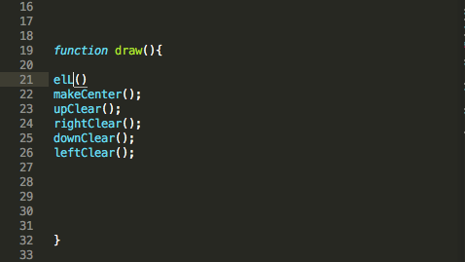
New Exploration.

Slide 15

New Exploration.

Slide 16
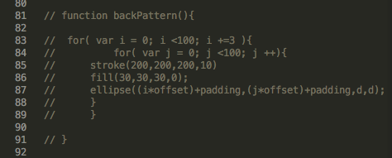
New Exploration.

Slide 17

New Exploration.

Slide 18
Final Thoughts.
http://localhost:8000/

