Slide 1

Analysis & Strategy for Portuguese Hotel Enterprise
Group D
2330036010 陈泽铭
2330036016 丁子潇
2330036158 吴书瑾
2330036190 张硕彦

Slide 2
2.Data Processing
3.Modeling
CONTENTS
1.Introduction
4.Visualization & Recommendation

Slide 3

1.Introduction

Slide 4

Introduction & Problem Statement
A major Portuguese hotel enterprise faces a critically high booking cancellation rate, leading to significant lost revenue and operational unpredictability.
Our objective is to analyze the provided booking data to identify the root causes of cancellations, using data-driven insights and recommendations to formulate an effective development strategy aimed at stabilizing bookings and maximizing overall profitability.

Slide 5
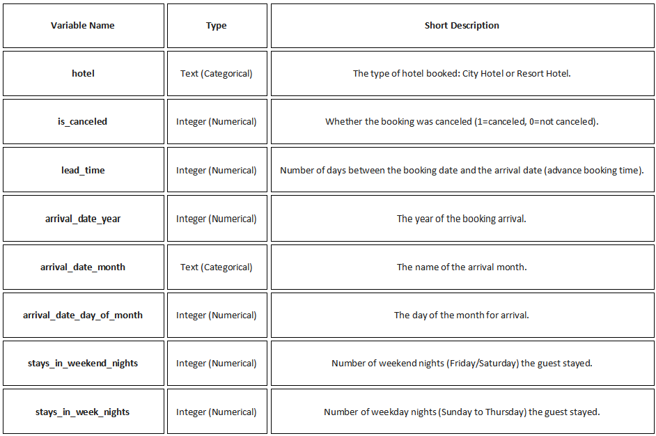
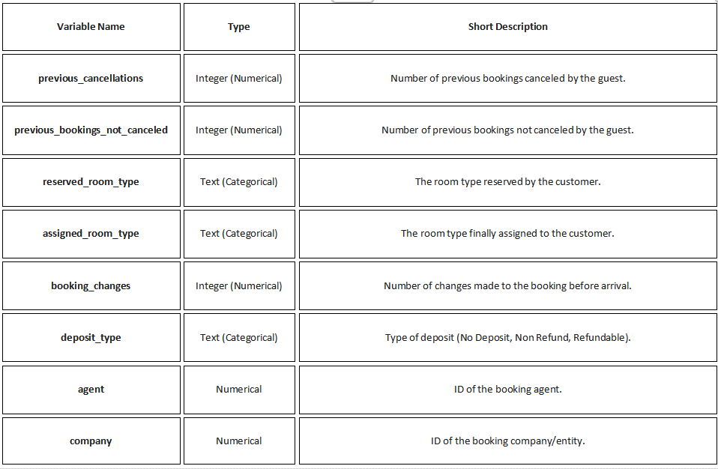
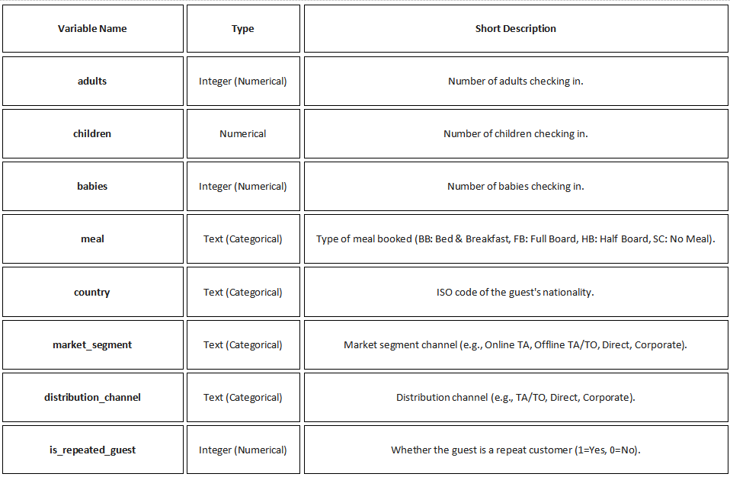
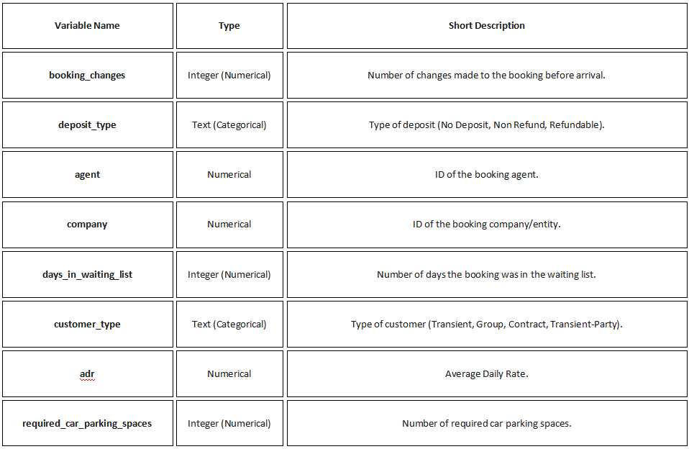
Data Sources & Dictionary
Data Dictionary
This data set contains booking information for 2 hotels, includes basic information of every bookings.
https://www.kaggle.com/datasets/jessemostipak/hotel-booking-demand/data

Slide 6
2. Data Processing

Slide 7
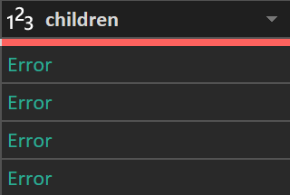
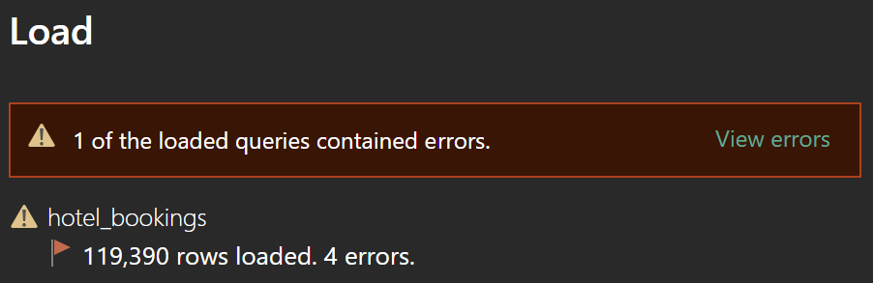
Challenges & Data Processing
Challenges
We have some missing values in columns like babies, children, agent and company, causing errors in data loading.
Since there are lots of people cancel their bookings, we have to distinguish the successful bookings and canceled bookings to analyze the cancellation rate.
Missing value handling: Set children error values to 0; uniformly label missing agent/company fields as 'Unused' and country fields as 'Unknown'
Feature engineering: Create a unified arrival_date based on year, month, and day, while generating numerical month formats.
Structural optimization: Remove $15$ redundant columns not used for core analysis to streamline the fact sheet.

Slide 8
3. Modeling

Slide 9
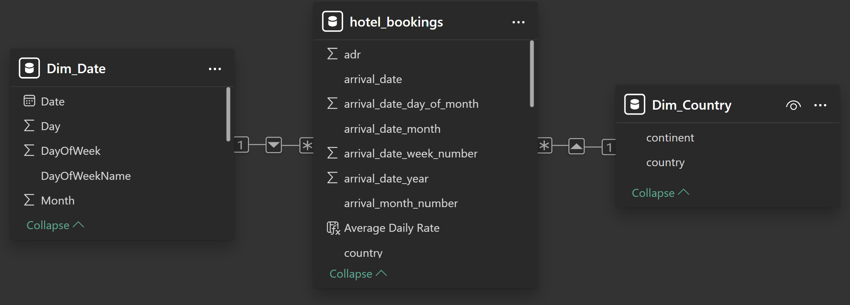
Modeling (Star schema)
Table Name | Table type | Function | Key link column
hotel_bookings | Fact Table | Including quantifiable business metrics and foreign keys | arrival_date, country
Dim_Date | Dimension Table | Provide time attributes (years, months, quarters, etc.) to enable time analysis | Date (Primary Key)
Dim_Country | Dimension Table | Provide geographic attributes (continent) to support geographic analysis | country (primary key)
This project employs a Star Schema design to ensure efficient data retrieval and flexible analysis.

Slide 10
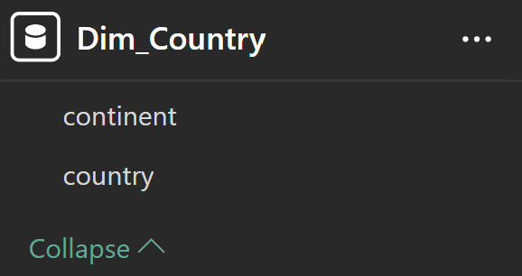
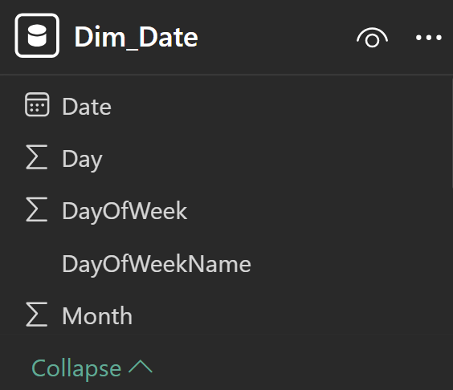
Modeling
Demonstrate the geographic information in the fact table by analyzing the country codes into different continents.
Process: Change the data category to Country/Region.
Relationship: The country column in the Dim_Country table is linked to the country column in the hotel_bookings fact table through a one-to-many relationship.
Use the DAX CALENDARAUTO() function to automatically generate a date range and exclude data from 2014, ensuring the calendar range aligns with the actual data.
Relationship: The unique column Date in the Dim_Date table is linked to the arrival_date column in the hotel_bookings fact table through a one-to-many relationship.

Slide 11
Calculated Columns
These columns are used to create new dimension attributes in the fact table (hotel_bookings)
for flexible grouping and slicing.
DAX | Type | Code | Explanation
Average Daily Rate | Calculated Column | SWITCH( TRUE(), 'hotel_bookings'[adr] <= 100, "0-100", 'hotel_bookings'[adr] <= 200, "100-200", 'hotel_bookings'[adr] <= 300, "200-300", ">300" ) | Price segment analysis. Convert the continuous average daily rate (ADR) into discrete categories.
Grouping based on the number of days of advance booking | Calculated Column | SWITCH( TRUE(), 'hotel_bookings'[lead_time] <= 7, "0-7 days", 'hotel_bookings'[lead_time] <= 30, "8-30 days", 'hotel_bookings'[lead_time] <= 90, "31-90 days", ">90 days" ) | Split the lead time into segments. Divide the lead time into different time periods.

Slide 12
Base Aggregations
These core metrics for counting and summing form the foundation for building all complex KPIs in the model.
DAX | Code | Explanation
Total Bookings | COUNTROWS ( 'hotel_bookings' ) | Total bookings. Calculate the total number of all booking records in the data set.
Stayed Nights | SUMX ( FILTER ( 'hotel_bookings', 'hotel_bookings'[is_canceled] = 0 ), 'hotel_bookings'[stays_in_week_nights] + 'hotel_bookings'[stays_in_weekend_nights] ) | Total actual check-in nights. Sum only for un-canceled bookings (is_canceled = 0) to calculate the total number of actual weekend and weekday nights.
Total Revenue | SUMX ( FILTER ( 'hotel_bookings', 'hotel_bookings'[is_canceled] = 0 ), 'hotel_bookings'[adr] * ( 'hotel_bookings'[stays_in_week_nights] + 'hotel_bookings'[stays_in_weekend_nights] ) ) | Actual revenue. This is calculated based on the total revenue from bookings that were not canceled, calculated by multiplying the room rate (ADR) by the actual number of nights occupied.
Lost Revenue | SUMX ( FILTER ( 'hotel_bookings', 'hotel_bookings'[is_canceled] = 1 ), 'hotel_bookings'[adr] * ( 'hotel_bookings'[stays_in_week_nights] + 'hotel_bookings'[stays_in_weekend_nights] ) ) | Potential lost revenue. Calculate potential revenue lost due to canceled bookings to assess high-risk market segments and develop targeted strategies.

Slide 13
Derived KPIs and Ratios
These metrics filter and calculate basic aggregated values to provide key performance indicators (KPIs)
DAX | Code | Explanation
Stayed Bookings | CALCULATE ( [Total Bookings], 'hotel_bookings'[is_canceled] = 0 ) | Actual check-in bookings. Calculate the number of all un-canceled bookings.
Canceled Bookings | CALCULATE ( [Total Bookings], 'hotel_bookings'[is_canceled] = 1 ) | Cancel reservations. Calculate the total number of canceled reservations.
Cancellation Rate | DIVIDE ( [Canceled Bookings], [Total Bookings] ) | The cancellation rate. Measures the proportion of cancellations to the total number of bookings and is used to assess booking risk.
Avg ADR (Stayed) | DIVIDE ( [Total Revenue], [Stayed Nights] ) | Average daily rate (occupied). Calculate the average daily rate for actual occupied bookings.

Slide 14
Contextual Analysis
These metrics are used to compare and rank across dimensions (e.g., countries/regions) to provide business insights.
DAX | Code | Explanantion
Revenue Contribution | DIVIDE([Total Revenue], CALCULATE([Total Revenue], ALL('Dim_Country')), 0) | Revenue contribution. Calculate the percentage of total revenue in the current filter context (e.g., a single country) relative to the total revenue of all countries to identify key markets.
Rank | RANKX( ALL('Dim_Country'), CALCULATE([Total Revenue]), , DESC, Dense ) | Revenue contribution ranking. Rank all countries in the Dim_Country table based on total revenue.

Slide 15
4. Visualization & Recommendation

Slide 16

PART ONE
Overview

Slide 17
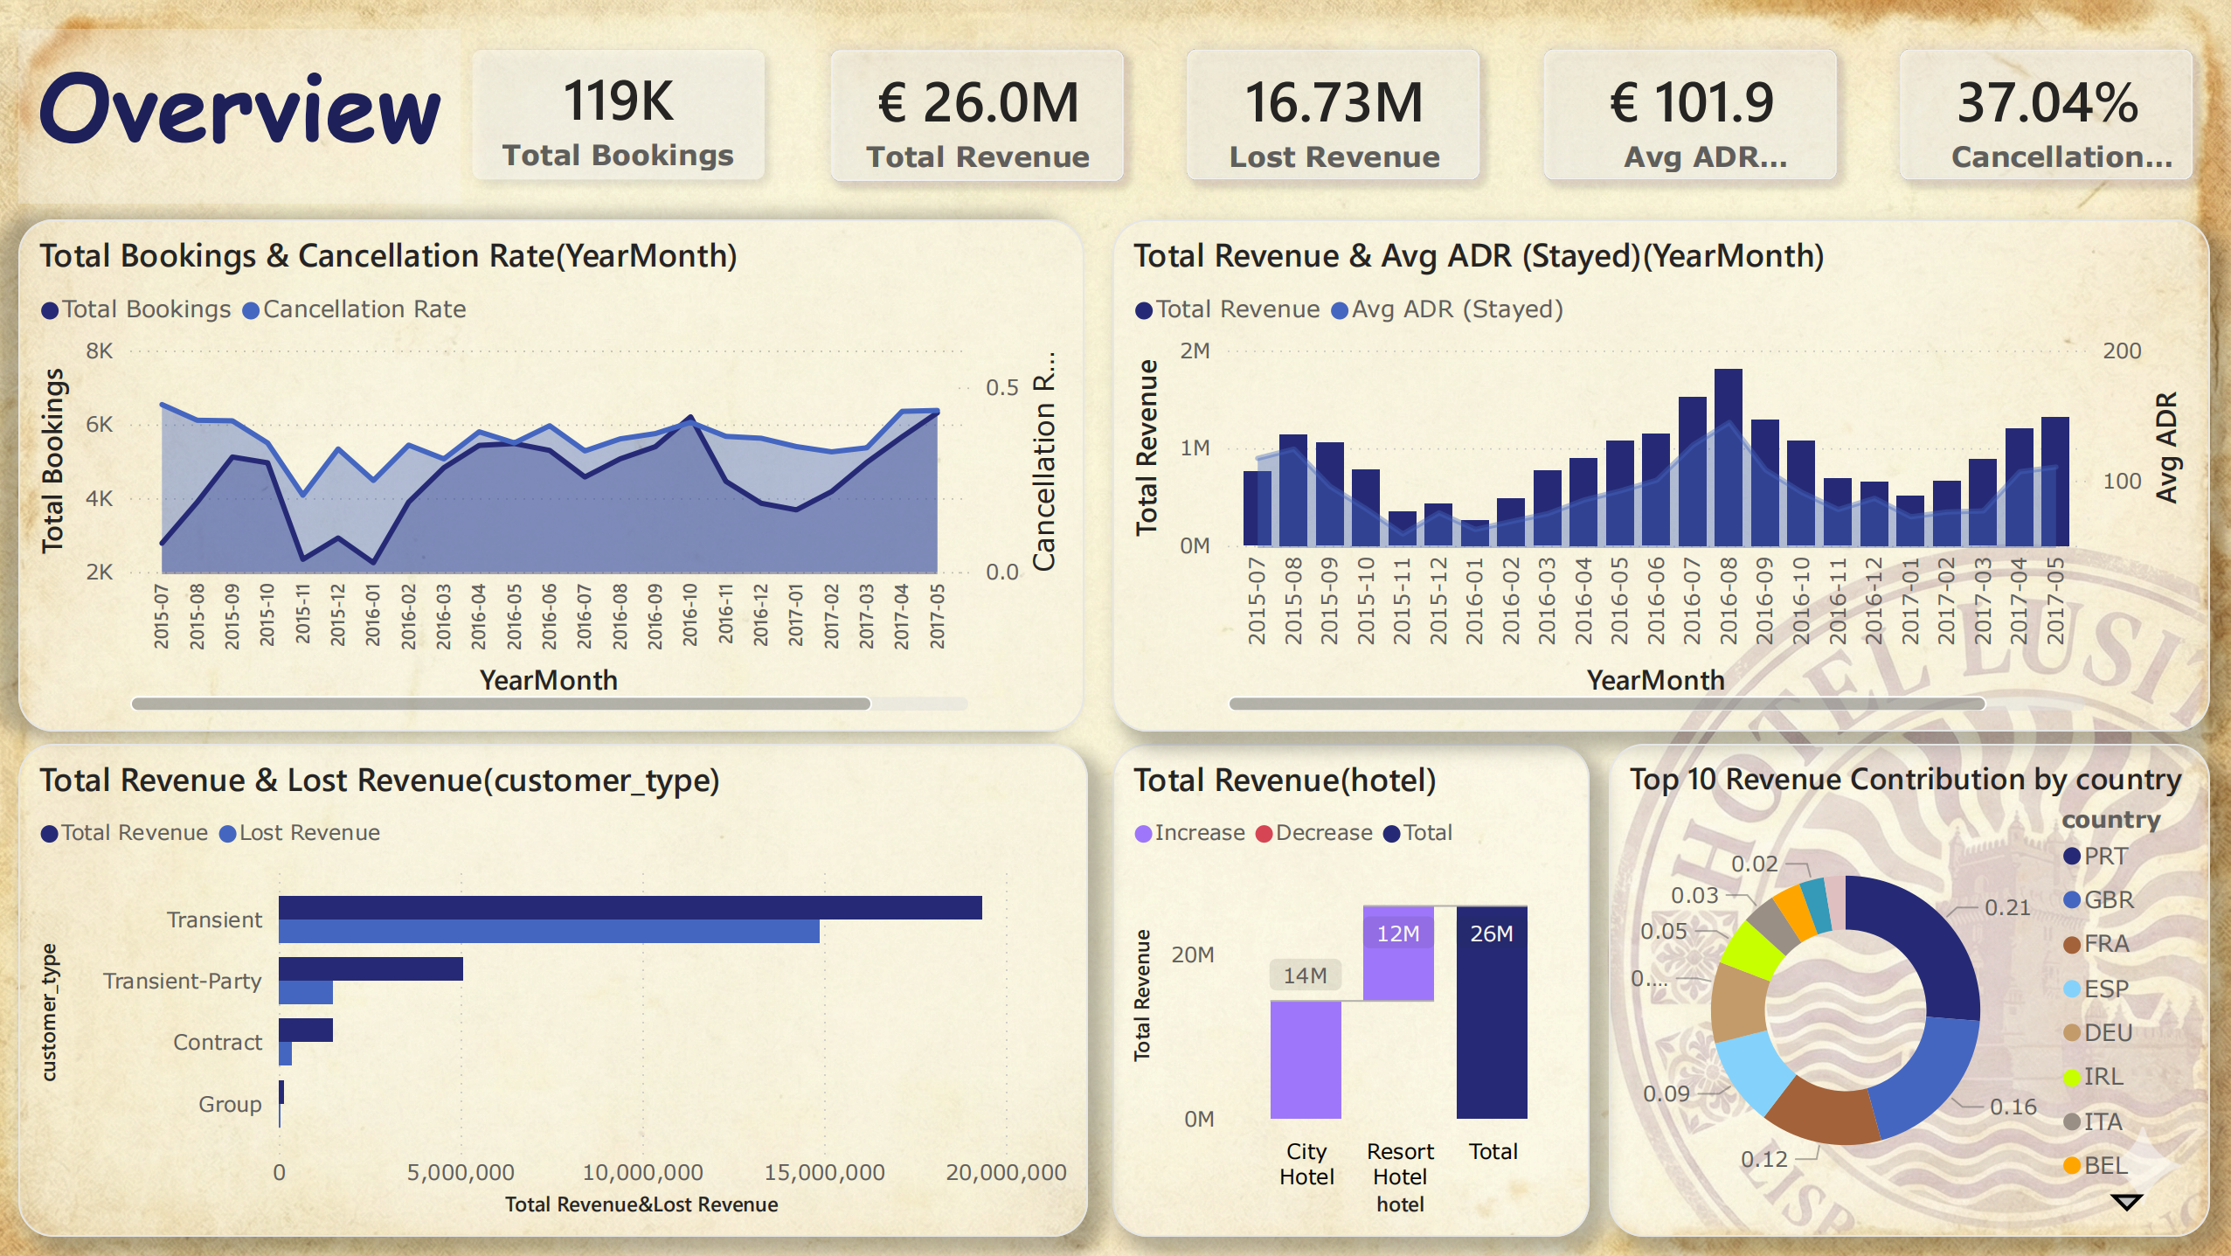
Dashboard 1
This page provides a snapshot of hotel operations.
It focuses on core metrics such as transaction volume, financial performance, and overall risk levels.

Slide 18

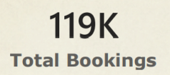
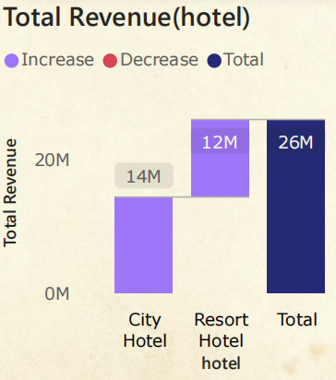

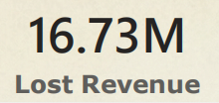

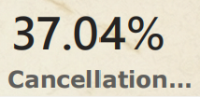
Overview
Key Metrics
Total Bookings: 119K
Total Revenue: €26.0M
Lost Revenue : €16.73M
Average Daily Rate (Avg ADR): €101.9
Cancellation Rate: 37.04%
Total revenue by hotel type
City Hotel: approximately 14M
Resort Hotel: 12M
Total: 26M
Cards
Waterfall Chart

Slide 19
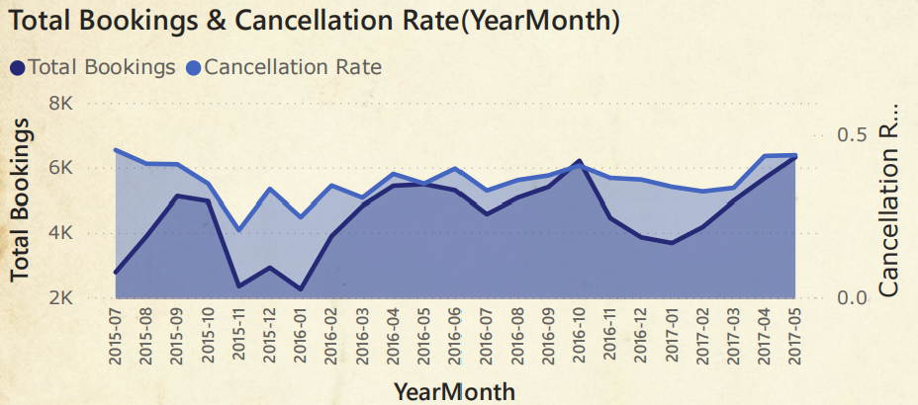
Overview
Area Chart
Illustrate the monthly trends of bookings and cancellations.
The total booking volume fluctuates between 2K and 6K
The cancellation rate not fully synchronized with the booking volume fluctuations.

Slide 20
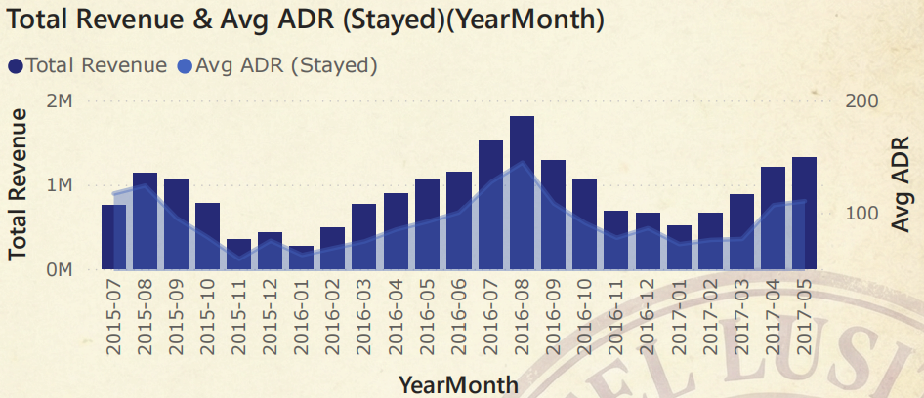
Overview
Line and Clustered Column Chart
Show the time series trends of income and average housing prices
It's evident that summer is the peak season for hotel bookings.
And the Total Revenue is positive related to Average ADR.

Slide 21
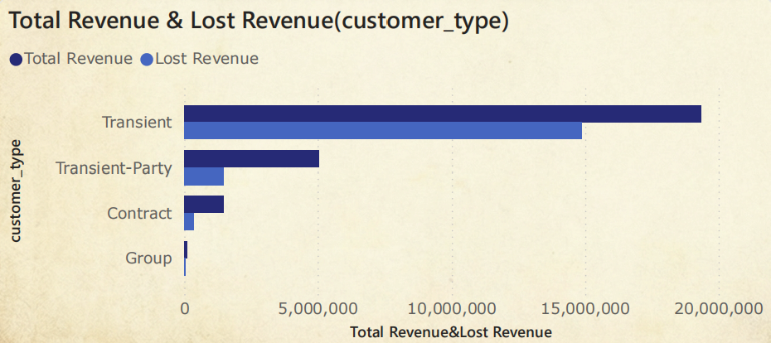
Overview
Clustered Bar Chart
Compare the contributions of different customer types to actual revenue and potential lost revenue
Transient customers contribute the most revenue, but also lose the most revenue.

Slide 22
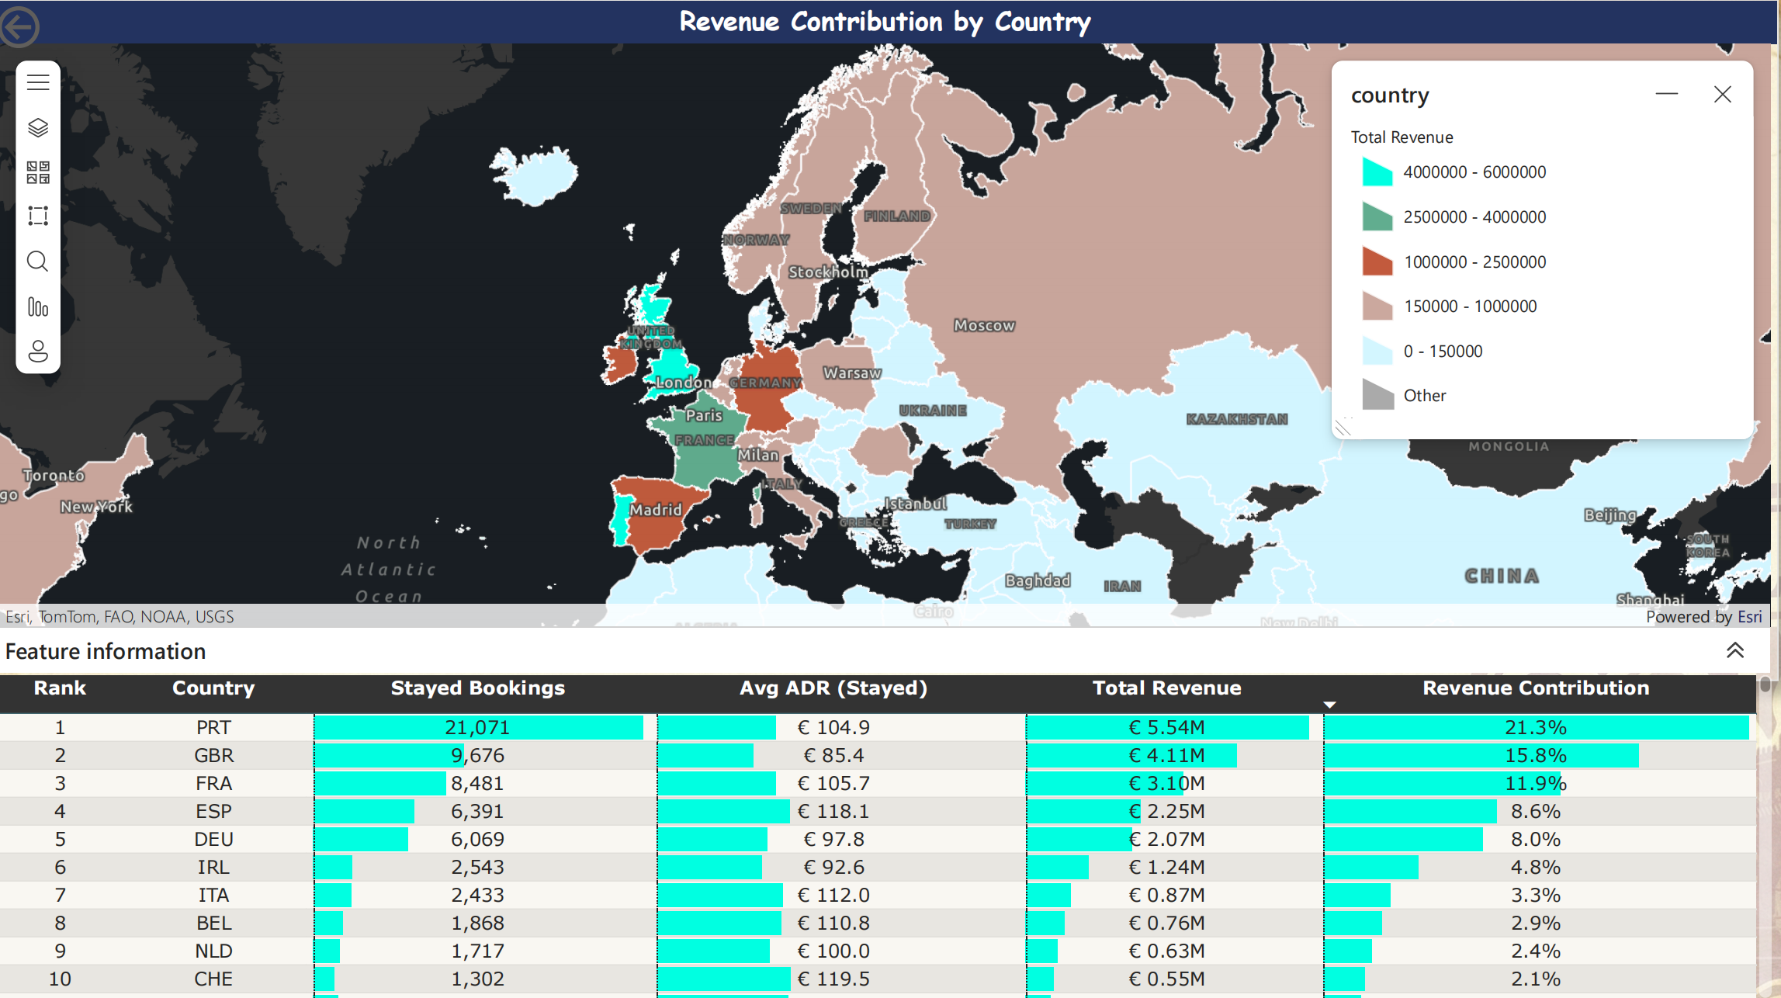
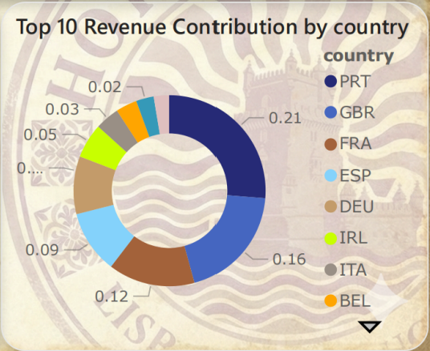
Overview
Dashboard 2
Pie Chart
Portugal (PRT) leads with 0.21 (21%) of the total revenue
United Kingdom (GBR) follows at 0.16 (16%)
France (FRA) ranks third at 0.12 (12%)
Other countries contribute less than 10%, highlighting a concentration of revenue from a few top-tier nations.
Revenue is heavily dependent on European countries, with Portugal being the dominant contributor (accounting for over 20%).
The combined revenue contribution from the top three countries approaches 50%, making them the core market for the hotel business.

Slide 23
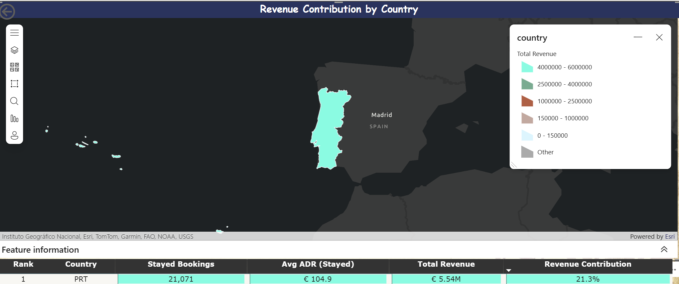
Drill-through
We add a drill-through of country in Top 10 Revenue Contribution by country pie chart (Page1) and Page 2
The drill-through feature allows the user to automatically transfer the data of a selected country/region from the overview page (Pie Chart) to the details page (Page 2) for in-depth analysis via tables and maps.

Slide 24
PART TWO
Revenue Analysis

Slide 25
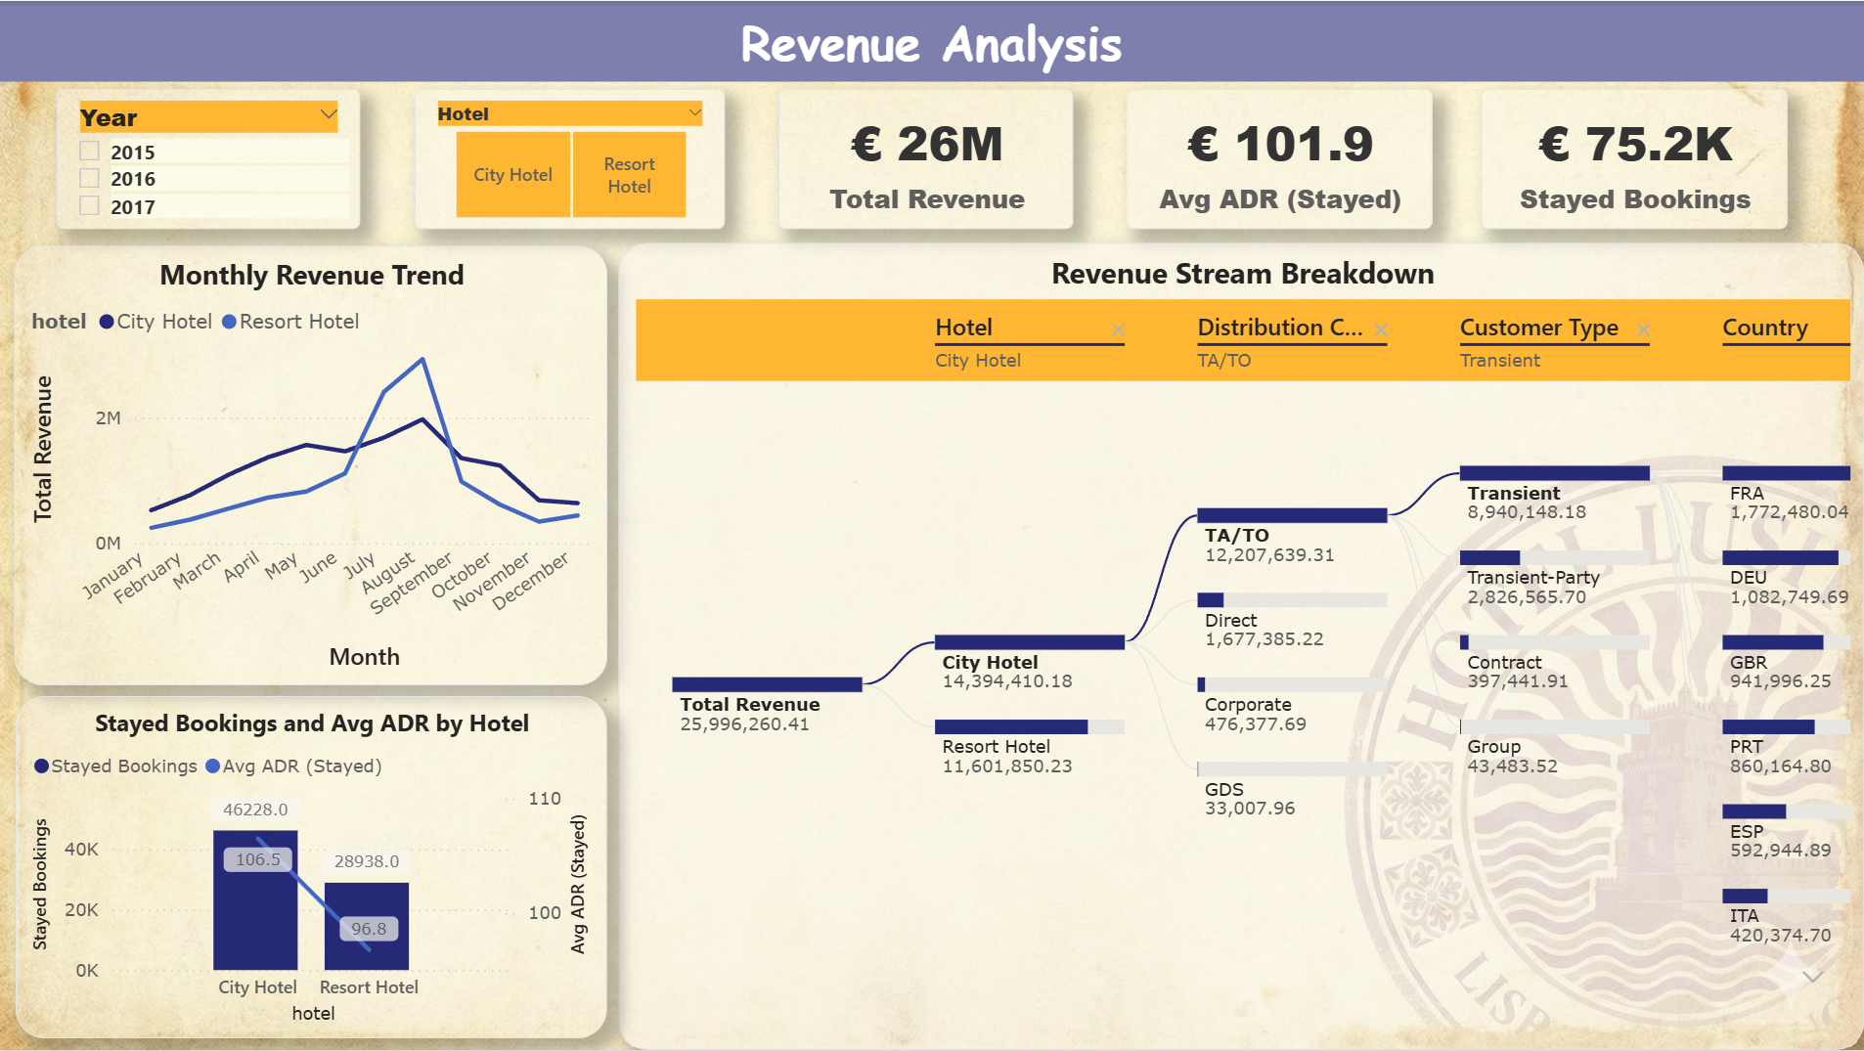
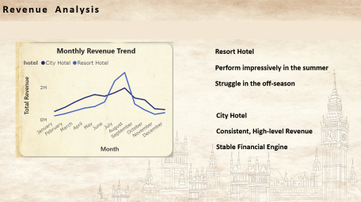
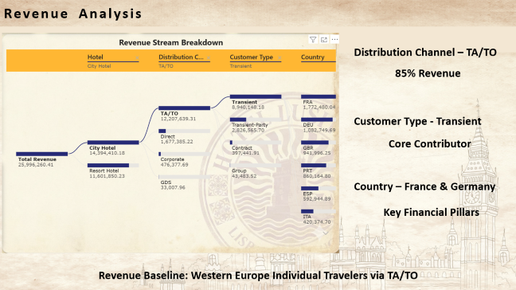
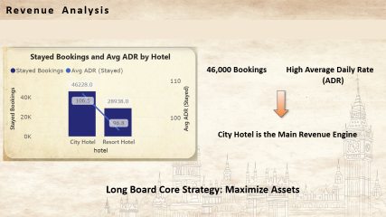
Dashboard 3 - Revenue Analysis
Where should we focus on the strategy to drive maximum revenue growth?

Slide 26
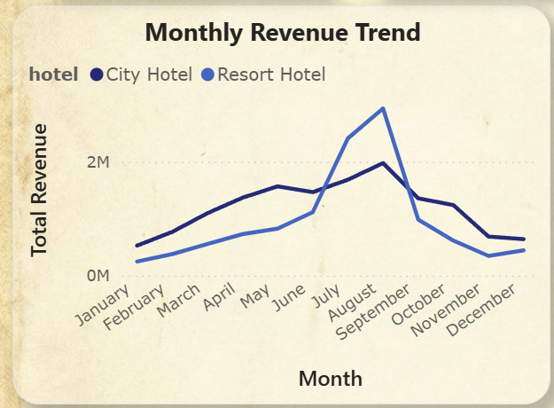
Revenue Analysis - Comparison
Resort Hotel
Perform impressively in the summer
Struggle in the off-season
City Hotel
Consistent, High-level Revenue
Stable Financial Engine

Slide 27
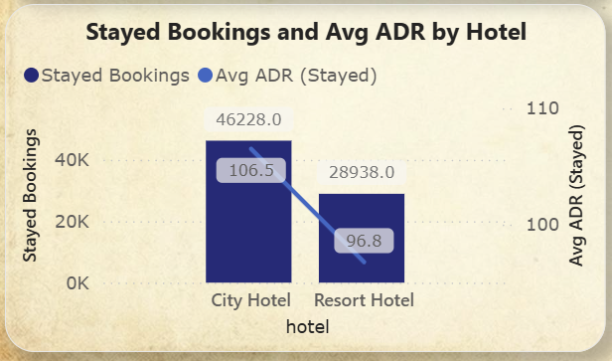
Revenue Analysis - Verify
46,000 Bookings
High Average Daily Rate
(ADR)
City Hotel is the Main Revenue Engine
Long Board Core Strategy: Maximize Asset

Slide 28
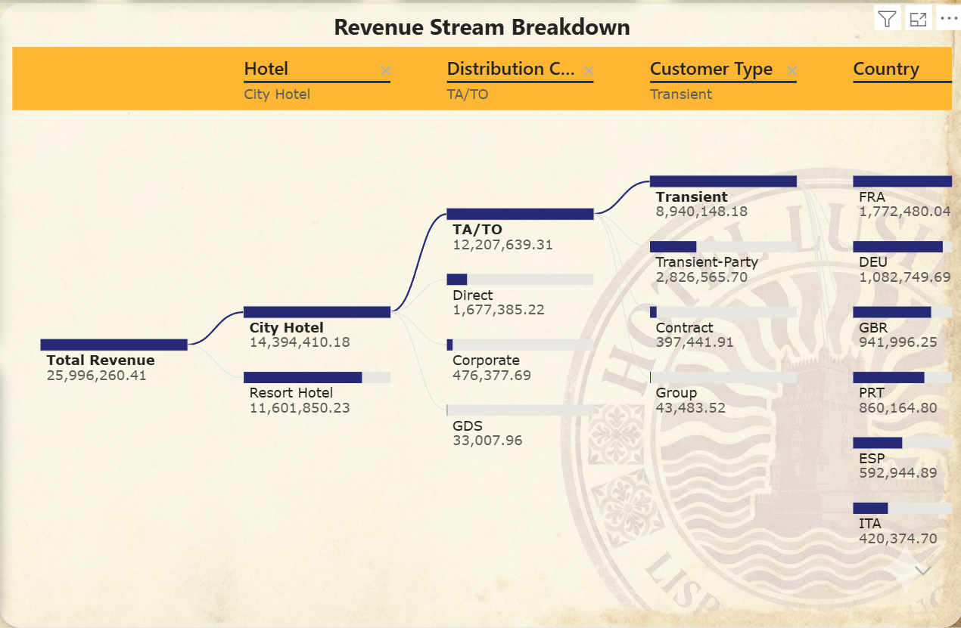
Revenue Analysis – Where revenue come from
Distribution Channel – TA/TO
85% Revenue
Customer Type - Transient
Core Contributor
Country – France & Germany
Key Financial Pillars
Revenue Baseline relies on Western European Individual Travelers via TA/TO

Slide 29
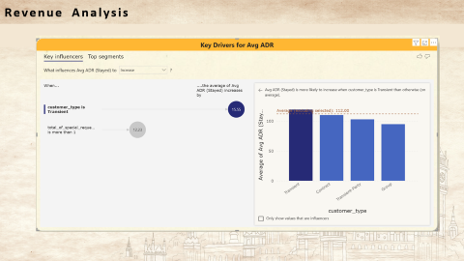
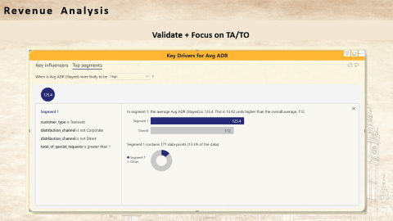
Revenue Analysis - Increase Profitability
Volume √
Profitability ?

Slide 30
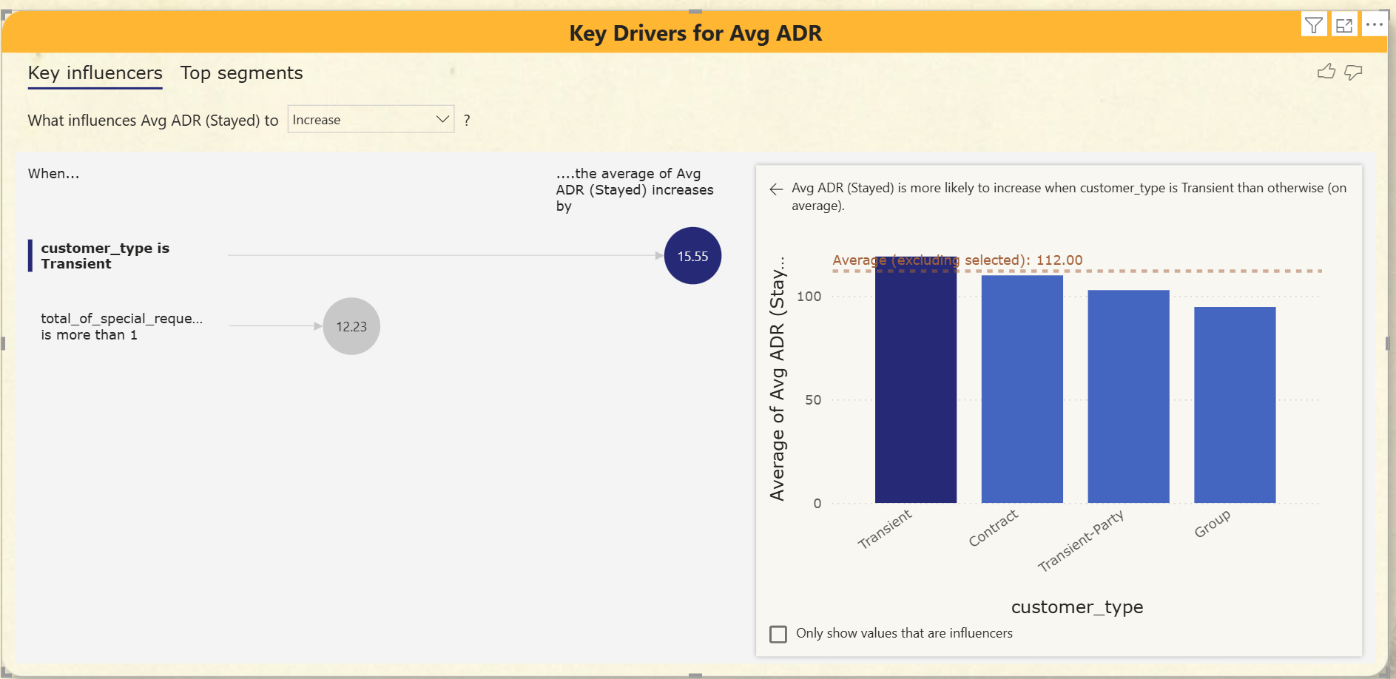
Dashboard 4 - Revenue Analysis

Slide 31
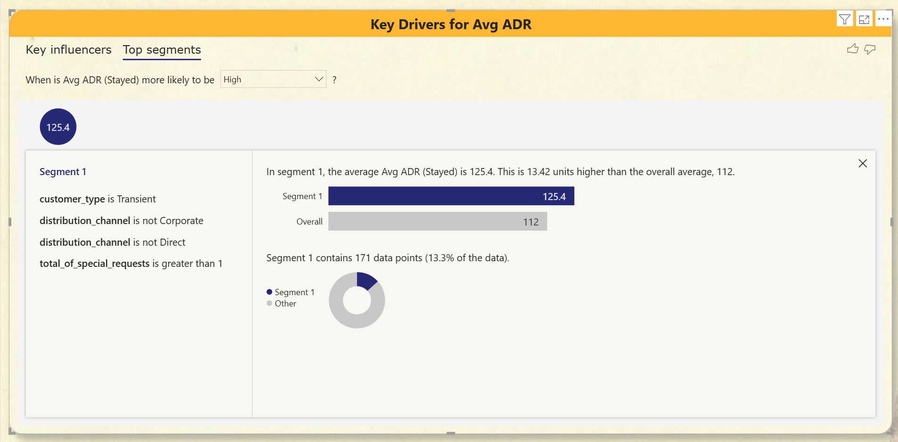
Dashboard 4 - Revenue Analysis
Validate + Focus on TA/TO

Slide 32
PART THREE
Cancellation Rate Analysis

Slide 33
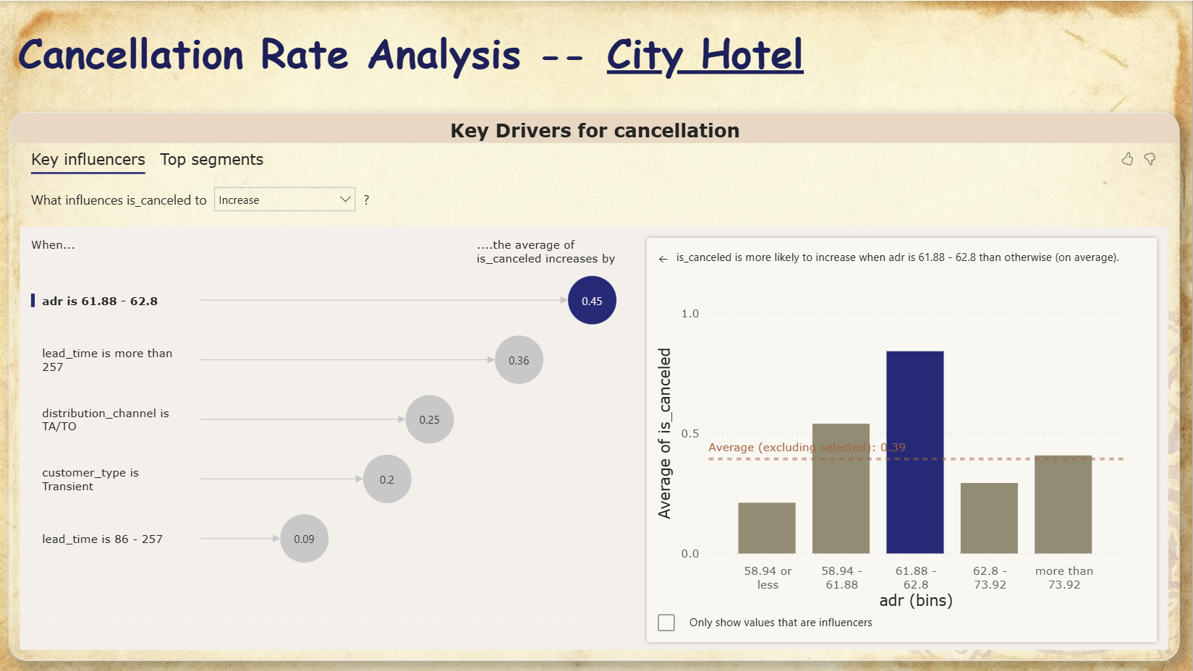
Dashboard 5

Slide 34
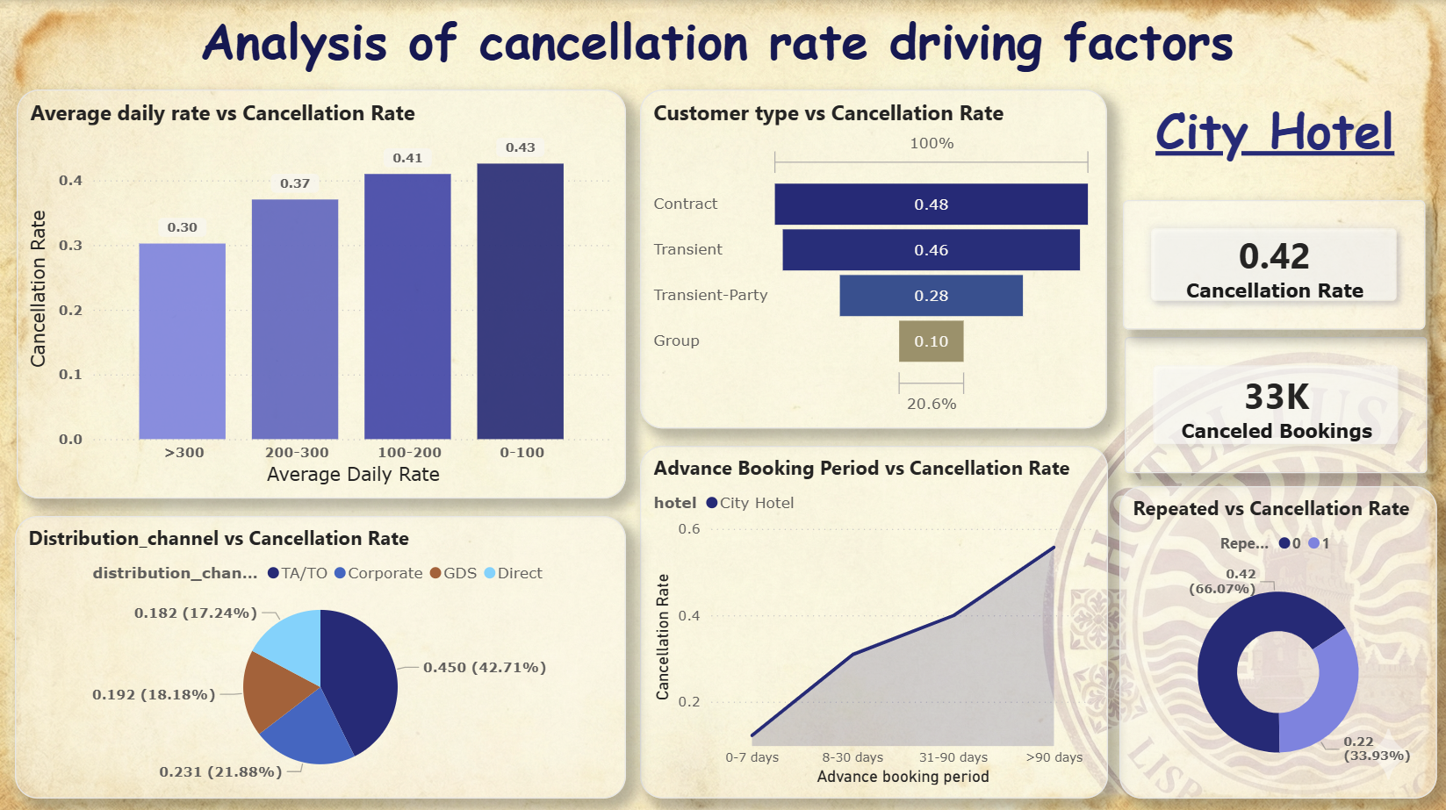
Dashboard 6

Slide 35
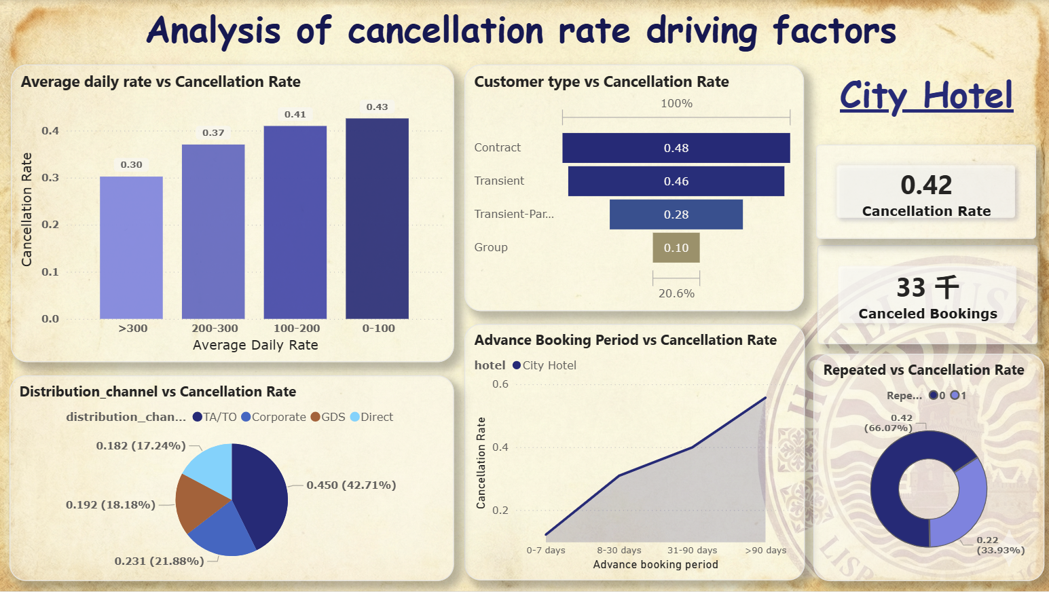
Analysis of cancellation rate driving factors
Average daily rate
Cancellation rate
Sunk cost effect
More cautious & willing to fulfill their obligations
Average Daily Rate (ADR) vs Cancellation Rate Chart
(Vertical Bar Chart)

Slide 36
Analysis of cancellation rate driving factors
Contract and individual travelers
Volatile plans
Low cancellation costs
Weak constraints after booking
Focus on managing & Avoiding risks
The most stable and high-quality
Strong planning & High commitment from organizers
Extremely low
Customer type cancellation rate comparison chart
(funnel chart)

Slide 37

Analysis of cancellation rate driving factors
Direct & GDS
Highest quality channel
Highest loyalty and planning
Successful official website marketing
TA/TO (travel agencies)
Nearly half cancelled
Distribution channel and cancellation rate (pie chart)
Price comparison/unstable customer source

Slide 38
Analysis of cancellation rate driving factors
Advance booking period
Cancellation rate
0-7 days: definite - business trips/ urgent matters
8-90 days: unstable - personal matters / finding better options / changing their minds
>90 days: greatest uncertainty - changes in plans / prices
Trend chart of advance booking period and cancellation rate (line chart)

Slide 39
Analysis of cancellation rate driving factors
Repeat customers - experienced the hotel's service
Trust the quality
Motivation to cancel reduced
Non-repeated customers - first stay experience
Receives an unexpected experience
Converting into repeat customers
Chart of repeat customers vs. non repeat customers
(circular chart)

Slide 40
Recommendations
1. Customer dimension
2. Booking and product dimensions:
1) Cultivate customer loyalty and convert repeat customers
Increase the number of repeat customers: providing exclusive discounts, early check-in, room type upgrades, and other privileges
Retain first-time customers: ensure an excellent experience ,receiving a coupon /design loyalty programs.
Implement a dynamic cancellation policy
“Early bird price” with strict cancellation policies
Flexible cancellation policies within 7 days booking
Appropriate amount of overbooking
2) Optimize booking channels and promote direct bookings
Refusing to cooperate with travel agencies with high cancellation rates
“Best price guarantee on the official website"
2) Differentiated management of customer types
Managing high cancellation rate customer type
Expand the high-quality customer group
3) Reform pricing strategy
Ensure the value of high-priced room

Slide 41
PART FOUR
Income & Risk Analysis
This part serves as a supplement to the utilization of the "strengths-based" effect.
Avoid the risk of a single structure and propose diversified risk mitigation strategies

Slide 42
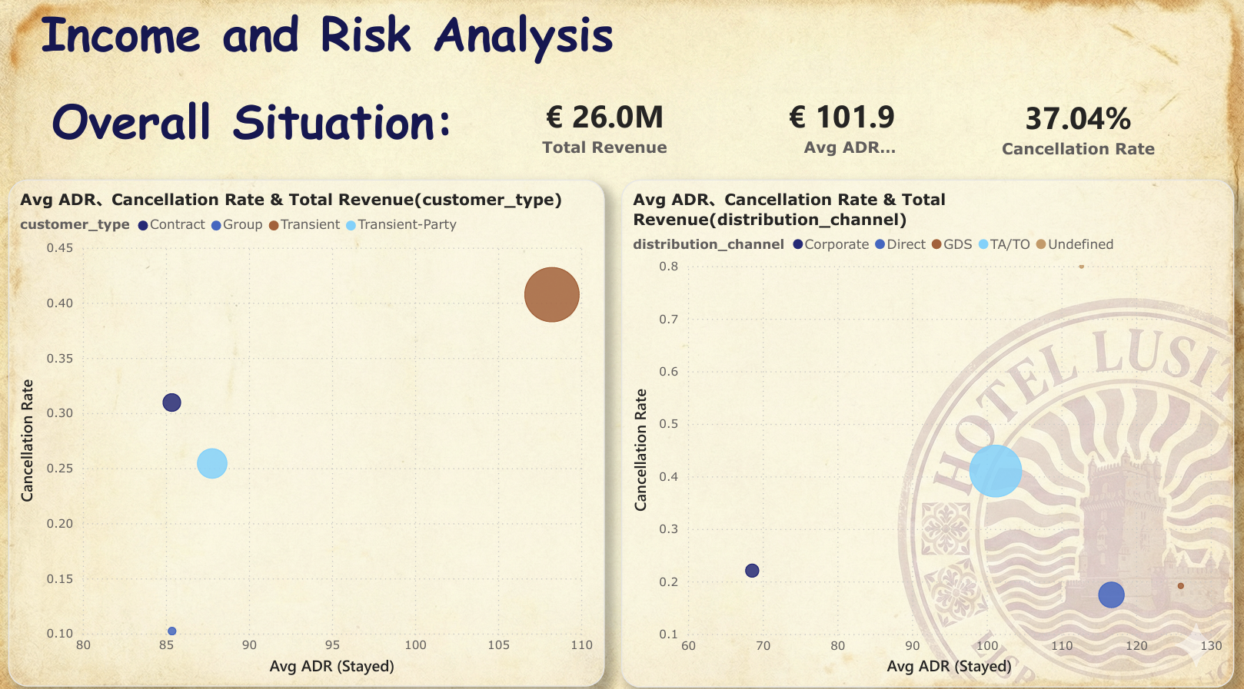
Dashboard 7
Classification
According to Customer Type
According to Distribution Channel
Cancellation rate: Measuring risk
Avg ADR (Stayed): Measuring income potential
Bubble Size: Measuring the contribution to income
Bubble Charts

Slide 43
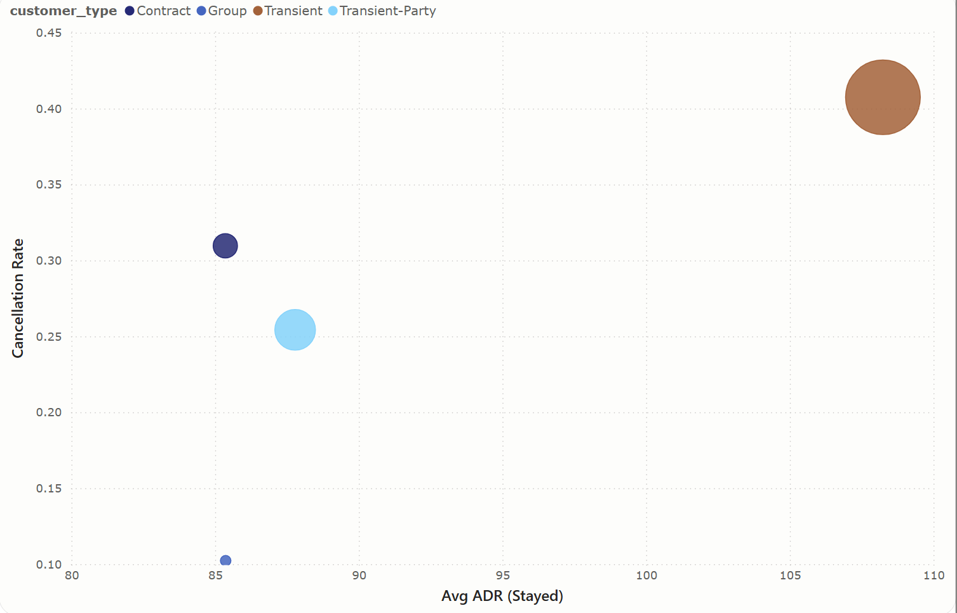
Dashboard 7
According to Customer Type
Analysis & Insight:
High price & risk & revenue: Transient
Moderate price & risk & revenue: Transient-Party & Contract
Low price & risk & revenue: Group
Recommendation:
1. Lack of the capacity to accommodate large tourist groups.
Rationally allocating rooms (especially during the annual holidays)
2. Stabilizing the contribution of other customers to our hotel’s revenue and reduce the probability of their cancellations.
Optimizing service measures:
Catering
Children's Facilities
Pick-up Services
Bubble Chart

Slide 44

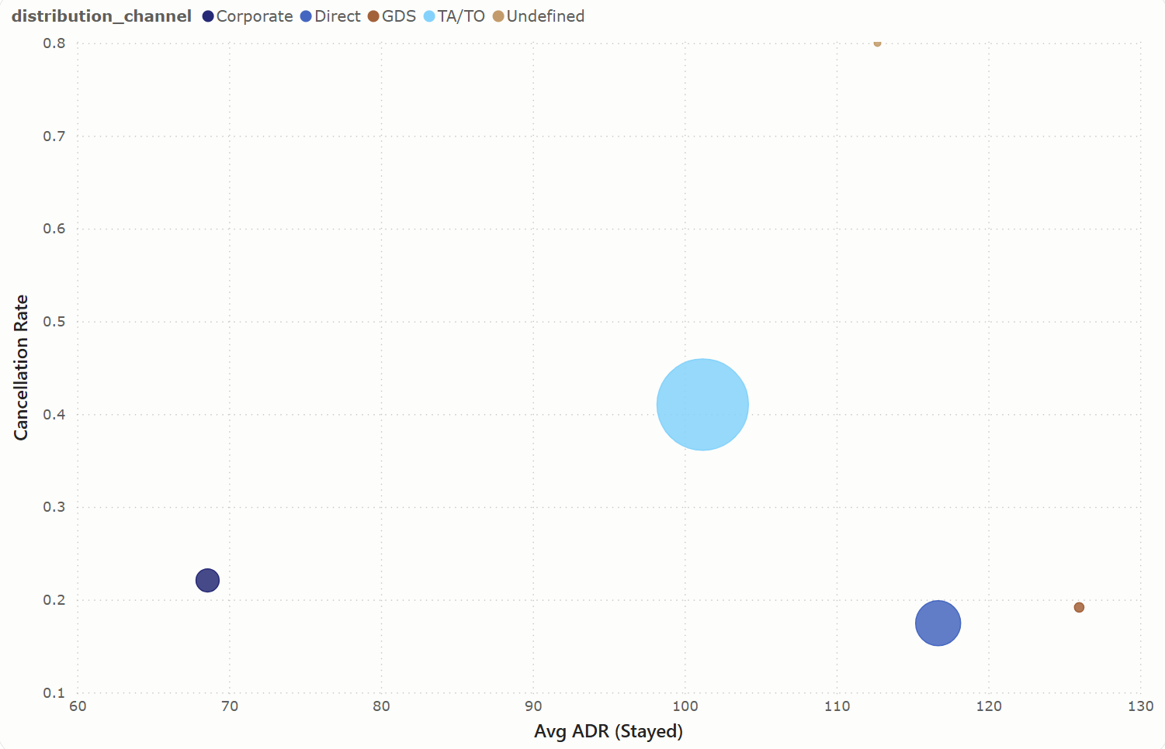
Dashboard 7
According to Distribution Channel:
Analysis & Insight:
Moderate price & risk & High revenue: TA/TO
High price & Low risk & Moderate revenue: Direct & GDS
Low price & risk & Moderate revenue: Corporate
Recommendation:
1. The revenue potential of the Direct and GDS channels is significant.
Optimizing the hotel’s own website and sales services
&
Deepening cooperation with third-party reservation platforms of the Global Distribution System.
2. The corporate (enterprise channel) customers are relatively stable but have weak profitability.
Bubble Chart
They can serve as a guaranteed income source, but they are not suitable for excessive reliance.

Slide 45
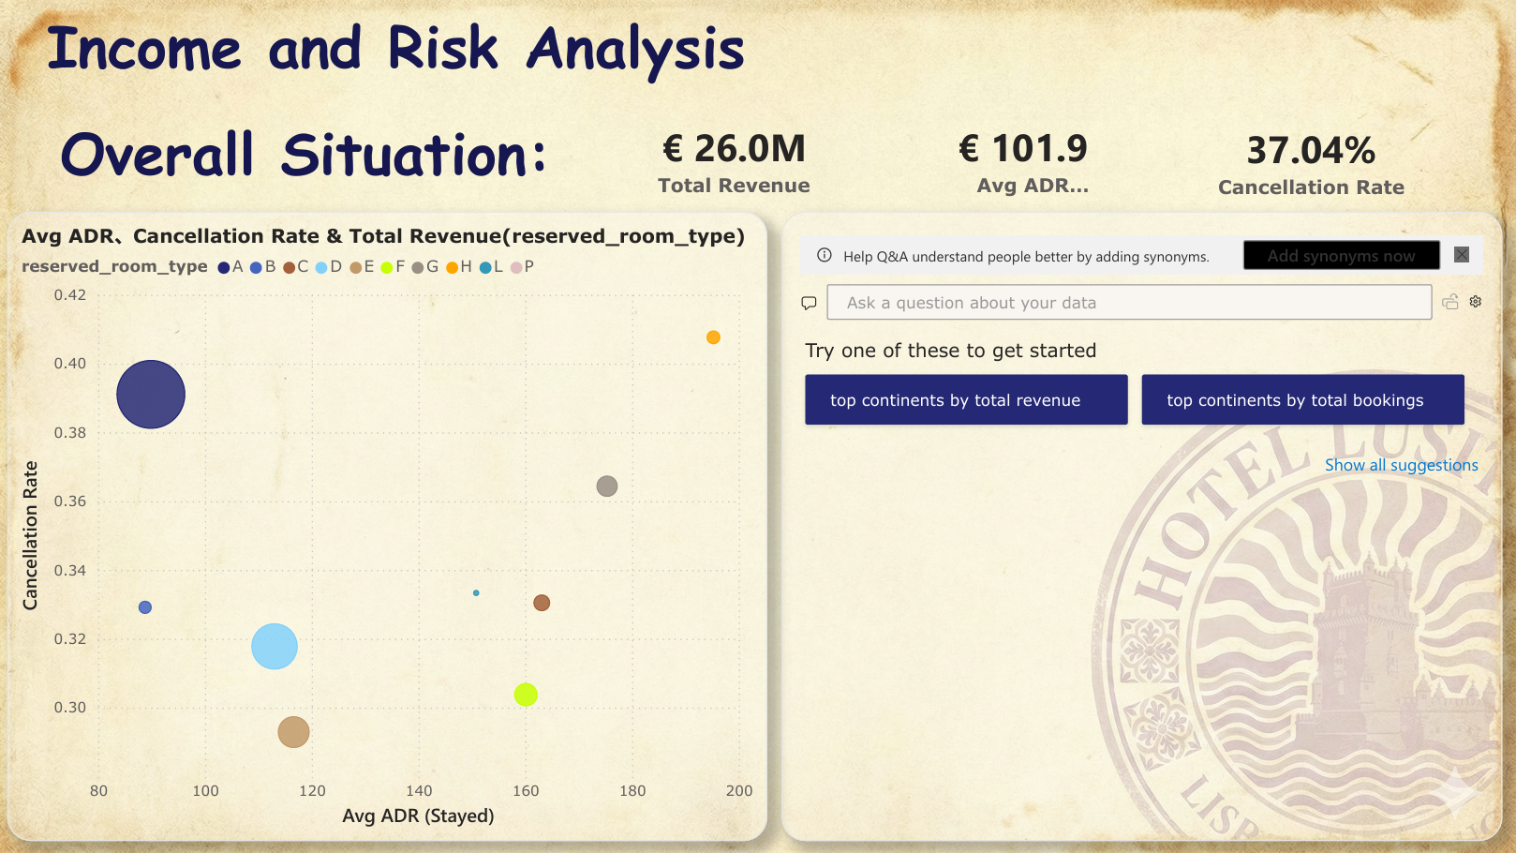
Dashboard 8
Classification
According to Room Type
Further Exploration
Q&A Box

Slide 46
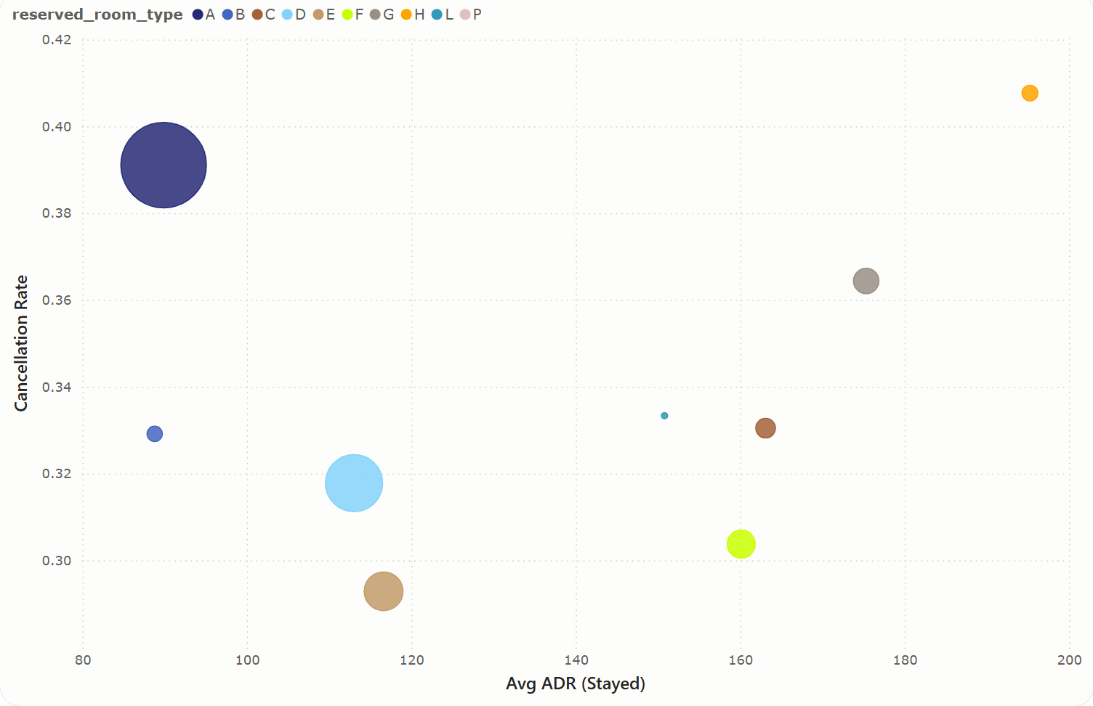
Dashboard 8
Classification
According to Room Type
Analysis & Insight:
High price & High risk: Room H, G
High price & Low risk: Room C, F, L
Low price & Low risk: Room B, D, E
Low price & High risk & revenue: Room A
Recommendation:
For Room H, G:
Promoting this type of rooms efforts & Optimizing the reservation policies (deposit policy & minimum stay days).
For Room C, F, L (Ideal types):
Increasing the promotion and discount efforts & Expanding the number of this type of rooms.
For Room B, D, E:
Served as a guaranteed income source in the low season, but are not suitable to be the profit growth point.
For Room A:
Setting the minimum number of nights for stay & setting the deadline or specific audience (returned customers) for free cancellation
Bubble Charts

Slide 47
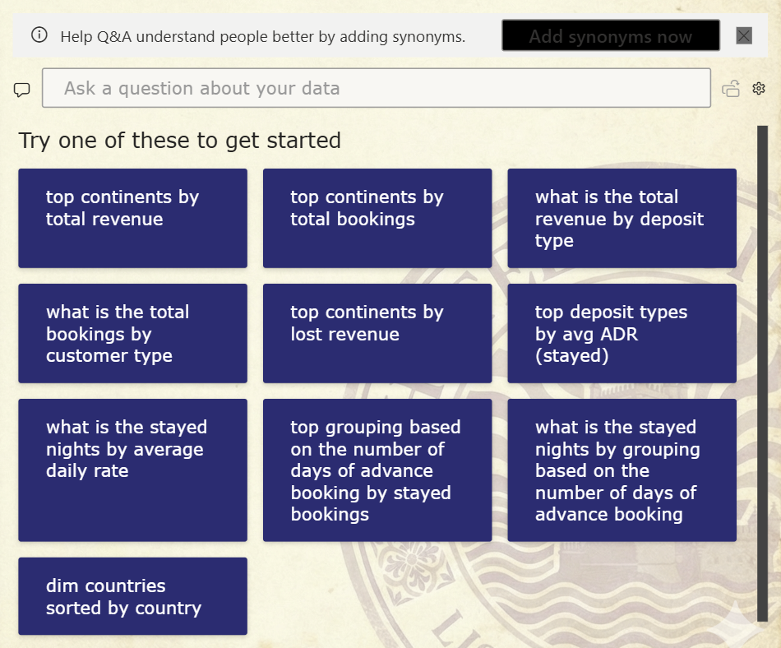
Dashboard 8
Further Exploration
Using the Q&A box, users can pose natural language questions and receive answers in the form of visual objects.
Q&A Box

Slide 48
Unique Perspective
Problem:
In the previous analysis, we found that there is always a certain group of people whose cancellation rate remains consistently high. The cancellation rate of this group is not affected by seasons, deposit policies, or distribution channels.
Why?

Slide 49


Unique Perspective
Guess:
We have taken into account the reasons for the serious immigration problem in Europe in recent years (Eurostat, 2024).
Many people increase the probability of obtaining a visa by showing proof of hotel reservations and travel orders (International Organization for Migration, 2018).

Slide 50
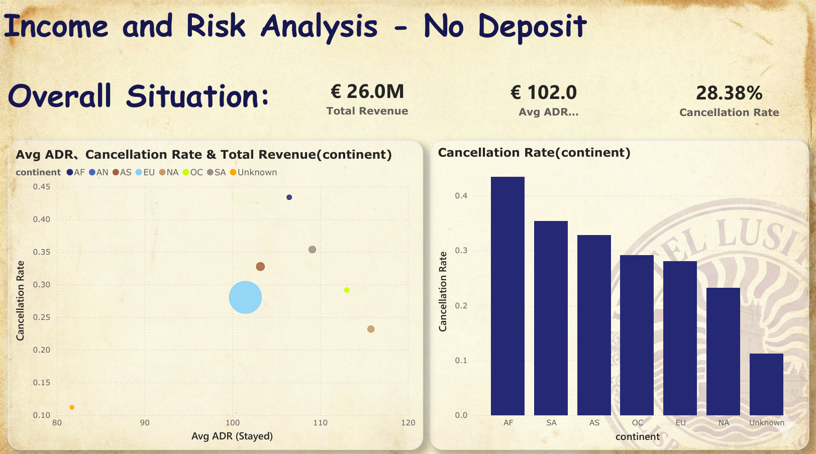
Dashboard 9
Proof
Analysis & Insight:
The cancellation rate of Africans without deposit was relatively high, and it contributed less to the hotel's revenue, and the revenue potential was not high either.
Consequence:
This will harm the interests of hotels and are detrimental to our operations and strategy making.
Recommendation:
The Influence of Immigration Problem
1. Establishing a deposit system for certain groups of people.
2. Collaborating with relevant government departments, sharing information, setting up a credit list, and paying attention to those with low credit ratings.

Slide 51
Thanks for Listening！
Group J

