Slide 1
Meal Delivery Supply Chain
Optimization
Group A
Chen Zeming
Deng Songhao
LIU Jiaming
Ma Ang
Wu Xin
Zhang Hanyuan
Zhang Shuoyan
2330036010
2330036015
2330036089
2330036106
2330036159
2330036186
2330036190
1/51

Slide 2
Content
1
2
3
4
5
6
Problem Definition
Data Selection & Preparation
Business Overview
Diagnostic Analysis
Deep-Dive
Insights, Recommendations & Limitations
Project Goal: The ultimate objective of turning data into action.
2/51

Slide 3
Problem Definition
1
3/51

Slide 4
1 Core Problem: Supply Chain Optimization
Risk of
Over-stocking
High Demand
Volatility
Increases inventory costs, waste, and operational pressure.
Meal products have short shelf lives and demand can fluctuate rapidly.
optimize demand planning and replenishment for every unique center-meal combination.
Risk of
Under-stocking
Data-Driven
Solution
Leads to lost orders and poor customer experience.
The goal is to use historical data to make smarter stocking decisions.
4/51

Slide 5
1 Three Key Decision Tensions
We must navigate three fundamental tensions in our decision-making process.
1. Product Tension
2. Center Tension
3. Promotion Tension
A small number of meals drive most orders, but we must respect local differences across centers.
The same meal can have very different demand stability across fulfillment centers; a fixed replenishment cycle does not fit all.
Promotions boost orders but also make short-term demand harder to predict, which creates fulfillment risks.
5/51

Slide 6
1 Analysis Supports Key Business Decisions
Five Key Decisions
Prioritize Meals
Flexible Replenish.
Promotion Stocking
Secure Combos
Avoid Overstocking
Identify which meal categories and SKUs to prioritize for inventory planning.
Determine which fulfillment centers need flexible replenishment strategies.
Decide if and when promotions should trigger temporary stock preparation.
Which center-meal combinations should be fully secured to meet demand.
Identify low-demand center-meal combinations to avoid heavy stocking and waste.
Clear guidance for critical operational decisions
6/51

Slide 7
Data Selection
&
Preparation
2
7/51

Slide 8
2 Data Selection & Preparation
CSV Files Used
train.csv
test.csv
meal_info.csv
center_info.csv
Final_combined_table
historical weekly demand records for SQL-based demand analysis
Future week data used for validation and testing of forecasting models
Details meal attributes such as category, cuisine type and price
Contains detailed attributes of each fulfillment center (location, type, etc.)
Combines historical and operational data to drive accurate forecasting
Data Foundation for Meal Delivery Analysis
8/51

Slide 9
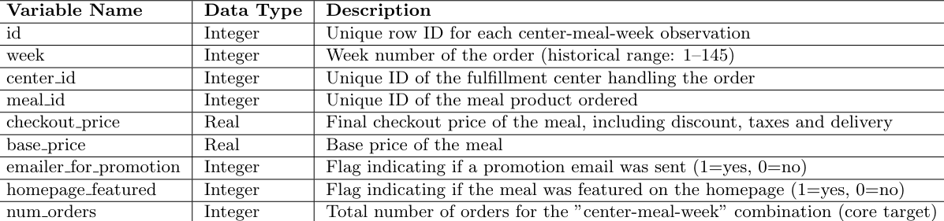
2 Data Dictionary
train.csv
Purpose: Stores historical order records (the primary ”fact table” for demand analysis).
test.csv
Purpose: Contains future-week data (reserved for demand prediction; lacks the target variable num orders).
9/51

Slide 10
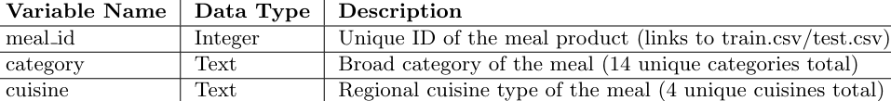
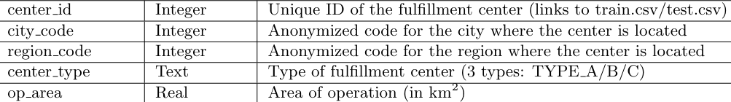
2 Data Dictionary
meal_info.csv
Purpose: Provides attribute information for each meal product (a ”dimension table” linked to order data).
fulfilment_center_info.csv
Purpose: Provides operational attributes for each fulfillment center (a ”dimension table” linked to order data).
10/51

Slide 11
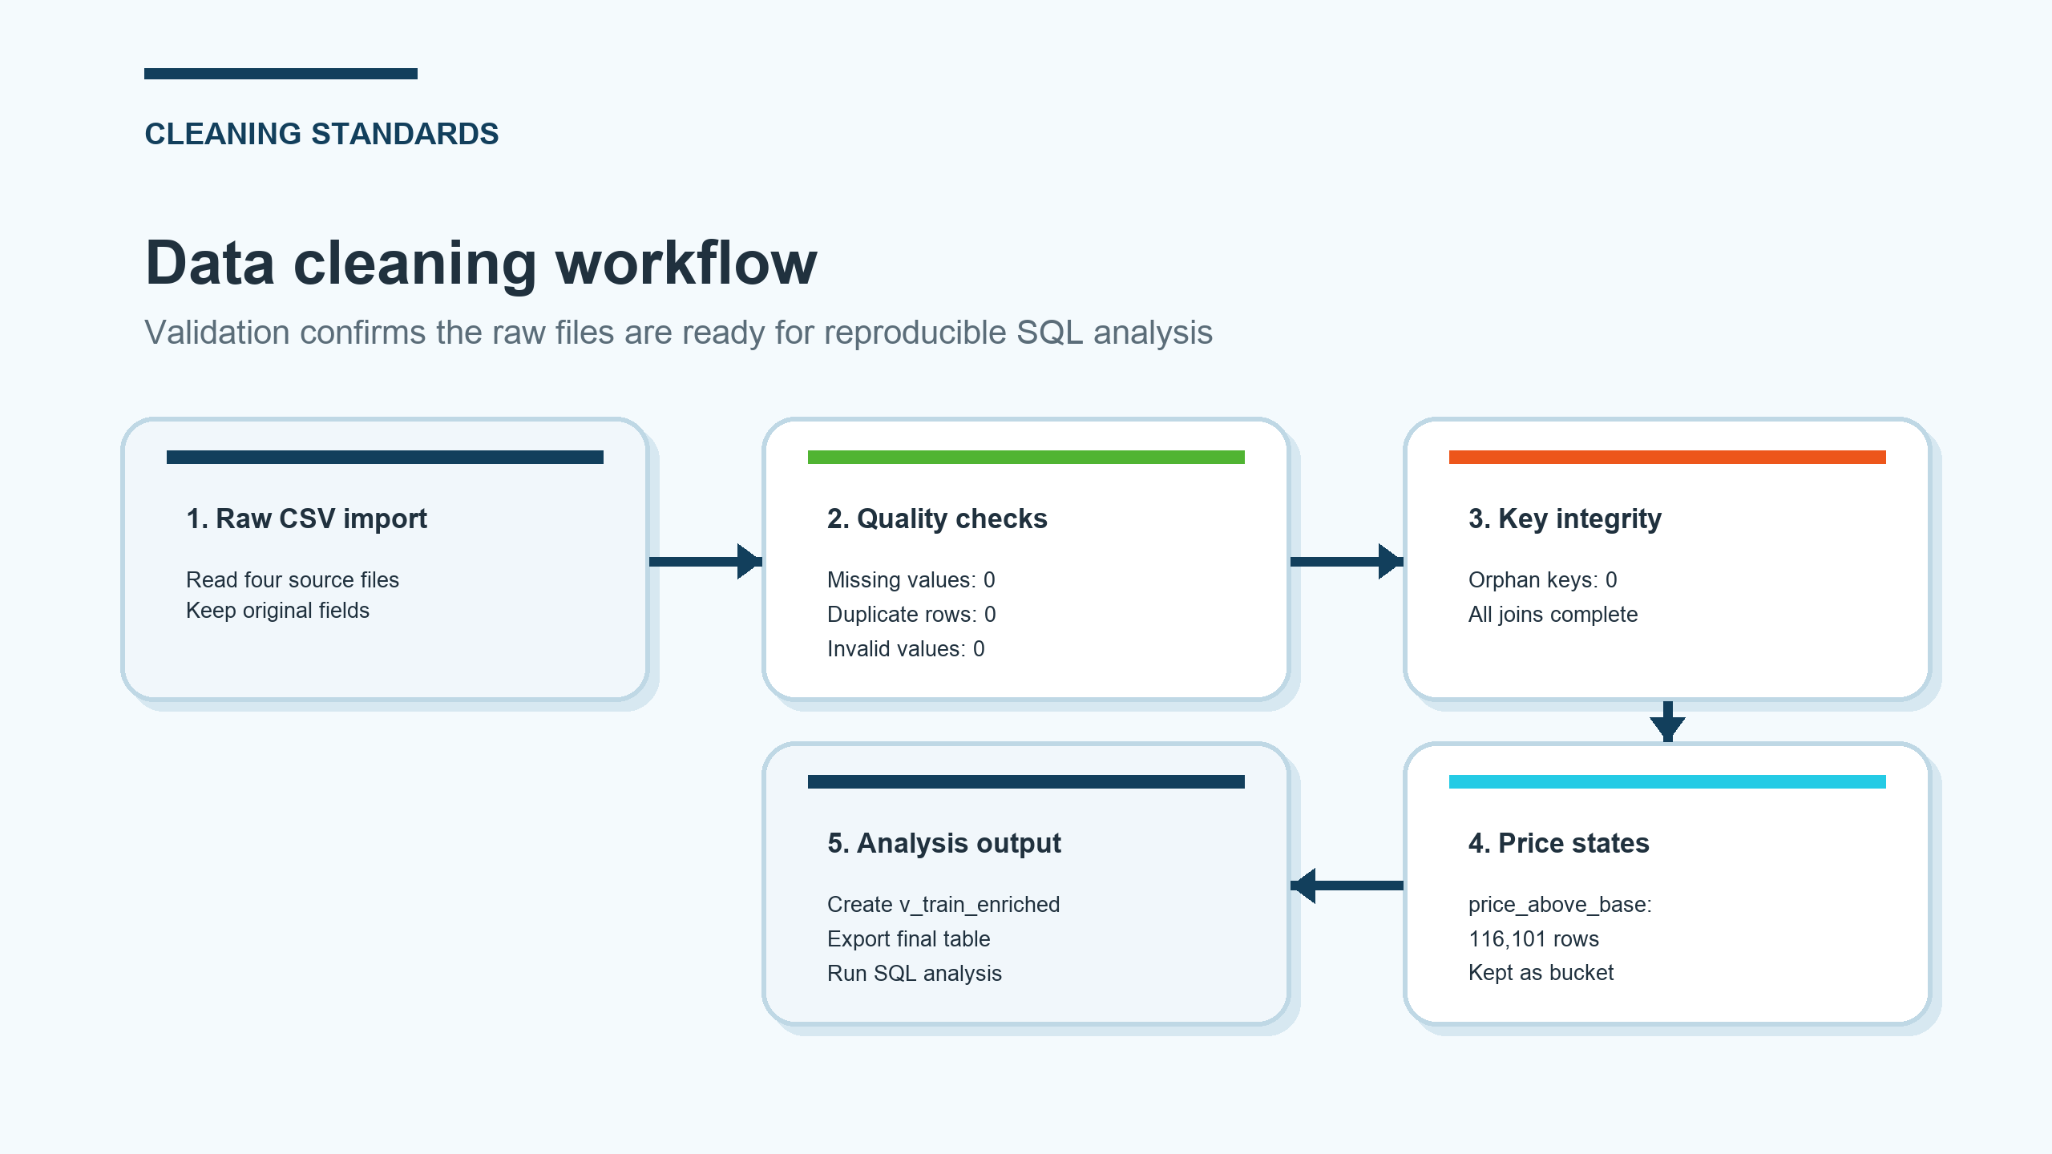
2 Data Cleaning
All valid rows (450K+) were kept. No missing key values were found. The dataset had no duplicates or outliers
11/51

Slide 12
2 Data Transformation
Four derived variables to enable deeper analysis
1. discount_rate
2. discount_bucket
3. promotion_flag
4. gross_sales_proxy
(base_price − checkout_price)
/ base_price
0–5%, 5–10%,
10–15%, >15%
1 = Any promotion
0 = No promotion
checkout_price × num_orders
12/51

Slide 13
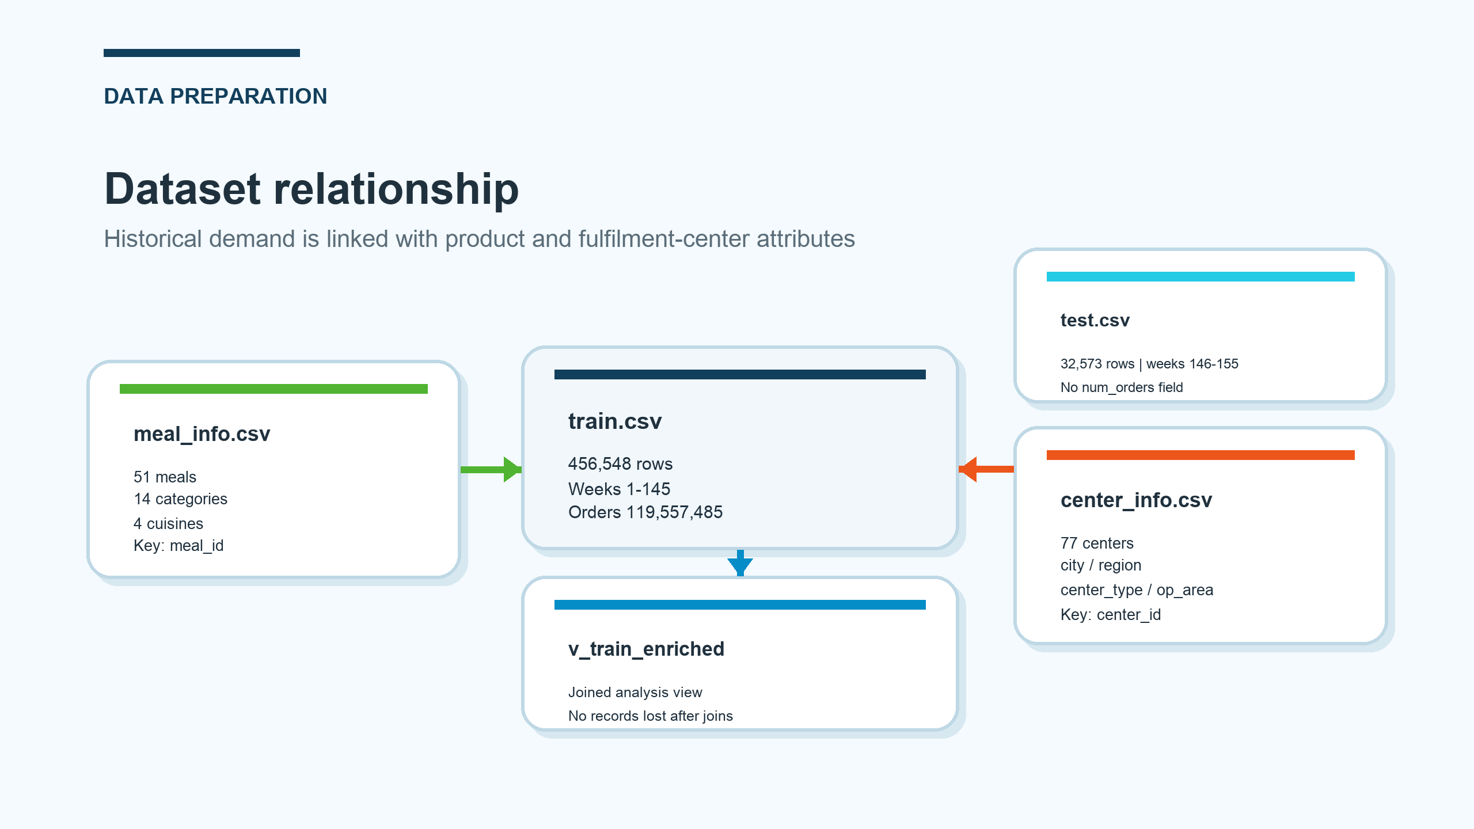
2 Data Linkage & Filtering
Data Linkage
Star Schema: Linked by meal_id and center_id. train.csv is the fact table, while meal_info.csv and fulfilment_center_info.csv are dimension tables. V_train_enriched includes additive variables.
Test.csv is not used in our analysis. It is a test data or forecast data being conducted in the future. The pattern we discover in our analysis will be applied in test.csv
Notice
.
13/51

Slide 14
2 Data Limitations
We must acknowledge the inherent limitations of our dataset.
1. Missing Data
2. Estimated Metrics
3. Limited Data
No real inventory or stockout data is available.
gross_sales_proxy is an estimate, not actual revenue.
Promotion data is binary only, and data is weekly-level only. Correlation does not imply causation.
14/51

Slide 15
Business Overview
3
15/51

Slide 16
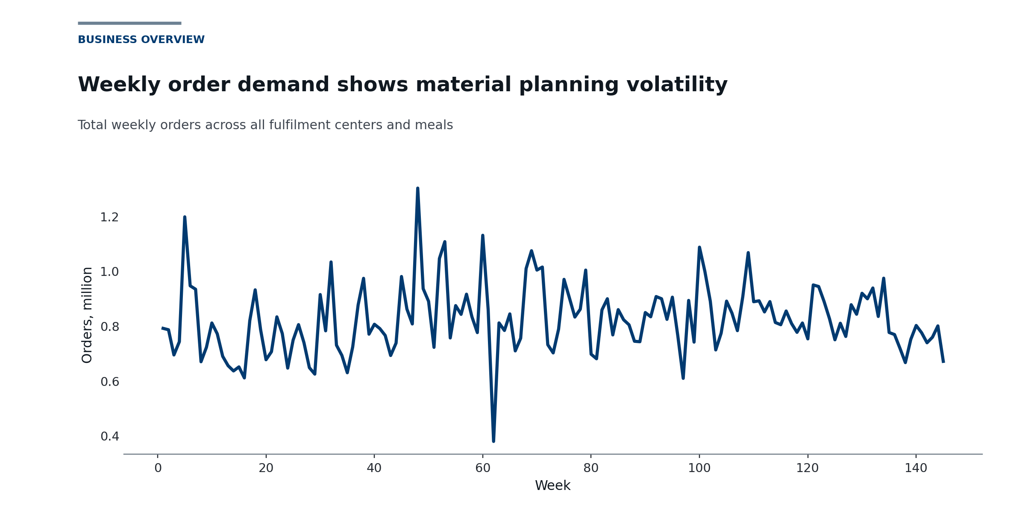
3. Business Overview
A food delivery platform
119.56M
orders
261.87
avg./record
The platform operates at a very large scale across multiple centers, regions, and meal categories.
Weekly demand fluctuations. Average demand alone is not enough for replenishment planning.
Weekly demand trend
16/51

Slide 17
3. Business Overview
Why This Matters for SCM
Key message: the business is both large-scale and demand-volatile, so later analysis must consider ->
1
2
3
Concentrated demand
Center volatility
Promotion impact
Identify which products and meal categories account for the largest share of demand.
Find which fulfillment centers show the greatest fluctuation and operational risk.
Test whether promotions and discounts further amplify demand uncertainty.
We should not only rank total sales, but also understand where uncertainty comes from in the supply chain.
17/51

Slide 18
Diagnostic
Analysis
4
18/51

Slide 19
Diagnostic Analysis
This section includes three diagnostic analyses about demand planning.
The analysis follows this logic:
High product demand concentration → unstable demand in fulfillment centers → promotions further increase demand uncertainty
The goal of this section is not just to compare which variable is higher. Instead, it helps narrow down the real management problem step by step.
First, the platform needs to know which products make up most of the customer demand.
Second, it needs to understand which fulfillment centers have demand that is harder to predict.
Finally, it needs to see whether promotions and discounts change short-term demand patterns.
Together, these three analyses help answer an important supply chain question:
Which demand should be kept stable, and which demand should be managed more flexibly?
19/51

Slide 20
Meal
Demand
4-1
20/51

Slide 21
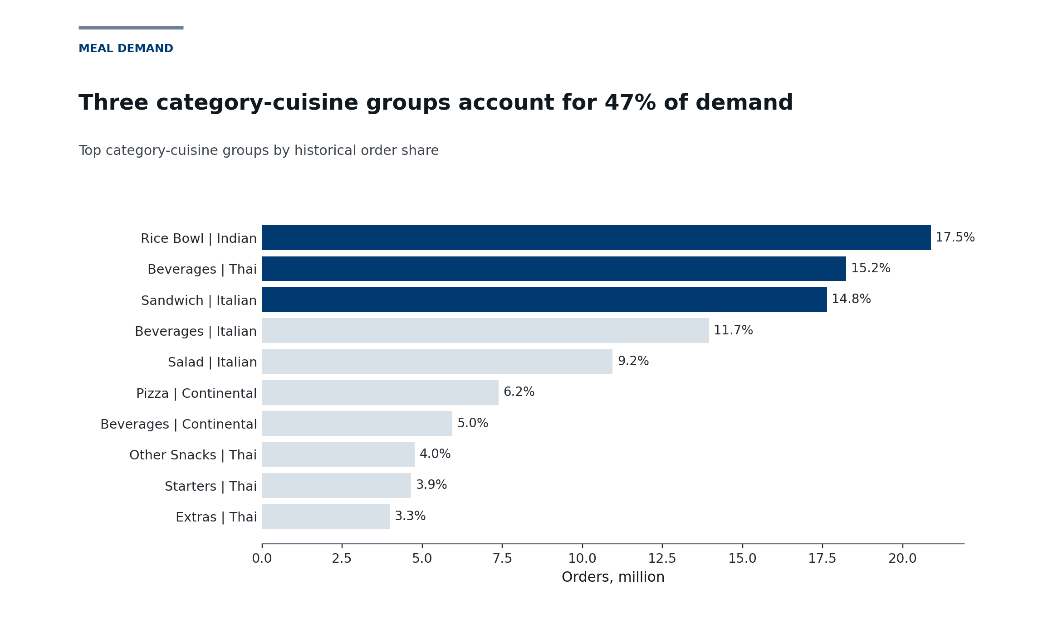
MEAL DEMAND DIAGNOSIS: WHICH MEALS AND CATEGORIES CONTRIBUTE THE MOST ORDERS?
KEY FINDING
The SQL analysis first groups orders by category and cuisine, and calculates the total number of orders, number of menu items, and order share for each category-cuisine combination. The business question behind this analysis is: if the supply chain team can only prioritize managing part of the products, which categories should they focus on first?
Consumer demand is not evenly distributed across all offerings. It is highly concentrated on a select few category-cuisine groups, which dominate overall sales.
21/51
Notes:
Hello everyone. Today, we begin our diagnosis with a fundamental observation: demand is not spread evenly across our menu. Instead, it is highly concentrated on a select few category-cuisine combinations.
As you can see from the data, the top five combinations—such as Indian Rice Bowls and Thai Beverages—account for nearly 70% of all orders. This is a critical insight.
It tells us that our inventory strategy cannot be one-size-fits-all. We must prioritize these high-demand categories with more robust supply chain support to ensure stability and prevent stock-outs, which would have a disproportionate impact on our overall business.

Slide 22
MEAL DEMAND DIAGNOSIS: WHICH MEALS AND CATEGORIES CONTRIBUTE THE MOST ORDERS?
TOP 5 COMBINATIONS BY ORDER VOLUME
1. Rice Bowl/Indian: 20.8M (17.5%)
2. Beverages/Thai: 18.2M (15.3%) 3. Sandwich/Italian: 17.6M (14.8%)
4. Beverages/Italian: 14.0M (11.7%)
5. Salad/Italian: 10.9M (9.2%)
Total Share: ~68.5% of all orders
22/51
Notes:
Hello everyone. Today, we begin our diagnosis with a fundamental observation: demand is not spread evenly across our menu. Instead, it is highly concentrated on a select few category-cuisine combinations.
As you can see from the data, the top five combinations—such as Indian Rice Bowls and Thai Beverages—account for nearly 70% of all orders. This is a critical insight.
It tells us that our inventory strategy cannot be one-size-fits-all. We must prioritize these high-demand categories with more robust supply chain support to ensure stability and prevent stock-outs, which would have a disproportionate impact on our overall business.

Slide 23
MEAL DEMAND DIAGNOSIS: WHICH MEALS AND CATEGORIES CONTRIBUTE THE MOST ORDERS?
The top five category combinations contribute nearly 70% of total orders, so inventory should focus more on high-demand products instead of being evenly distributed.
From a business perspective, categories such as Rice Bowl, Beverages, and Sandwich represent the main pressure points in the supply chain. If these products run out of stock in key fulfillment centers, the impact could affect overall order fulfillment performance. Therefore, these categories should be treated as priority supply items.
TOP 5 COMBINATIONS BY ORDER VOLUME
1. Rice Bowl/Indian: 20.8M (17.5%)
2. Beverages/Thai: 18.2M (15.3%) 3. Sandwich/Italian: 17.6M (14.8%)
4. Beverages/Italian: 14.0M (11.7%)
5. Salad/Italian: 10.9M (9.2%)
Total Share: ~68.5% of all orders
23/51
Notes:
Hello everyone. Today, we begin our diagnosis with a fundamental observation: demand is not spread evenly across our menu. Instead, it is highly concentrated on a select few category-cuisine combinations.
As you can see from the data, the top five combinations—such as Indian Rice Bowls and Thai Beverages—account for nearly 70% of all orders. This is a critical insight.
It tells us that our inventory strategy cannot be one-size-fits-all. We must prioritize these high-demand categories with more robust supply chain support to ensure stability and prevent stock-outs, which would have a disproportionate impact on our overall business.

Slide 24
WHEN THE ANALYSIS IS FURTHER DRILLED DOWN TO INDIVIDUAL MEAL IDS, DEMAND CONCENTRATION STILL EXISTS.
Top 5 Meals by Orders
1.Meal 2290 (Rice Bowl / Indian): 9.77M (8.17%)
2.Meal 1885 (Beverages / Thai): 8.35M (6.98%)
3.Meal 1754 (Sandwich / Italian): 6.82M (5.70%)
4.Meal 1993 (Beverages / Thai): 6.66M (5.57%)
5.Meal 1109 (Rice Bowl / Indian): 6.37M (5.33%)
Total top 5 share: ~31.7%
Key Insight: Amplification Effect
These top meals are not only high-selling but also have a strong supply chain impact, as they are widely distributed across 77 centers and 145 weeks, meaning any issue can affect the entire fulfillment network. Therefore, they should be treated as priority items with centralized monitoring, stable supply planning, and closer operational control.
24/51
Notes:
Now, let's zoom in even further to the individual meal level. The story remains the same: demand is highly concentrated. Meals like Meal 2290, an Indian Rice Bowl, account for over 8% of all orders. The critical thing to note here is the 'amplification effect'. These top meals are served in every single one of our 77 fulfillment centers. This means a problem with one of these meals isn't a local issue; it's a network-wide crisis. We need to monitor these items closely across all centers. However, this analysis only tells us which products are important. It doesn't tell us where they are most unstable. That is the question we will address next, as we move into analyzing center-level demand volatility.

Slide 25
Center
Volatility
4-2
25/51

Slide 26



Demand volatility is concentrated in a small set of centers
Why this matters
Methodology
Key Metric: CV
The same meals may exhibit huge different demand patterns and volatility levels across various fulfillment centers.
Allows us to compare relative volatility across centers with different order scales
CV =
(Weekly order standard deviation) / (Average weekly orders)
Weekly order data was aggregated by unique center_id and week to calculate the volatility metrics.
Key Question：Whether demand is stable across different centers.
26/51
Notes:
After identifying high-demand meals, this section moves from the product perspective to the fulfilment center perspective. The key question is whether demand is stable across different centers. To answer this, weekly orders are aggregated by center and week, and the coefficient of variation is calculated. CV allows us to compare relative volatility across centers with different order scales. The chart shows that volatility is concentrated in a small set of centers, such as Center 91, Center 41, Center 124, Center 92 and Center 102. These centers may not be suitable for a simple fixed replenishment cycle, because average-based planning can lead to shortages in peak weeks and waste in low-demand weeks.

Slide 27
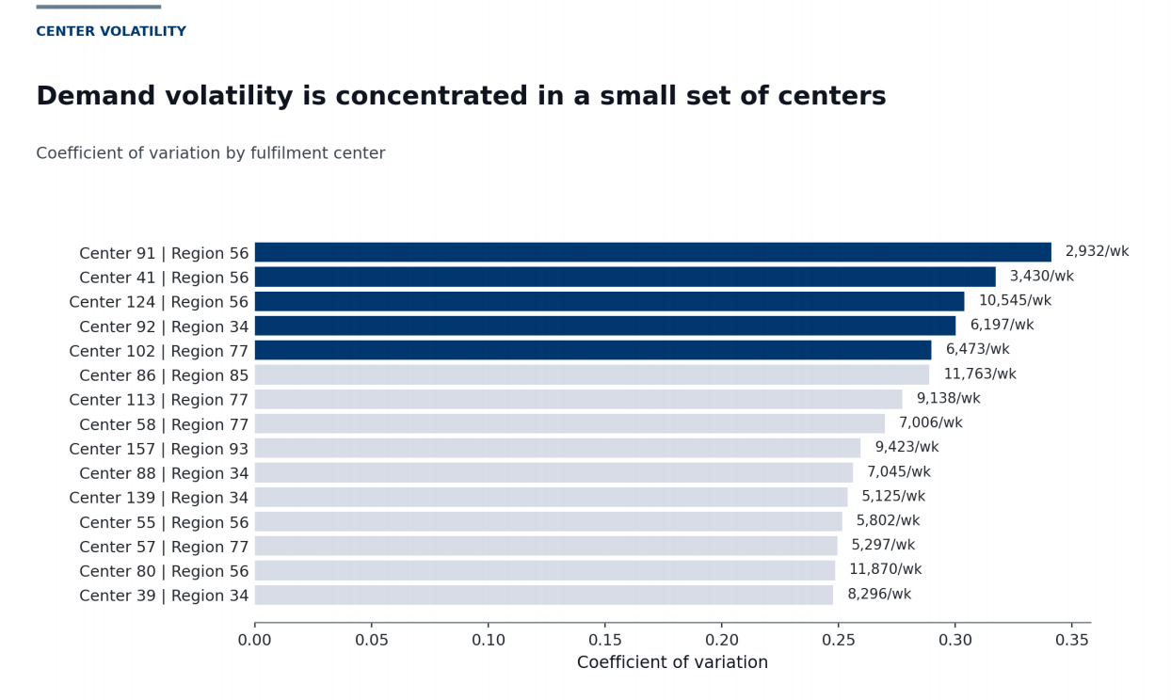
CENTER VOLATILITY
• Each row = one fulfilment center
• Bar length = CV demand volatility
• Right label = average weekly orders
03
Flexible planning needed
These centers are more suitable for rolling replenishment, pre-promotion preparation and more frequent demand monitoring.
02
Fixed replenishment risk
If stock is planned based on the average level, peak weeks may lead to shortages.
If stock is planned based on the peak level, low-demand weeks may lead to waste.
01
Center-level differences
Clear operational differences in demand volatility.
27/51
Notes:
This chart shows demand volatility across different fulfilment centers. Each row represents one specific center, and the region label only indicates where that center belongs. The horizontal axis shows the coefficient of variation, or CV, which measures relative demand volatility. A longer bar means that weekly demand fluctuates more strongly compared with the center’s own average level. The numbers on the right show average weekly orders, not CV. The result shows that centers such as Center 91, Center 41, Center 124, Center 92 and Center 102 have the highest volatility. This means fulfilment centers have clear operational differences. For high-volatility centers, a fixed replenishment plan is riskier. If stock is planned based on the average level, peak weeks may lead to shortages. If stock is planned based on the peak level, low-demand weeks may lead to waste. Therefore, these centers are more suitable for rolling replenishment, pre-promotion preparation and more frequent demand monitoring.

Slide 28
Scale and volatility require different replenishment actions
Low Scale + High Volatility
• Careful replenishment
• Avoid overstocking from temporary peaks
High Scale + High Volatility (Priority)
• Priority monitoring & rolling forecast
• Pre-promotion stock check
High scale = larger impact of shortages
High volatility = higher planning uncertainty
Plan using both dimensions together
Demand
Volatility
(Low → High)
Low Scale + Low Volatility
• Standard monitoring
• Basic replenishment control
High Scale + Low Volatility
• Standardized replenishment
• Stable capacity planning
Replenishment priority should consider both demand scale AND volatility, not total orders alone.
28/51
Notes:
To summarize, center demand analysis shows that scale and volatility are two different management problems. High-scale centers need strong supply capacity because shortages may affect many orders. High-volatility centers need flexible replenishment because demand is harder to predict. Therefore, a single fixed replenishment rule is not suitable for all fulfilment centers. High-scale and relatively stable centers can use standardized replenishment, while high-scale and high-volatility centers require priority monitoring, rolling forecasts and pre-promotion stock checks. This logic also explains why the later replenishment priority score includes both demand scale and demand volatility.

Slide 29
Promotion
&
Discount
4-3
29/51

Slide 30
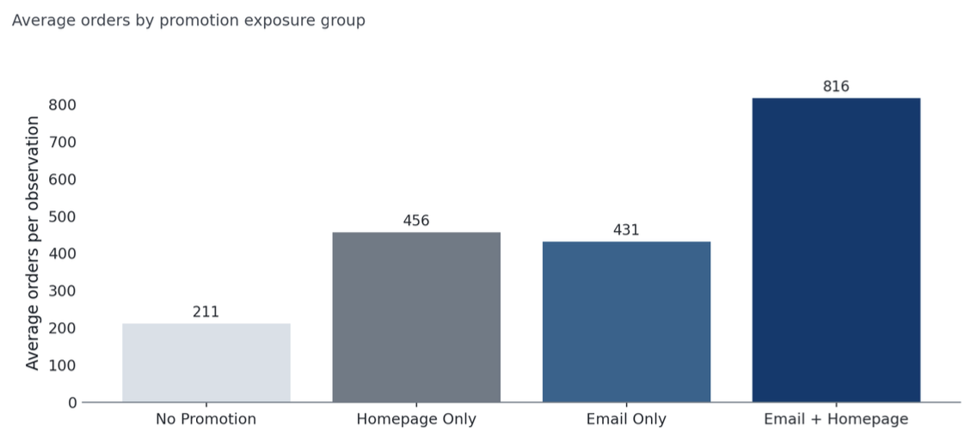
Promotion and Discount Diagnosis
Whether the demand amount in peak season is impacted by the promotion activity
If the promotion activity triggers a higher demand, an advance temporary preparation is needed
The 3 core steps of lean agile
Combined promotion exposure is associated with the highest order volume
Orders with double exposure performed the highest
30/51
Notes:
We exame CV fits for comparing the volatility for centers with different scales, 业务规模不一定与管理难度相等

Slide 31
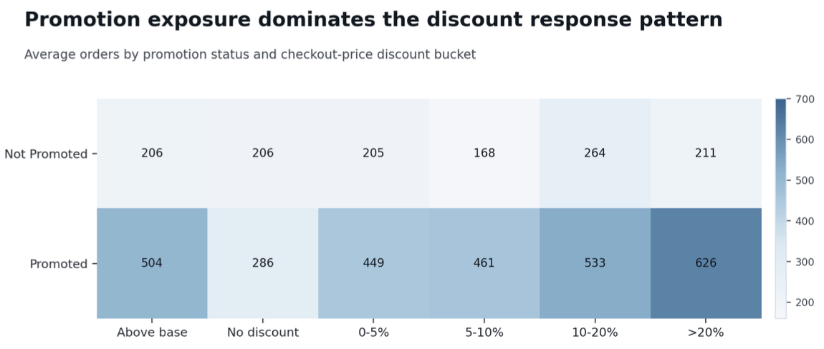
Promotion and Discount Diagnosis
Whether the demand amount in peak season is impacted by the promotion activity
If the promotion activity triggers a higher demand, an advance temporary preparation is needed
The 3 core steps of lean agile
31/51
Notes:
这表明促销状态与更高需求表现相关，也可能增加补货不确定性

Slide 32
Promotion and Discount Diagnosis
Promotion exposure drives order volume more than discount depth
Promotion directly impacts supply chain load, reshaping short-term order structure and fulfillment center pressure
Analysis
Promotion without preparation would lead to stockouts and raise the risk
The replenishment strategy should count in the promotion factor
32/51
Notes:
这说明 fulfilment centers 之间存在明显运营差异。对高波动
心，固定补货计划的风险更高：如果按平
均值备货，旺周容易
缺货；如果按高峰值备货，淡周容易浪费。因此，这些中心更适合采用滚动补货、
促销前预
备和更频繁的需求监控。

Slide 33
Deep
Dive
5
33/51

Slide 34
Deep-Dive: Demand Risk Classification
+ Replenishment Priority Score
Previous Diagnosis
Deep-dive level
Demand scale
Volatility
Promotion response
center_id + meal_id
Replenishment is for a specific meal at a specific fulfillment center
34/51
Notes:
The previous diagnosis sections give us the basis for the decision. In my deep-dive section, because replenishment is for a specific meal at a specific fulfillment center in practice, I bring those signals down to the center_id + meal_id level.

Slide 35
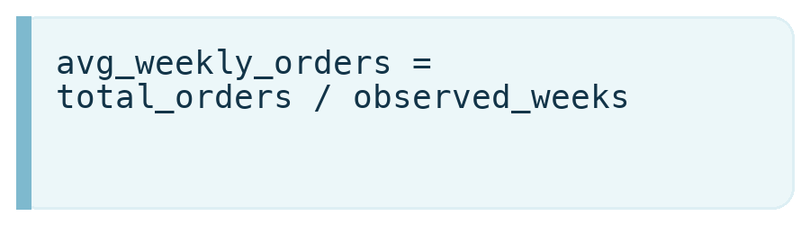
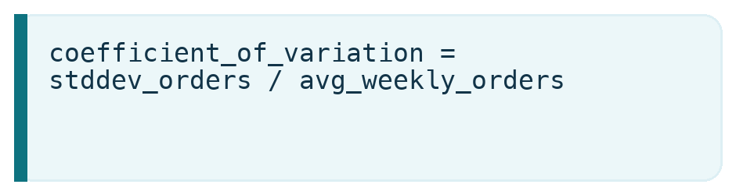
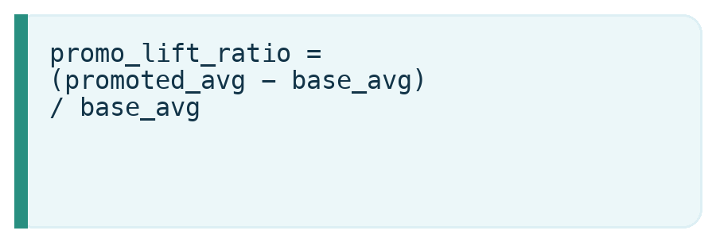
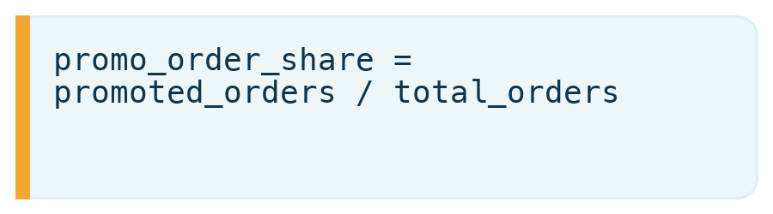
01
Classify Each Center-Meal Combination
Average weekly orders
Coefficient of variation
Demand scale
Demand volatility
Promotion lift
Promo order share
Promotion dependence
Promotion dependence
35/51
Notes:
We first classify each center-meal combination with three signals: average weekly orders, coefficient of variation, and promotion dependence. The signals are calculated first, then converted into relative percentile positions using PERCENT_RANK.

Slide 36
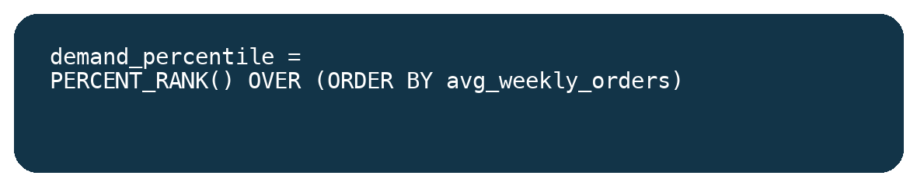
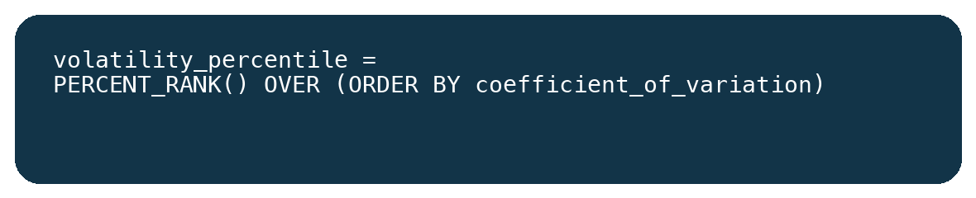
02
Convert Signals Into Relative Percentile Positions
PERCENT_RANK() lets the signals share one comparable scale.
This step prepares the inputs for the demand risk classification rule.
36/51
Notes:
The three signals are converted into relative percentile positions using PERCENT_RANK. This lets the classification rule compare different metrics consistently.

Slide 37
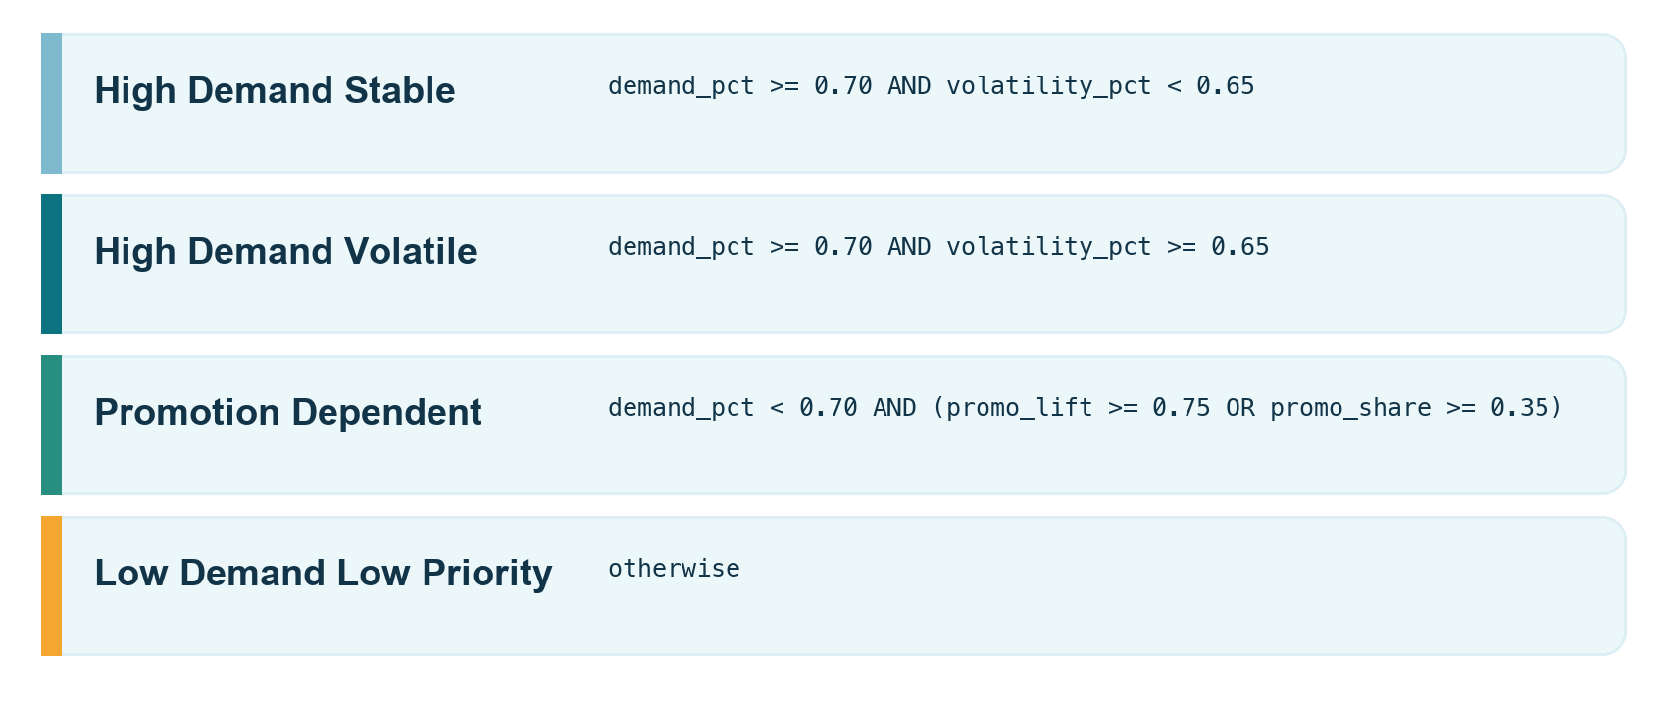
03
Assign Four Demand Risk Groups
Based on these percentiles and promotion information, each pair receives one risk type.
This is the rule that turns calculated signals into classification results.
37/51
Notes:
Based on these percentiles and promotion information, the four demand risk groups are assigned using the rule.

Slide 38
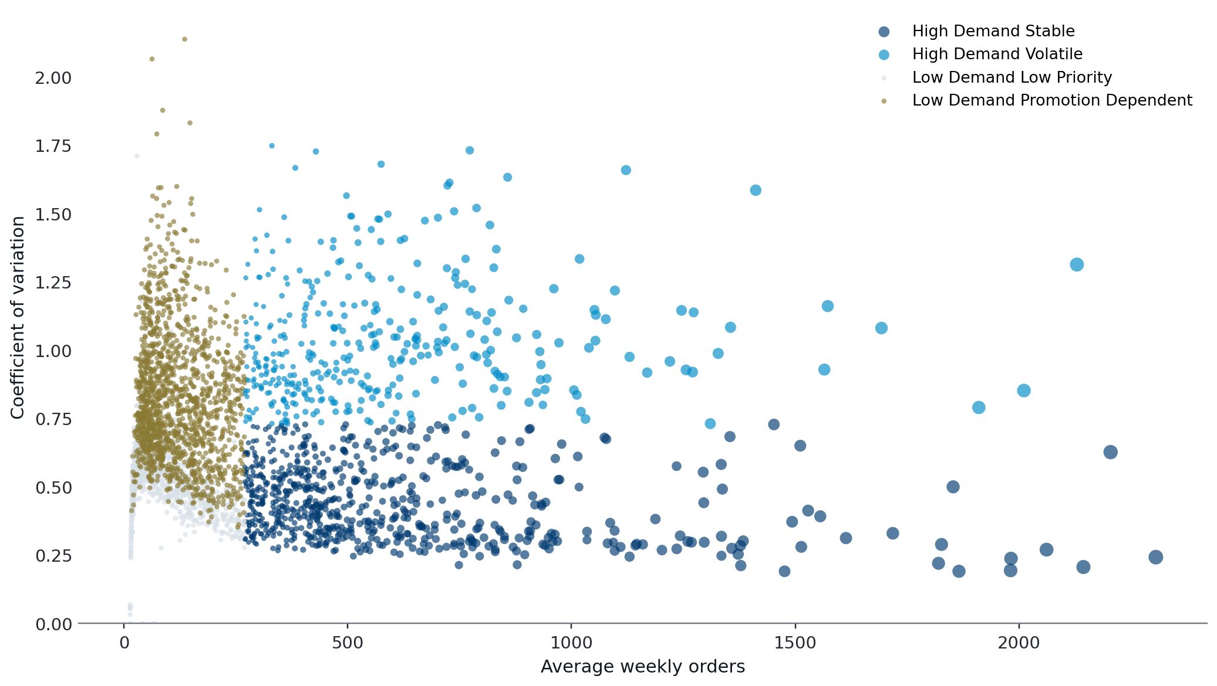
04
Visualization Shows The Four Risk Types
The distribution supports us in making the corresponding strategies.
Distribution
Four risk types across demand and volatility.
Support
The visual supports corresponding strategies.
Bridge
From classification to management actions.
38/51
Notes:
Then, we obtain this visualization to demonstrate the distribution of the four risk types, which supports us in making the corresponding strategies.

Slide 39
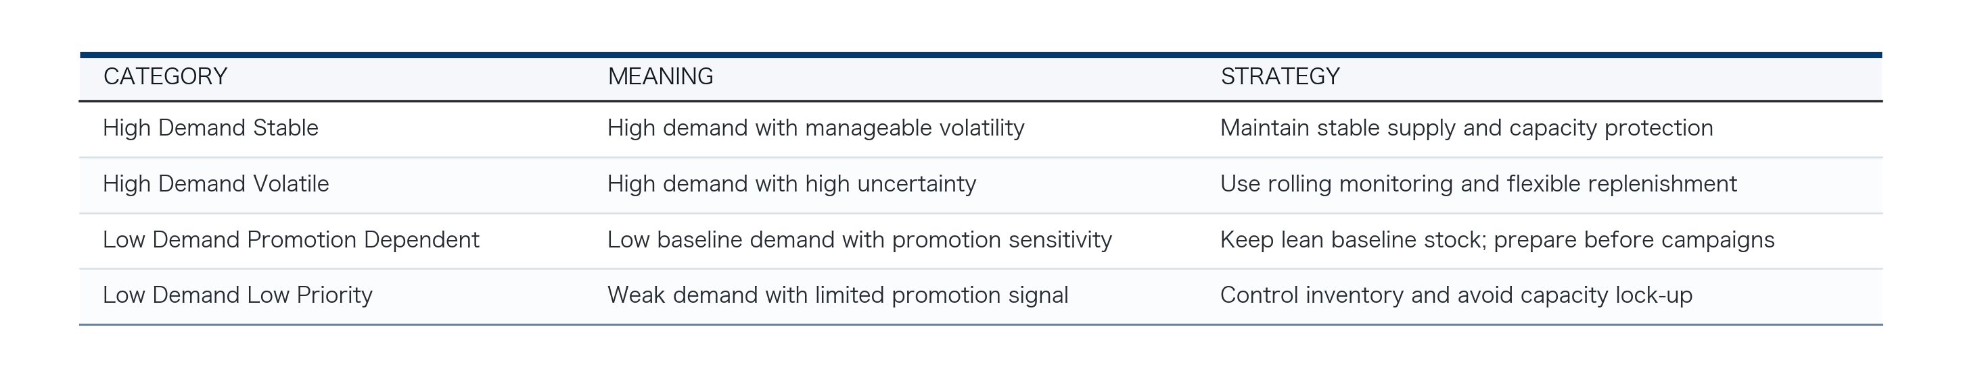
05
Turn Categories Into Actions
Each demand risk type links to a matching inventory strategy.
High Demand Stable
High Demand Volatile
Promotion Dependent
Low Priority
Maintain stable supply and capacity protection.
Rolling monitoring and flexible replenishment.
Lean baseline stock; prepare before campaigns.
Control inventory and avoid capacity lock-up.
39/51
Notes:
After that, this table turns the categories into actions and links each demand risk type to a matching inventory strategy.

Slide 40
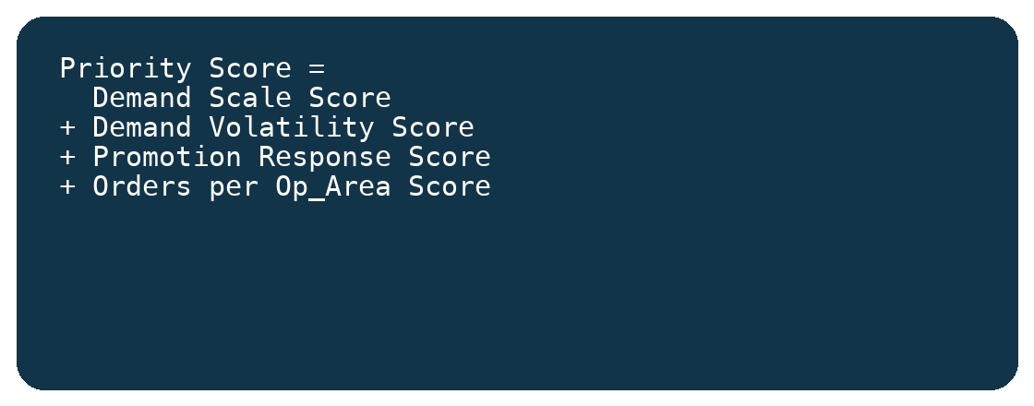
06
Which Combinations Should We Manage First?
We build a 20-point replenishment priority score using four sub-scores.
Demand scale
Demand volatility
sub-score
sub-score
Promotion response
Orders per area
sub-score
sub-score
Demand scale + demand volatility + promotion response + orders per operating area.
40/51
Notes:
To answer which combinations should we manage first, we build a 20-point replenishment priority score by using four sub-scores: demand scale, demand volatility, promotion response, and orders per operating area.

Slide 41
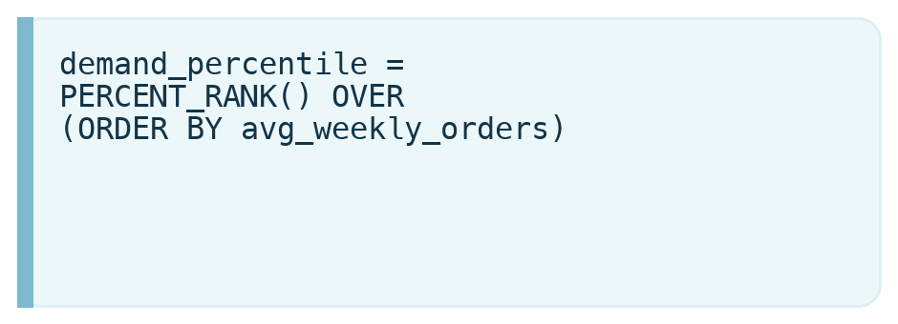
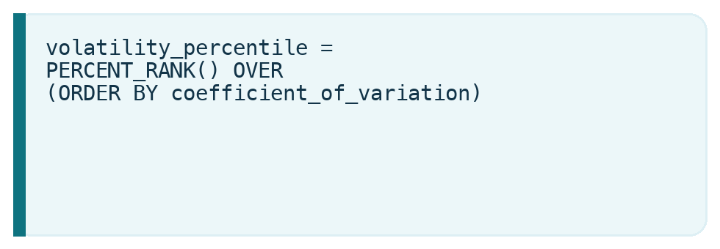
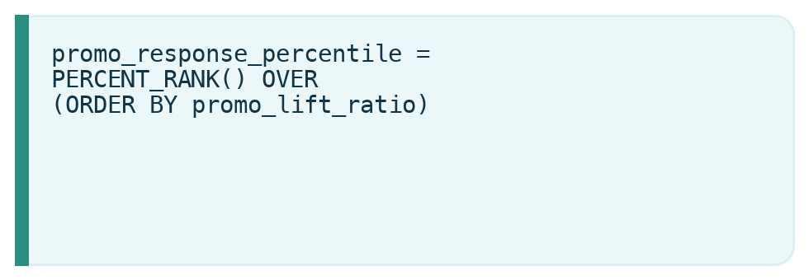
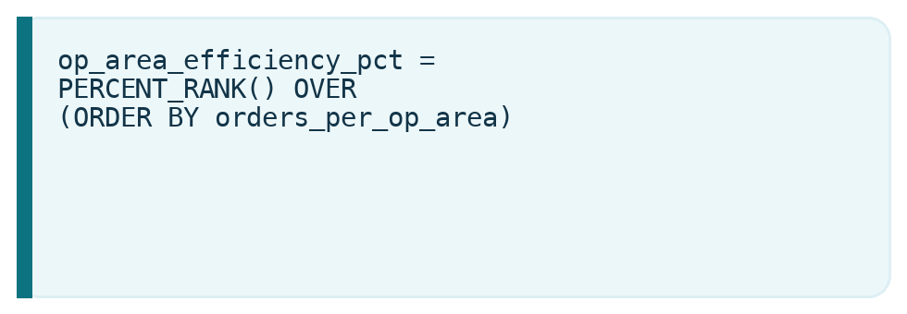
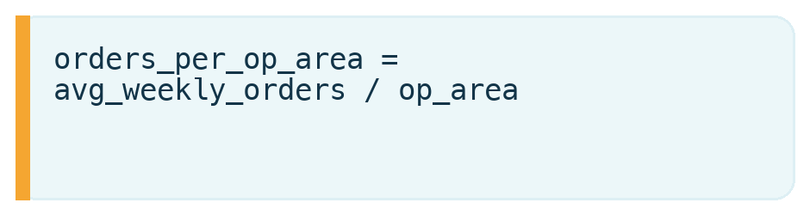
07
Components Also Use The Percentile Method
Demand scale, volatility, promotion response, and op-area efficiency are calculated with formulas.
41/51
Notes:
Each component is also using the percentile method. Demand scale, volatility, promotion response, and op-area efficiency are calculated with these formulas.

Slide 42
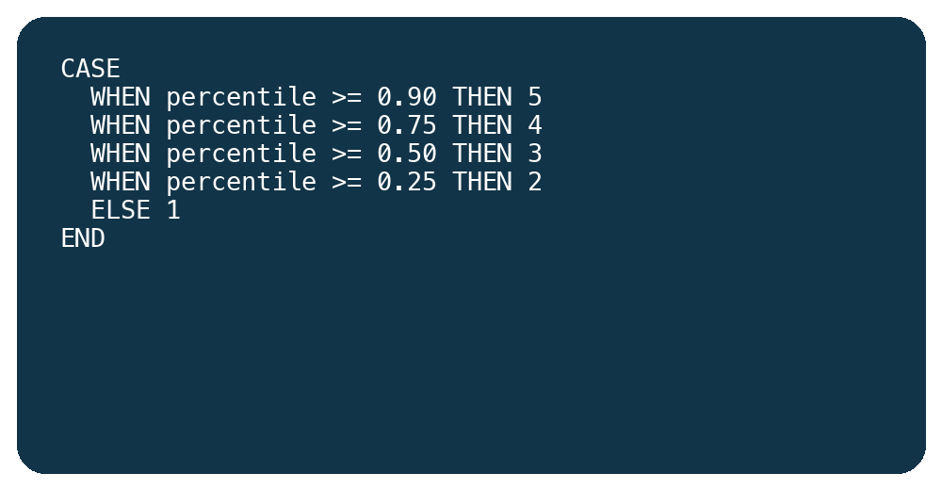
08
Score Each Component From 1 To 5
5
The total score is therefore a ranking signal.
top 10%
4
75-90%
20
3
max total
50-75%
2
25-50%
1
Each component is scored from 1 to 5 using this conversion rule.
bottom 25%
42/51
Notes:
Each component is scored from 1 to 5 using this conversion rule. The total score is therefore a ranking signal.

Slide 43
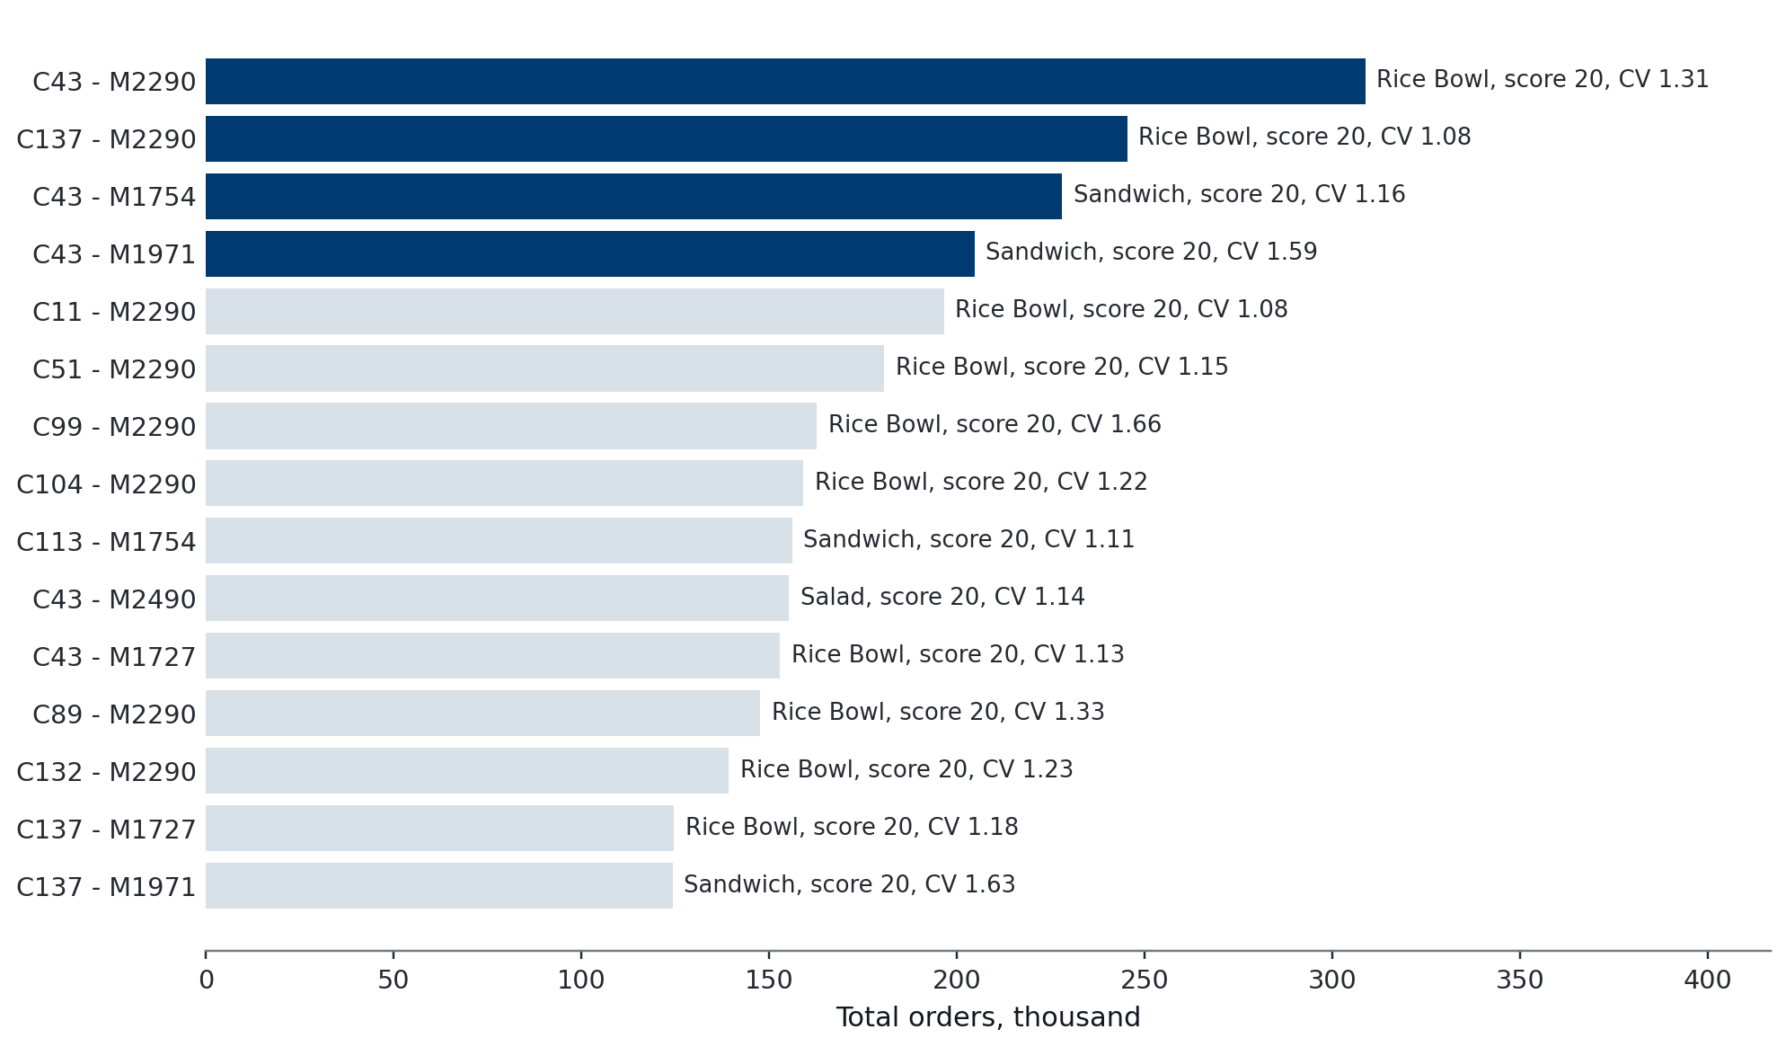
09
Final Output Of The Deep-Dive
This figure ranks center-meal pairs by replenishment priority.
Final output
Rank center-meal pairs by priority.
Directly actionable
The analysis points to what to manage first.
Next step
Bring the insight and recommendation out.
43/51
Notes:
This figure is the final output of the deep-dive. It ranks center-meal pairs by replenishment priority, so the analysis becomes directly actionable. In this way, we can then bring the insight and recommendation out.

Slide 44
Key Insights
6
44/51

Slide 45
6 Key Insights
01
Demand is highly concentrated
Orders are mainly concentrated in a few food categories.
Rice Bowl-Indian
Beverages-Thai
Sandwich-Italian
47% of total orders
The supply chain risk is also concentrated. If these key meals are out of stock, the impact will be large. However, overstocking low-demand and long-tail meals may create inventory waste.
45/51

Slide 46
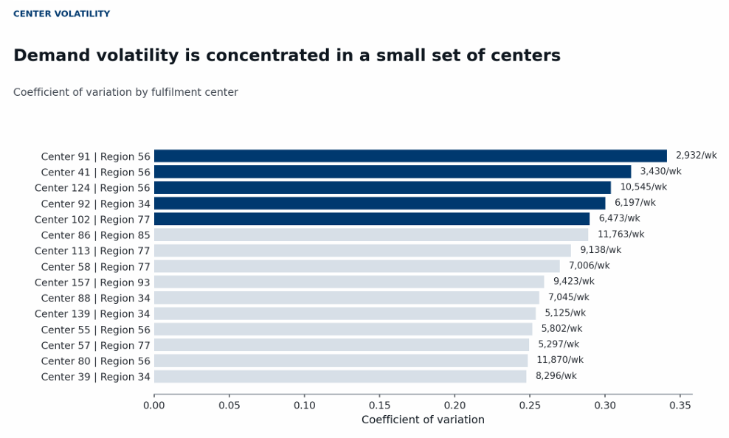
6 Key Insights
02
Fulfillment centers have different demand fluctuations
Some fulfillment centers show much higher demand volatility than others.
A fixed replenishment plan is not suitable for all centers. The company should manage centers differently based on their demand fluctuation level.
46/51

Slide 47
6 Key Insights
03
Promotion strongly affects
Email
Homepage
Email + Homepage” promotion group has much higher average orders than the no-promotion group.
Promotion should not be treated only as a marketing activity.
It must be connected with supply chain planning, because promotions can suddenly increase demand.
But the company should also check the original demand level. A high growth rate for a low-demand meal does not always mean a large real increase in orders.
Marketing
🔒
Supply Chain
47/51

Slide 48
6 Key Insights
04
Center-meal combination is the best management unit
Food Category
fulfillment center
Food Category
fulfillment center
<
and
or
The company should not only analyze demand by food category or by fulfillment center separately.
The better unit is center_id + meal_id, because demand risk often happens at the specific combination level: which meal, in which center.
This helps the company create a more specific replenishment action list.
48/51

Slide 49
6 Key Insights
05
Replenishment priority does not mean stocking more
MARS
Product Type | Supply Chain Strategy
High-demand & stable | Ensure stable supply
High-demand & fluctuating | Monitor more frequently and replenish flexibly
Low-demand & promotion-dependent | Prepare before promotion
Low-demand & low-priority | Control inventory and avoid waste
Priority management means using different strategies for different product types.
The goal is not to increase inventory for everything, but to allocate resources more accurately.
49/51

Slide 50
Recommendations
7
50/51

Slide 51
7 Recommendations
Build a differentiated replenishment strategy
01
02
Flexible Replenishment
Priority Supply Mechanism
Apply dynamic replenishment to high-fluctuation centers to reduce stockout and waste risks.
Ensure stable supply for key meals and high-priority center-meal combinations.
04
03
Promotion-supply Coordination
Inventory Control
Reduce unnecessary stock for low-demand and low-priority combinations.
Link marketing activities with inventory preparation before promotions.
The goal is not to stock more for everything, but to allocate inventory and management resources more accurately.
51/51
Notes:
The platform should build a differentiated replenishment strategy instead of using one fixed replenishment plan for all meals and centers.

