Slide 1

Evaluating the Effectiveness of Promotional Email Campaigns on Customer Conversion
Group D
A/B Testing Analysis Based on Email Marketing Dataset
2330036010
2330036015
2330036089
2330036106
2330036159
2330036186
2330036190
Chen Zeming
Deng Songhao
LIU Jiaming
Ma Ang
Wu Xin
Zhang Hanyuan
Zhang Shuoyan

Slide 2
Content
1 Business Needs Analysis
2 Experiment Design and Effect Definition
3 Data Collection and Quality Check
4 Descriptive Statistics
5 Statistical Analysis and Hypothesis Testing
6 Deep Analysis and Insight Discovery
7 Future Work and Limitations

Slide 3
Background
Our Role:
a Consulting Team hired by a Clothing Retail Company
Client’s Problem:
The client has been using email marketing to bring customers back to its website and encourage purchases, but management is not sure whether these promotional emails are truly effective.

Slide 4
1. Business Needs Analysis

Slide 5
1 Business Needs Analysis
Business Issue: Do promotional emails actually improve customer purchase conversion?
Goals
How many Emails are Sending
Increase
More Purchase
Purchases Conversion
No Significant Change
Problems
Several Conditions
Waste Resources / Create Customer Fatigue
Partial Customers
Specific Content

Slide 6
1 Business Needs Analysis
Business Issue: Do promotional emails actually improve customer purchase conversion?
Goals
Control Group: not receive emails
A/B Testing
Treatment Group: receive emails
Compared with non-sending promotional email, does sending promotional emails significantly increase purchase conversion?

Slide 7
Clean and validate datasets
Earth is the third planet from the Sun and has life
Share insights clearly
Act and
measure impact
1 Business Needs Analysis
Primary Metric
Supporting Metric
Conversion Rate
Visit Rate
It reflects whether the campaign creates actual business value.
whether the emails first succeed in bringing customers back to the website.
Define
the
Metrics
Emails
Whether Visit Website
Whether Make a Purchase
First, whether promotional emails are worth continuing
Second, whether company should optimize the email content or targeting strategy
Third, whether more refined customer segmentation should be used in future campaigns.

Slide 8
2 Experiment Design and Effect Definition

Slide 9
2 Experiment Design and Effect Definition
Primary A/B Test Group Definition
Grouping Logic
Rationale:
No E-mail serves as the control group, while Mens E-mail and Womens E-mail represent two different types of promotional content.
To ensure the main analysis corresponds to a standard A/B test, this report merges the two email categories into a single Any E-mail" experimental group.
Category | Control Group | Treatment Group
Definition | No E-Mail | Any E-Mail(Mens E-Mail + Womens E-Mail)
Explanation | Users who received no promotional emails. | Users who received either the Mens or Womens promotional email.
Purpose | Establish a baseline for comparison to isolate the effect of receiving promotional emails. | Determine the effectiveness of the promotional strategy.
Notes:
Let's start by defining our groups. In our main A/B test, we have two primary groups. On the left, the Control Group, which consists of users who received 'No E-Mail'. This group establishes our baseline performance. On the right, the Treatment Group, which we've defined as 'Any E-Mail'. This group combines users who received either the Mens or Womens promotional email. By combining them, we can assess the overall effectiveness of sending any promotional email versus sending none.

Slide 10
2 Experiment Design and Effect Definition
Treatment Effect: Uplift
UP Lift Calculation
If the uplift is greater than 0, it indicates that the treatment group outperformed the control group in terms of conversion rate.
Interpretation of Uplift
Statistical Significance
The treatment effect is represented by uplift, which is the difference between the treatment conversion rate and the control group conversion rate.
UP Lift = CVR (Treatment) - CVR (Control)
A positive uplift alone is not sufficient for a valid conclusion.
The improvement is only considered statistically valid if the entire 95% confidence interval of the calculated uplift is greater than 0.
Notes:
To be clear, the treatment effect, or 'lift', is calculated by subtracting the control group's conversion rate from the treatment group's conversion rate. We call this difference 'uplift'. A positive uplift means the treatment group performed better. For this result to be statistically significant, the entire 95% confidence interval of the uplift must be above zero.

Slide 11
3. Data Collection & Quality Check

Slide 12
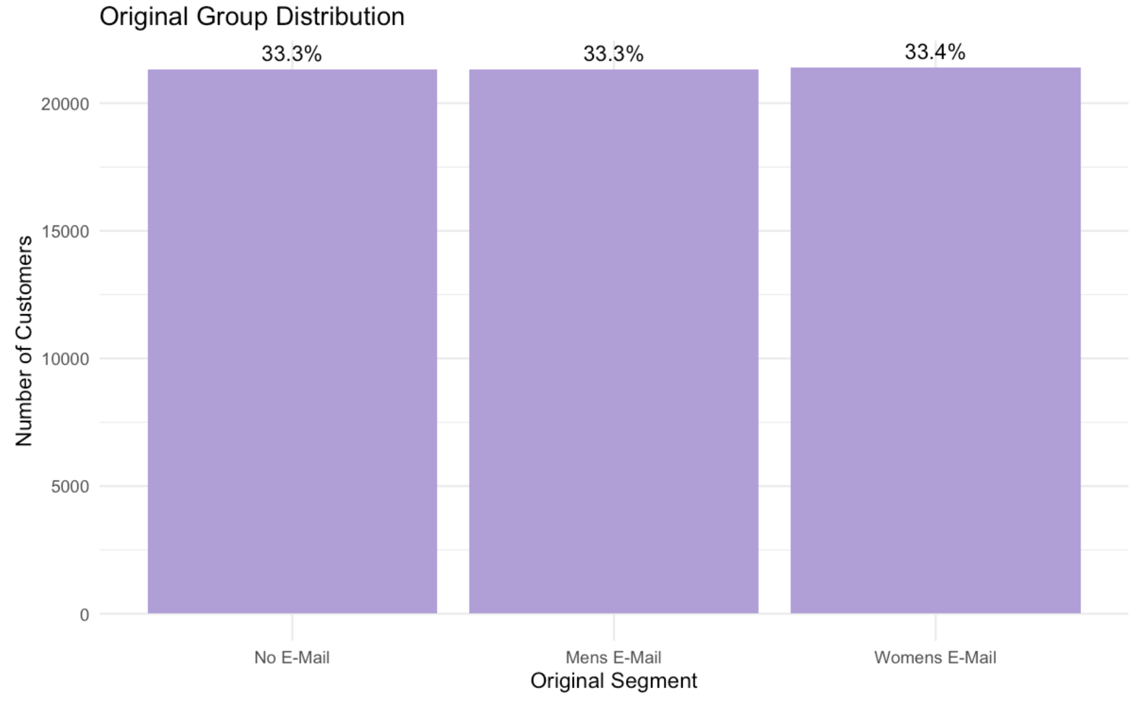
3. Data Collection and Quality Check
Original Group Distribution
Data Qality
Item | Value
Total rows | 64000
Unique customer IDs | 64000
Original groups | 3
Main A/B groups | 2
Total missing values | 0
64,000 unique customers with 0 missing values, indicating 100% data integrity
3 original groups are evenly balanced (~33% each), confirming successful randomization
Notes:
### Dataset Overview & Quality Check
- **Sample Characteristics**: The dataset contains **64,000 records**, with one unique customer ID per row, eliminating duplicate observations and ensuring a valid sample frame.
- **Experimental Group Configuration**: - Original design includes 3 treatment arms: *No E-Mail*, *Mens E-Mail*, and *Womens E-Mail*.
- For the primary analysis, these are aggregated into 2 groups: a control group (*No E-Mail*) and a combined treatment group (*Any E-Mail*).
- **Data Completeness**: No missing values are present across all variables, confirming full data integrity and removing the risk of bias from imputation or case exclusion. –
**Quality Conclusion**: The dataset meets all pre-defined quality standards—with sufficient sample size, complete grouping structure, and zero missing values—to support robust A/B testing and analysis.

Slide 13
4. Descriptive Statistics

Slide 14
4. Descriptive Statistics
Variable Type | Variable | n | Mean/Count | Median/Percentage | SD | Min/Max
Continuous | recency | 64000 | 5.76 | 6 | 3.51 | 1-12
Continuous | history | 64000 | 242.09 | 6 | 256.16 | 29.99-12
Continuous | spend | 64000 | 1.05 | 0 | 15.04 | 0-499
Binary | conversion | 64000 | 578 | 0.90% | - | -
Binary | visit | 64000 | 9394 | 14.68% | - | -
Binary | newbie | 64000 | 32144 | 50.22% | - | -
Binary | mens | 64000 | 35266 | 55.10% | - | -
Binary | womens | 64000 | 35182 | 54.97% | - | -

Slide 15
4. Descriptive Statistics
Category | Segment | n | Percentage
Channel | Multichannel | 7762 | 12.13%
Channel | Phone | 28021 | 43.78%
Channel | Web | 28217 | 44.09%
Zip Code | Rural | 9563 | 14.94%
Zip Code | Suburban | 28776 | 44.96%
Zip Code | Urban | 25661 | 40.10%
Type | Segment | n | Percentage
Original | No E-Mail | 21306 | 33.29%
Original | Mens E-Mail | 21307 | 33.29%
Original | Womens E-Mail | 21387 | 33.42%
A/B Test | No E-Mail | 21306 | 33.29%
A/B Test | Any E-Mail | 42694 | 66.71%
Notes:
First, pre-experiment customer characteristics.
These are customer attributes that already exist before the email campaign. They include recency, history, history segment, customer type like newbie, shopping channel, zip code region, and past purchase of men’s or women’s items. We use these variables for segmentation analysis and logistic regression to control for customer differences.
Second, the experimental group variable, which is segment.
It divides customers into three groups: Mens E-Mail, Womens E-Mail, and No E-Mail. Importantly, segment is our real treatment variable for A/B testing. Do not confuse it with mens and womens—those only record customers’ past shopping behavior, not the email they received in this experiment.
Third, post-experiment outcome variables.
These are the results we measured after the campaign: visit means whether customers visited the website, conversion means whether they made a purchase, and spend records their actual spending amount.
For our project, conversion rate is our core metric. Our main research question is:
Compared with customers who received no email, do customers who received promotional emails have a higher purchase conversion rate?
The logical flow of our analysis is straightforward:
We start with customer historical characteristics, then look at the experimental email groups, and finally examine their visit, conversion and spending outcomes.
Based on this variable framework, the following summary tables show the overall statistical distribution of all continuous, binary and categorical variables, helping us understand the basic profile of all customers before we conduct formal A/B testing and deep segmentation analysis.

Slide 16
5. Statistical Analysis & Hypothesis Testing

Slide 17
5.1 Hypothesis and Test Design
Select the KPI first, then choose the statistical test that matches the data type.
Selected KPI
Outcome type
Method
Conversion Rate
Binary
2-proportion
primary KPI
conversion = 0 or 1
test: prop.test()
Hypothesis
Meaning
H0
Email and no-email groups have the same conversion rate
H1
Email and no-email groups have different conversion rates
Business logic
If the p-value is below 0.05, we reject H0 and treat the email effect as statistically supported.

Slide 18
5.2 Main A/B Test Result: Conversion
The p-value drives the decision; the uplift translates the result into business impact.
Key result
Absolute uplift
Decision
p = 4.27e-10
+0.495%
Significant
< 0.05; reject H0
Any E-Mail - No E-Mail
email improves conversion
Group
n
Conversions
Rate
Uplift
Decision
Any E-Mail
42,694
456
1.068%
+0.495%
Reject H0
No E-Mail
21,306
122
0.573%
-
-
Test evidence
Value
Interpretation
z value
6.905962
large positive difference
p-value
4.272e-10
statistical evidence that email improves conversion
Business readout: promotional email has statistical evidence for attracting more purchases.

Slide 19
5.3 Secondary Outcome: Visit Rate
Website visits explain the upstream funnel effect before customers purchase.
Visit test
Absolute uplift
Business meaning
p = 1.75e-93
+6.088%
More traffic
< 0.05; reject H0
more site visits
before conversion
Group
n
Visits
Visit rate
Absolute uplift
Any E-Mail
42,694
7,132
16.705%
+6.088%
No E-Mail
21,306
2,262
10.617%
-
Test evidence
Value
Interpretation
z value
21.92178
very large visit-rate difference
p-value
1.75e-93
email significantly increases visits
Business readout: email brings more customers into the website funnel, supporting the conversion result.

Slide 20
5.4 Pairwise Comparison and Holm Correction
Multiple comparisons are corrected before choosing the strongest email version.
Comparisons
Correction
Result
3 tests
Holm adjusted
3 significant
Mens, Womens, No E-Mail
controls Type I error
all adjusted p < 0.05
Comparison
Treat rate
Control
Uplift
p-value
Holm adj. p
Decision
Mens vs No E-Mail
1.253%
0.573%
+0.681%
1.47e-13
4.41e-13
Significant
Womens vs No E-Mail
0.884%
0.573%
+0.311%
0.000156
0.000312
Significant
Mens vs Womens
1.253%
0.884%
+0.369%
0.000206
0.000312
Significant
Holm application
Use p.adjust(method = "holm") to adjust the three raw pairwise p-values together, then compare adjusted p-values against 0.05.
Business readout: email works overall, and Mens E-Mail is the strongest version for future campaigns.

Slide 21
6.Deep Analysis & Insight Discovery
Segmentation Analysis, Confounding Variable Discussion, Pattern Discovery, Power Analysis

Slide 22
6.1 Segmentation Analysis
“Which customers is more effective for email?”
Channel Analysis:
Is email more effective for customers from Web, Phone, or Multichannel backgrounds?
History Segment Analysis:
Are high-value customers more responsive to promotional emails?
Newbie Analysis:
Will new customers and old customers have different responses to the emails?
Zip Code Analysis:
Will urban/suburban/rural customers have different reactions?

Slide 23
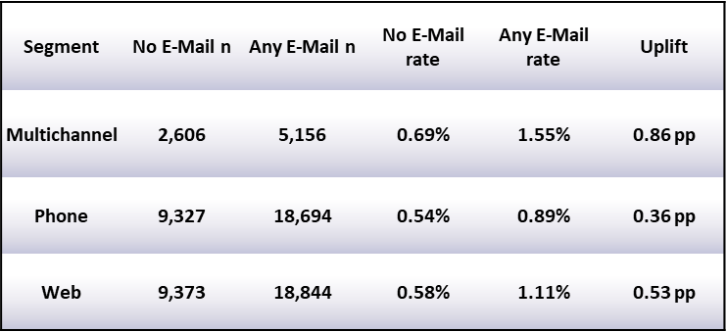
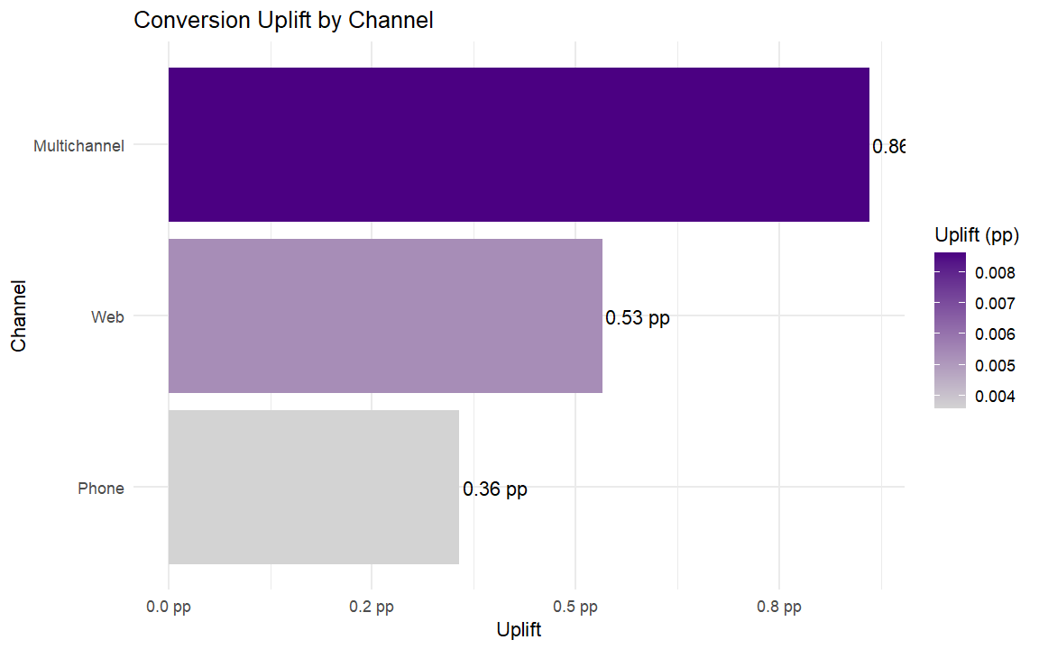
6.1 Channel Analysis
From the channel segmentation, Multichannel customers show the highest uplift, suggesting that customers who have purchased through multiple channels in the past are more likely to be reactivated by email campaigns. These customers have richer brand and channel engagement histories, making promotional emails more effective at driving return visits and purchases.

Slide 24
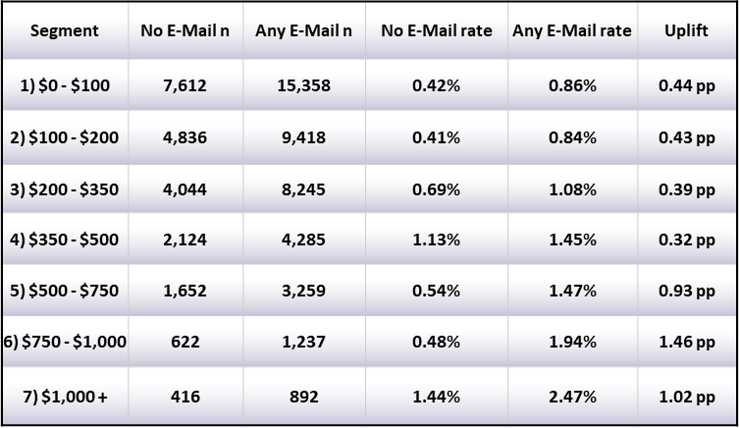
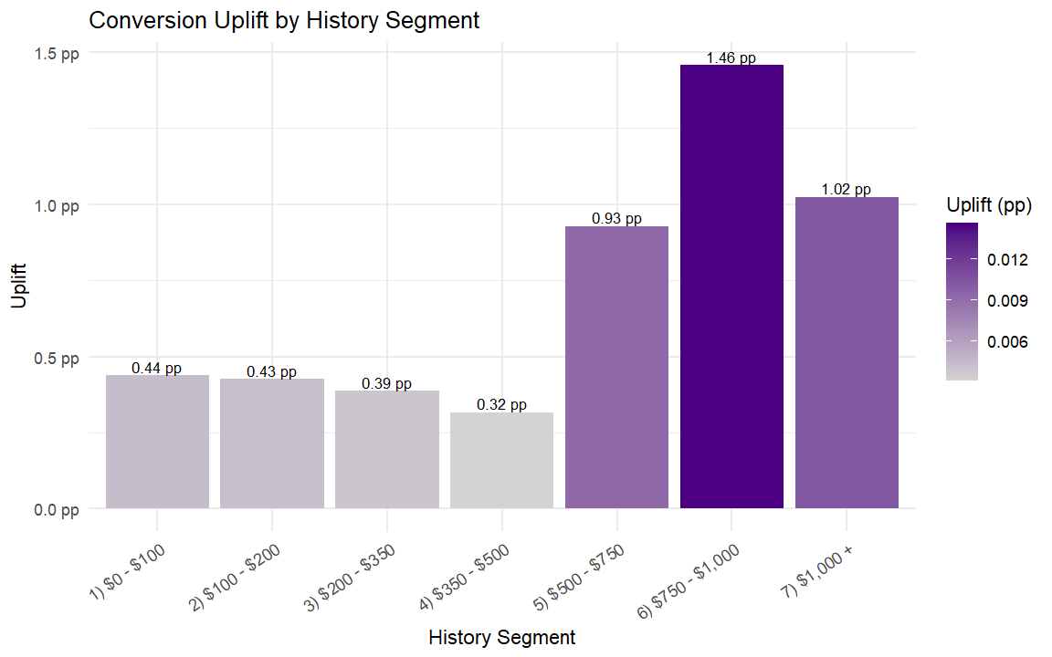
6.1 History Segment Analysis
Analysis by history segment reveals that customers with higher historical spending exhibit greater uplift. In particular, high-value segments such as $750-$1,000 and $1,000+ show substantially larger absolute improvements in conversion rate from email campaigns. This suggests that historical spending amount can serve as an important criterion for prioritizing email targeting.

Slide 25
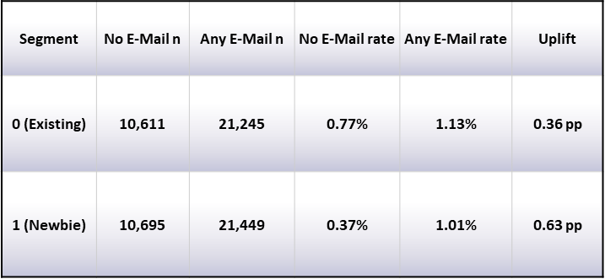
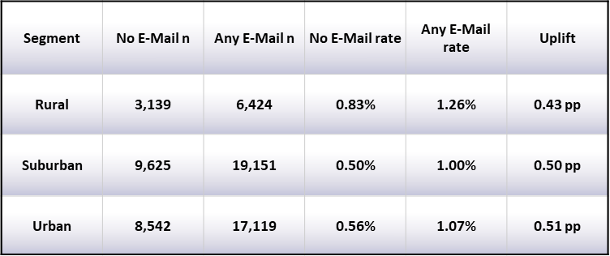
6.1 Newbie Analysis & Zip Code Analysis
According to the analysis result, the newbie is a binary variable showing whether the experimented one is new customer over the past one year. This table shows that new customers have higher uplift than existing customers, indicating that email campaigns may have customer activation value for new buyers
For zip code segmentation representing customers’ locations, the uplift differences among Urban, Suburban, and Rural areas are relatively small. Therefore, it is roughly reasonable that geographic type is not a key driver of heterogeneity in this dataset.

Slide 26
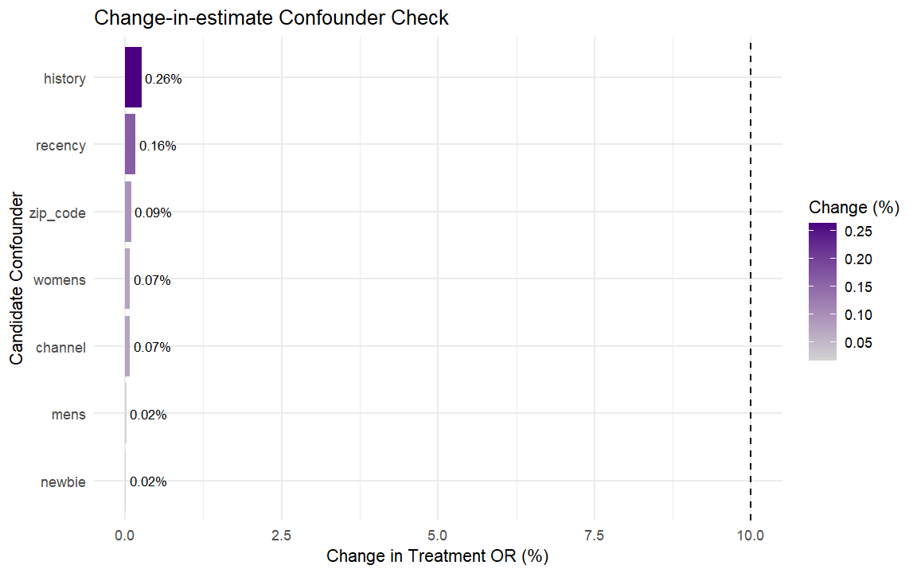
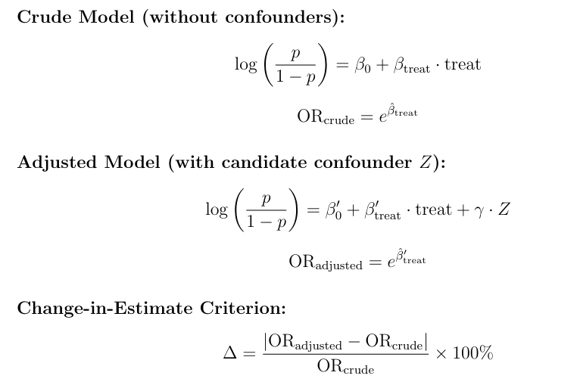
6.2 Confounding Variable Discussion
If ∆ ≥ 10%, the variable Z is considered a potential confounder.
The results show that all candidate variables produce treatment OR changes well below 10%, with the maximum change being only 0.26%. Therefore, according to the change-in-estimate criterion, none of these variables are identified as major confounders.
This finding aligns with the logic of randomized experimentation: random assignment typically reduces the confounding influence of pre-experiment customer characteristics on the treatment effect.

Slide 27
6.3 Pattern Discovery
Three Core Patterns Uncovered
A: Content Matters
B: Visits vs. Conversions
Promotional emails significantly improve conversion. The "Mens' E-Mail" treatment shows a stronger effect than the "Womens' E-Mail".
Emails generate a much larger lift in visit rate than in conversion rate, indicating an opportunity to optimize the post-click path.
A
C
B
C: Segmentation is Key
Email effectiveness varies across customer segments. High-value targets like multichannel customers show the strongest uplift.
Notes:
Our analysis revealed three core patterns. First, the content of the email matters significantly; specifically, the 'Mens' E-Mail' outperformed the 'Womens' E-Mail'. Second, emails are excellent at driving website visits, but converting those visits into sales needs more work. And third, segmentation is key; targeting the right customer groups maximizes ROI.

Slide 28
6.3 Three Main Patterns
Finding 1: Email Content Significantly Impacts Conversion Rate
Key Takeaways
Comparison Groups | Trt / Ctrl Rate | Uplift (pp)
Men's E-mail vs Ctrl | 1.25% / 0.58% | +0.68
Women's E-mail vs Ctrl | 0.88% / 0.58% | +0.31
Men vs Women E-mail | 1.25% / 0.88% | +0.37
Data Interpretation
Men's email had higher conversion than control, and 40% more effective than Women's.
Strategic Action
Allocate more budget to "Men's" content; A/B test Women's variations.
Notes:
Let's look at the first finding in detail. The table clearly shows that the 'Mens' E-Mail' treatment had a conversion rate of 1.25%, which is more than double the control group's 0.58%. It was also 40% more effective than the 'Womens' E-Mail'. This tells us that content design is critical and we should treat different email types as separate strategies.

Slide 29
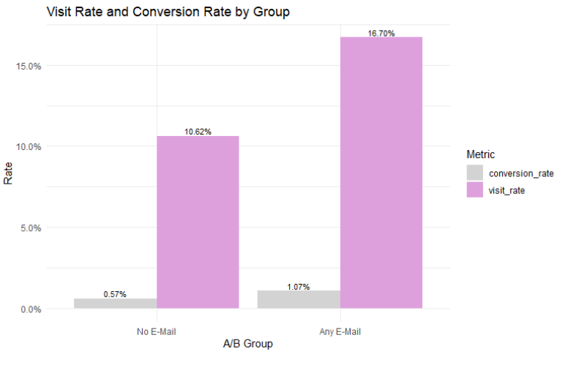
6.3 Three Main Patterns
Finding 2: Emails Drive Visits, but Conversions Lag
No E-Mail Group: Visit 10.62% | Conv. 0.57%
Any E-Mail Group: Visit 16.70% | Conv. 1.07%
Visit Rate Lift: +6.08 pp
Conversion Lift: +0.50 pp
Key Observations
The lift in visit rate is over 12 times greater than the lift in conversion rate.
This reveals a significant drop-off between website visits and completed purchases.
Interpretation
ACTION NEEDED: Optimize the post-click experience to close the conversion gap.
Comparison of Visit & Conversion Rates
Notes:
The second finding is about the difference between driving visits and driving conversions. As the chart shows, sending an email increased the visit rate by a substantial 6 percentage points, from 10.6% to 16.7%. However, the conversion rate only increased by 0.5 percentage points. This means the lift in visits is over 12 times greater than the lift in conversions, pointing to a clear opportunity to optimize our post-click experience.

Slide 30
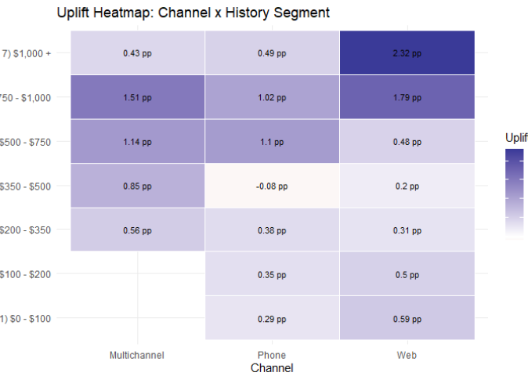
6.3 Three Main Patterns
Finding 3 Deep Dive: Uplift Heatmap Analysis
KEY OBSERVATIONS
+2.32%
Peak uplift: Web / >$1000 Segment
INTERPRETATION
High Spending ≠ High Uplift
Channel matters!
STRATEGIC TAKEAWAY
Focus email marketing budget and efforts on high-spending customers (> $700) who primarily use Web or Multi-channel platforms
Notes:
To identify these high-value segments, we used a heatmap. The darkest blue represents the highest uplift. As you can see, the sweet spot is the 'Web Channel' combined with customers who have spent over $1000, showing an uplift of 2.32 percentage points. In general, high-spending customers on Web or Multichannel platforms show the strongest positive response. This confirms our strategy should be to focus on these groups.

Slide 31
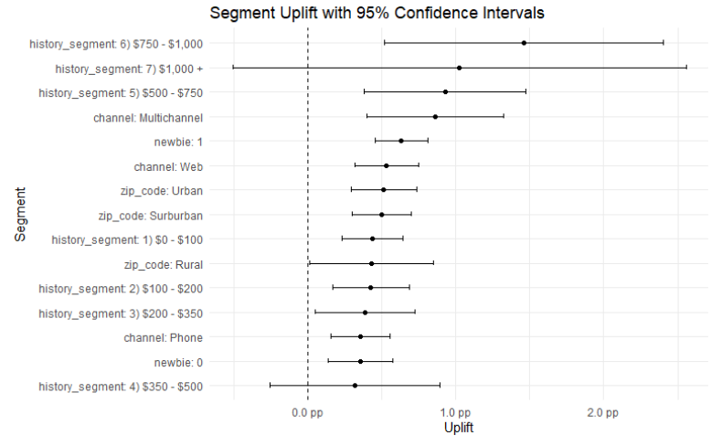
6.3 Three Main Patterns
Finding 3 Deep Dive: Forest Plot Analysis for Robust Insights
A: Highest Uplift
Segments > $750 show the highest point estimates for uplift. These are the top performers.
B: Statistical Significance
Confidence intervals for high-value and multi-channel segments do not cross zero, confirming their uplift is statistically significant.
C: Uncertainty & Precision
Some high-uplift segments have wider confidence intervals due to smaller sample sizes, indicating less precise estimates.
Notes:
For a more robust view, we used a forest plot, which shows both the uplift and its statistical confidence. The segments at the top, like those who spent over $1000, have the highest uplift. Importantly, their confidence intervals do not cross the zero line, meaning their positive effect is statistically significant. This gives us confidence that these are the segments we should prioritize.

Slide 32
Metric | Observed uplift | MDE 0.25 pp | MDE 0.50 pp | MDE 0.75 pp | MDE 1.00 pp
Control rate (%) | 0.573 | 0.573 | 0.573 | 0.573 | 0.573
Treatment rate (%) | 1.068 | 0.823 | 1.073 | 1.323 | 1.573
Uplift (pp) | 0.495 | 0.25 | 0.50 | 0.75 | 1.00
Control n used | 21,306 | 21,306 | 21,306 | 21,306 | 21,306
Treatment n used | 42,694 | 42,694 | 42,694 | 42,694 | 42,694
Power | 1.000 | 0.947 | 1.000 | 1.000 | 1.000
Req'd control n | – | 13,340 | 3,985 | 2,058 | 1,318
Req'd treatment n | – | 26,732 | 7,986 | 4,124 | 2,642
6.4: Power Analysis
Ensuring Reliable Results
Key Finding 1: High Detection Power
• Observed Uplift: 0.495 percentage points
• Statistical Power: 1.000
• Conclusion: The experiment has extremely high ability to detect the measured effect.
Key Finding 2: Robust Results
• Minimum Detectable Effect (MDE):0.25percentage points
• Corresponding Power:0.947
• Conclusion: Power is well above the conventional threshold of 0.80, confirming robust results.

Slide 33
7. Future Works & Limitations

Slide 34
7 Result Interpretation: What Do the Results Mean for Business?
CONVERSION
VISIT LIFT
SEGMENTATION
IMPLICATION
Promotional emails improve conversion
Visit lift > Conversion lift
Impact varies across customer segments
Business Strategy
• Any E-Mail group has a higher conversion rate than the No E-Mail group.
• This means promotional emails are effective at activating customers in the short term.
• Emails drive more website visits than final purchases.
• The post-click user journey needs further optimization.
• Multichannel & high-spend customers show strongest uplift.
• Newbie customers also show high activation potential.
• Avoid a "one-size-fits-all" email campaign strategy.
• Prioritize segments with proven high response rates.
Notes:
首先，促销邮件提高了转化率。Any E-Mail 组的转化率高于 No E-Mail 组。这说明促销邮件在短期内可以有效激活顾客。
第二，访问率提升大于转化率提升。邮件带来了更多网站访问，但没有同等程度地转化为最终购买。这说明顾客愿意点击回到网站，但点击后的用户路径仍然需要进一步优化。
第三，邮件影响在不同顾客群体之间并不一致。Multichannel 用户和高消费用户的 uplift 最强，新用户也有较高的激活潜力。
所以商业启示很清楚。公司应该避免“一刀切”的邮件营销策略，而是优先关注已经表现出高响应率的顾客群体。
First, promotional emails improve conversion. The Any E-Mail group has a higher conversion rate than the No E-Mail group. This means promotional emails are effective at activating customers in the short term.
Second, the visit lift is larger than the conversion lift. Emails drive more website visits than final purchases. This means customers are willing to click back to the website, but the post-click user journey still needs further optimization.
Third, the impact varies across customer segments. Multichannel and high-spend customers show the strongest uplift, and Newbie customers also show high activation potential.
So the business implication is clear. The company should avoid a one-size-fits-all email campaign strategy and prioritize segments with proven high response rates.

Slide 35
7 Limitations and Bias Discussion
Time Extrapolation Bias
• Based on only two weeks of customer behavior.
• Short-term conversions may not reflect long-term retention.
• Long-term campaign ROI remains uncertain.
Survivorship Bias
Short-Term
View
• Unsubscribed/inactive users may be underrepresented.
• Analysis may focus more on active customers.
• Negative long-term reactions may be underestimated.
Filtered
Sample
Heterogeneous Treatment Effect Bias
• Men's & Women's emails are combined as "Any Email".
• Averages may hide significant content-level differences.
• Separate testing of creatives is recommended.
Aggregated
Analysis
Notes:
First, time extrapolation bias. The analysis is based on only two weeks of customer behavior. Short-term conversions may not reflect long-term retention, and the long-term campaign ROI remains uncertain.
Second, survivorship bias. Unsubscribed or inactive users may be underrepresented. As a result, the analysis may focus more on active customers, and negative long-term reactions may be underestimated.
Third, heterogeneous treatment effect bias. Men’s and Women’s emails are combined as Any Email. This aggregated analysis may hide significant content-level differences. Therefore, separate testing of creatives is recommended.
第一，时间外推偏差。这个分析只基于两周内的顾客行为。短期转化不一定能反映长期留存，长期活动 ROI 仍然不确定。
第二，幸存者偏差。退订用户或不活跃用户可能没有被充分代表。因此，分析可能更多集中在仍然活跃的顾客身上，负面的长期反应可能被低估。
第三，异质性处理效应偏差。Men’s 和 Women’s emails 被合并成 Any Email。这种汇总分析可能掩盖邮件内容层面的重要差异。因此，未来建议单独测试不同邮件创意。

Slide 36
7 Future Work and Business Recommendations
1. Prioritize High-Uplift Segments
2. Optimize Conversion Path
Focus on Multichannel & high-spending customers.
Use emails to activate Newbie segments for stronger response.
Improve landing page design & product recommendations.
Simplify checkout & promotion redemption to reduce drop-offs.
3. A/B Test Email Contents
4. Extend Observation Window
Separate campaigns for Men/Women.
Test subject lines, discount levels, frequency & personalization strategies.
Track outcomes over 1-3 months.
The company can track outcomes over one to three months and measure repeat purchase, retention, unsubscribe rate, and long-term value.
Notes:
First, the company should prioritize high-uplift segments. It should focus on Multichannel and high-spending customers, and use emails to activate Newbie segments for stronger response.
Second, the company should optimize the conversion path. Since emails drive visits but not all visits become purchases, the company should improve landing page design and product recommendations. It should also simplify checkout and promotion redemption to reduce drop-offs.
Third, future campaigns should A/B test email contents. Instead of only combining Men’s and Women’s emails, the company can test separate campaigns for different customer groups.
Fourth, future research should extend the observation window. The company can track outcomes over one to three months and measure repeat purchase, retention, unsubscribe rate, and long-term value.
The key strategic takeaway is to combine targeted delivery, content-level testing, and long-term tracking to maximize campaign ROI.
第一，公司应该优先关注高 uplift 群体。具体来说，可以重点投放 Multichannel 用户和高消费用户，同时使用邮件激活 Newbie 用户，以获得更强的响应。
第二，公司应该优化转化路径。因为邮件能够带来访问，但不是所有访问都会变成购买，所以公司应该改进落地页设计和产品推荐。同时，也应该简化结账流程和促销兑换流程，从而减少用户流失。
第三，未来活动应该对邮件内容进行 A/B 测试。不要只把 Men’s 和 Women’s emails 合并分析，而是可以针对不同顾客群体分别测试不同邮件内容。
第四，未来研究应该延长观察窗口。公司可以追踪一到三个月的结果，并衡量复购、留存、退订率和长期顾客价值。
核心战略启示是，把精准投放、内容层面的测试和长期追踪结合起来，从而最大化活动 ROI。、

Slide 37
Thank You!

