Slide 1

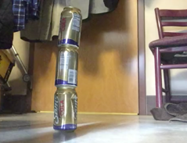
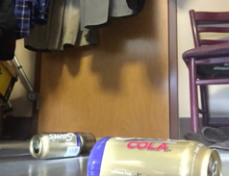
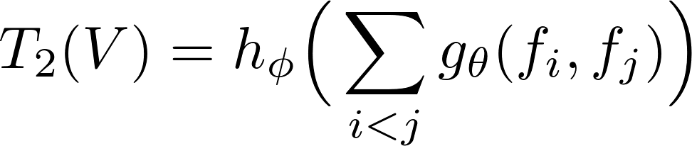


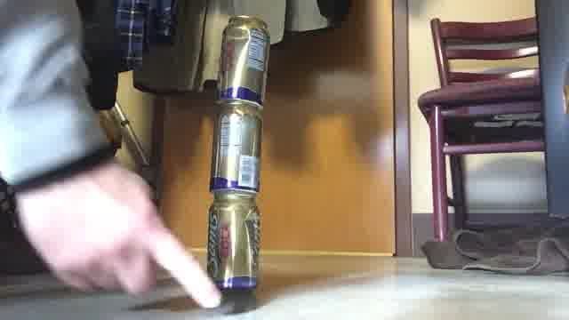
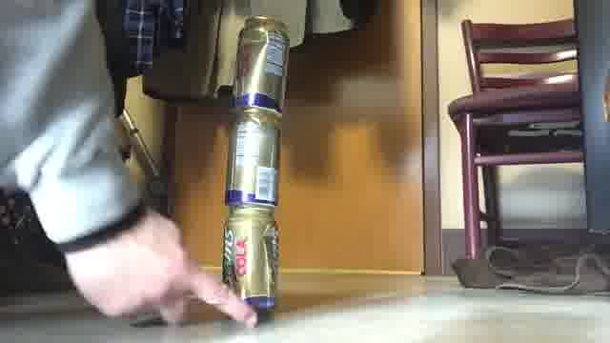
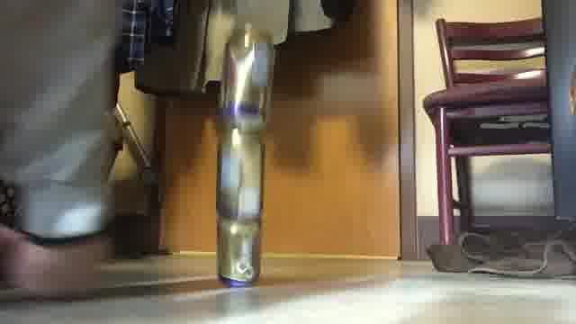
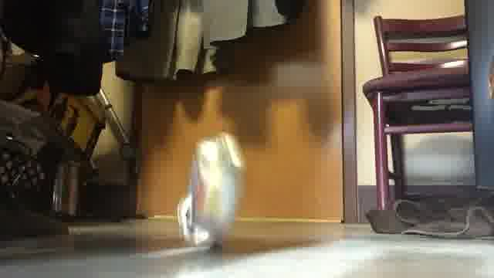
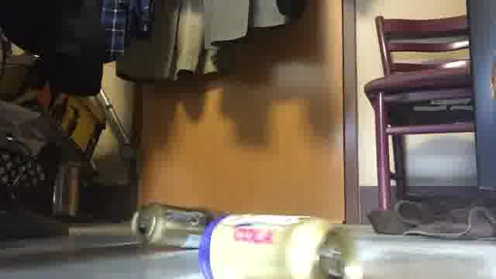










Temporal Relational Reasoning in Videos
Bolei Zhou, Alex Andonian, Aude Oliva, Antonio Torralba
What Happened in the Video?
Experiments
We can recognize the activities through the key frames of a video.
Classification accuracy on Sth-Sth dataset
Comparison of TRN and TSN [2]
Start frame
End frame
Start frame
End frame
Model | Sth-Sth-V1 | Sth-Sth-V2
Single-Frame | 11.41 | -
MultiScale TRN | 33.60 | 50.85
2-Stream TRN | 40.71 | 56.24
Best in leaderboard | 43.88 [1] | 50.76
 | TRN | TSN
2-frame | 22.23 | 16.72
3-frame | 26.22 | 17.30
5-frame | 30.39 | 18.11
7-frame | 31.01 | 18.48
Processing key frames is much more efficient for activity recognition.
Representing Videos as Temporal Relations
Results are also reported on charades and Jester dataset
Previous work: 3D convolution network (dense frames)
2-stream network (one RGB frame)
Representative relations scored by the model
Our temporal relation: sampled key frames + temporal order
Time
Multi-Scale Temporal Relational Networks (TRN)
Importance of temporal orders in the model
Crowd-sourced videos
Youtube videos
CNN
CNN
CNN
CNN
. . .
+
+
+
Models and code are publicly available:
http://relation.csail.mit.edu/
[1] Zolfaghari,et al, ECO, ECCV’18 [2] Wang, et al, TSN, ECCV’16
Poke a stack of something so it falls

