Slide 1
Programming in C/C++: A Hands-on Introduction
Shuyue Jia
Ph.D. Student
Boston University
Feb. 1st, 2025

Slide 2
Programming in C/C++: A Hands-on Introduction
Coding Principle 1:
Practice makes perfect.

Slide 3
Programming in C/C++: A Hands-on Introduction
Coding Principle 2:
Always follow the standards.
Reference: https://google.github.io/styleguide/

Slide 4
Programming in C/C++: A Hands-on Introduction
Coding Principle 3:
The beauty is in simplicity.

Slide 5
Outline
Programming in C/C++: A Hands-on Introduction
The Bigger Picture
Types of C files
C Program Structure
Syntax of C
C++: An Extension to the C Language
Resources

Slide 6
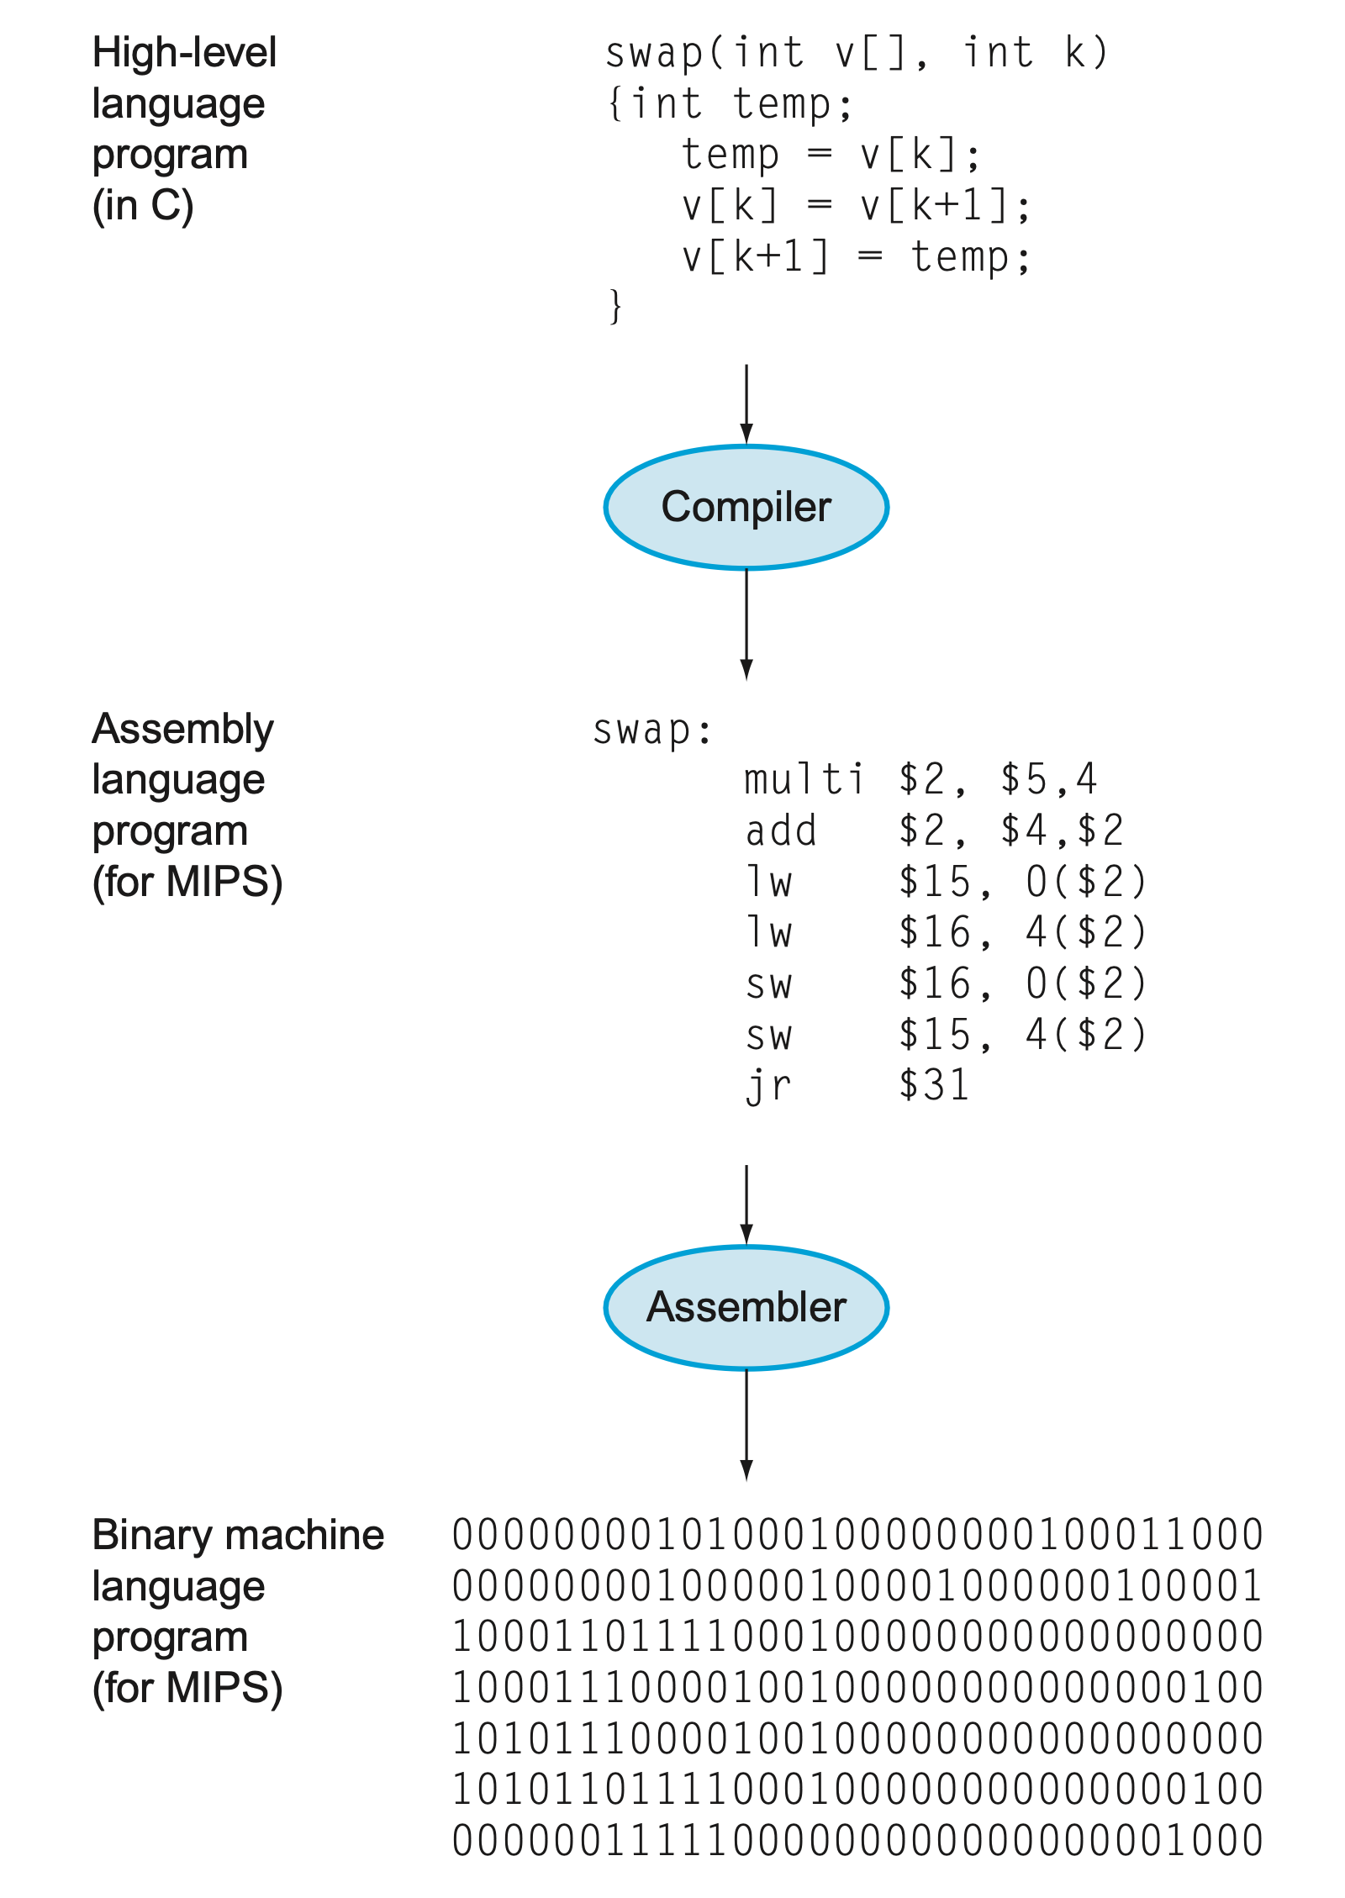
Part 1 – The Bigger Picture
Programming in C/C++: A Hands-on Introduction
C program: compiled into assembly language and then assembled into binary machine code
Compiler: The compiler transforms the C program into an assembly language program, a symbolic form of what the machine understands.
Assembler: The assembler turns the assembly language program into an object file (symbol table), a combination of machine language instructions, data, and information needed to place instructions properly in memory.
Credits: David Patterson and John Hennessy, Computer Organization and Design, Fifth Edition: The Hardware/Software Interface, Morgan Kaufmann Publishers Inc., San Francisco, CA, USA.
Image by courtesy of Patterson and Hennessy

Slide 7
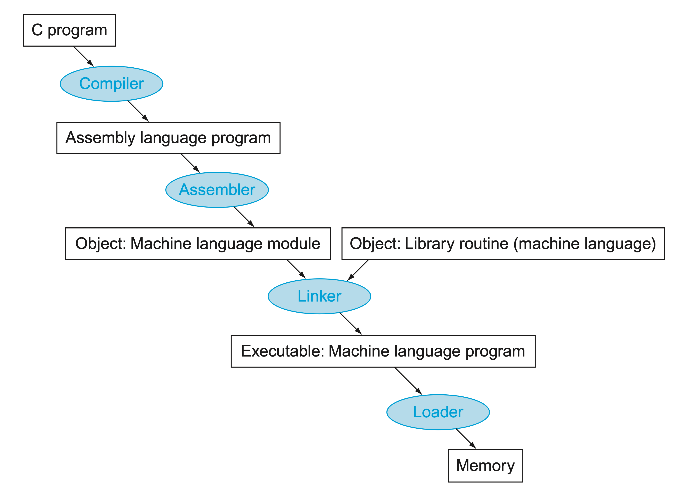
Part 1 – The Bigger Picture
Programming in C/C++: A Hands-on Introduction
.c and .h
Linker: combines independently assembled machine language programs and resolves all undefined labels into an executable file (binary machine code).
Loader: A systems program that places an object program in the main memory so that it is ready to execute.
Detect changes at the file level, only recompiling the modified .c file.
.s
.o
.a (statically)
.so (dynamically)
.out
Credits: David Patterson and John Hennessy, Computer Organization and Design, Fifth Edition: The Hardware/Software Interface, Morgan Kaufmann Publishers Inc., San Francisco, CA, USA.
Image by courtesy of Patterson and Hennessy

Slide 8
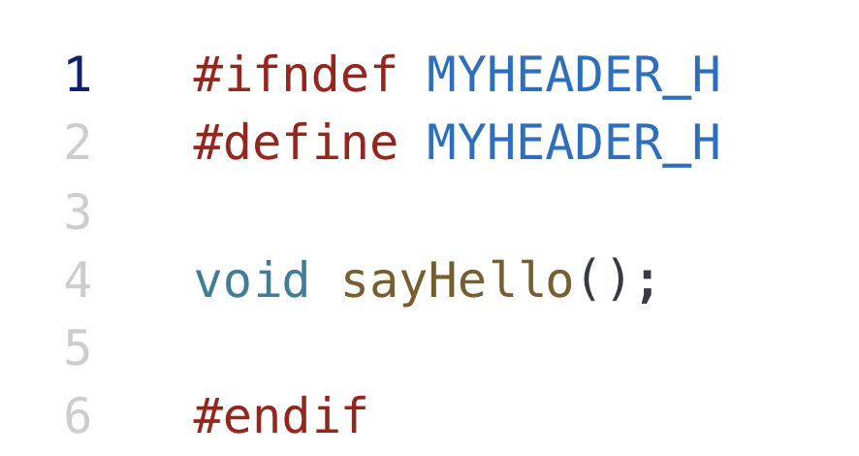
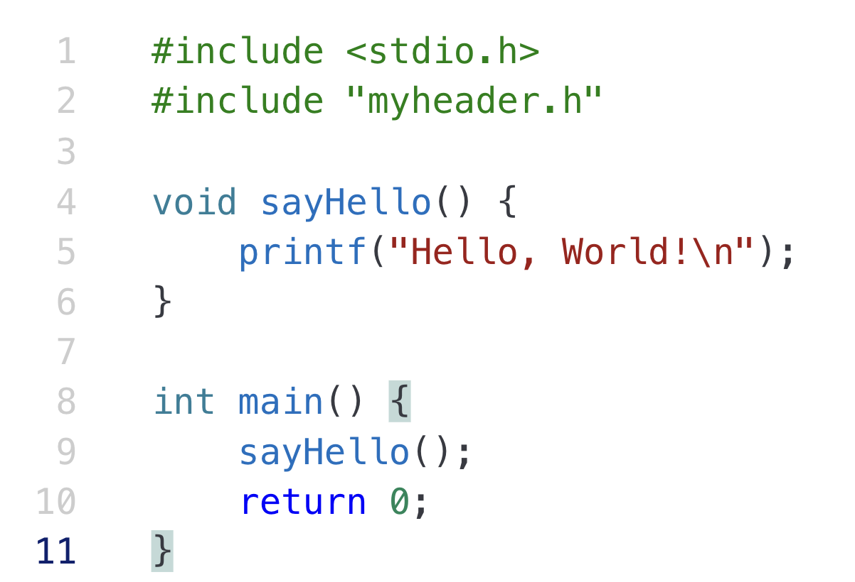
Part 2 – Types of C files
Programming in C/C++: A Hands-on Introduction
Name of your header file
myheader.h: header file, containing function prototypes and various pre-processor statements. They are used to allow source code files to access externally-defined functions.
main.c: source file, containing function definitions and the entire program logic.
#include: request to use a header file in our program
myheader.h
Your own defined function statement
Details of
your own defined function
main.c
The main function
Credits: https://www.geeksforgeeks.org/header-files-in-c-cpp-and-its-uses/
https://utat-ss.readthedocs.io/en/master/c-programming/c_h_files.html

Slide 9
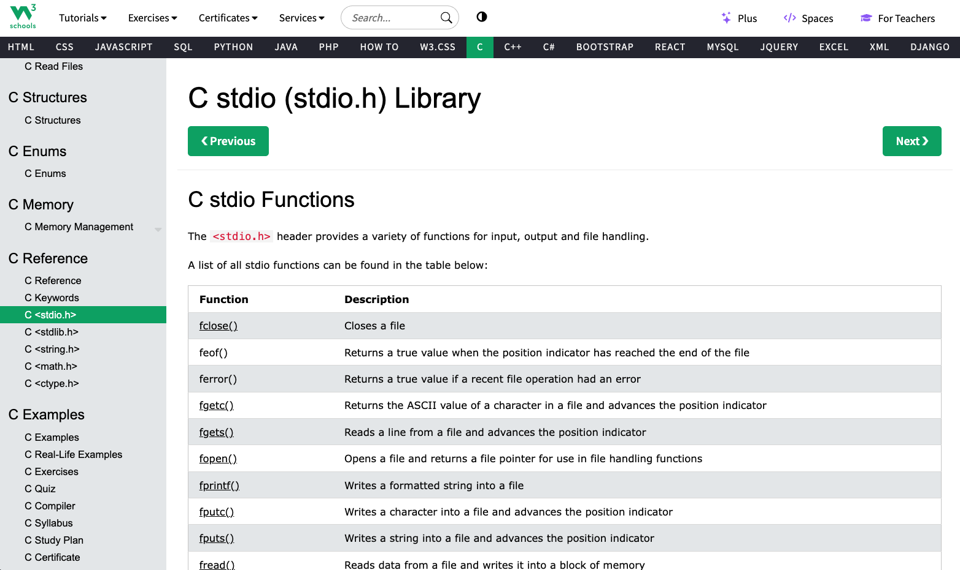
Credits: https://www.w3schools.com/c/c_ref_stdio.php

Slide 10
Part 3 – C Program Structure
Programming in C/C++: A Hands-on Introduction
Program defined by:
global declarations
function definitions
May contain preprocessor directives
Always has one function named main, and may contain others
Credits: Rich Maclin, CS 1621: Computer Science I, University of Minnesota-Duluth

Slide 11
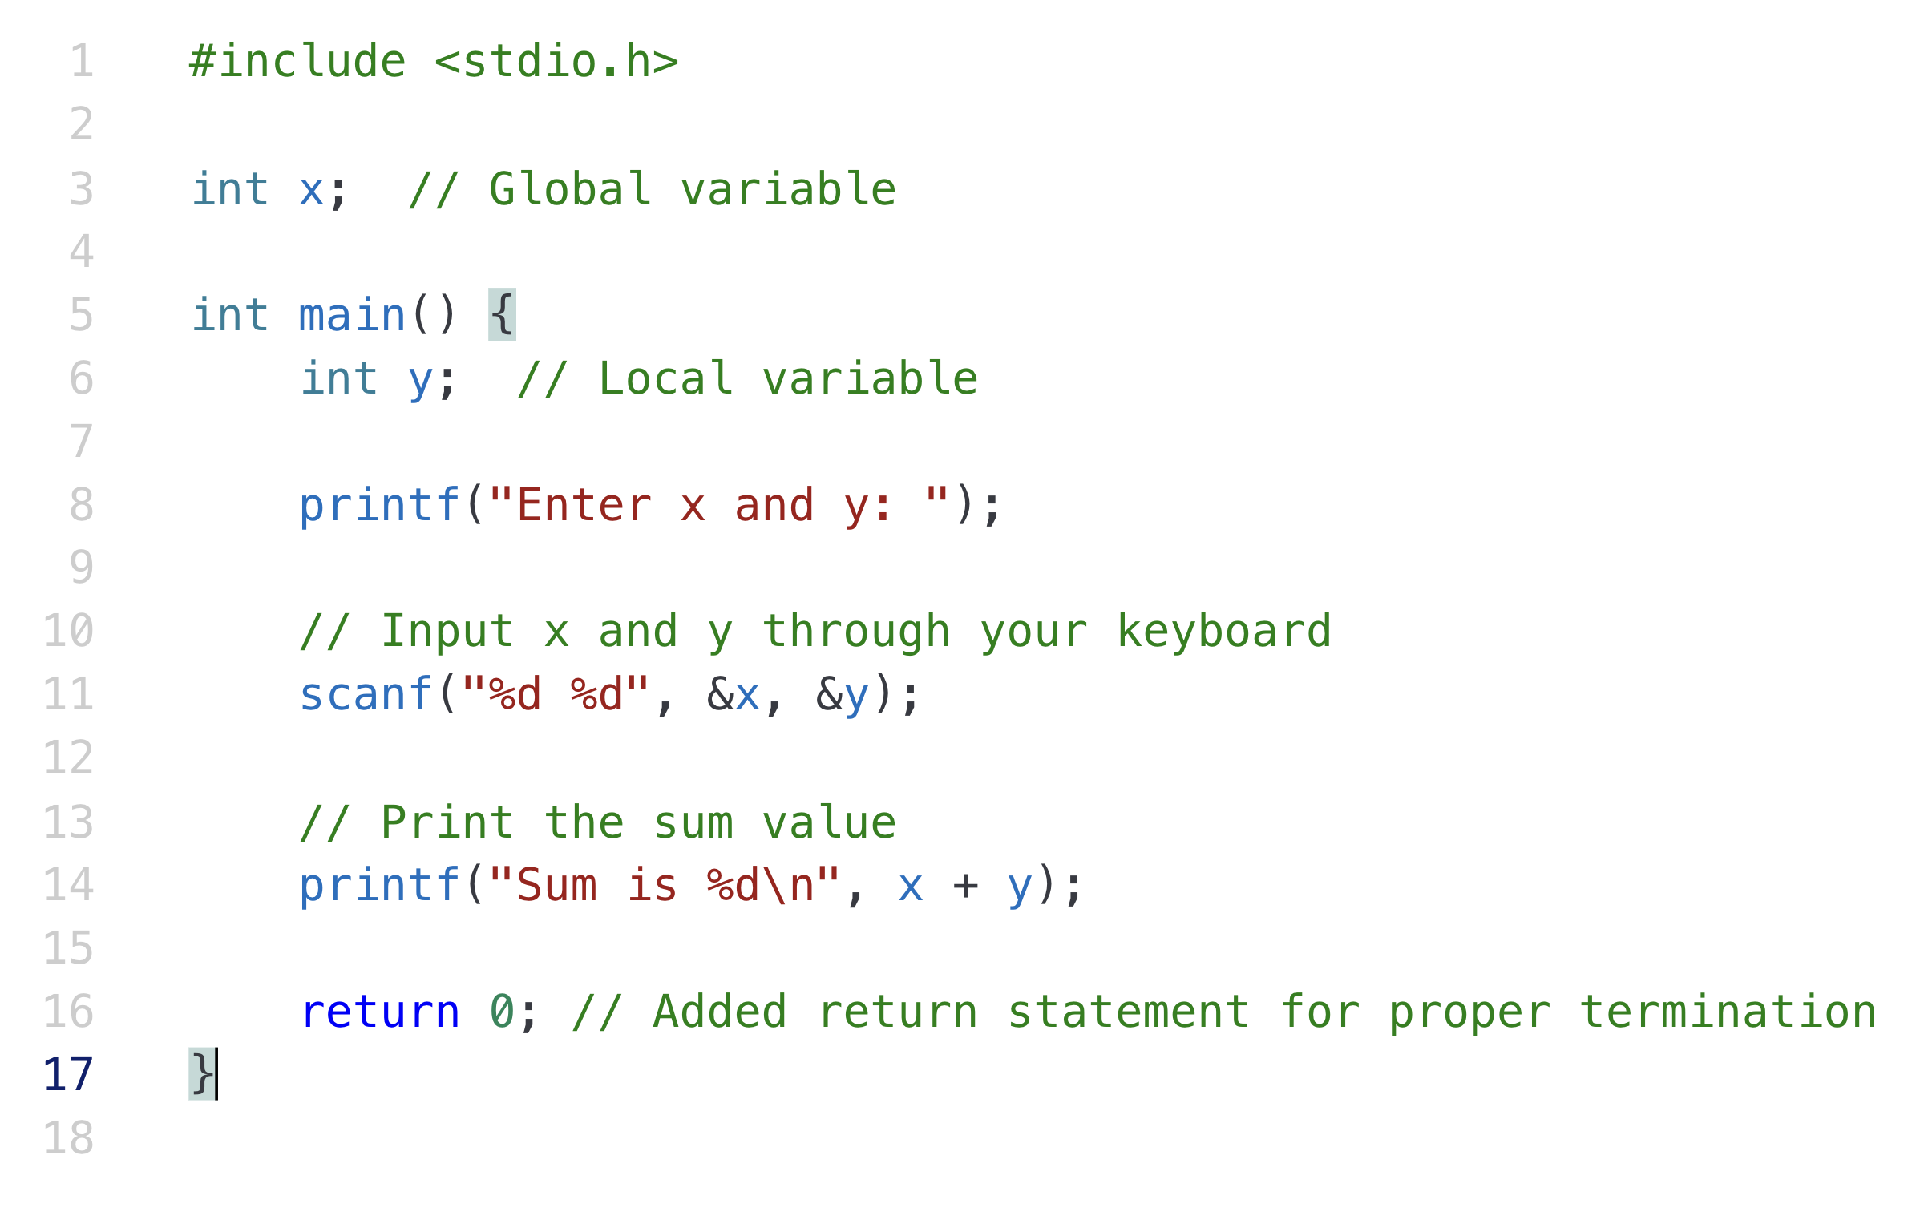
Part 3 – C Program Structure
Programming in C/C++: A Hands-on Introduction
Preprocessor Directive
Global Declaration
Local Declaration
Statements

Slide 12
Part 3 – C Program Structure – PD
Programming in C/C++: A Hands-on Introduction
Preprocessor Directives:
Begin with #
Instruct the compiler to perform some transformation to the file before compiling
Example: #include <stdio.h>
add the header file stdio.h to this file
.h for header file
stdio.h defines useful input/output functions
Preprocessor Directive

Slide 13
Part 3 – C Program Structure – Declarations
Programming in C/C++: A Hands-on Introduction
Declarations:
Global
visible throughout program
describes data used throughout program
Local
visible within function
describes data used only in function
Global Declaration
Local Declaration

Slide 14
Part 3 – C Program Structure – Functions
Programming in C/C++: A Hands-on Introduction
Functions and Program Extraction:
Consists of header and body
header: int main()
body: contained between { and }
starts with location declarations
followed by a series of statements
More than one function may be defined
Every program has one function main and main is executed
Procedural programming: executed in order and defined functions are called (invoked)

Slide 15
Part 3 – C Program Structure – Comments
Programming in C/C++: A Hands-on Introduction
Comments:
Single line: //
Multiple lines: Text between /* and */
Used to “document” the code for the human reader
Ignored by the compiler (not part of the program)
Have to be careful
comments may cover multiple lines
ends as soon as */ encountered
so no internal comments: /* An /* internal */ comment */

Slide 16
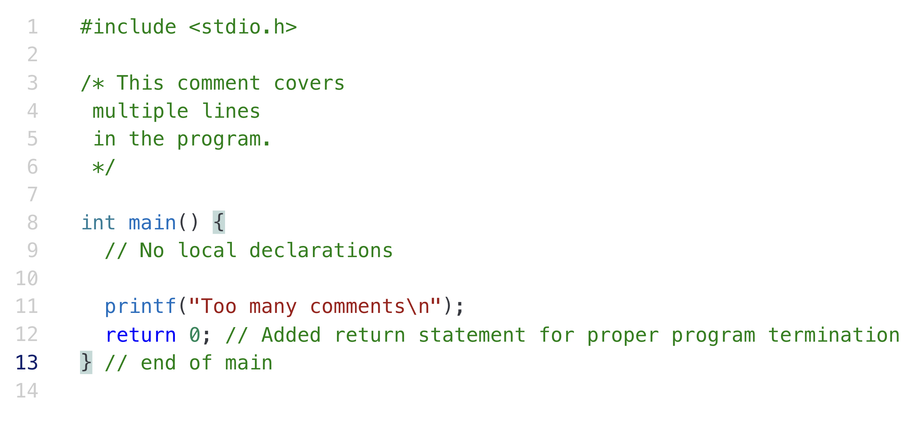
Part 3 – C Program Structure – Comments
Programming in C/C++: A Hands-on Introduction
Comment multiple lines
Comment one line

Slide 17
Part 3 – C Program Structure – Comments
Programming in C/C++: A Hands-on Introduction
Comments:
Global: start of program, outlines overall solution, may include structure chart
Module: when using separate files, an indication of what each file solves
Function: inputs, return values, and logic used in defining function
Add documentation for key (tough to understand) comments
Names of variables: should be chosen to be meaningful, make program readable

Slide 18
Part 4 – Syntax of C – Basics
Programming in C/C++: A Hands-on Introduction
Rules that define C language
Specify which tokens are valid
Also indicate the expected order of tokens
Some types of tokens:
reserved words: include printf
identifiers: x, y
literal constants: 5, ‘a’, 5.0
punctuation: { } ; < > # /* */
Credits: https://www.geeksforgeeks.org/c-identifiers/

Slide 19
Part 4 – Syntax of C – Naming Rules
Programming in C/C++: A Hands-on Introduction
Names used for objects in C
Rules for identifiers in C
first char alphabetic [a-z,A-Z]
or underscore (_)
has only alphabetic, digit, underscore chars
cannot duplicate a reserved word
case (upper/lower) matters
Credits: https://www.geeksforgeeks.org/c-identifiers/

Slide 20
Part 4 – Syntax of C – Naming Rules
Programming in C/C++: A Hands-on Introduction
Invalid
7of9
x-name
name with spaces
1234a
int
AXYZ&
Valid
sum
c4_5
A_NUMBER
timeofflight
TRUE
_split_name

Slide 21
Part 4 – Syntax of C – Variables
Programming in C/C++: A Hands-on Introduction
Variables declared in global or local declaration sections
Syntax: Type Name;
Examples:
int sum;
float avg;
char dummy;

Slide 22
Part 4 – Syntax of C – Variables
Programming in C/C++: A Hands-on Introduction
Indicates how much memory to set aside for the variable
Also determines how that space will be interpreted
Basic types: char, int, float, double, bool
specify the amount of space (bytes) to set aside
what can be stored in that space
what operations can be performed on those vars

Slide 23
Part 4 – Syntax of C – Variables
Programming in C/C++: A Hands-on Introduction
Can create multiple variables of the same type in one statement:
int x, y, z;
is a shorthand for
int x;
int y;
int z;
- stylistically, the latter is often preferable

Slide 24
Part 4 – Syntax of C – Variables
Programming in C/C++: A Hands-on Introduction
Giving a variable an initial value
Variables not necessarily initialized when declared
Can initialize in the declaration:
Syntax: Type Name = Value;
Example:
int x = 0;
int x, y, z = 0;

Slide 25
Part 4 – Syntax of C – void
Programming in C/C++: A Hands-on Introduction
Type name: void
Possible values: none
Operations: none
Useful as a placeholder
Meaning: No value is present. It does not provide a result value to its caller. It has no values and no operations. It is used to represent nothing.

Slide 26
Part 4 – Syntax of C – Integers
Programming in C/C++: A Hands-on Introduction
Type name: int, short int, long int
Note: long long int and unsigned long long int: 8 bytes
Credits: https://www.geeksforgeeks.org/data-types-in-c/

Slide 27
Part 4 – Syntax of C – Unsigned Integers
Programming in C/C++: A Hands-on Introduction
Type name: unsigned int
No negative values
unsigned int
possible values: 0 to 65536
Representation: binary number

Slide 28
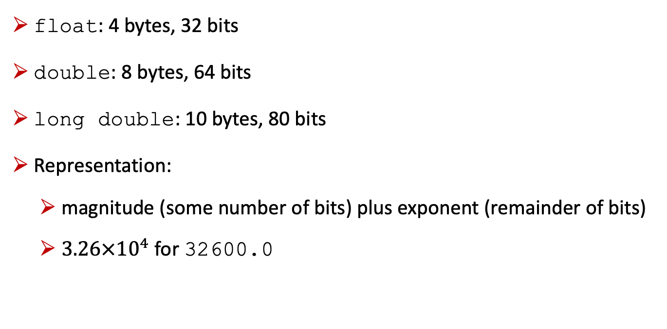
Part 4 – Syntax of C – Floating Points
Programming in C/C++: A Hands-on Introduction
float: 4 bytes, 32 bits
double: 8 bytes, 64 bits
long double: 10 bytes, 80 bits
Representation:
magnitude (some number of bits) plus exponent (remainder of bits)
$3.26×{10}^{4}$ for 32600.0

Slide 29
Part 4 – Syntax of C – Characters
Programming in C/C++: A Hands-on Introduction
Type name: char
Possible values: keys that can be typed on the keyboard
Representation: each character is assigned a value (8-bit ASCII)
A : binary number 65
a : binary number 97
b : binary number 98
2 : binary number 50

Slide 30
Part 4 – Syntax of C – Characters
Programming in C/C++: A Hands-on Introduction
Single key stroke between quote char ‘ ’
Examples: ‘A’, ‘a’, ‘b’, ‘1’, ‘@’
Some special chars:
\0 : null char
\t : tab char
\n : newline char
\ : single quote char
\\ : backslash char

Slide 31
Part 4 – Syntax of C – Constants
Programming in C/C++: A Hands-on Introduction
Literal constants: tokens representing values from type
Defined constants
syntax: #define Name Value
preprocessor command
Name replaced by Value in the program
example: #define MAX_NUMBER 100

Slide 32
Part 4 – Syntax of C – Constants
Programming in C/C++: A Hands-on Introduction
Memory constants
declared similar to variables, type, and name
const added before the declaration
example: const float PI = 3.14159;
can be used as a variable, but one that cannot be changed
since the value cannot be changed, it must be initialized

Slide 33
Part 4 – Syntax of C – Format Specifiers
Programming in C/C++: A Hands-on Introduction
Format string may contain one or more field specifications
syntax: %Code or %[Width].[Precision]Code
Code:
c : data printed as character
i or d : data printed as integer
f : data printed as a floating-point value
for each field specification, have one data value after the format string, separated by commas
Credits: https://www.geeksforgeeks.org/format-specifiers-in-c/

Slide 34
Part 4 – Syntax of C – Format Specifiers
Programming in C/C++: A Hands-on Introduction
printf(“%c %d %f\n”, ’A’, 35, 4.5);
produces
A 35 4.50000
Can have variables in place of literal constants
(value of variable printed)
Credits: https://www.geeksforgeeks.org/format-specifiers-in-c/

Slide 35
Part 4 – Syntax of C – Format Specifiers
Programming in C/C++: A Hands-on Introduction
When printing numbers, generally use Width/Precision to determine format
Width: how many character spaces to use in printing the field (minimum, if more needed, more used)
Precision: for floating point numbers, how many characters appear after the decimal point, width counts decimal point, number of digits after decimal, remainder before decimal
Credits: https://www.geeksforgeeks.org/format-specifiers-in-c/

Slide 36
Part 4 – Syntax of C – Format Specifiers
Programming in C/C++: A Hands-on Introduction
printf(“%5d%8.3f\n”, 753, 4.1678);
produces
753 4.168
values are right justified (aligned)
If not enough characters in width, minimum number used
use 1 width to indicate minimum number of chars should be used
Credits: https://www.geeksforgeeks.org/format-specifiers-in-c/

Slide 37
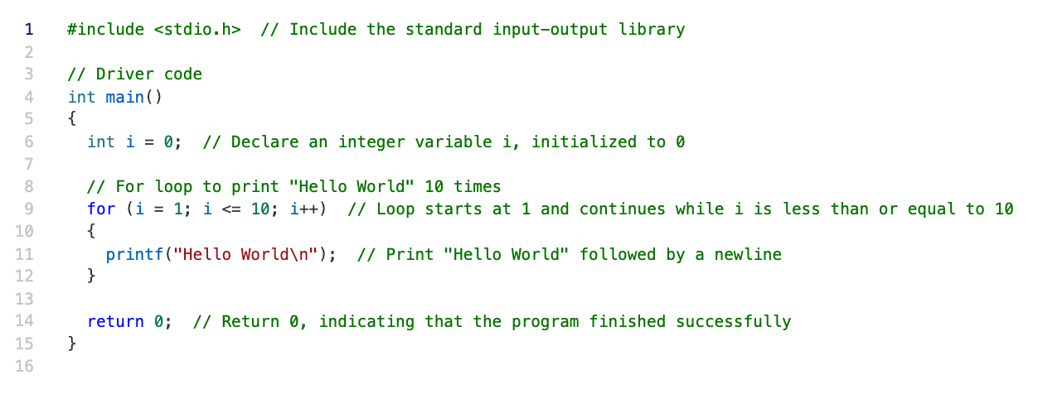
Part 4 – Syntax of C – Repetition Control
Programming in C/C++: A Hands-on Introduction
for (initialize expression; test expression; update expression)
{
//
// body of for loop
//
}
Credits: https://www.w3schools.com/c/c_for_loop.php

Slide 38
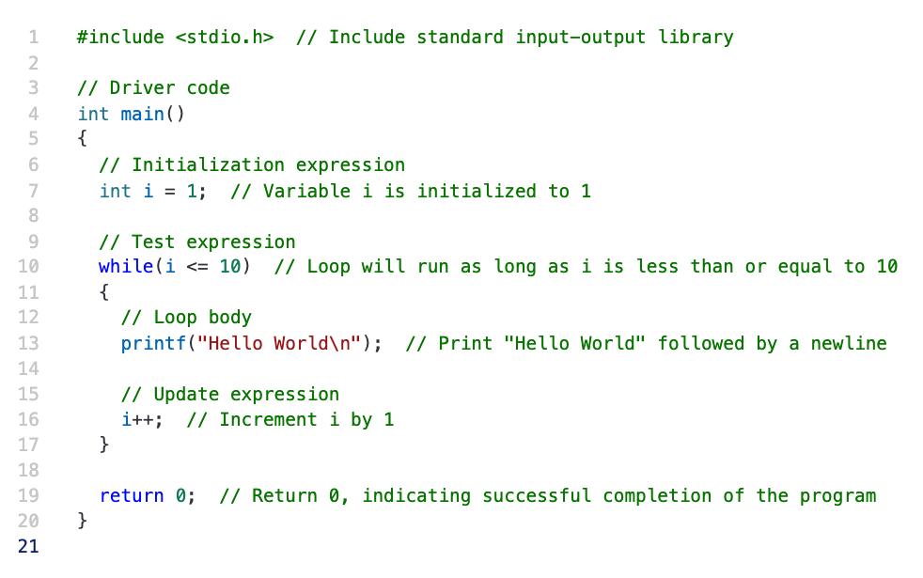
Part 4 – Syntax of C – Repetition Control
Programming in C/C++: A Hands-on Introduction
while (test_expression)
{
// body of the while loop
update_expression;
}
Credits: https://www.w3schools.com/c/c_while_loop.php

Slide 39
Part 4 – Syntax of C – Conditions
Programming in C/C++: A Hands-on Introduction
if (condition1) {
// block of code to be executed if condition1 is true
} else if (condition2) {
// block of code to be executed if the condition1 is false and condition2 is true
} else {
// block of code to be executed if the condition1 is false and condition2 is false
}
Credits: https://www.w3schools.com/c/c_conditions_elseif.php

Slide 40
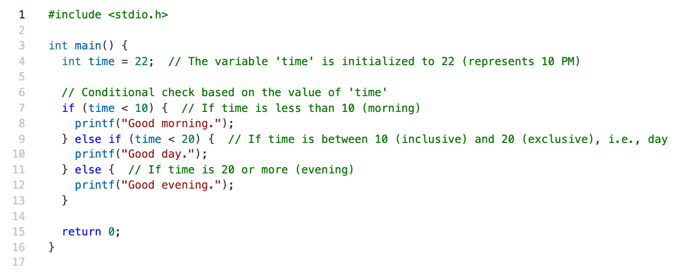
Part 4 – Syntax of C – Conditions
Programming in C/C++: A Hands-on Introduction
Credits: https://www.w3schools.com/c/c_conditions_elseif.php

Slide 41
Part 4 – Syntax of C – Conditions
Programming in C/C++: A Hands-on Introduction
switch (expression) {
case x:
// code block
break;
case y:
// code block
break;
default:
// code block
}
Credits: https://www.w3schools.com/c/c_switch.php

Slide 42
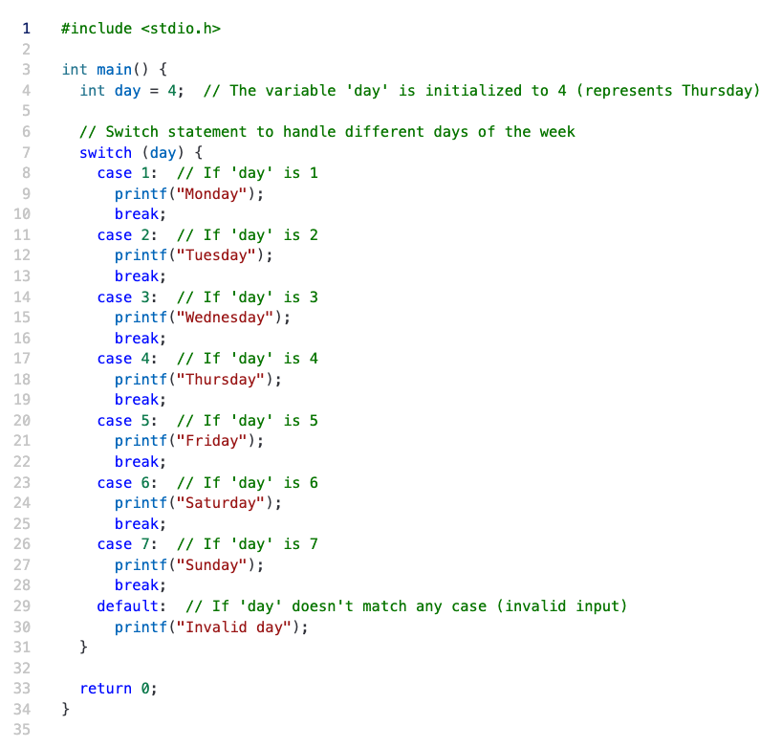
Credits: https://www.w3schools.com/c/c_switch.php

Slide 43
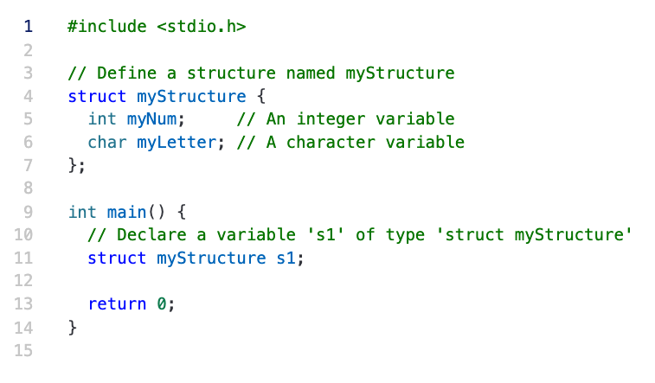
Part 4 – Syntax of C – Structures
Programming in C/C++: A Hands-on Introduction
A way to group several related variables into one place
Each variable in the structure is known as a member of the structure
Credits: https://www.w3schools.com/c/c_structs.php

Slide 44
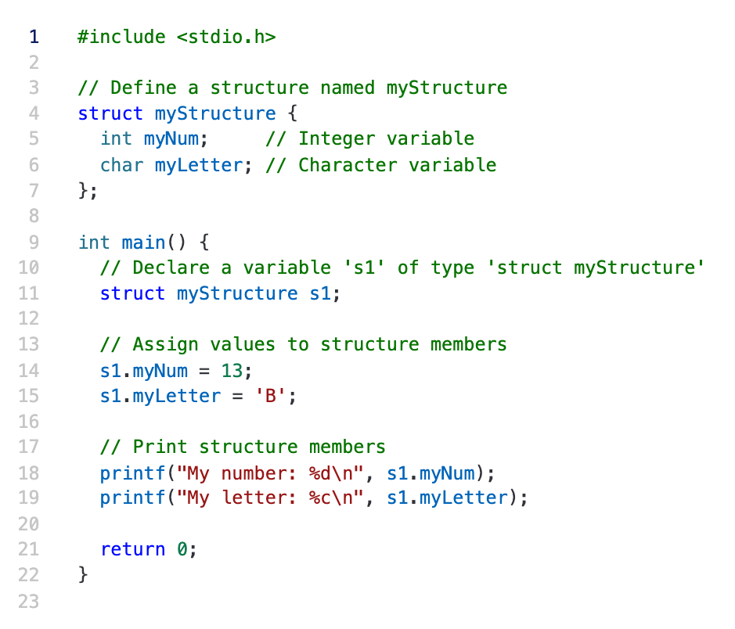
Credits: https://www.w3schools.com/c/c_structs.php

Slide 45
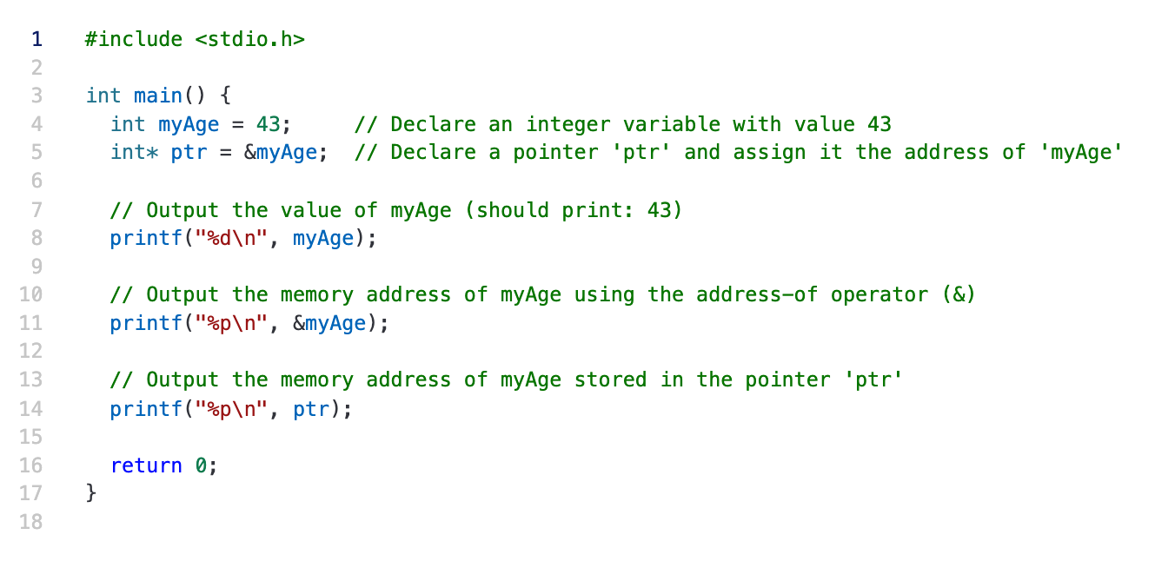
Optional – Syntax of C – Pointers
Programming in C/C++: A Hands-on Introduction
Creating Pointers: &
A variable that stores the memory address of another variable as its value
Credits: https://www.w3schools.com/c/c_pointers.php

Slide 46
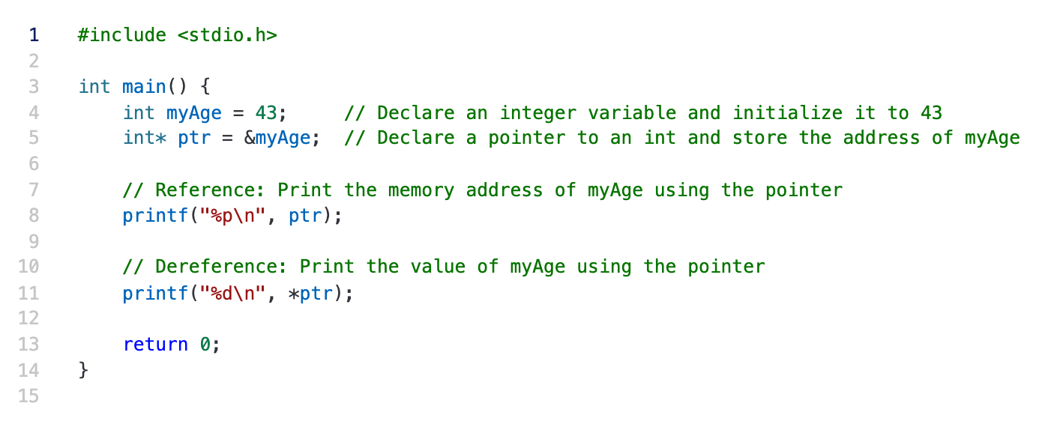
Optional – Syntax of C – Pointers
Programming in C/C++: A Hands-on Introduction
Dereference Pointers: *
You can also get the value of the variable the pointer points to, by using the * operator
Credits: https://www.w3schools.com/c/c_pointers.php

Slide 47
Programming in C/C++: A Hands-on Introduction
To learn more about C:
https://www.w3schools.com/c/index.php

Slide 48
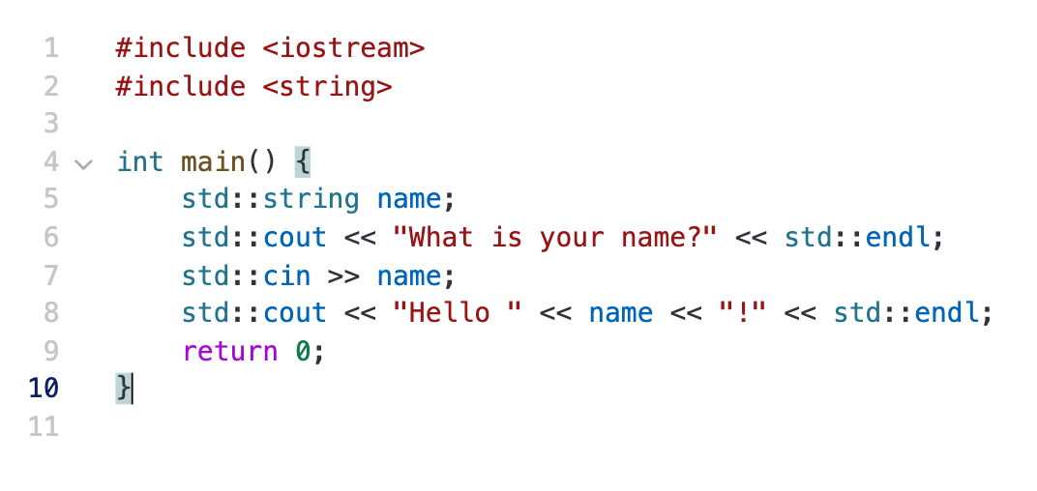
Part 5 – C++: An Extension to the C Language
Programming in C/C++: A Hands-on Introduction
std::
is a namespace that contains the standard library components, such as Data types, Functions, and Objects.

Slide 49
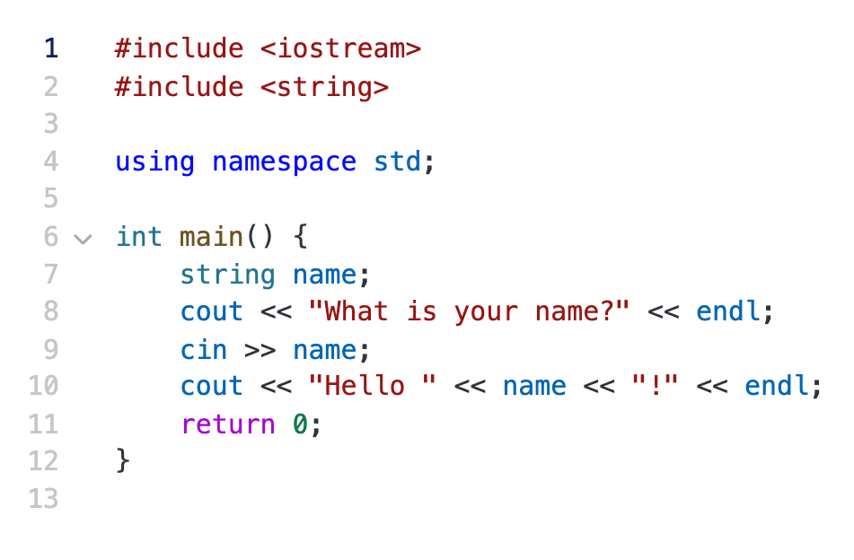
Part 5 – C++: An Extension to the C Language
Programming in C/C++: A Hands-on Introduction
Widely used in practice!

Slide 50
Part 5 – C++: An Extension to the C Language
Programming in C/C++: A Hands-on Introduction
An Example
Welcome to EC327
Introduction to Software Engineering!

Slide 51
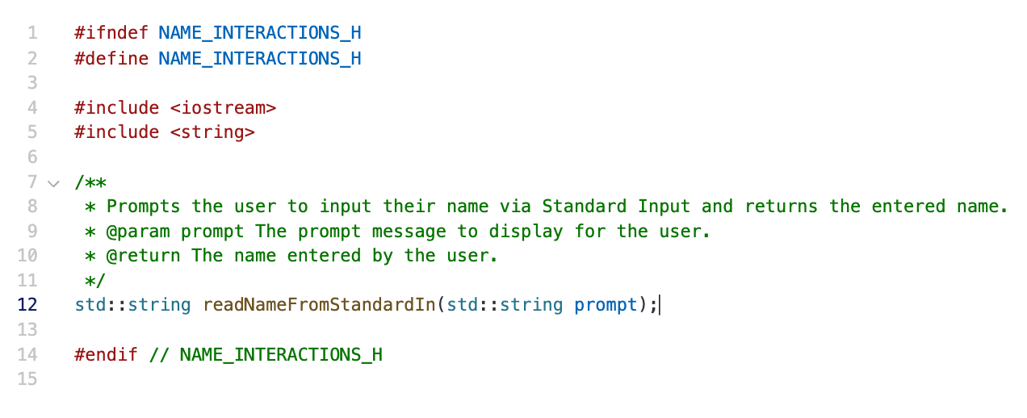
Part 5 – C++: An Extension to the C Language
Programming in C/C++: A Hands-on Introduction

Slide 52
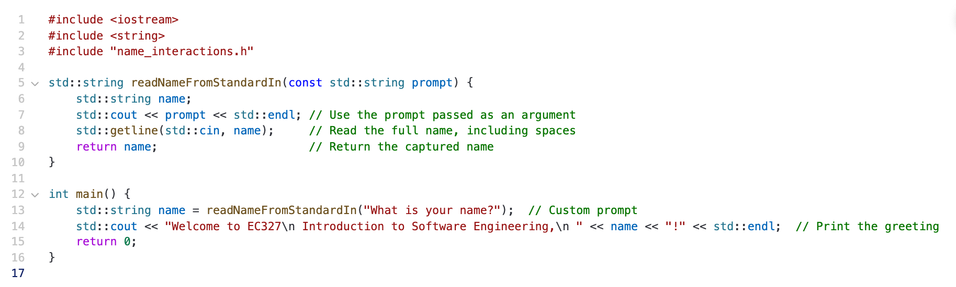
Part 5 – C++: An Extension to the C Language
Programming in C/C++: A Hands-on Introduction

Slide 53
Programming in C/C++: A Hands-on Introduction
To learn more about C++:
https://www.w3schools.com/cpp/default.asp

Slide 54
Programming in C/C++: A Hands-on Introduction
If you wanna explore more about C++, please check its Standards
(widely used in Companies) https://www.geeksforgeeks.org/cpp-11-standard/

Slide 55
Part 6 – Resources
Programming in C/C++: A Hands-on Introduction
Coding standards
Google style guide: https://google.github.io/styleguide/
C
learn C basics: https://www.w3schools.com/c/
C++
learn C++ basics: https://www.w3schools.com/cpp/default.asp
learn C++ standards: https://www.geeksforgeeks.org/cpp-11-standard/

Slide 56
Thank you very much for your attention!

