Slide 1
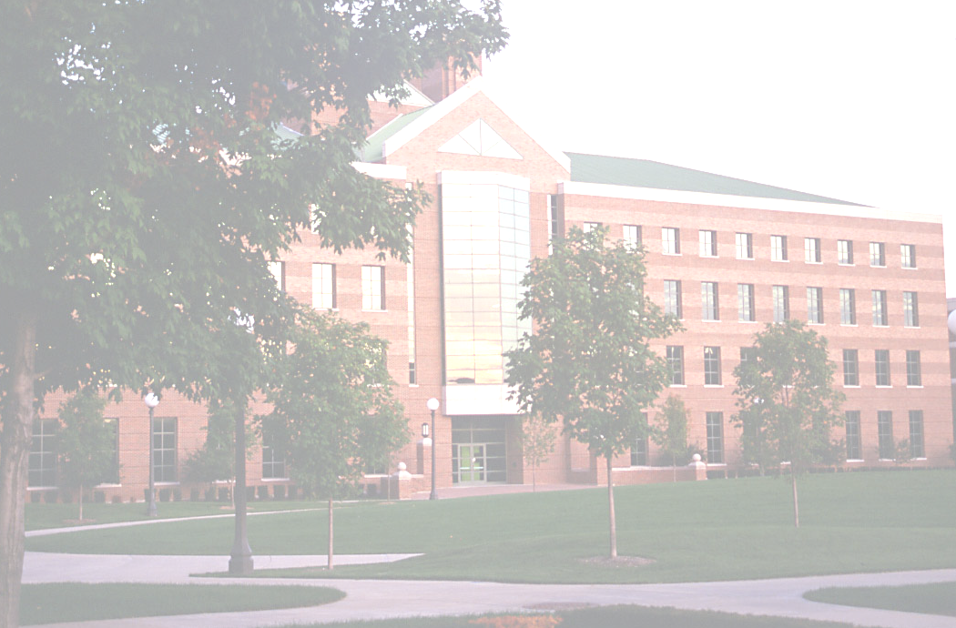
Microsoft Research Asia, 2009
What is Research and How to do it?
Yi Ma
Visual Computing Group, MSRA
Electrical & Computer Engineering, UIUC

Slide 2
Prepare Yourself Psychologically
Is being a top student enough?
Neither necessary nor sufficient…
2. Do you know your intellectual or mental limit?
Ready for failures?
Are you extremely motivated?
All you need is passion…
Research is not a job, and is more like a hobby!

Slide 3
What is Research?
What is the difference between a homework problem and a research problem?
Probably no, except for your fear.
Research is anything but homework:
Finding a good problem to study is part of research too.
3. Research is about pushing the limits:
Dismiss the problem if the solution is not interesting enough.
Research is a game for which you get to set the rules,
but it cannot be a trivial one!

Slide 4
What is Engineering Research?
Engineering is about optimization, but engineering research is not! Research is to find the limits and better ways for optimization.
Engineering is about invention, but engineering research is not! Research is to explain why an invention works.
Engineering research is not science nor empirical science.
It is close to applied math or applied sciences.
A good engineer needs not to be a good researcher; a good researcher needs not to be a good engineer.

Slide 5
Different Levels of Research
Level one: research assistant
Learn the drill
2. Level two: homework like research
Build up your confidence
3. Level three: formulating your own problem and solve it
Exercise your creativity
Level four: formulating problems for others to solve
Realize your vision
Knowing what to do is more important than knowing how!

Slide 6
What is Good Research?
Novelty (better if you were not able to publish it at first)
Simplicity (better if your advisor refused to grant you a degree)
Universality (better if others found it trivial at first sight)
You recognize a great research result if it keeps you up all night, feeling like your first date.

Slide 7
Warning Signs of Bogus Research
Prove by successful instances
Compound and conquer
Results too complicated to reproduce
Reinvent the wheel without proper acknowledgment
Tackle ill-posed problems directly
Solicit popularity over expert opinions
Ocam’s razor reversed
Monkey collects corn cobs
Such results will NOT stand the test of time!

Slide 8
How to Do Research? Common Misunderstandings
Think research is only for genius.
Think yourself is a genius.
Think you need to know everything about the subject in advance.
Think you should wait for the most important problem to work on.
Think a solution is correct just because you cannot find anything wrong.

Slide 9
How to Do Research?
Be both confident and humble
Be both critical and collaborative
Be both ambitious and realistic
Be proactive and willing to take a chance!
The only way you can improve yourself is to learn
things that you are the most afraid of!
Notes:
Build a top structure from apiece of paper.

Slide 10
How does Doing Research Feel Like?
An endless cycle between excitement and depression…
An endless cycle between sense of success and failure…
An endless cycle between over-confidence and self-doubt…
Research needs faith in there are always interesting new things for you to discover and by doing so you can make the world a better place!

