Slide 1
Prompt-based Learning and Robustness Evaluation
Shuyue Jia Ph.D. Student Boston University September 25th, 2023
Notes:
Good afternoon, everyone.
Today, I gonna talk about the Prompt-based Learning and Robustness Evaluation,
which is my ongoing research on Perturbation Sensitivity of Prompts and Prompt Robustness.
I built a private GitHub repo to report and monitor my progress of coding, experiments, and results analysis.
If you have any questions during the meeting, please feel free to ask me.

Slide 2
Outline
Prompt-based Learning and Robustness Evaluation
Prompt Category
Continuous Prompt-based Learning
Discrete Prompt-based Learning
Prompt Perturbation and Robustness
Prompt Robustness Evaluation
Notes:
There are six items on today’s agenda.
First, I’ll talk about two kinds of prompts. One is continuous prompt, also called soft prompt.
The other is the discrete prompt, which is also called the hard prompt. I’ll compare them and talk about their pros and cons.
Then, I gonna talk about some representative works of Continuous Prompt-based Leaning and Discrete Prompt-based Learning.
Next, Prompt Perturbation and Robustness will be discussed with you.
Furthermore, I‘ll show you one prompt robustness evaluation metric. I would present more in the future.
Finally, I summarized last week’s meeting, and I’ll talk about my next week’s work.

Slide 3
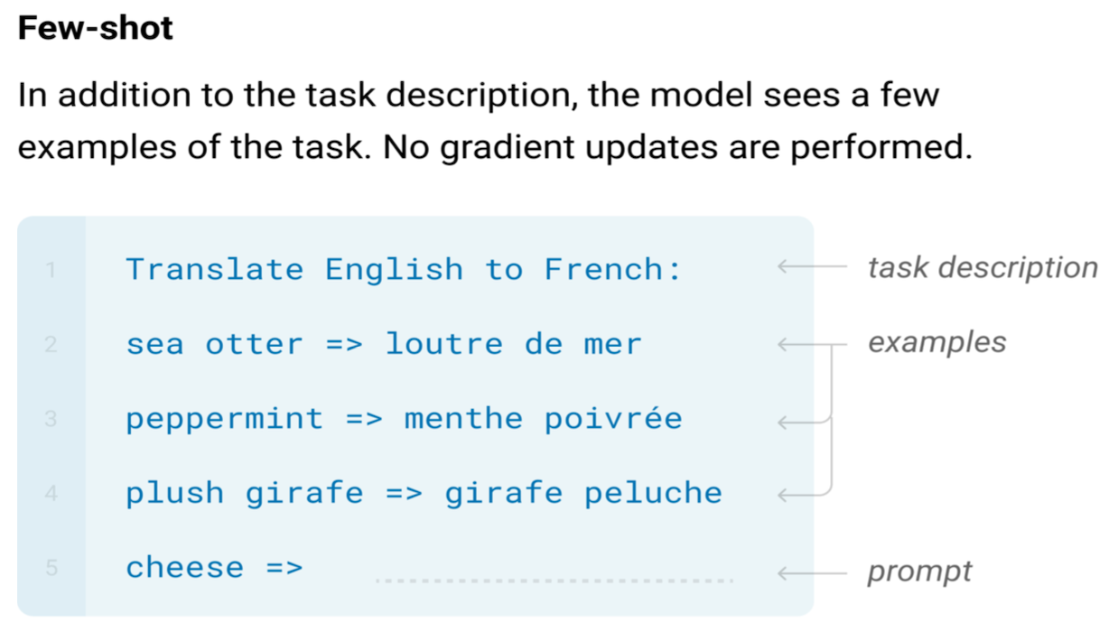

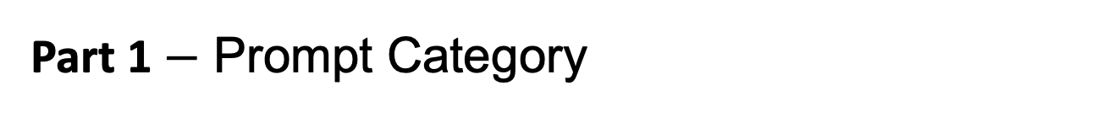




Part 1 $−$ Prompt Category
Prompt-based Learning and Robustness Evaluation
Template
$$T=\{\left[P_{0:i}\right], x,\left[P_{i+1:m}\right],y\}$$
$$\left[P_{0:i}\right]$$
$$y$$
$$x$$
$$\left[P_{i+1:m}\right]$$
(Few-shot) In-Context Learning Imitation
No gradient update or fine-tuning
Literally just take a pre-trained model and give it the following prefix
Image Credits: in the public domain. Paper Credits: Brown et al., Language Models are Few-Shot Learners, In NeurIPS’20.
Notes:
During my past presentation on Large Language Models, I briefly talked about few-shot in-context learning.
Here, I want to claim that the in-context learning is not a fine-tuning method because there is no gradient update.
On the right side, you can see the template T consists of P_zero to P_i, X, P_i+1 to P_m, and Y.
There is an example on the left hand.

Slide 4
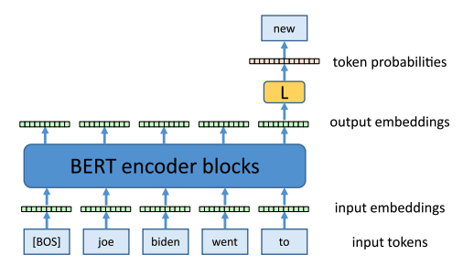



Part 1 $−$ Prompt Category
Prompt-based Learning and Robustness Evaluation
User’s Input
Sentence
$$→$$
Tokenization
Sub-words
$$→$$
Input Tokens
Tokens
Continuous Prompt
Discrete Prompt
$$→$$
Model’s Input
Word Embedding
A Framework of Autoregressive LM
Discrete Prompt (Hard Prompt): Words, learn lexical sequences
Continuous Prompt (Soft Prompt): Vectors, learn embeddings (Soften Version)
Credits: Paaß et al., Foundation Models for Natural Language Processing: Pre-trained Language Models Integrating Media, In Springer Nature’23.
Notes:
Tokenization splits paragraphs and sentences into smaller units that can be more easily assigned meaning.
In language models, people usually use sub-words to represent tokens.
I mean, each sub-word is a token. Then, the token will be mapped into a vector by a linear layer.
The vector is called word vector and this process is called word embedding.
Here, I’ll introduce two kinds of prompts.
The first one is the Discrete prompt, which is also called Hard Prompt.
The discrete prompt is the words that are originally in the vocabulary. Manipulating discrete prompts is to modify the input tokens.
The second prompt is the continuous prompt, also called the soft prompt, because it is the softened version of the discrete prompts.
The continuous prompt is the vectors initialized from word embeddings.
Working on the continuous prompt is to update the input word embeddings.

Slide 5
Part 1 $−$ Prompt Category – Continuous Prompt
Prompt-based Learning and Robustness Evaluation
Continuous Prompt
A Framework of Autoregressive LM
Continuous Prompt (Soft Prompt): Vectors initialized from word embeddings
Prompt Tuning: Additional learnable parameters injected into the model
Pros: Learn generalizable task-specific embeddings and parameter-efficient
Cons: Hard to interpret and cannot be applied to publicly unavailable models ^{[1]}
Credits: [1] Ishibashi et al., Evaluating the Robustness of Discrete Prompts, In arXiv’23.

Slide 6
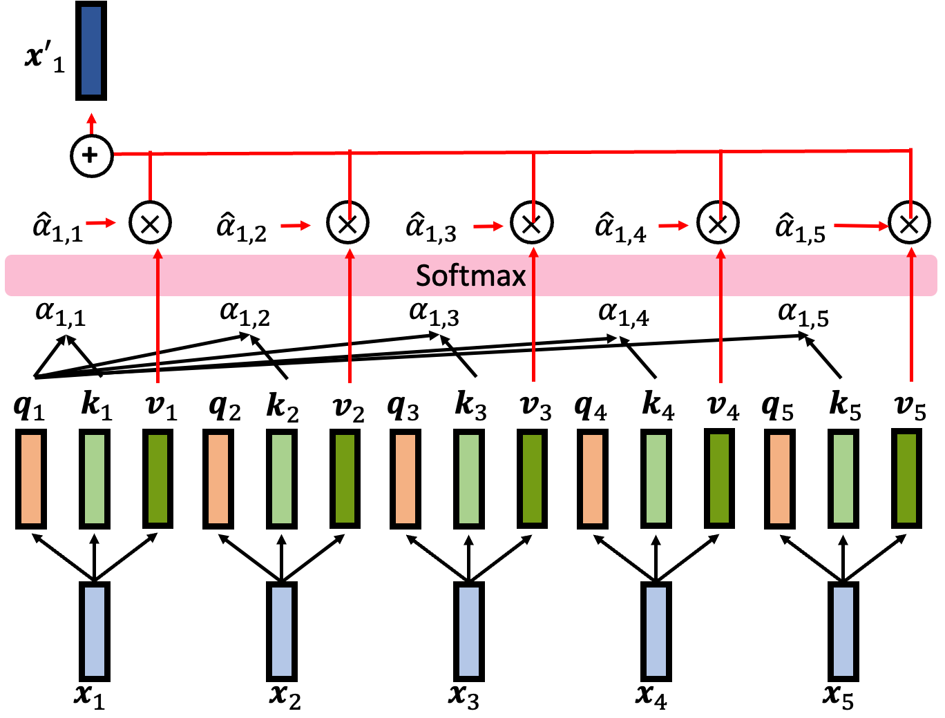
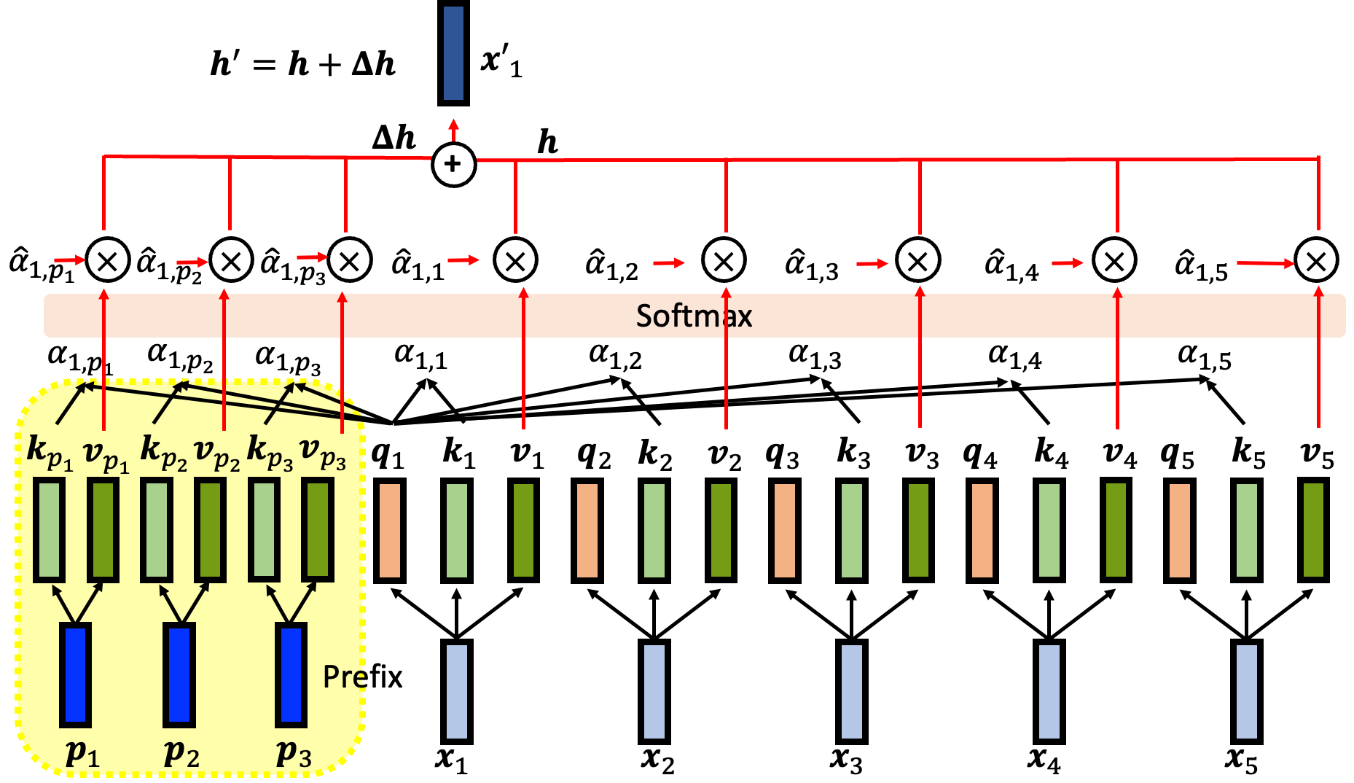
Part 2 $−$ Continuous Prompt-based Learning
Prompt-based Learning and Robustness Evaluation
Prompt Tuning: Additional learnable parameters injected into the model
Original
Prefix Tuning
Credits: AACL 2022 Tutorial: Recent Advances in Pre-trained Language Models: Why Do They Work and How to Use Them
Notes:
Prefix: Something that is put in front of another something

Slide 7
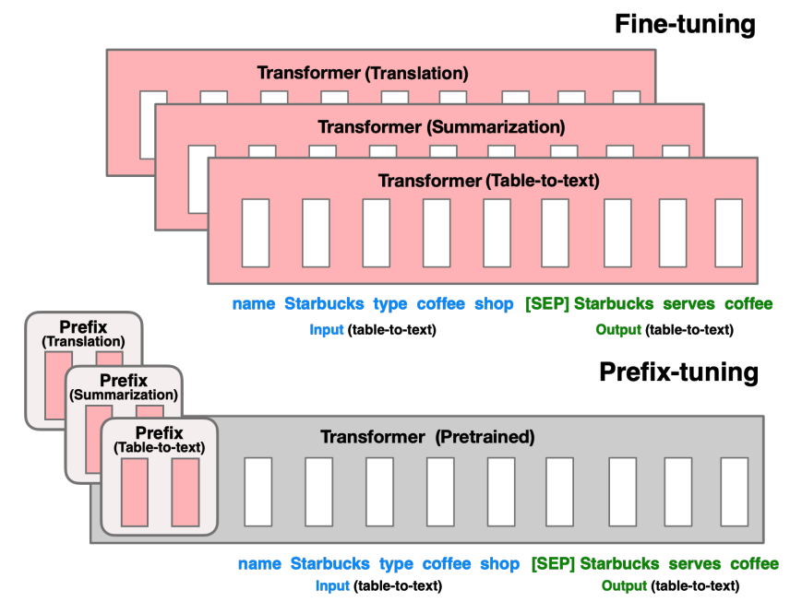

Part 2 $−$ Continuous Prompt-based Learning
Prompt-based Learning and Robustness Evaluation
Prompt Tuning: Additional learnable parameters injected into the model
Prefix-Tuning
$$z=[Prefix;x, y]$$
continuous task-specific vector
Credits: Li et al., Prefix-Tuning: Optimizing Continuous Prompts for Generation, Too, In ACL’21.
Notes:
Prefix: Something that is put in front of another something

Slide 8
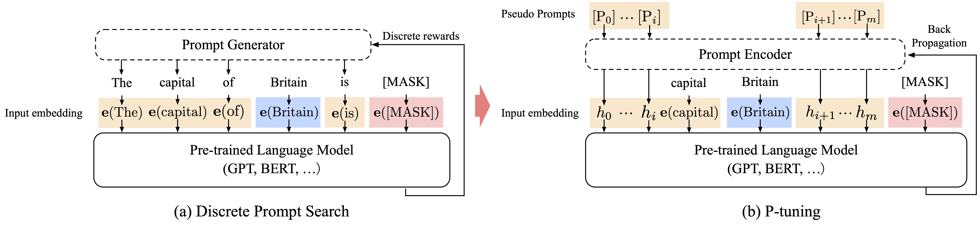

Part 2 $−$ Continuous Prompt-based Learning
Prompt-based Learning and Robustness Evaluation
Prompt Tuning: Additional learnable parameters injected into the model
Pseudo-tuning (P-tuning)
$$T=\{\left[P_{0:i}\right], x,\left[P_{i+1:m}\right],y\}$$
Credits: Liu et al., GPT Understands, Too, In AI Open’23.
Notes:
Prefix: Something that is put in front of another something

Slide 9

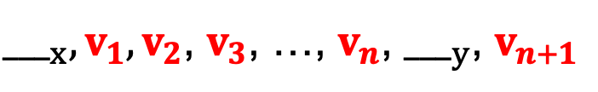
Part 2 $−$ Continuous Prompt-based Learning
Prompt-based Learning and Robustness Evaluation
Prompt Tuning: Additional learnable parameters injected into the model
Soft Prompts
${___}_{x}, v_{1},v_{2}$, $v_{3}$, …, $v_{n}$, ${___}_{y}$, $v_{n+1}$
$$v_{i}^{(l)}←v_{i}^{(l)}+∆$$
Credits: Qin et al., Learning How to Ask: Querying LMs with Mixtures of Soft Prompts, In NAACL’21.
Notes:
Prefix: Something that is put in front of another something

Slide 10
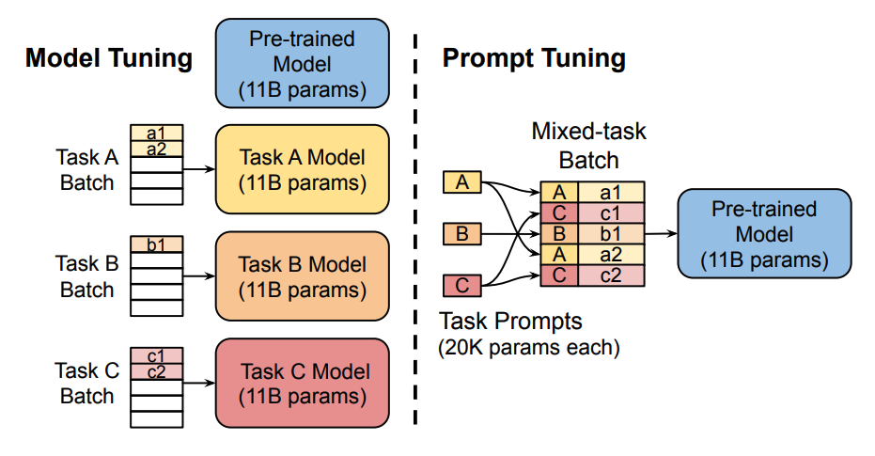

Part 2 $−$ Continuous Prompt-based Learning
Prompt-based Learning and Robustness Evaluation
Prompt Tuning: Additional learnable parameters injected into the model
Prompt Tuning
$$[P_{e};X_{e}]∈ℝ^{(p+n)×e}$$
Task-specific
prompt vectors
Task Batch
Credits: Lester et al., The Power of Scale for Parameter-Efficient Prompt Tuning, In EMNLP’21.
Notes:
Prefix: Something that is put in front of another something

Slide 11
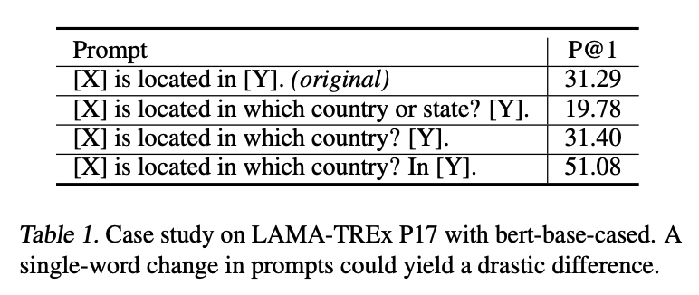
Part 1 $−$ Prompt Category – Discrete Prompt
Prompt-based Learning and Robustness Evaluation
A Framework of Autoregressive LM
Discrete Prompt (Hard Prompt): Words that are originally in the vocabulary
Discrete Prompt Learning: Learn lexical sequences
Pros: Easy to interpret
Cons: Require domain expertise/understanding, and sub-optimal and sensitive ^{[1, 2]}
Credits: [1] Liu et al., GPT Understands, Too, In AI Open’23. [2] Zhao et al., Calibrate Before Use: Improving Few-Shot Performance of Language Models, In ICML’21.
Notes:
• requiring domain expertise/understanding of the model’s inner workings
• performance still lags far behind SotA model tuning results
• sub-optimal and sensitive (prompts that humans consider reasonable is not necessarily effective for language models, pre-trained language models are sensitive to the choice of prompts)

Slide 12
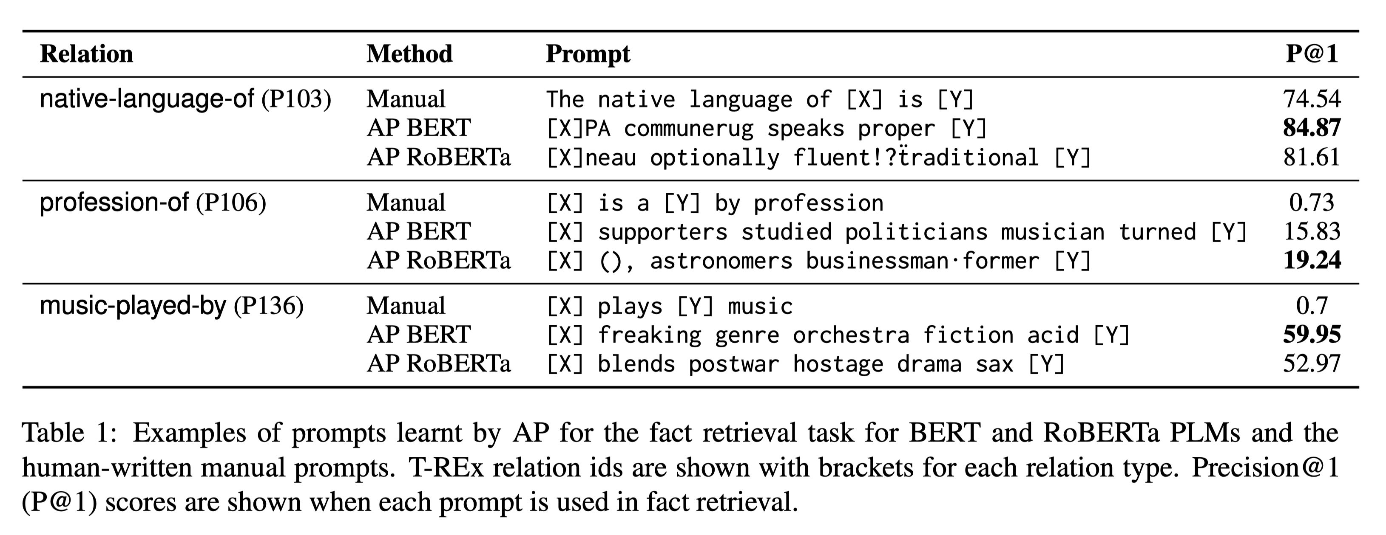
Part 3 $−$ Discrete Prompt-based Learning
Prompt-based Learning and Robustness Evaluation
Discrete Prompt-based Learning: Automatically learn prompts from training data
Credits: Ishibashi et al., Evaluating the Robustness of Discrete Prompts, In EACL’23.

Slide 13
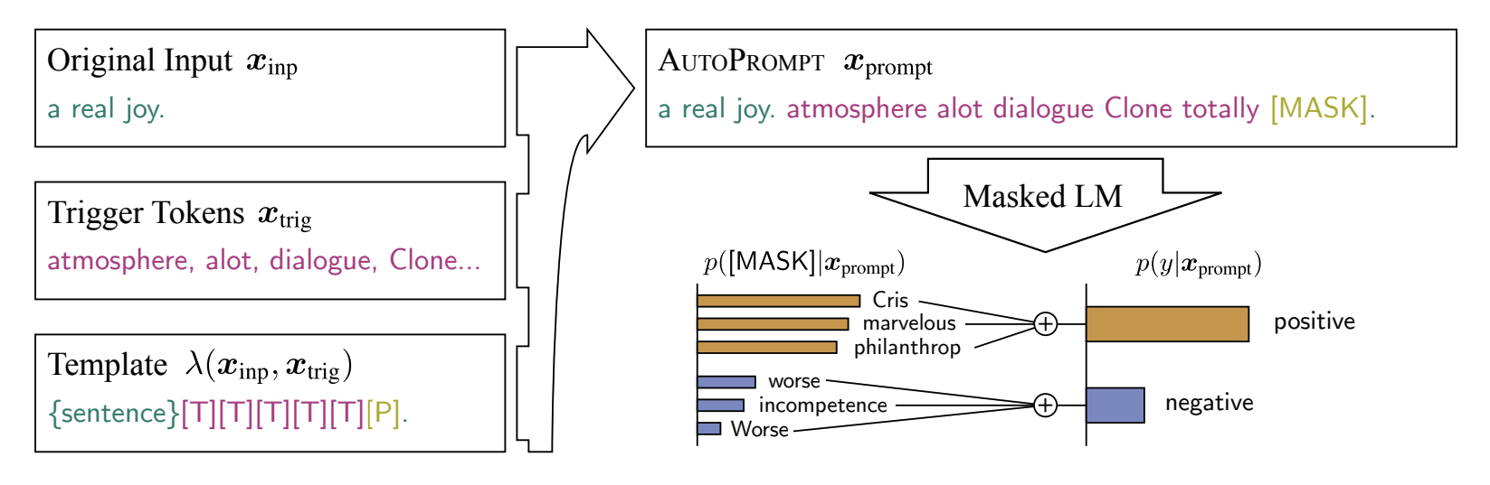
Part 3 $−$ Discrete Prompt-based Learning
Prompt-based Learning and Robustness Evaluation
Discrete Prompt-based Learning: Automatically learn prompts from training data
AutoPrompt (AP)
Trigger Tokens
Credits: Shin et al., AutoPrompt: Eliciting Knowledge from Language Models with Automatically Generated Prompts, In EMNLP’20.

Slide 14


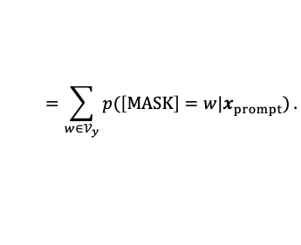





Prompt-based Learning and Robustness Evaluation
AutoPrompt (AP) – Template
Trigger Tokens
$$=\sum_{w∈𝒱_{y}}{p(\left[MASK\right]=w|x_{prompt})}.$$
$$Selected from a set of label tokens 𝒱_{y}$$
$$\left[CLS\right]\left\{sentence\right\}\left[T\right]\left[T\right]\left[T\right]\left[T\right]\left[T\right]\left[P\right][SEP]$$
$$Relation$$
(sub, rel, obj)
For
Classification
Task
$$x_{inp}$$
Separate
Multiple
Sentences
$$x_{trig}$$
$$\left[MASK\right]$$
$$Subject$$
$$Object$$
Trigger Tokens
Credits: Shin et al., AutoPrompt: Eliciting Knowledge from Language Models with Automatically Generated Prompts, In EMNLP’20.

Slide 15







Prompt-based Learning and Robustness Evaluation
AutoPrompt (AP) – Gradient-based Prompt Search
$$\left[CLS\right]\left\{sentence\right\}\left[T\right]\left[T\right]\left[T\right]\left[T\right]\left[T\right]\left[P\right][SEP]$$
For
Classification
Task
$$x_{inp}$$
Separate
Multiple
Sentences
$$x_{trig}$$
$$\left[MASK\right]$$
Trigger Tokens
$$p\left(y | x_{prompt}\right)=\sum_{w∈𝒱}{p\left(\left[MASK\right]=w | x_{prompt}\right)}.$$
$$x_{trig}^{(j)}←w∈𝒱$$
First-order approximation to get a candidate set $𝒱_{cand}$:
$$𝒱_{cand}={}_{w∈𝒱}^{top−k}{[w_{in}^{T}∇log p(y|x_{prompt})]}.$$
$$W_{in}: input embedding of w$$
Credits: Shin et al., AutoPrompt: Eliciting Knowledge from Language Models with Automatically Generated Prompts, In EMNLP’20.
Notes:
These tokens are initialized to [MASK] tokens, and then iteratively updated to maximize the label likelihood

Slide 16



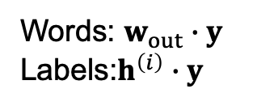

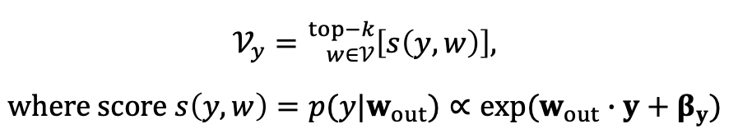
Prompt-based Learning and Robustness Evaluation
AutoPrompt (AP) – Automating Label Token Selection
$$\left[CLS\right]\left\{sentence\right\}\left[T\right]\left[T\right]\left[T\right]\left[T\right]\left[T\right]\left[P\right][SEP]$$
For
Classification
Task
$$x_{inp}$$
Separate
Multiple
Sentences
$$x_{trig}$$
$$\left[MASK\right]$$
Trigger Tokens
Label
Tokens
$$h={Transformer}_{enc}\left(\tilde{x}\right),$$
Classifier
$$p\left(y | h^{\left(i\right)}\right)∝exp\left(h^{\left(i\right)}∙y+β_{y}\right).$$
Words: $w_{out}∙y$
Labels:$h^{\left(i\right)}∙y$
$$𝒱_{y}={}_{w∈𝒱}^{top−k}{\left[s\left(y,w\right)\right]},$$
$$where score s\left(y,w\right)=p(y|w_{out})∝exp(w_{out}∙y+β_{y})$$
Credits: Shin et al., AutoPrompt: Eliciting Knowledge from Language Models with Automatically Generated Prompts, In EMNLP’20.
Notes:
These tokens are initialized to [MASK] tokens, and then iteratively updated to maximize the label likelihood

Slide 17
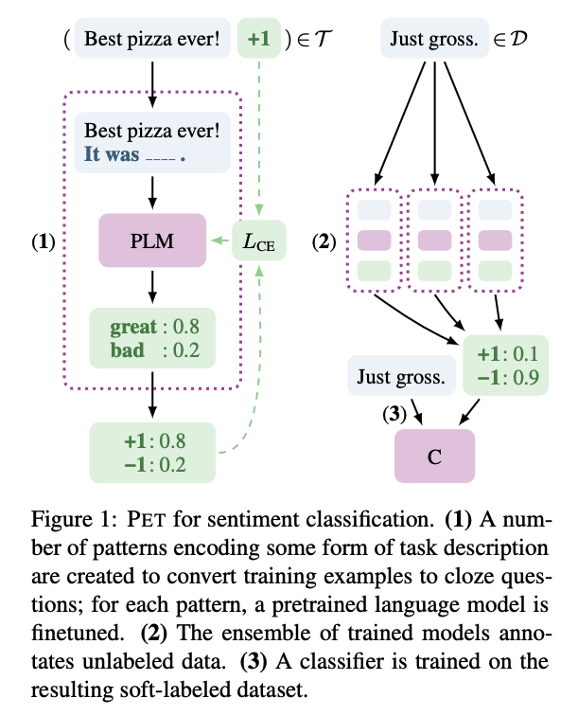
Part 3 $−$ Discrete Prompt-based Learning
Prompt-based Learning and Robustness Evaluation
Discrete Prompt-based Learning: automatically learn prompts from training data
Manually-written Prompts (MP)
$$\left\{hypothesis\right\}?|<MASK>, \{premise\}$$
Yes
Entailment
No
Contradiction
Maybe
Neutral
Verbalizer
(injective function)
Credits: Schick et al., Exploiting Cloze-Questions for Few-Shot Text Classification and Natural Language Inference, In EACL’21.

Slide 18
Part 3 $−$ Other Prompt-based Learning Methods
Prompt-based Learning and Robustness Evaluation
Manual Prompt Design: In-Context Learning – Brown et al., Language Models are Few-Shot Learners, In NeurIPS’20. Pattern Exploiting Training (PET) – Schick et al., Exploiting Cloze Questions for Few Shot Text Classification and Natural Language Inference, In EACL’21.
Mining and Paraphrasing-based Methods: Jiang et al., How Can We Know What Language Models Know?, In TACL’20.
Gradient-based Search: AutoPrompt – Shin et al., AutoPrompt: Eliciting Knowledge from Language Models with Automatically Generated Prompts, In EMNLP’20.
Automatic Prompt Generation: Gao et al., Making Pre-trained Language Models Better Few-shot Learners, In ACL’21.
Notes:
cloze-style phrases

Slide 19
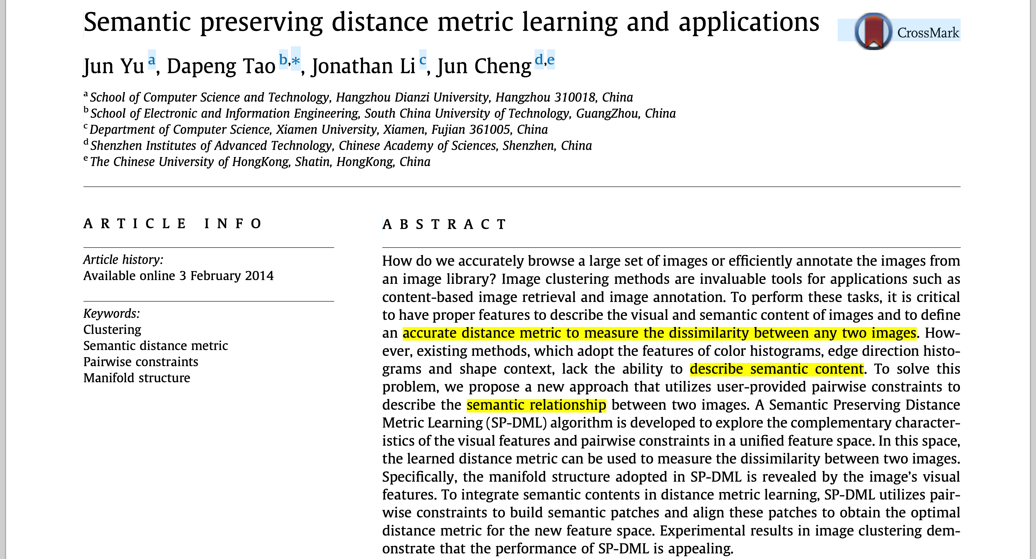
Prompt-based Learning and Robustness Evaluation
Can we propose a Metric to measure the
semantic preserving distance between two prompts?
Notes:
A certified robust LLM is expected to generate the correct output y, given at max d percentage word perturbation on the input.

Slide 20
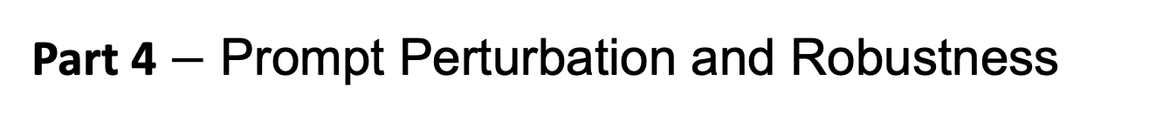
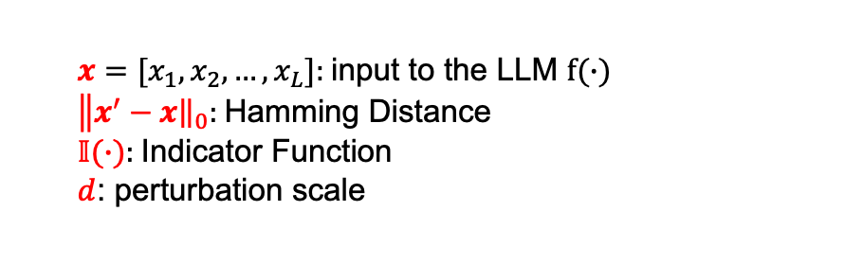
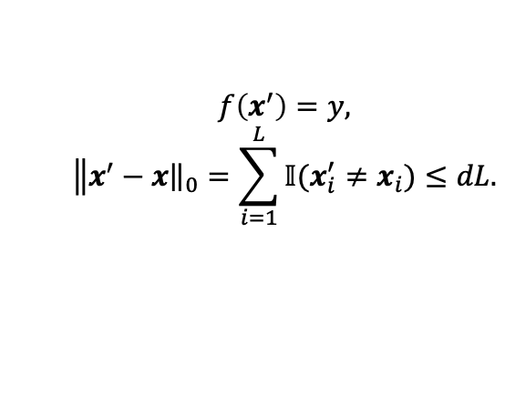
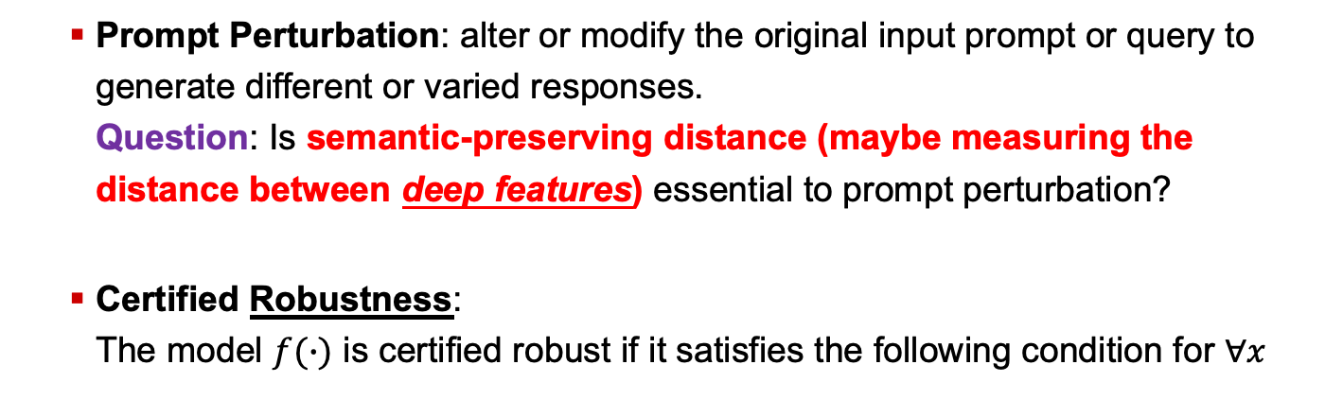
Part 4 $−$ Prompt Perturbation and Robustness
Prompt-based Learning and Robustness Evaluation
Prompt Perturbation: alter or modify the original input prompt or query to generate different or varied responses. Question: Is semantic-preserving distance (maybe measuring the distance between deep features) essential to prompt perturbation?
Certified Robustness: The model $f(∙)$ is certified robust if it satisfies the following condition for $∀x$
define
$$f\left(x^{′}\right)=y,$$
$$\left\|x^{′}\right.−{\left.x\right\|}_{0}=\sum_{i=1}^{L}{𝕀(x_{i}^{′}≠x_{i})}≤dL.$$
$x=[x_{1},x_{2},…,x_{L}]$: input to the LLM $f(∙)$
$\left\|x^{′}\right.−{\left.x\right\|}_{0}$: Hamming Distance
$𝕀(∙)$: Indicator Function
$d$: perturbation scale
Credits: Zhang et al., Certified Robustness for Large Language Models with Self-Denoising, In arXiv’23.
Notes:
A certified robust LLM is expected to generate the correct output y, given at max d percentage word perturbation on the input.

Slide 21
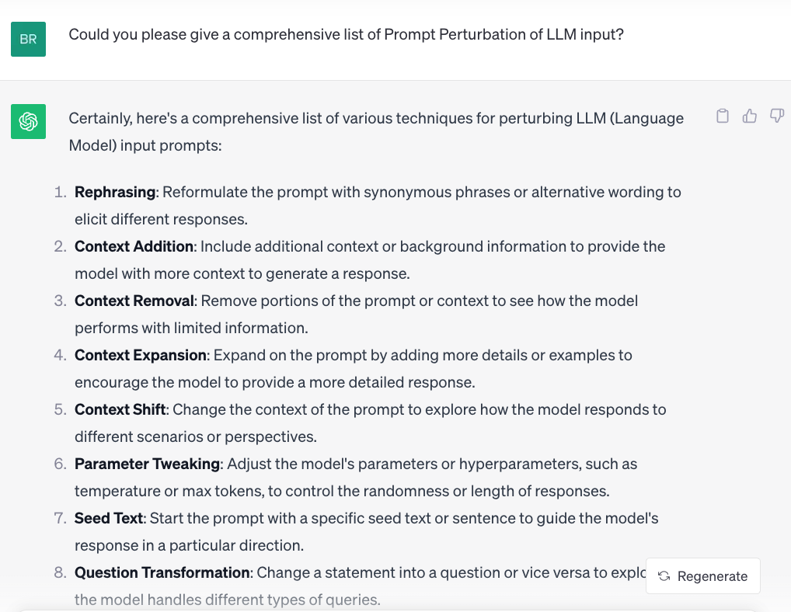
Part 4 $−$ Prompt Perturbation and Robustness
Prompt-based Learning and Robustness Evaluation
Credits: ChatGPT.
Notes:
A certified robust LLM is expected to generate the correct output y, given at max d percentage word perturbation on the input.

Slide 22
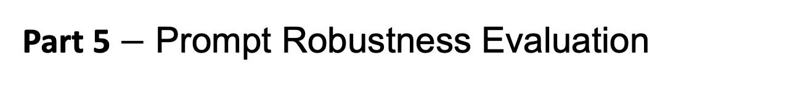
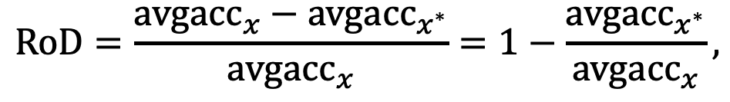
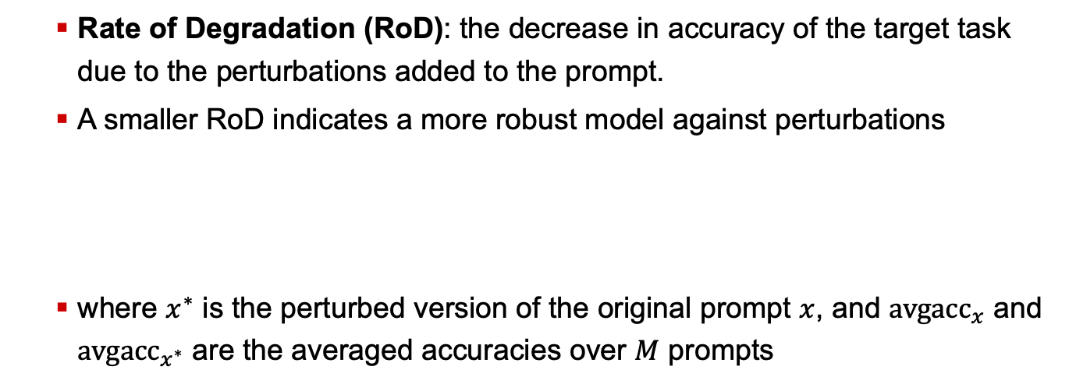
Part 5 $−$ Prompt Robustness Evaluation
Prompt-based Learning and Robustness Evaluation
Rate of Degradation (RoD): the decrease in accuracy of the target task due to the perturbations added to the prompt.
A smaller RoD indicates a more robust model against perturbations
where $x^{∗}$ is the perturbed version of the original prompt $x$, and $avg{acc}_{x}$ and $avg{acc}_{x^{∗}}$ are the averaged accuracies over $M$ prompts
$$RoD=\frac{avg{acc}_{x}−avg{acc}_{x^{∗}}}{avg{acc}_{x}}=1−\frac{avg{acc}_{x^{∗}}}{avg{acc}_{x}},$$
Credits:
Meyers et al., Signal Processing on PV Time-series Data: Robust Degradation Analysis Without Physical Models, In IEEE Journal of Photovoltaics’19.
Ishibashi et al., Evaluating the Robustness of Discrete Prompts, In EACL’23.

Slide 23
Thank you very much for your attention!

